Slide 1
Zebra Mussels
Environmental Sciences 12

Slide 2
Invasive Species
A species that is non-native to the area and due to no natural predator, their population goes unchecked
In video – record 3 notes that interest you. Share out with class and write down additional notes and concepts

Slide 3
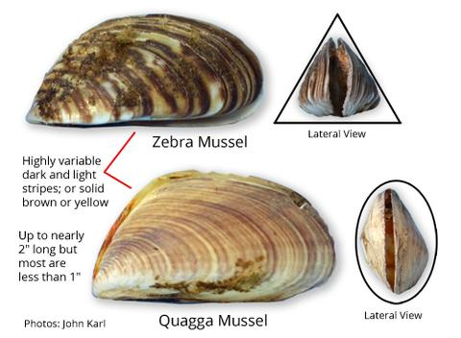
Zebra Mussels in Canada
Zebra mussels are an invasive species that has spread from their native Black Sea region of eastern Europe and western Asia waters to Canada
can be found throughout all of the Great Lakes, Lake St. Clair (between Michigan and Ontario) and the Mississippi River watershed.

Slide 4
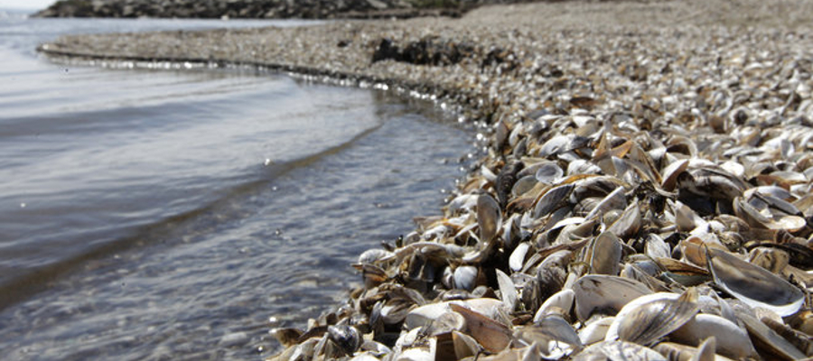
How does the Quagga impact the food chain in the Great Lakes?
What is the trophic cascade that this invasive species causes?

Slide 5
Case Study
Read Part 1 and 2 as a table team
Answer the below questions:
What might be causing what Matt and Flora are seeing?
What data or information should you collect to test this theory?

Slide 6
Part 2
They thought that it might be phosphorous. Look at the data below. What do you notice from the graph?

Slide 7
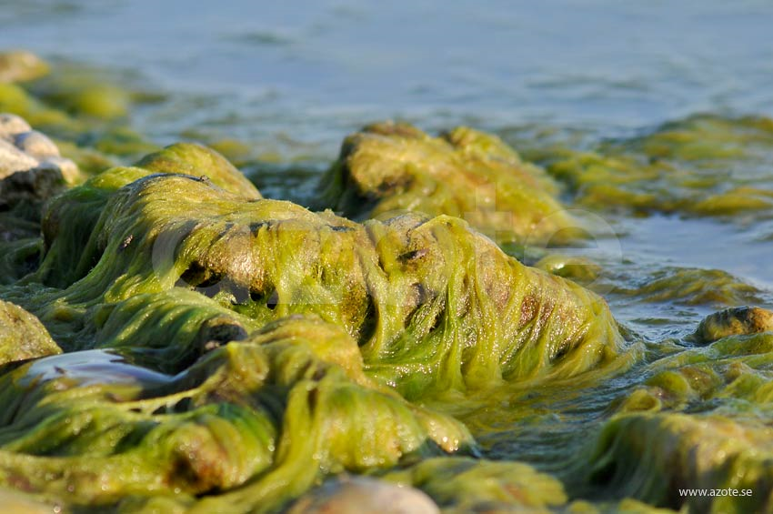
Cladophora glomerata
Filamentous green algae
Phylum Chlorophyta

Slide 8
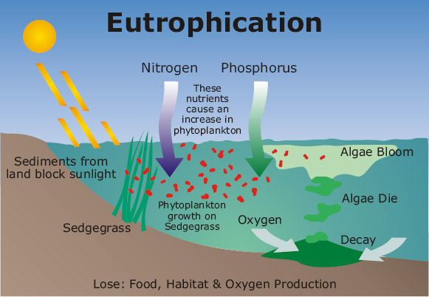
Eutrophication
High nitrogen and phosphorous can causes algal bloom
Decreases light penetration of water
Photosynthetic plants at bottom of water die
No generation of oxygen to water
Fish and other wild life die
Can “kill” water ecosystem
Destroy biodiversity

Slide 9
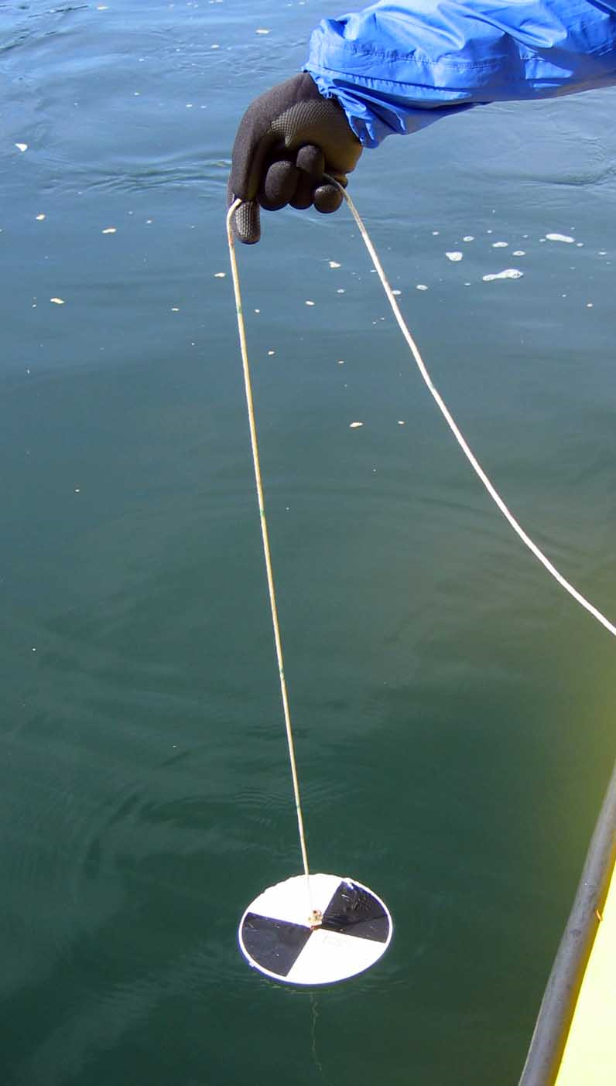
Part 3
Secchi disc – tool used to measure light penetration of water
Production of phytoplankton includes the amount of carbon in the ocean they bind into glucose

Slide 10
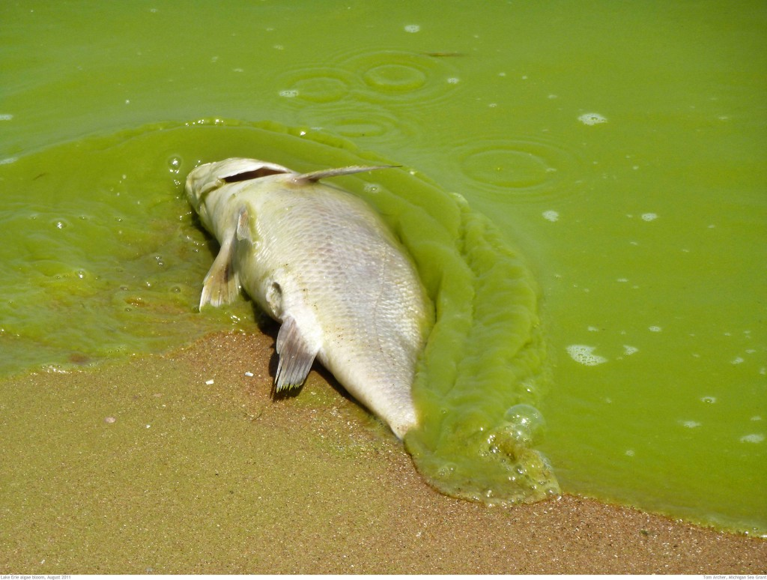
Part 3 Question and Research
What are limiting factors of phytoplankton production?
Why have the population of phytoplankton decreased, but the population of Cladophora increased? Use the ipad to do some research on how this might happen.

Slide 11
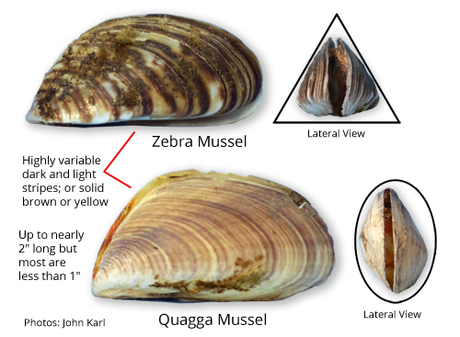
Part 4
Explain in your own words how the zebra and Quagga mussels has impacted phytoplankton and algal growth.

Slide 12
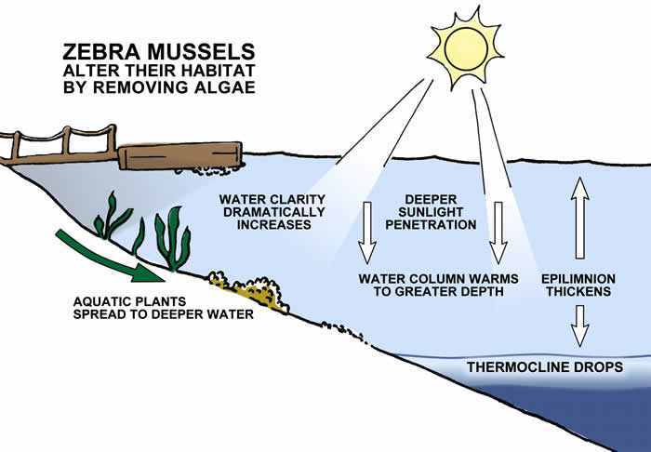
Filter Feeders Impact on Water Environments
Less phytoplankton due to food source for filter feeders
More light penetrates down the water column
More larger algal due to light
Sun heats the lower water (thermocline goes lower)
More larger algal due to increased heat

