Slide 1
Z-scores
FOM 11

Slide 2
What do we now so far…

Slide 3
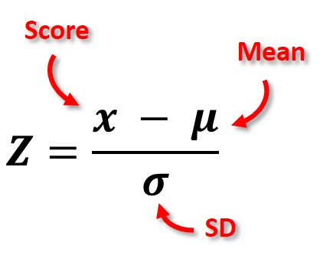
What is a z-score?
The number of standard deviations away from the mean a specific data point is

Slide 4
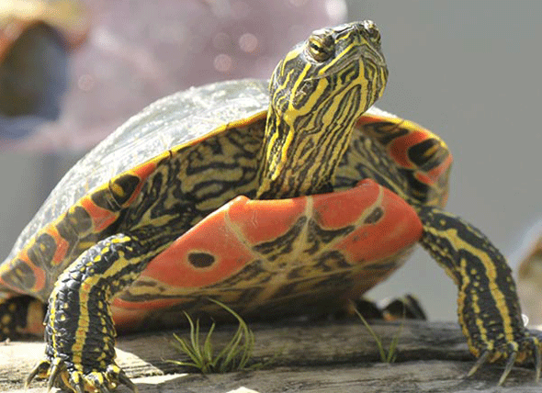
Example #1
You are a biologist looking at the length of painted turtles in a specific population. There are only 6 turtles remaining in this specific pond population. The lengths are: 10cm, 11.2 cm, 15cm, 17.2 cm, 14.9cm, 11.5 cm. Find the z-scores for each data point (use desmos to find mean and standard deviation first).
X | X - μ | Z-score
10
11.2
15
17.2
14.9
11.5

Slide 5
Example #2
Before applying to law school, students need to take an exam called the LSAT. Before applying to medical school, students need to take an exam called the MCAT. Here are some summary statistics for each exam:
LSAT → μ = 151, σ = 10
MCAT → μ = 25.1, σ = 6.4
Jackie took both exams. She scored 172 on the LSAT and 27 on the MCAT. Which exam did he do relatively better on?

Slide 6
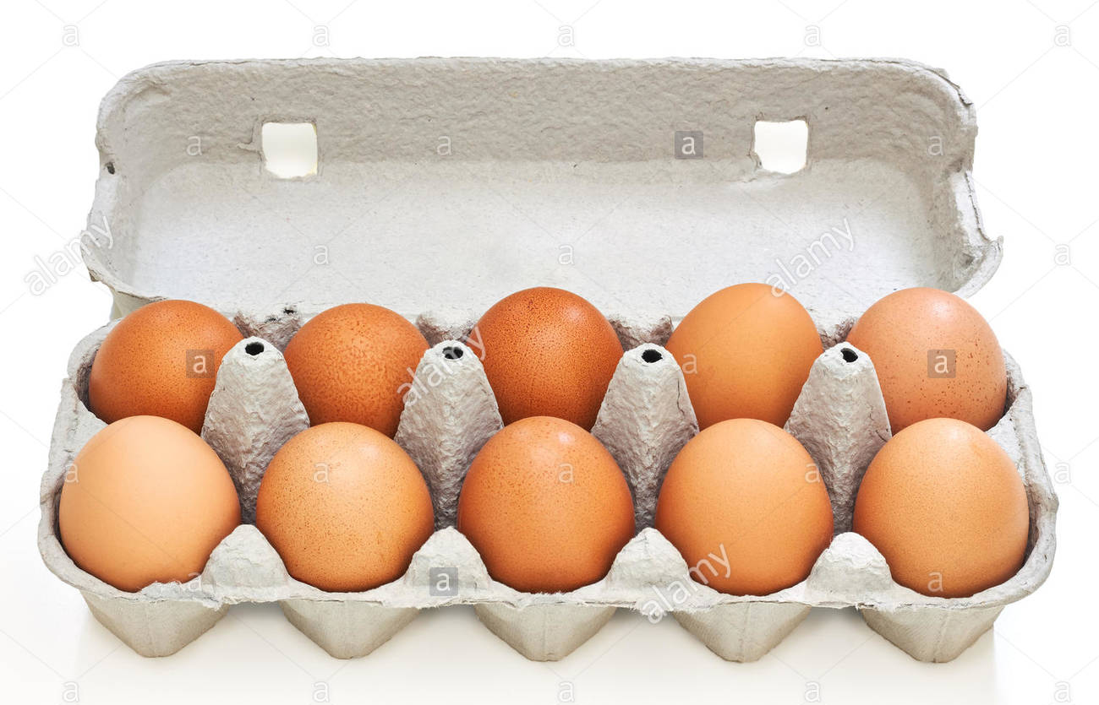
Example #3
The weight of a cartoon of eggs (12 eggs) is normally distributed with a standard deviation of 4g. The weight of one egg picked at random from the cartoon is 55g with a z-score of -1.25. What is the mean to the nearest tenth of a gram?

Slide 7
Table Team Task

Slide 8
To Do:
Page 271 in workbook
#1 – 12
If old book → page 204 - 207
Finish for homework if not done
Mark using KEY at back of assignment section

