Slide 1
Yellowstone Wolves
Environmental Sciences 12

Slide 2
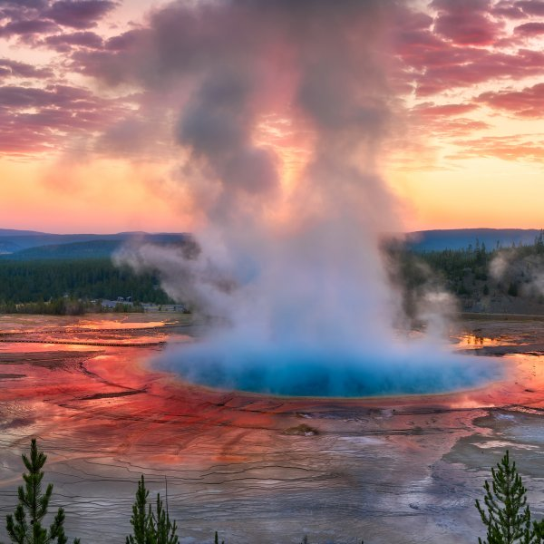
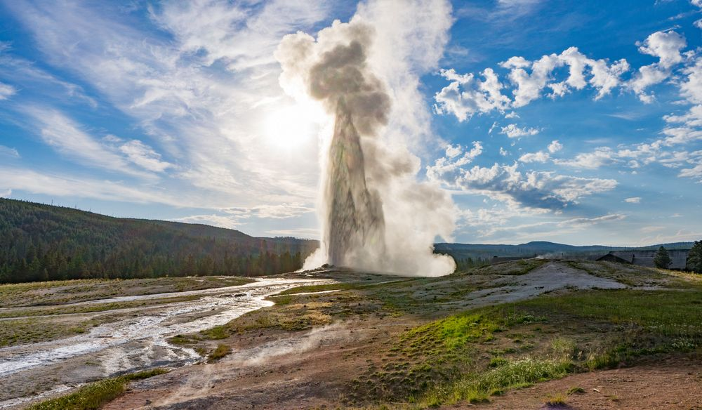
Yellowstone National Park
US National Park
On March 1, 1872 Yellowstone was the first US National Park
Known for geological formations
Ecosystem of bison, elk, wolves

Slide 3
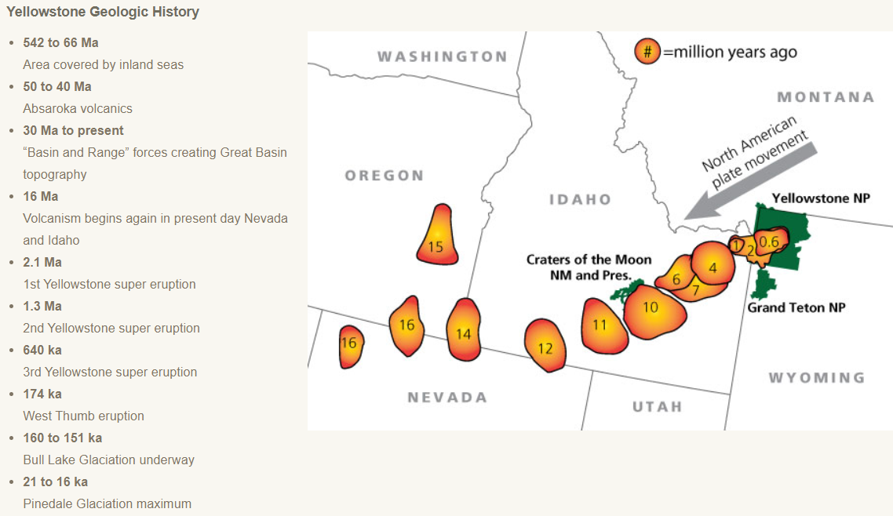

Slide 4
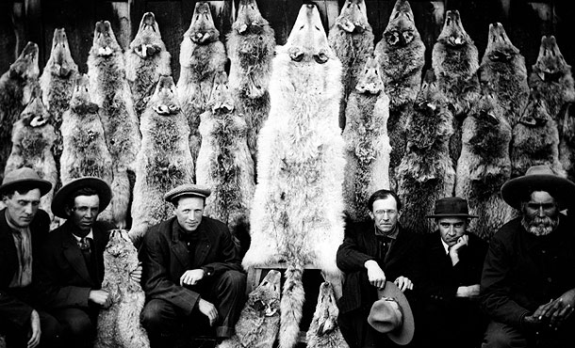
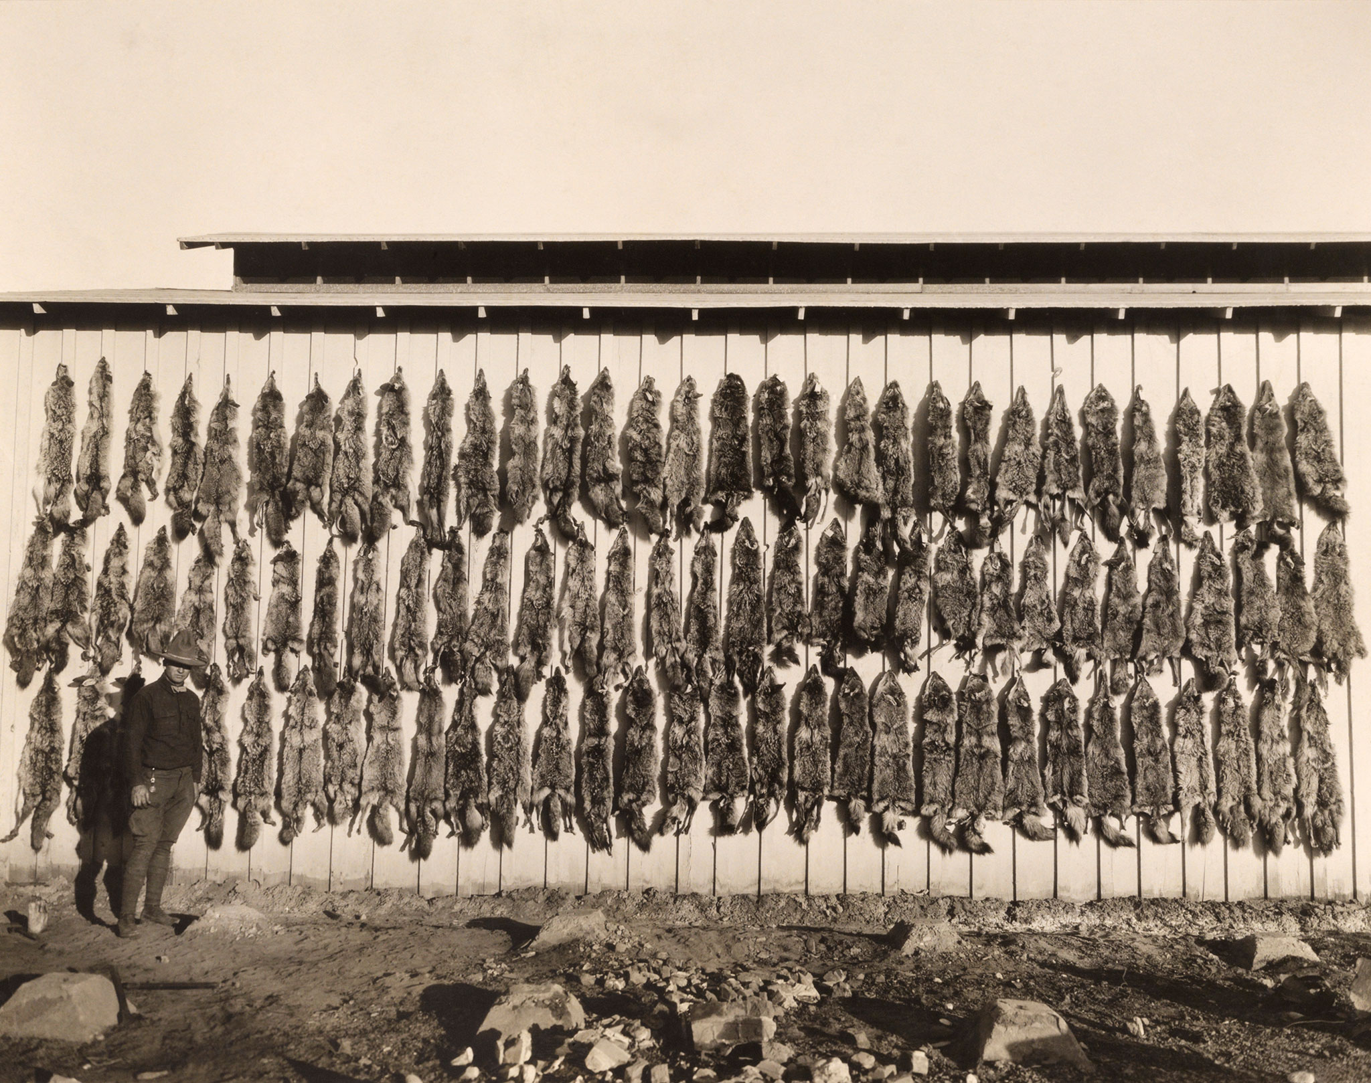
History of the Wolves
US government predator control programs in 1900-1910 eliminated the gray wolf from Yellowstone.
The last wolves were killed in Yellowstone in 1926.
Wolves were extirpated from Yellowstone for 70 years.
Biologists re-introduced in 1995

Slide 5
How Wolves Change Rivers

Slide 6
Wolf Reintroduction Case Study
As a table team, take turns reading “Background”
Using the ipads, research some pro’s and con’s for the reintroduction on wolves to Yellowstone
Make a list using a white board marker on your desk

Slide 7
Wolf Reintroduction Case Study
Pro’s of Wolves in Ecosystem
Con’s of Wolves in Ecosystem

Slide 8
Read Part 1 – Wolf #9
Read as a team
Questions:
Why did they reintroduce wolves back into Yellowstone?
Explain what a keystone species is, and why they thought the wolf was one? How did the absence of the wolf impact Yellowstone?
Wolf #8 showed a rare type of social behaviour by adopting offspring that were not his own. Why would this behaviour be rare in mammals> How is this a beneficial behaviour?

Slide 9
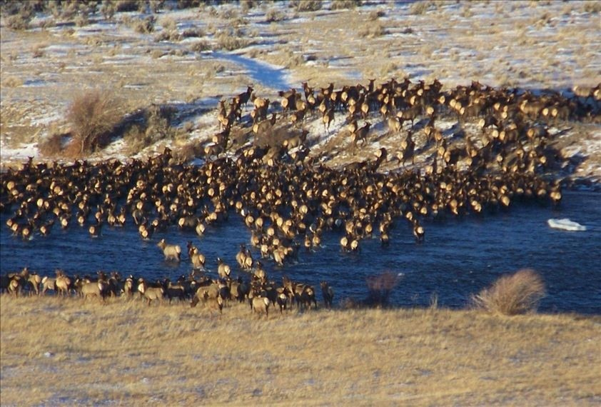
Read Part 1 – Wolf #9
re-introduction of wolves into Yellowstone was to stabilize the ecosystem
elk were overpopulated because of the absence of their main predator
the aspen and cottonwood trees were decreasing dramatically because of overgrazing

Slide 10
Read Part 2 – Wolf #21
Read together as a team
Questions:
Wolf #21 was very success at reproducing. Come up with a couple hypothesis as to what made him this successful. How do you think we was able to hold his alpha status for so long?
His pack of 37 wolves did not last. Knowing what you know about factors that limit population growth, why was this so? What is the difference between interspecific and intraspecific competition?

Slide 11
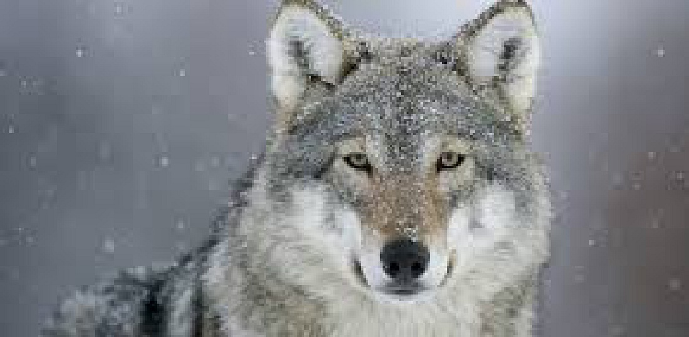
Read Part 2 – Wolf #21
Wolf #21 was described as a large wolf, which would have helped him in fending off potential alpha males
take down an elk when others could not, which is an indication that he was strong and fit
population reached the carrying capacity for that particular area (more wolves in the pack than the pack itself could support)
wolves were at greater risk of disease and starvation
Interspecific competition is competition between two different species (i.e., grizzly bears, black bears, coyotes, and mountain lions)
Intraspecific competition refers to competition within the same species (fighting for alpha, competition for food)

Slide 12
Read Part 3 - Data
Look at each of the charts
What information can you get from this?
What trends or connections do you see?
What is the difference between density-dependent and density-independent factors that might impact the wolf population?
What do you think the carry capacity for the wolves in Yellowstone might be?

Slide 13
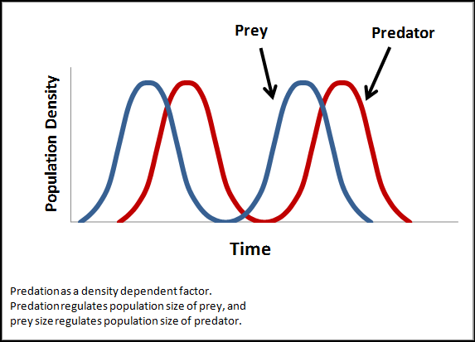
Read Part 3 - Data
Density-dependent factors can limit population growth
food, water, shelter, the ability to find a mate, and the transmission of diseases.
If the wolf population is too high for a given area, the chance for finding food decreases…survival decreases.
Density-independent factors do not depend on the size, or density of the population
climate, disease outbreak, and natural disasters
Possible hypotheses for trends:
wolves dropped slightly from 2003–04 and then dramatically from 2007–11 may be because there may have been more wolves in Yellowstone than resources to support them
some wolves may have simply left the GYE because of overcrowding and thus may not have been counted
there may have been disease outbreaks that killed wolves
diseases like canine distemper, canine parvovirus, or mange are discussed as causing declines in wolf population numbers.

Slide 14
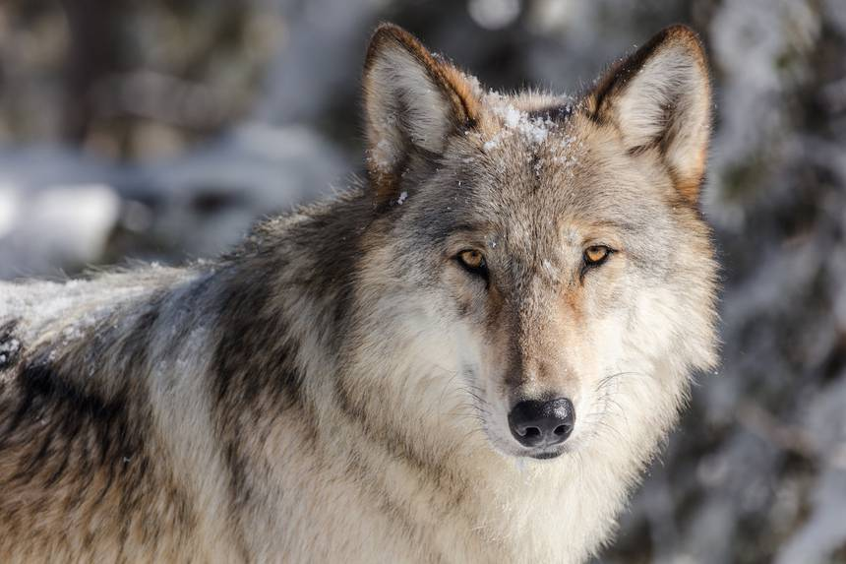
Wolvesin Yellowstone

Slide 15
Journal Reflection
Do you think that the re-introduction of wolves into Yellowstone will stabilize the community?
Do you think that wolves are a keystone species for Yellowstone? Why or why not? What is your evidence?
List some reasons for the ups and downs of the wolf population in Yellowstone. Are these reasons intraspecific or interspecific? Explain for each.

