Slide 1
Wetlands
Enviro Sci 12

Slide 2
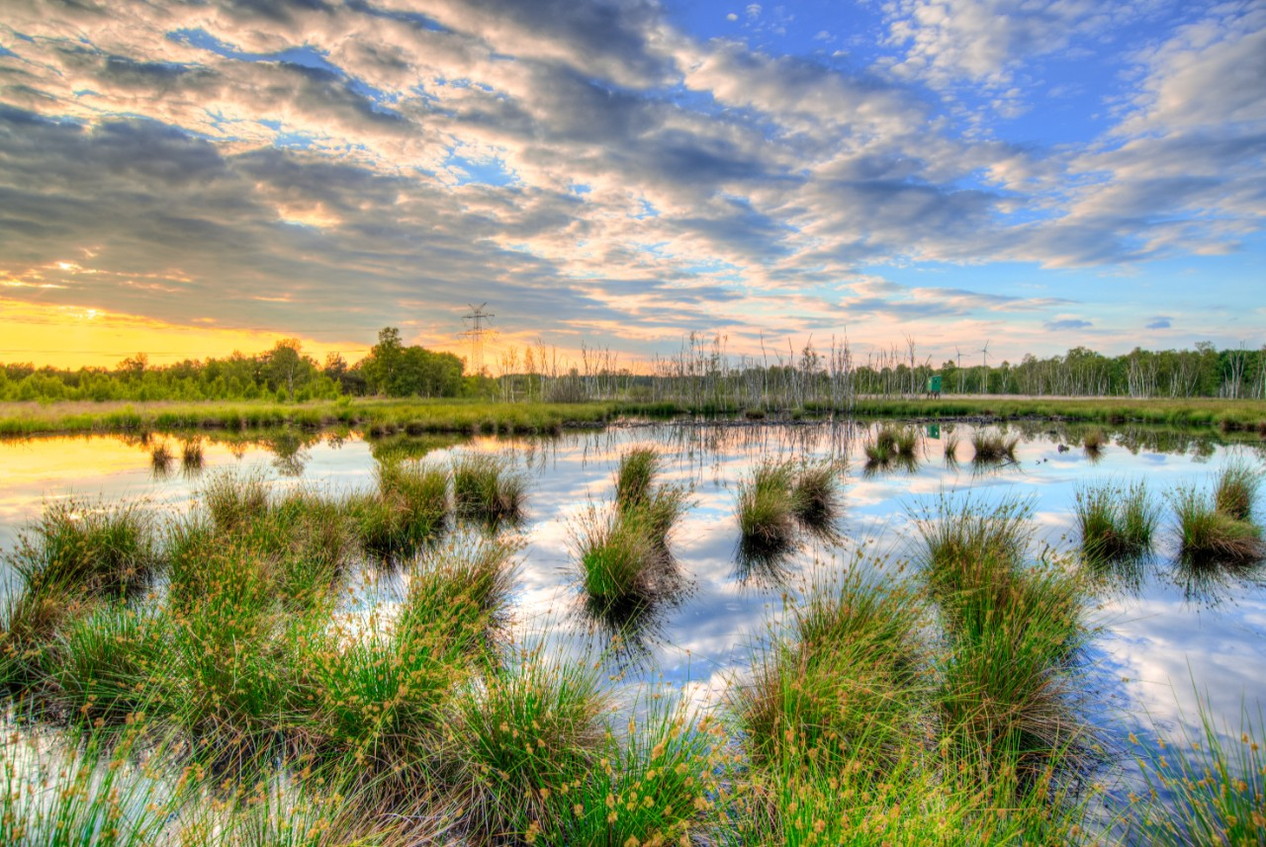
What is a wetland?
wetland is an area saturated with water
It is not saturated year round, depends on rain fall and water table

Slide 3
BC Wetlands
Wetlands cover 5% of BC, 21% of alberta
Wetlands in Canada has decreased by 15% over past century
Mainly due to agriculture
Channelization of areas
Forest Practice code protects BC wetlands

Slide 4
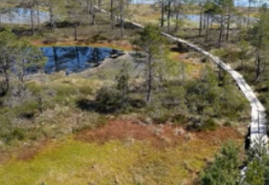
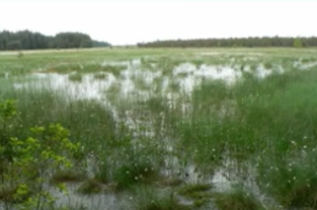
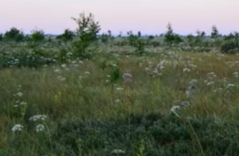
Types of wetlands
Marsh
No trees
Nutrient rich soil
Grasses and reeds
Fen
Dominated by high grasses
Alkaline soils
No trees
Nutrient rich soil
High grasses
Swamps
Lots of trees
Nutrient rich soil
Murky water

Slide 5
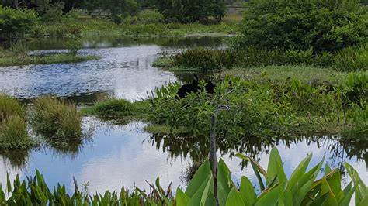
Benefits of wetlands
Filters toxins out of water
Contributes to nitrogen cycle
Part of water cycle
Carbon sink

Slide 6
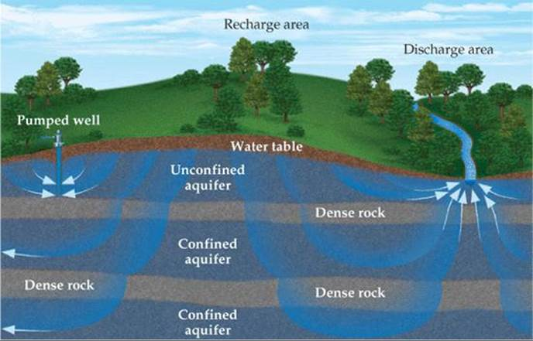
What is a water table?
The level of the underground water
Goes up and down depending on season

Slide 7
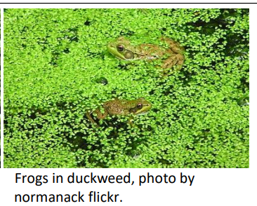
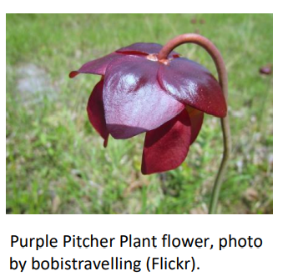
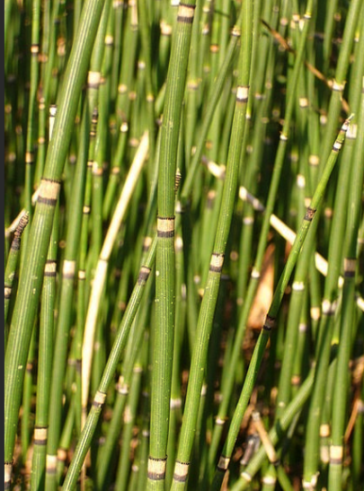
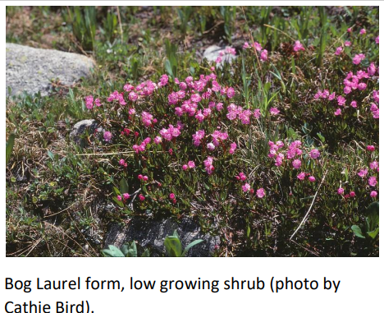
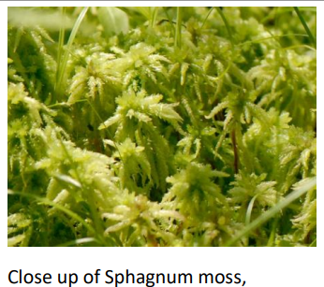
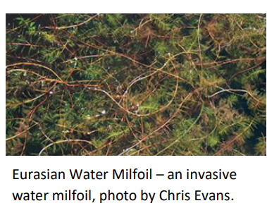
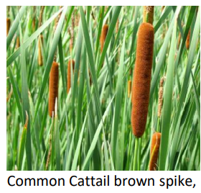
How do you know if a wetland is healthy?
Aquatic invertebrates

Slide 8
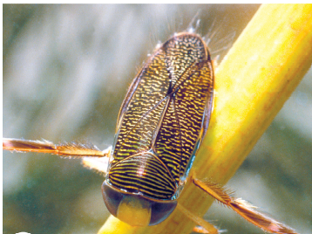
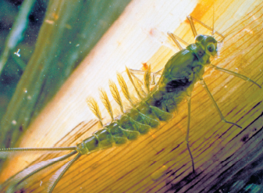
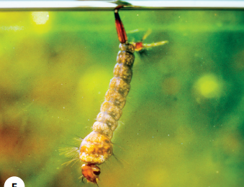
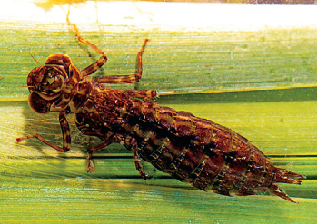
How do you know if a wetland is healthy?
Mayfly nymph
Water boatman
Mosquito larva
Dragonfly Nymph

Slide 9
When visiting a wetland…
observe plants around restored wetland
Invertebrate collection
Look at nymph and larva
Try to identify
Behaviour expectations
Leave property better than we found it
Close all gates
Be kind and appreciative of other’s property
Dress weather appropriate

