Slide 1
Water Unit Review
Environmental Sciences 12

Slide 2
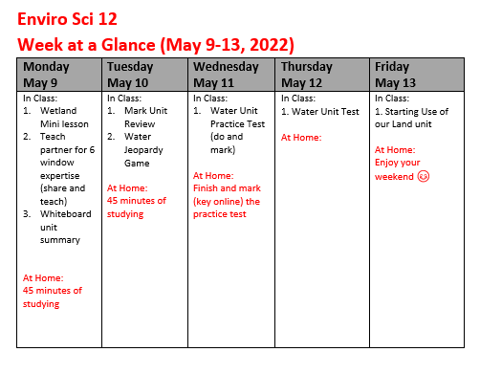

Slide 3
The Water Unit Summary
Freshwater issues
Ocean issues
Aquacultures issues
Aquifer issues
Water Treatment issues
Use of water issues
Water Test on Thursday, May 12th

Slide 4
6 Windows as a study tool
Freshwater Issues 3% freshwater Turbidity, temperature, dissolved oxygen, dissolved solids, bacteria, pH Eutrophication (zebra/quagga) Drought Wetlands (5% of BC) – types/benefits | Ocean issues Overfishing Convection stream Heating Plastic patch Bycatch Change of fish population impacting large mammals Ocean acidification | Aquaculture issues Methods Species Ethical consumerism Lice/SPLICE Impact on native species
Aquifer issues Ground water Sink holes Water out>water refill Confined aquifer vs unconfined | Water Treatment issues 40% of earth’s population lacks access to freshwater How do we clean reservoir water? How do we clean waste water? | Use of water issues 8% water personal use 70% of water use agriculture, 22% industrial use Day Zero (what contributes) leaks

Slide 5
Six Windows share-out
You and your partner TEACH EACH OTHER your windows
20 minutes each to teach
Come back at _________ with a completed 6 windows for the unit

Slide 6
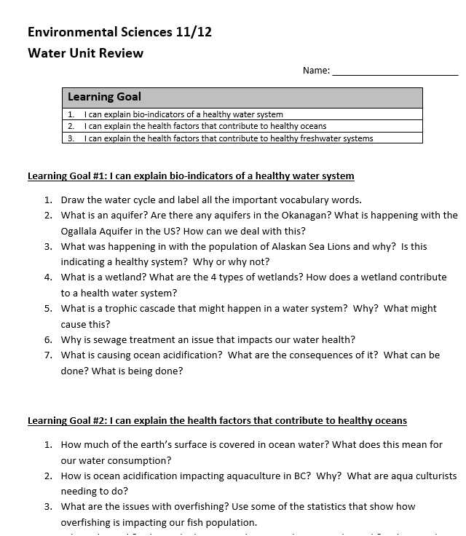
Water Unit Review
Any questions?

Slide 7
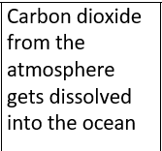
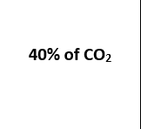
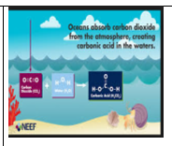
Water Vocab Practice

Slide 8
HOME WORK FOR TONIGHT
45 minutes of studying at home
Possible study options:
Sketch out your 6 windows AGAIN
Explain the concepts to a family member
Make cue cards

