Slide 1
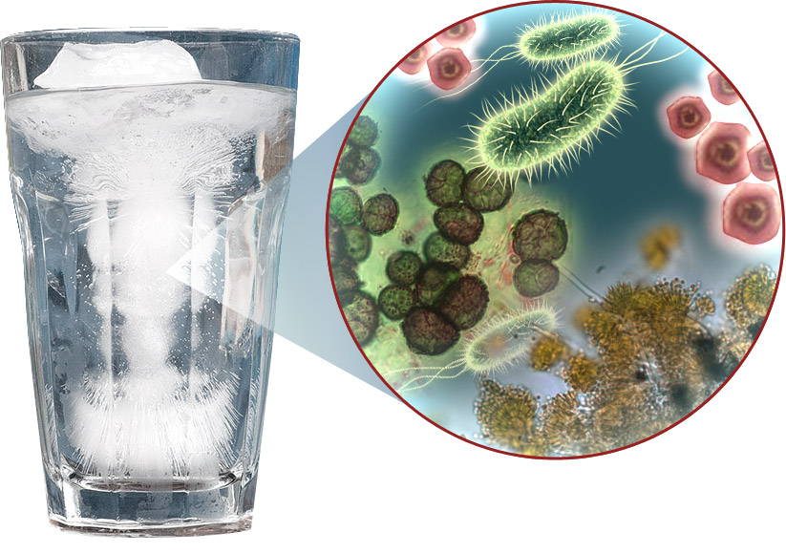
Water Inquiry Lab
Enviro Sci 12

Slide 2
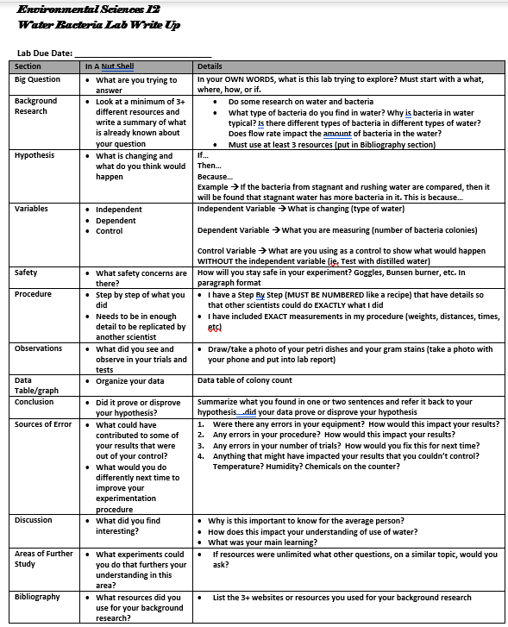

Slide 3
What is your BIG QUESTION?
This is what we have…
Water sample and bacteria sample of:
Stagnant water Adams Bird Sanctuary
Running water Adams Bird Sanctuary
Dale Meadows
Distilled Water
What question could you ask about this data?

Slide 4
What BACKGROUND RESEARCH is needed for you to understand your question?
Ask 5 questions for research:
What type of bacteria is in water?
Are there healthy and harmful bacteria in water?

Slide 5
What is your HYPOTHESIS?
If, then, because
Come up with your hypothesis now…
Share out with your partner…

Slide 6
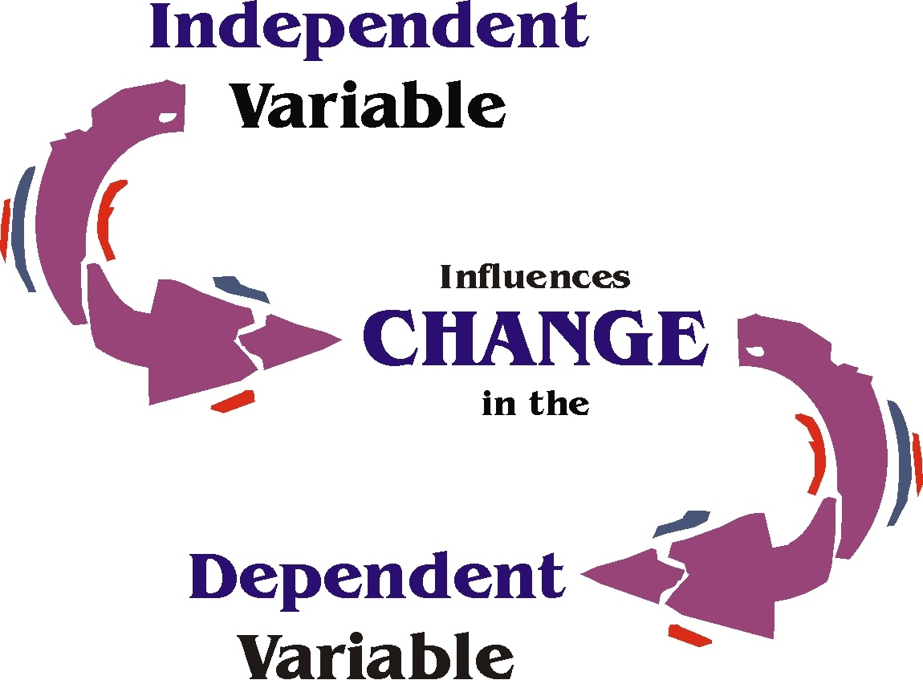
What are your VARIABLES?
Independent variable
Dependent variable
Control variable

Slide 7
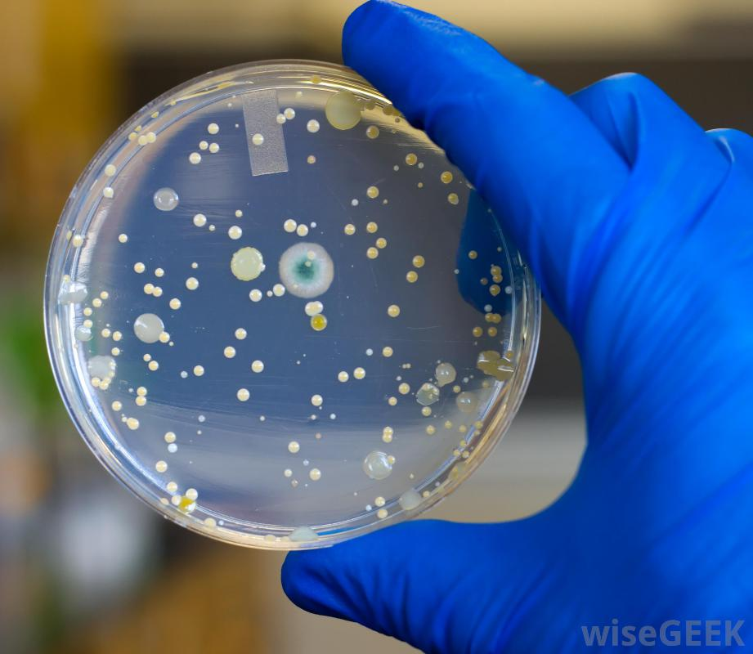
What OBSERVATIONS can you make?
1. photos of agar plates (with labels)
2. Description of bacteria colony morphology
margins
colour

Slide 8
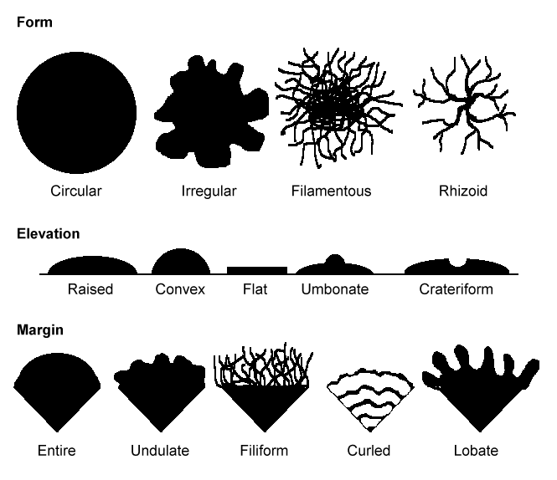
Colony Morphology

Slide 9
Data To Collect
1. How many bacteria colonies are on your plates?
2. Gram stains (with labels, which plate, which sample)
Can you use your gram stain to figure out the type of bacteria in the water?
Gram positive or gram negative
Bacilli, cocci, linked, singular?

Slide 10
Data To Collect
Water Location | Colony Count | Number of Colony TYPES
Control – distilled water
Stagnant Adams Bird Sanct
Running Adams Bird Sanct
Dale Meadows

Slide 11
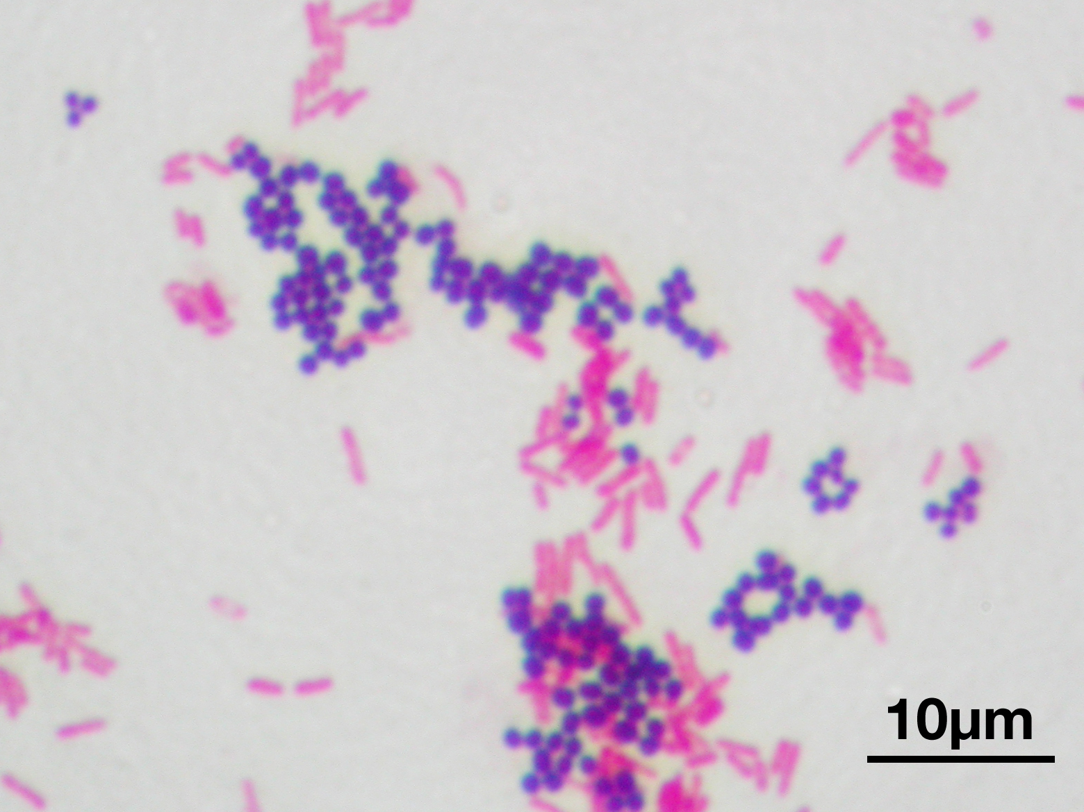
Data To Collect
Gram Stain each TYPE of colony

Slide 12
What is your Conclusion?
Think back to your BIG QUESTION….answer it
What data supports this conclusion?

Slide 13
What are your SOURCES OF ERROR?
Not enough trials
Didn’t label?
Lawn?
Distilled water spout has bacteria?
Broken plate?
Not temperature regulated

Slide 14
Have a Discussion why this is important?
What did you learn about bacteria in the water?
Why might this be important to know in society?
Does bacteria in the water impact you? Other in our north American society? Others in our global society?
How might we use this understanding of bacteria in water?

Slide 15
What FURTHER STUDIES/EXPERIMENTS interest you in this topic?
What other questions do you have about bacteria in water? (specifically state 3 other questions you have about bacteria in water)

Slide 16
State your Bibliography
In your research, what websites did you use?
Include the following details
Author of website, year it was published, Website link

