Slide 1
Water
Biology 12

Slide 2
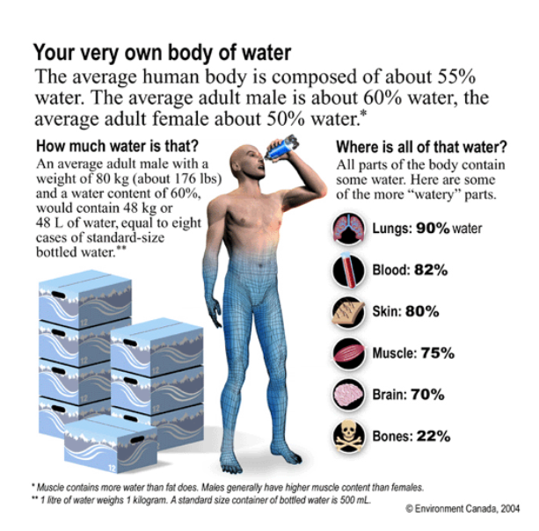
Water % is different in various cells of the body
On average you are 60% water
Lung cells 90%
Bone cells 22%

Slide 3
Basic Structure of Molecule
Water is a covalent molecule
Polarized (+ve and –ve poles of molecule)
Can form weak hydrogen bonds between itself and other molecules
Cohesion (with other water molecules)
Adhesion (with other types of substances)

Slide 4
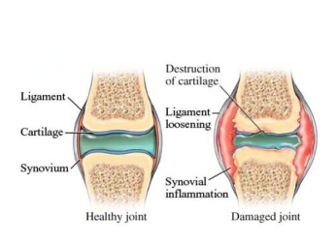
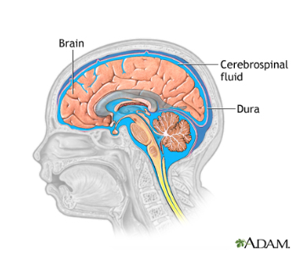
Roles of Water in the Human Body
1. Lubrication of joints
Synovial Fluid of Joints
Tears
Saliva
Amniotic Fluid
Spinal Column

Slide 5
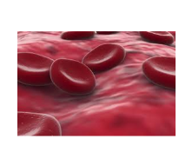
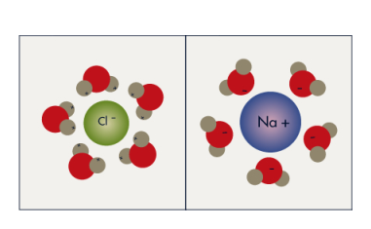
Roles of Water in the Human Body
2. Universal Solvent
Provides a medium for chemical reactions
water in the blood acts as a transport system

Slide 6
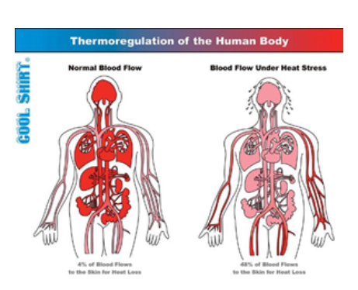
Roles of Water in the Human Body
3. Thermal Regulation
Ability to sweat
Water can absorb huge amounts of energy with only a small increase in temperature

Slide 7
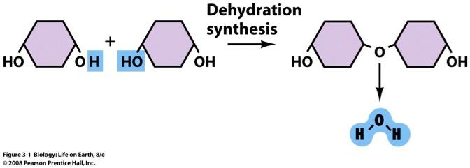
Roles of Water in the Human Body
4. Dehydration synthesis
Make new polymers for the body
Use monomers of body to link together to form new larger polymers
Remove an H and OH from two molecules forces chemical attractions and bonding

Slide 8
Roles of Water in the Human Body
5. Hydrolysis
Rip apart polymers to make monomers
When you rip apart food to smaller monomers
Only monomers can pass from small intestine to circulatory system
Add water molecule to split polymer

Slide 9
Roles of Water in the Human Body
6. Acts as a buffer
Water will react with carbon dioxide to create an acid
Water weak connection, so carbon dioxide will come out of solution to create water (neutral)
Helps with pH maintenance
Homeostasis (balance in the body)

Slide 10
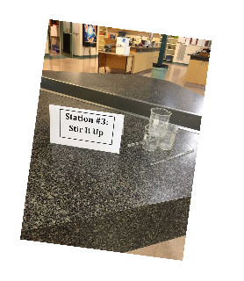
Water Lab
In groups of 2 you are to rotate through the 9 stations
follow the directions on the labels
you may need to grab water or ice from fridge or sink
make observations on what happens, think critically, use science vocabulary, and try to explain WHY water is behaving like this.

