Slide 1
Volume Scale Factor
FOM 11

Slide 2
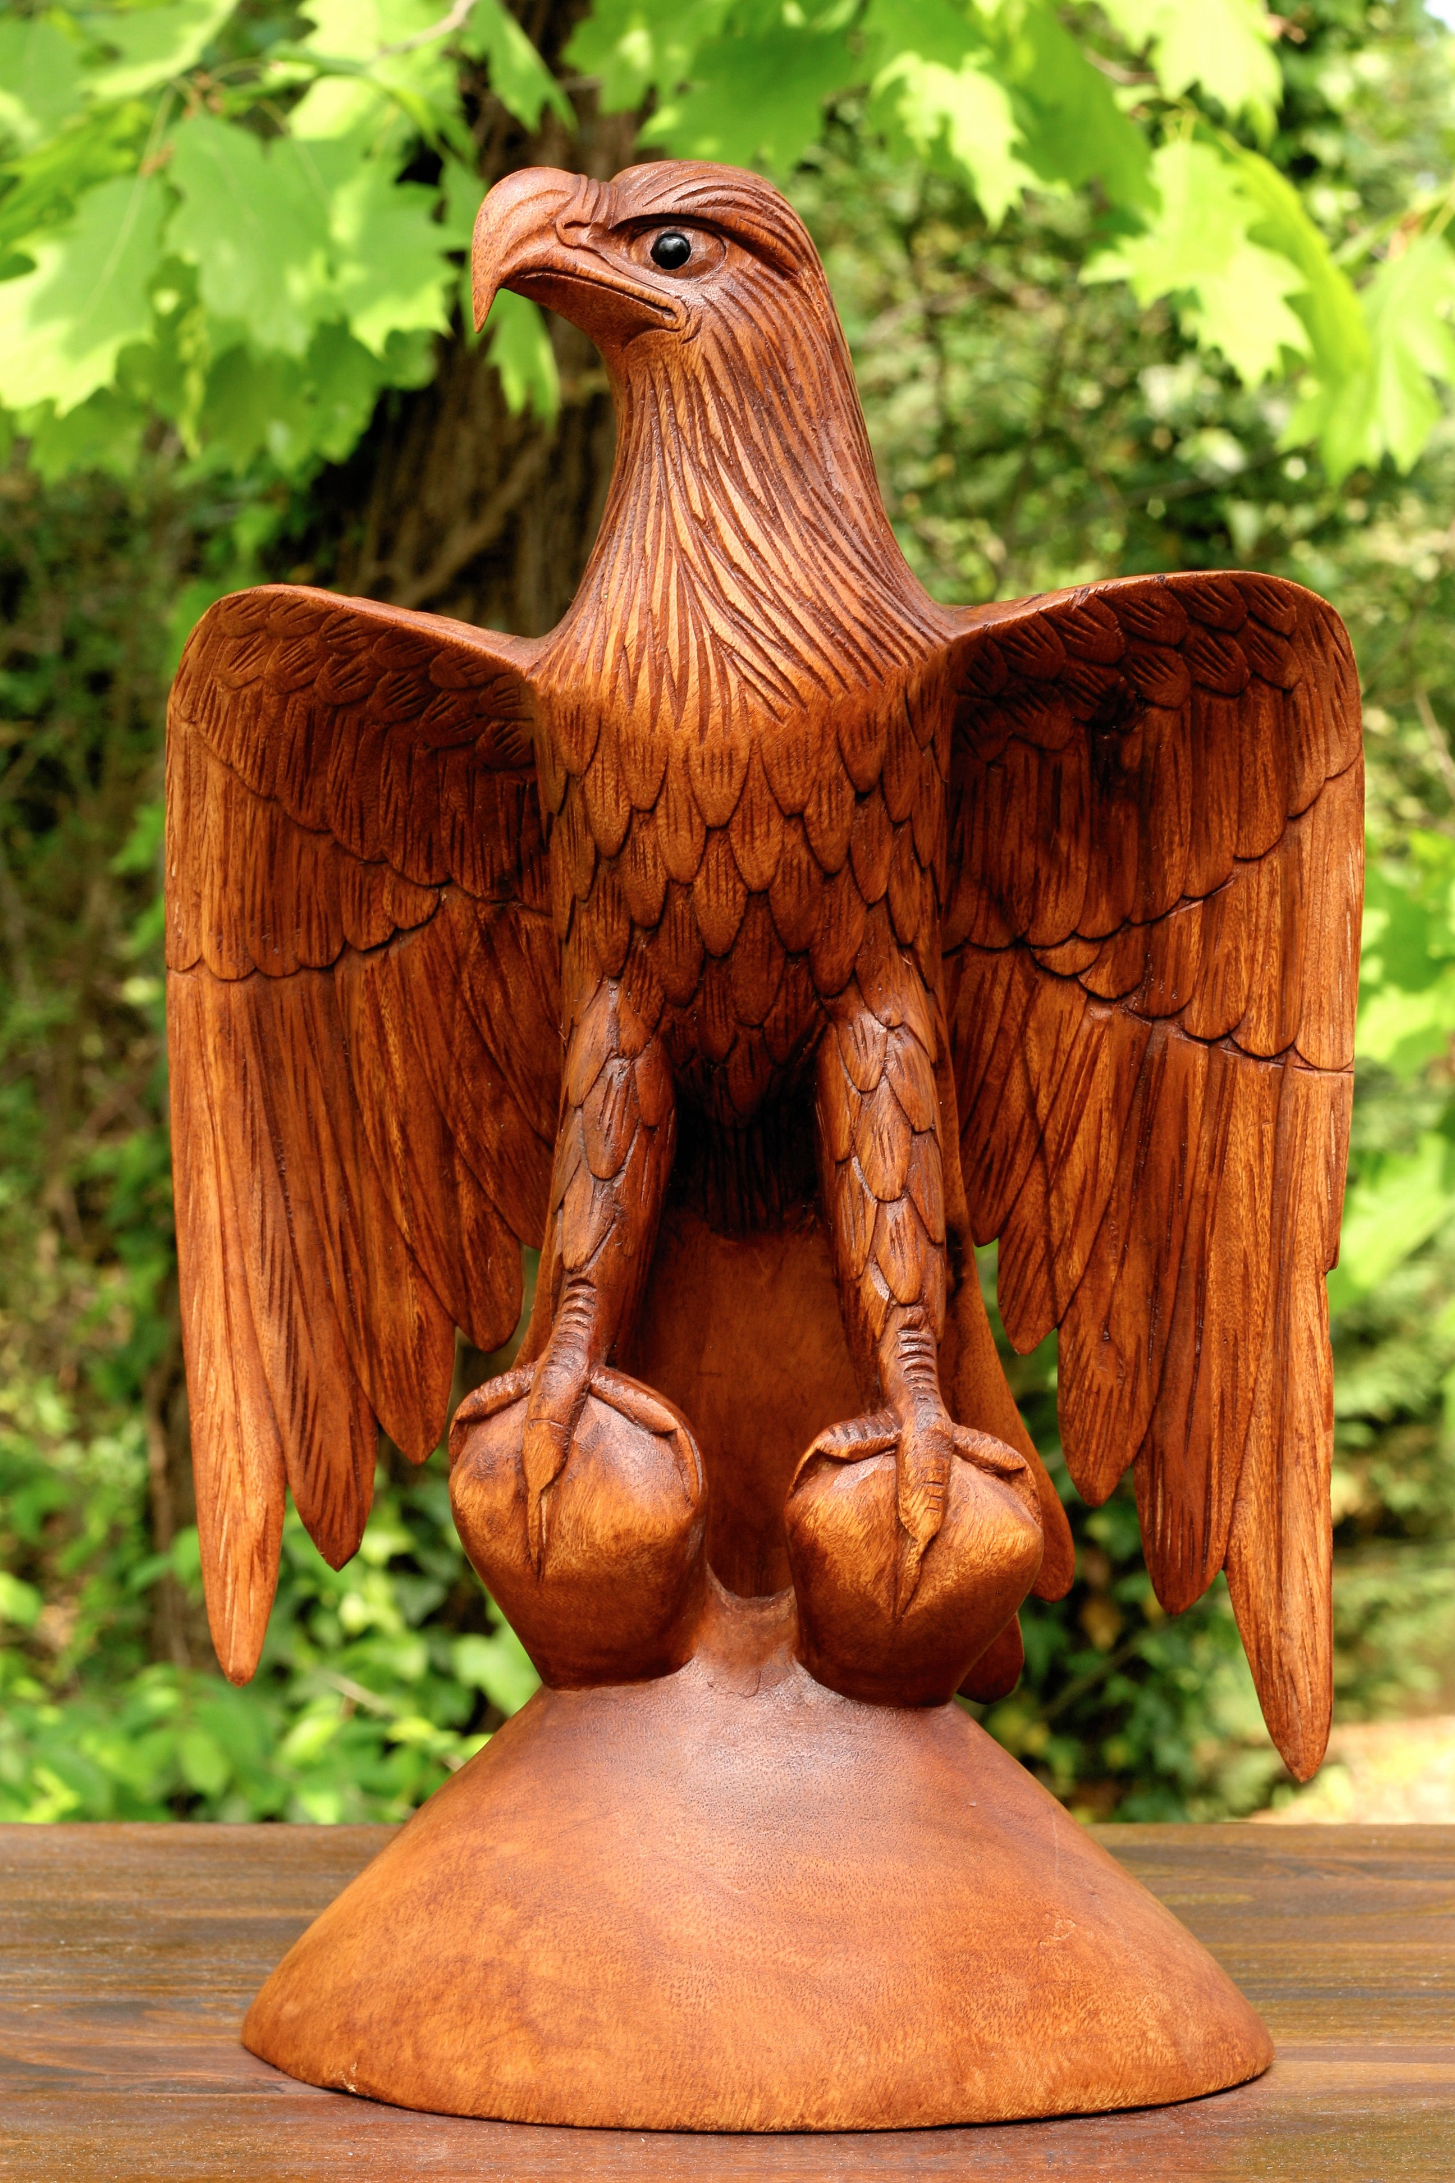
Last Days Nuggets
The bald eagle is Canada’s largest bird of prey. It has a body length of 90cm and while perched, a height of about 75 cm. Hank is a wood carver who wants to create a carving, to scale, of a bald eagle while perched. He has a block of woos that is 150 cm long, 150 cm wide, and 200 cm high.
Suggest a scale factor that Hank could use for his carving.
If he uses the scale factor you suggest, determine the height and length of the eagle he will create.

Slide 3
Last Days Nuggets
The circumference of a circle is enlarged from 10cm to 23 cm. Determine the area scale factor.

Slide 4
Last Days Nuggets
The scale factor of two regular octagons is 5 : 2. Find the ratio of their perimeters and the ratio of their areas.

Slide 5
Last Days Nuggets
The perimeter of regular figures Y and Z are 7 yards and 14 yards respectively.
If the area of Z is 40 yards, what is the area of figure Y

Slide 6
Last Days Nuggets

Slide 7
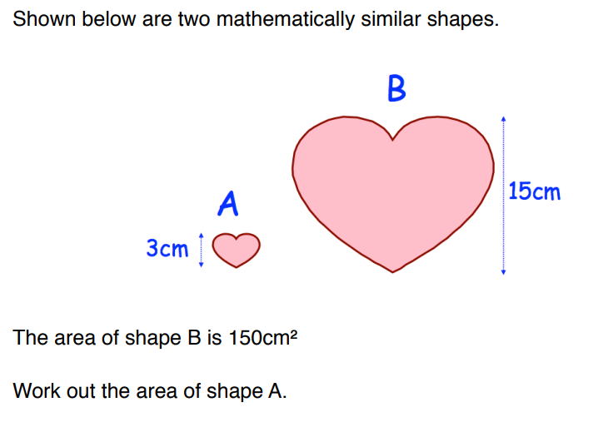
Last Days Nuggets

Slide 8
Unit Conversion Practice METRIC to METRIC
km
hm
dam
m
dm
cm
mm

Slide 9
Unit Conversion
How many km is 2450 cm?
How many cm is 3.4m?
How many dm is 12.1cm?

Slide 10
Unit Conversion METRIC to IMPERIAL

Slide 11
Unit Conversion METRIC to IMPERIAL
How many inches is 20 cm?
How many cm is 5 inches?
How many miles is 20 km?
1 inch = 2.54 cm
1 km = 0.625 mile

Slide 12
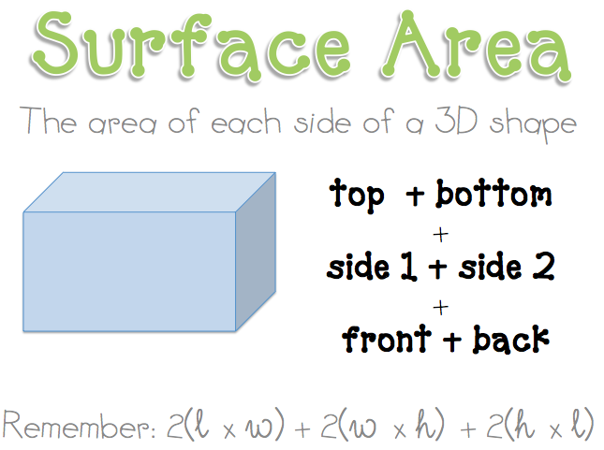
What is Surface Area?
Still an area calculation
2 dimensions
Think of a net flattened out

Slide 13
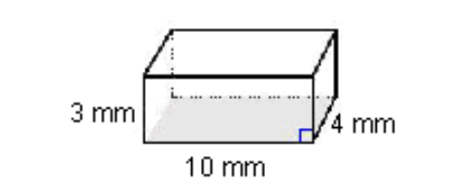
Calculate Surface Area of a rectangular box
How do you calculate the surface area of this image?

Slide 14
Surface Area Scale Factor

Slide 15
Surface Area Scale Factor
Complete in your workbook
Linear scale factor → area scale factor
(L.S.F.)²= A.S.F.

Slide 16
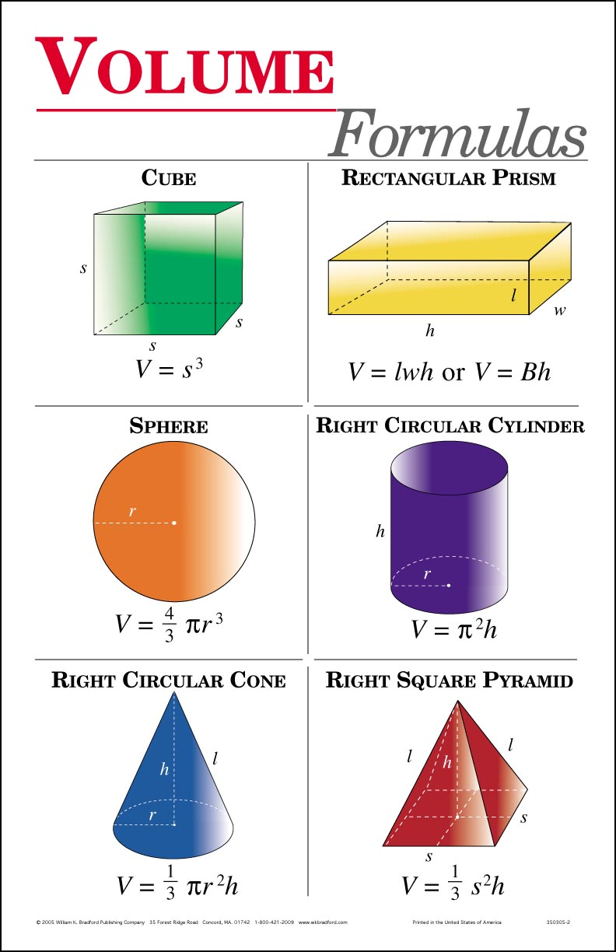
Volume
Volume is the space INSIDE of a shape (that you could fill)
Volume includes three dimensions

Slide 17
Calculate Volume of a shape
The two shapes are similar. Calculate the volume of both and find the Volume Scale Factor using volume.
New
Old

Slide 18
Volume Scale Factor

Slide 19
Calculate Volume of a shape

Slide 20
Calculate Volume of a shape

Slide 21
Surface Area and Volume scale factors
Shape | Surface Area | Volume | Linear Scale Factor | New Surface Area | New Volume
Cube | 150 m² | 125 m² | 3:2
Rectangular Prism | 340 m² | 400 m² | 5:4
Sphere | 804 m² | 2144 m² | 3:7

Slide 22
Complete the chart (Pg 27) Remember: linear SF = area² linear SF = volume³

Slide 23
Assignment & Home Practice
#3 – 8 Page 28 and 29
Home Practice --> 30 minutes of practice test (Page 31)

