Slide 1
Using Z-scores Day 2
FOM 11

Slide 2
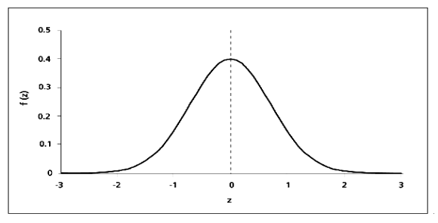
Last Days Nugget
Shade the area under the curve for P(z<1.7). Determine the probability that data will fall in the shaded region and show as a percent.

Slide 3
Last Days Nugget
Shade the area under the curve for P(z>-1.04). Determine the probability that data will fall in the shaded region and show as a percent.

Slide 4
Last Days Nugget
Shade the area under the curve for P(-1.2<z<2.3). Determine the probability that data will fall in the shaded region and show as a percent.

Slide 5
Last Days Nugget
What is the z-score?

Slide 6
Last Days Nugget
What is the z-score?

Slide 7
Example #1
Page 281
A light bulb manufacturer produced 35,000 light bulbs. From past data, the lifetimes of the bulbs are normally distributed with a mean life of 900 hours and a standard deviation of 50 hours.
Predict the percentage of light bulbs that will last between 825 and 875 hours?
How many of the 35,000 light bulbs would you expect to last between 825 and 875 hours?
Determine the probability that a bulb selected at random will last less than 920 hours?

Slide 8
Example #2
Page 281
A study showed that the mean duration oft a certain strain of flu virus was 12 days with a standard deviation of 3 days. If the data is normally distributed, and you caught this strain of flu virus, determine the probability to the nearest hundredth, that it would last
Longer than 17 days
Between 13 and 15 days

Slide 9
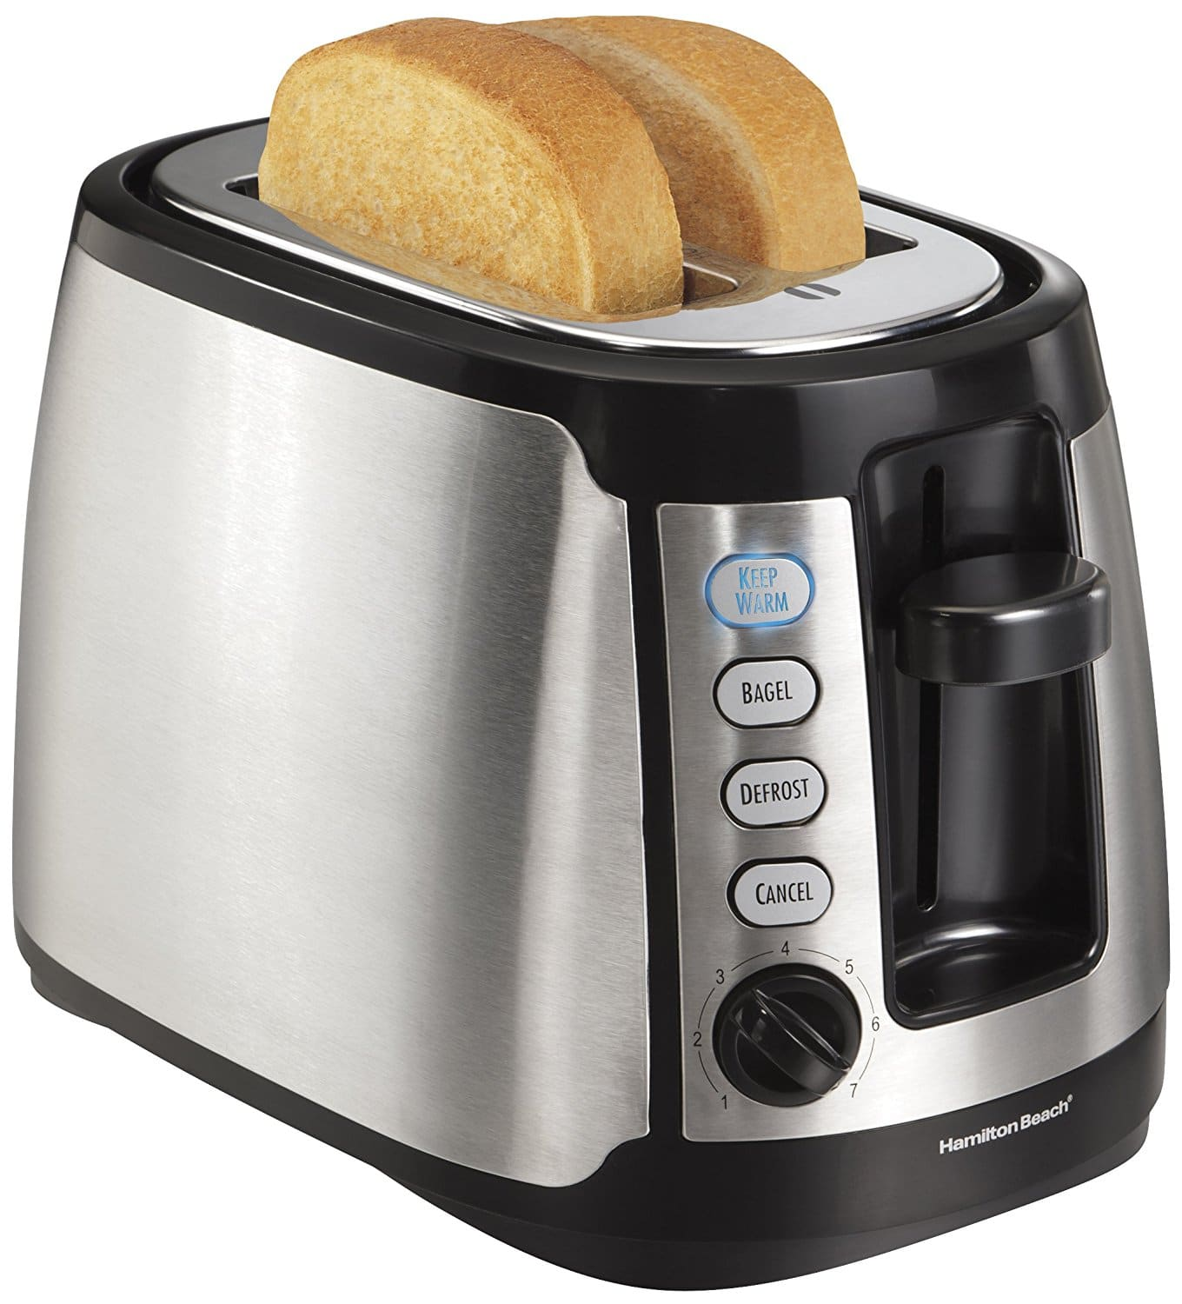
Example #3
Page 282

Slide 10
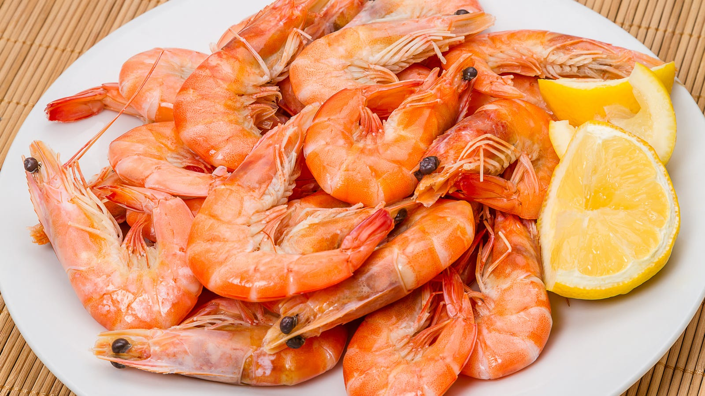
Example #4
Page 282

Slide 11
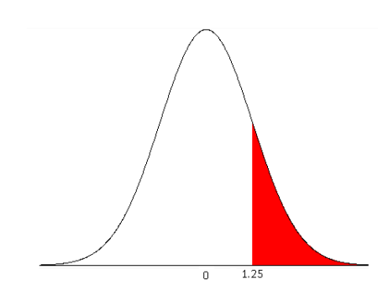
Partner Practice
Question
Work together
Solve 14 questions
Check answers
Move to an opened question
Get around to as many as you can
Answer

Slide 12
To Do:
30 minutes of…
Page 283 in workbook
#1 – 9
Finish for homework if not done
Mark using KEY at back of assignment section

