Slide 1
Using Z-scores
FOM 11

Slide 2
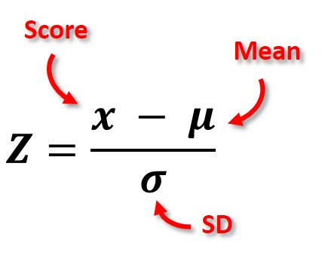
What do we now so far…

Slide 3
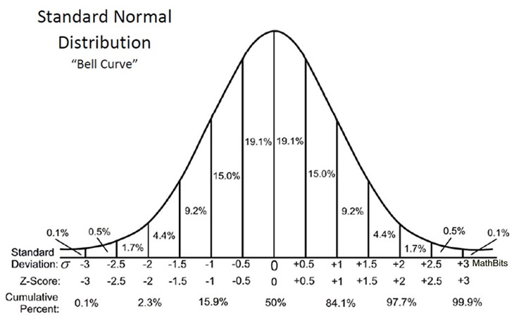
How do we turn z-scores into usable data?

Slide 4
Properties of z-scores tables
A z-score table gives the:
Area under the curve to the LEFT of the z-score
Percentage of data to the LEFT of the z-score
Probability that a randomly chosen data value is to the left of the z-score

Slide 5
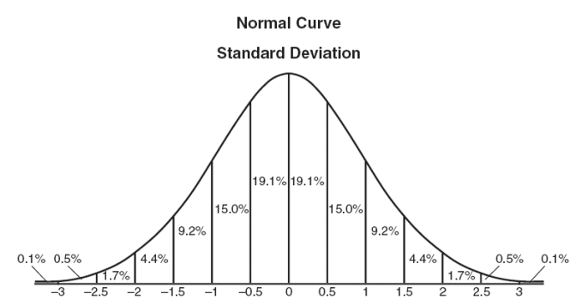
Symbols to Know:
A = area under the curve to the LEFT of the z-score
For example: A(-1.5)

Slide 6
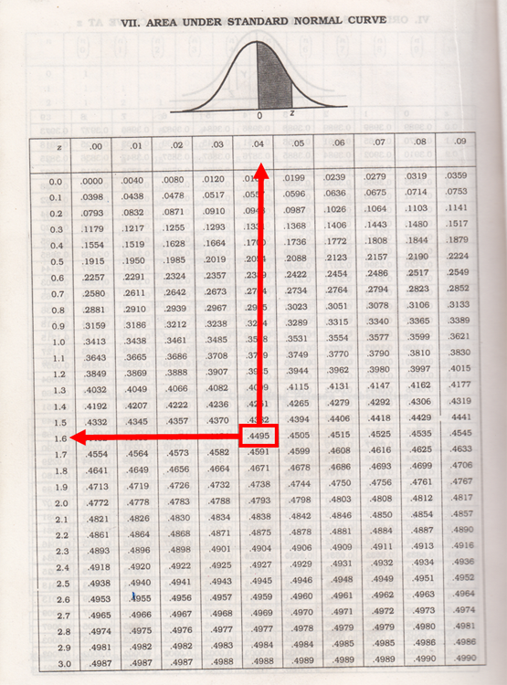
Using a z-table Example z = 1.64
Have your z-score to 2 decimal places
Left column is ones and tenth decimal place
Top row is hundredth decimal place
Value gives you the area to the LEFT of the St.Dev.
Area x 100 = % of population

Slide 7
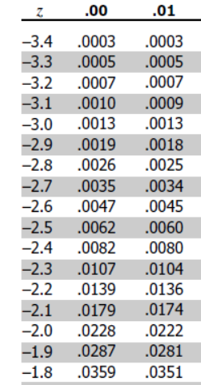
Example #1
Determine the area under the curve for z < (-1.91)
What is the area expressed as a percent?

Slide 8
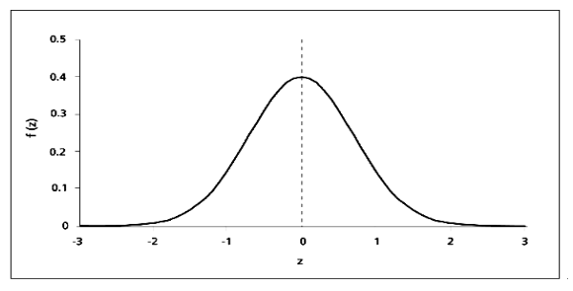
Example #2
Determine the probability to four decimal places of P(-1.25 < z < 1.93)

Slide 9
Example #3
Determine the probability to four decimal places of P(-1.25 < z < 1.93)

Slide 10
Example #4
The speed of cars travelling on the Coquihalla was recorded and the average speed is 130 km/hr with a standard deviation of 7 km/hr. A policeman is assigned to set photo radar on the Coquihalla in a section that the speed limit is 120 km/hr. The policeman sets the camera so that only those exceeding the limit by 5% is photographed and ticketed.
What is the lowest speed you would get a ticket?
If 1000 cars passed the radar, how may drivers can the police expect to ticket?

Slide 11
Example #5
The average height of a NBA basketball player is 6’7”. The standard deviation of the data is 5’. There are 446 NBA players in the league right now.
What is the number of players in the league ABOVE 7’?
What is the number of players in the league BELOW 6’?

Slide 12
To Do:
Page 277 in workbook
#1 – 7
If old book → page 233-236
Finish for homework if not done
Mark using KEY at back of assignment section

