Slide 1
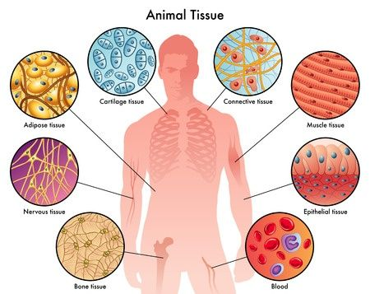
Type of Tissues

Slide 2
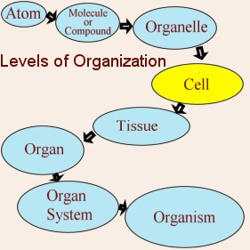
Level of Organization in Human Body

Slide 3
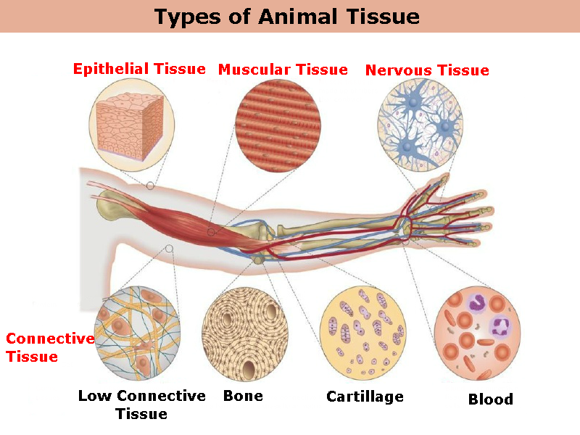
Type of Tissues in
Human Body

Slide 4
Muscle Tissue
responsible for movement both inside and out of the body
Moves blood
Maintains blood pressure
Stabilize skeleton
guards entrance and exit to digestive system
protects internal organs
Move fluid in digestive system and reproductive fluids

Slide 5
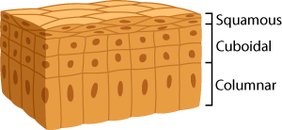
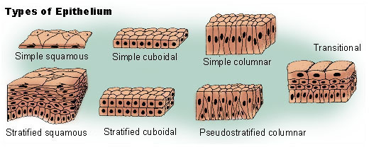
Epithelial Cells
Roles:
1. Protection
2. Secretions (mucous, acid)
3. Absorption of gasses
sensation
Sheet of cells that cover the body surface or line the body cavity

Slide 6
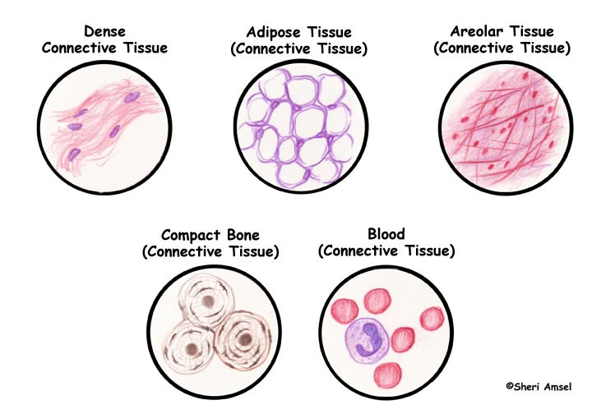
Connective Cells
Roles:
1. structure
2. support
3. binds
4. transport
includes collagen and elastic fibers that uses water and matrix proteins to hold cells together

Slide 7
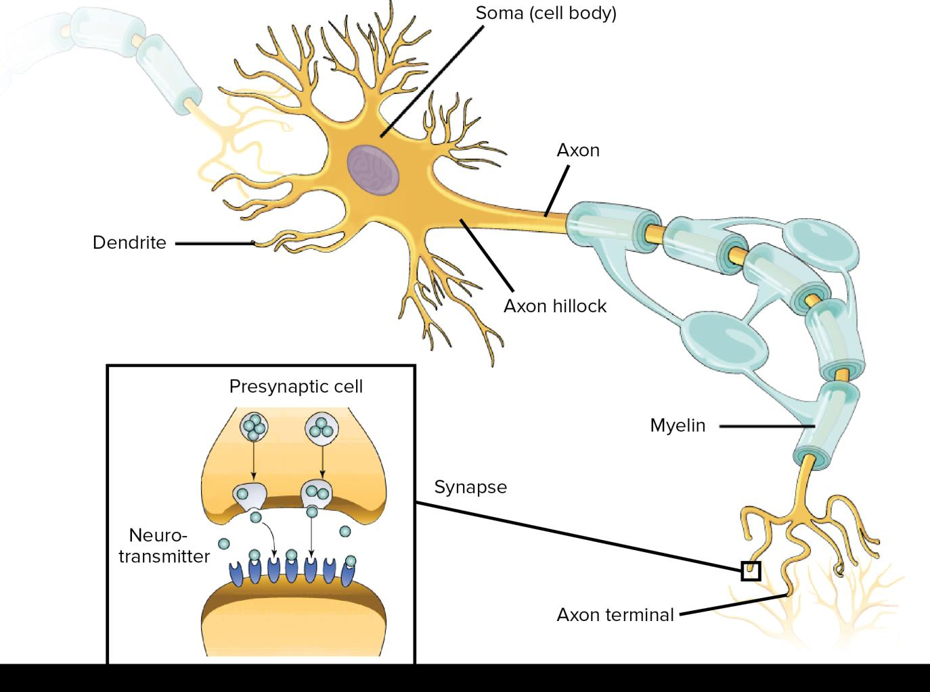
Nervous Cells
Role:
1. Transmit electrical messages
Includes cells of the brain, spinal cord, and peripheral nervous system

