Slide 1
The Buzz About Colony Collapse Disorder Case Study
Environmental Sciences 11/12

Slide 2
Part 1 - Introduction
As a table team, read part 1 aloud
Using the ipad, research and answer the following questions:
1. Where do honeybees live? Where are they indigenous to?
2. Do we have honeybees in the Okanagan?

Slide 3
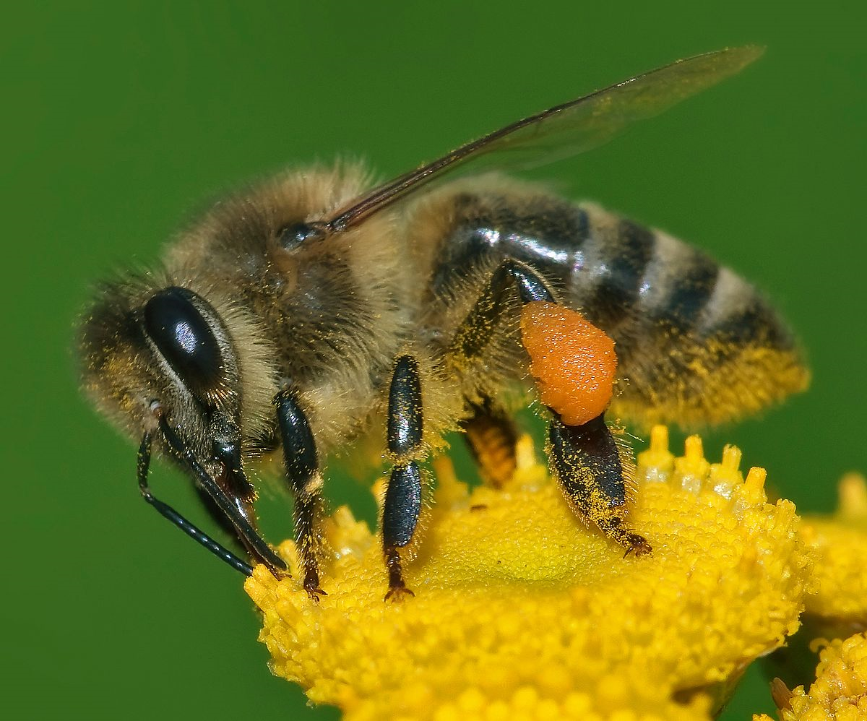
Do we have honeybees in the Okanagan?
Indigenous to Europe
Brought to BC in the 1850’s
Liquid nectar contains 80% water and 20% sugar. The end product (honey) contains only 14% water, which prevents microbial growth

Slide 4
Part 2 – In Search of a Cause
Read part 2 aloud as a table team
Answer the following questions:
What are some of the reasons for Colony Collapse?
How do the mites affect the bee?
Why not use pesticides to kill the mites?
How do the neonicitinoids impact the bee’s memory and functioning?
What are some changes in agricultural practices that could help the bee popultions?

Slide 5
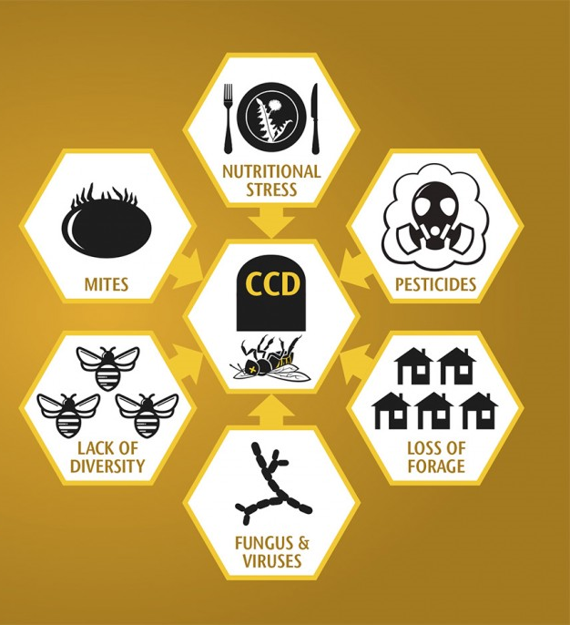
Reasons for Colony Collapse

Slide 6
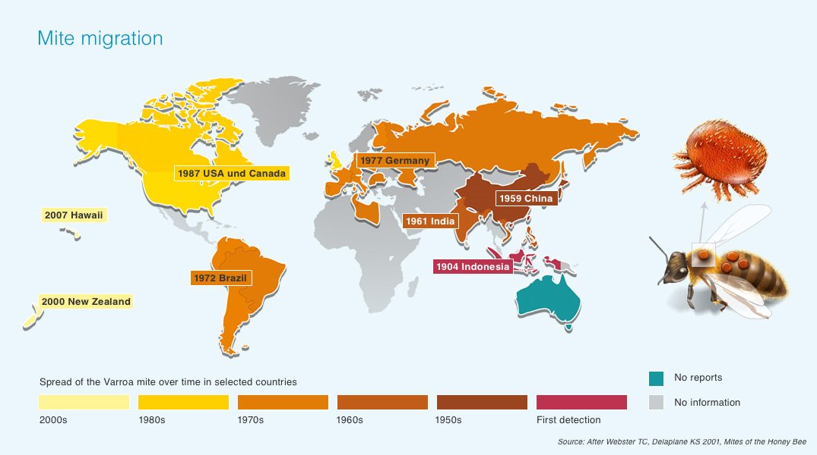
The spread of the mite

Slide 7
Neonicitinoids

Slide 8
Part 3 – RNA Interference
Read part 3 together as a table team.
Answer the below questions:
1. What is the IAPV virus that is impacting bees? What does it do to the bee?
2. How does feeding bees a fragment of double stranded RNA from the IAP virus help the bee become “immune”?

Slide 9
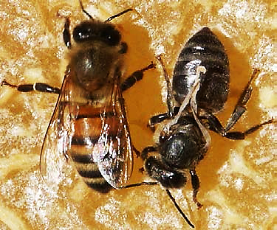
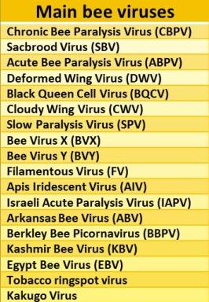
Bee Viruses

Slide 10
Part 4 – How Can We Help?
Read Part 4 as a table team.
Answer the below questions:
1. What are some actions we can start taking to help the bee population?

