Slide 1
Statistics
Lesson #2
Standard Deviation

Slide 2
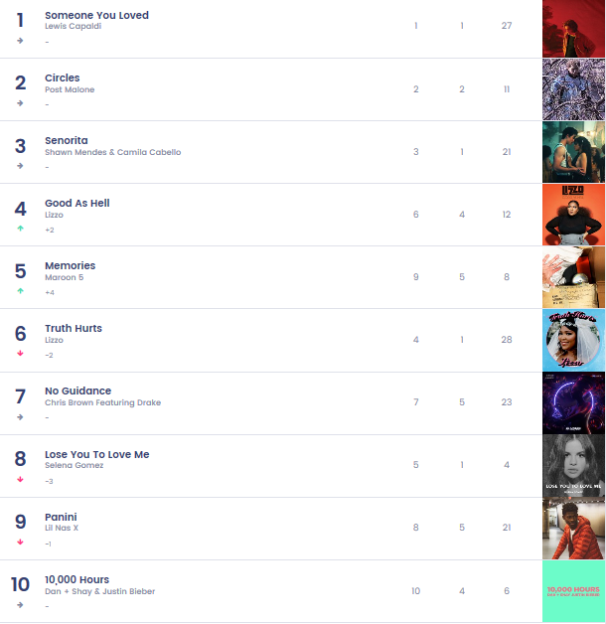
Brain Warm Up
Number of weeks at number 1
How can you use central tendency statistics to communicate this data?
How many different statistics could you use? Be specific!
Number of weeks on the TOP 100 chart

Slide 3
This is the ages of the 2020 Team Canada Junior Team. What is the mean, median, and mode age?
18, 17, 18, 17, 19, 20, 19, 19, 18, 18, 18, 17, 18, 19, 17, 17, 18, 18, 18, 19, 19, 19

Slide 4
What is the mean and standard deviation for each of the below situation?
There are 4 students writing a Math test. Below are their test scores. Use Desmos to calculate the mean and standard deviation for each of the student test scores.
Student 1 = 100
Student 2 = 100
Student 3 = 0
Student 4 = 0
Student 1 = 50
Student 2 = 50
Student 3 = 50
Student 4 = 50
Student 1 = 100
Student 2 = 75
Student 3 = 25
Student 4 = 0

Slide 5
How can describe your data?
Measure of Dispersion
How spread out the data is (the RANGE)
Helps describe the “mean” so that we can understand if the data is close similar, or if there is a large spread
Range
The different between the highest and lowest data point.
Fault → uses only 2 data points
Standard Deviation
A measure of dispersion (spread) of data
Positive → Uses all data points to calculate

Slide 6
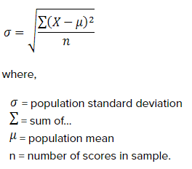
Calculating Standard Deviation?
Standard deviation of a sample shown in symbol (s)
Standard deviation of a population shown in symbol (σ) – lower case sigma

Slide 7
Calculating Standard Deviation?
Steps to Calculate St. Dev:
Subtract the mean value of the data set from each individual data point
Square each difference
Add up all the values
Divide the sum by the number of values
Take the square root of the quotient

Slide 8
Below are the heights (cm) of the Toronto Raptors Starting Line up.
Steps to Calculate St. Dev:
Subtract the mean value of the data set from each individual data point
Square each difference
Add up all the values
Divide the sum by the number of values
Take the square root of the quotient
Lowry – 183 cm
Ibaka – 208 cm
VanVleet – 183 cm
Anunoby – 203 cm
McCaw – 201 cm
Calculate the average height of the players
Include mean and standard deviation

Slide 9
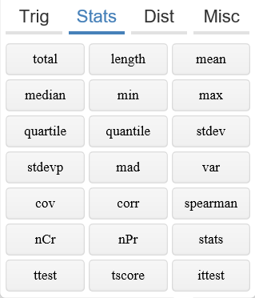
Susie is looking at the daily average temperature for Summerland and Vancouver
Penticton, BC
Vancouver, BC
Calculate the annual average temperature for each location.
Include mean and standard deviation

Slide 10
This frequency table shows the number of hits per game by a baseball player during 1 month of play.
# of Hits per game | # of games
0 | 5
1 | 10
2 | 4
3 | 3
4 | 1
What does this raw data look like?

Slide 11
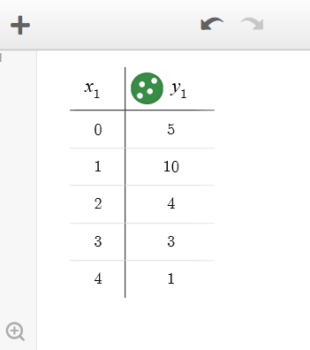
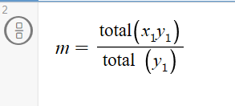
Calculate the mean and standard deviation of the number of hits per game
# of Hits per game | # of games
0 | 5
1 | 10
2 | 4
3 | 3
4 | 1
Step 1 – enter into table on desmos
Step 2 – enter equation on next line for mean

Slide 12
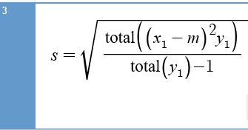
Calculate the mean and standard deviation of the number of hits per game
# of Hits per game | # of games
0 | 5
1 | 10
2 | 4
3 | 3
4 | 1
Step 3 – enter into table on desmos
Be sure to properly put in the brackets!!
Keep the m in the above row

Slide 13
To Do:
Page 257 in workbook
#1 – 14
Use Desmos for #1, 4, 5, 7, 8, 9
Finish for homework if not done
Mark using KEY at back of assignment section

