Slide 1
Spirit Bear
Environmental Sciences 12

Slide 2
Habitat
BC’s mid-coast
Great Bear Rainforest

Slide 3
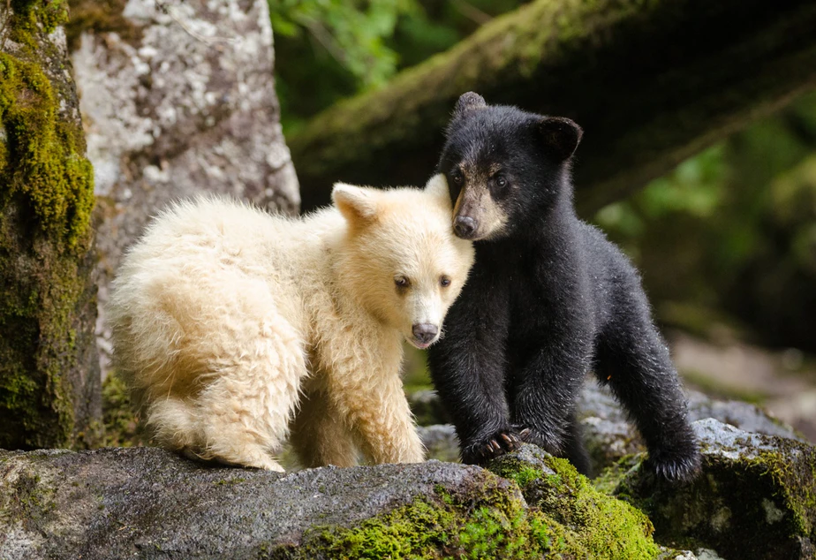
Kermode Bear
A white variation of the North American Black Bear
Low to moderate frequency on BC’s mid-coast
Due to a recessive allele
Bear still has pigmented eyes and skin
Dubbed spirits of the forests
Only found in the Great Bear Rainforest
Approximately 400 bears remaining

Slide 4
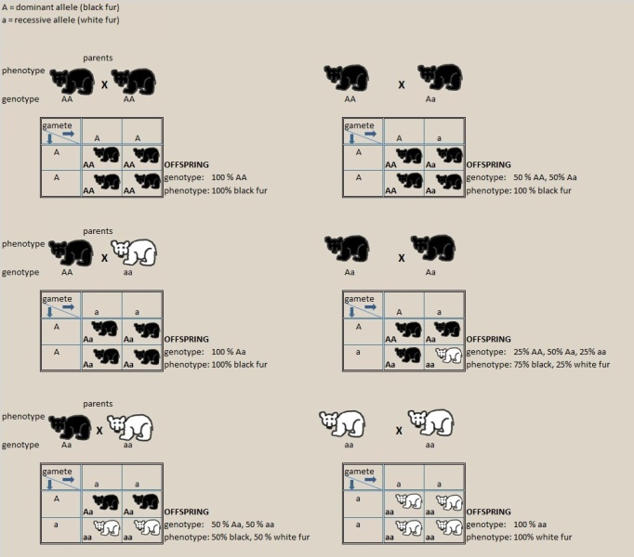
A recessive mutation
single nucleotide replacement in the melanocortin-1 (Mc-1r) receptor
Change nucleotide to adenine rather than guanine
both parents contribute this recessive gene, the result is white fur (NOT albino)

Slide 5
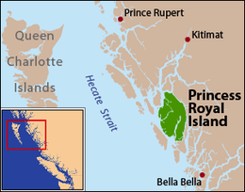
Kermode Bear
1 out of 10 black bears in the Great Bear Rain Forest of west-central British Columbia has white fur
The highest concentration of these bears lives on and around Princess Royal Island.

Slide 6
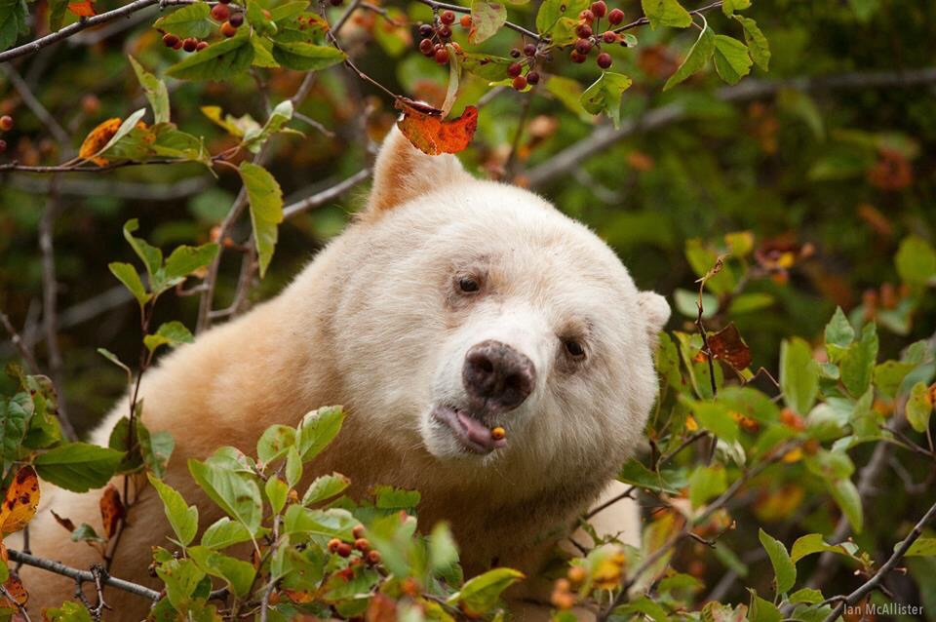
Kermode Bear
A theory of their success is that the Kermode bear is a stronger fishermen than the black bear as they cast less of a shadow as they fish (for fish to detect)
Similar to idea of white bellies of many ocean animals

Slide 7
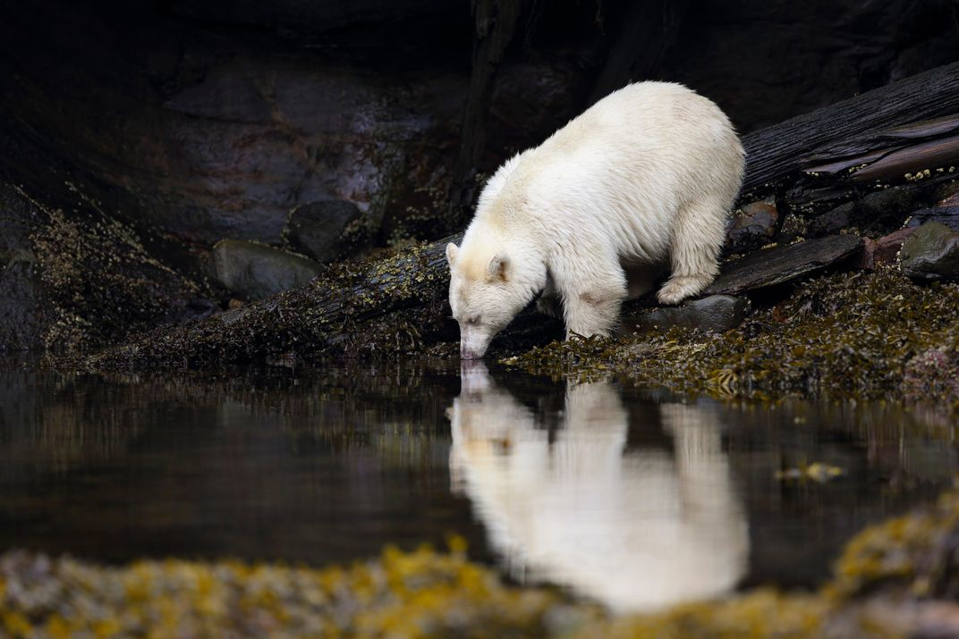
Watch video

Slide 8
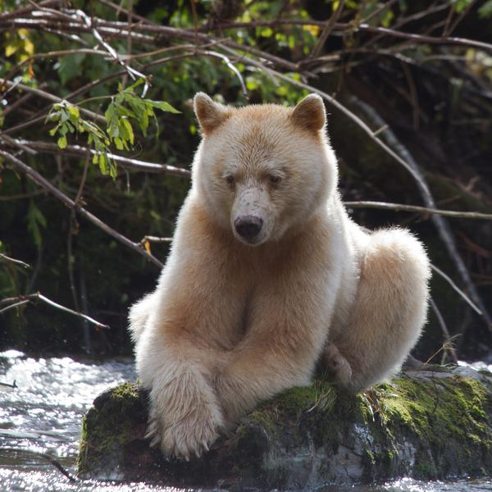
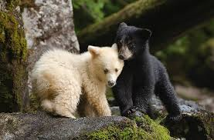
Spirit Bear

Slide 9
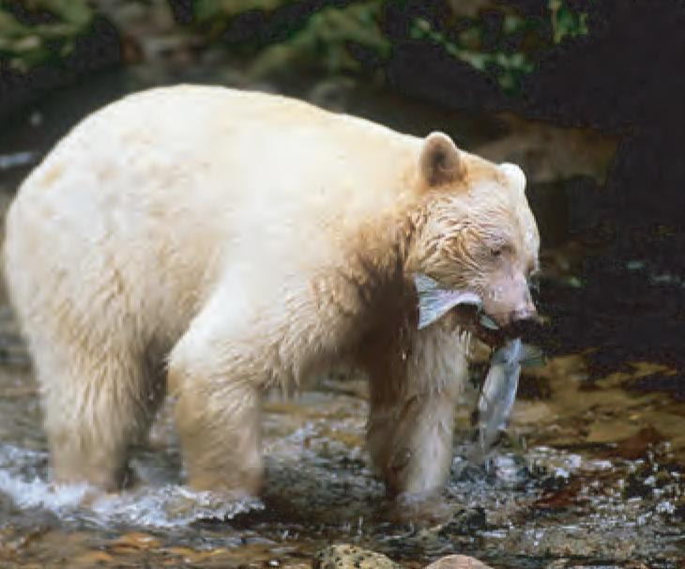
Fostering Fitness
White bears are more successful at catching salmon in daylight compared with black ones.
The bears play a key role in the ecosystem, contributing to the growth of the forest by spreading marine nutrients. They carry salmon carcasses deep into the forest where they are absorbed by the forest floor and the nutrients from the ocean are effectively transferred to the trees.

Slide 10
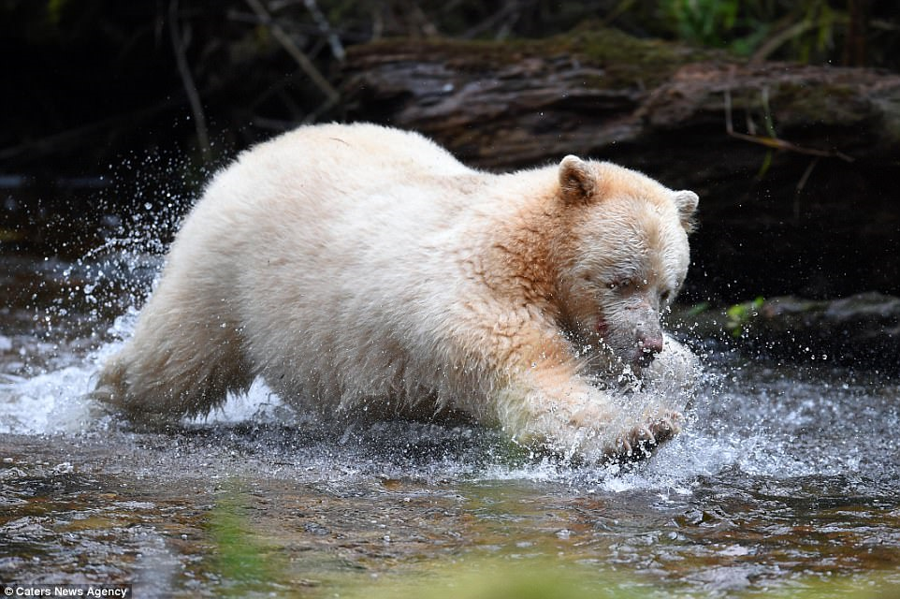
The Tsimshian Legend
Raven, the Creator, made a pact with the Black Bear. He promised the bear could live in peace and safety, in exchange for letting him turn every tenth bear white as a reminder of the hardships of the last ice age.

Slide 11
Competitors
There are an estimated 15,000 grizzly bears in B.C.
Because numbers of salmon are down, grizzlies travel farther to look for food and are encroaching on spirit bear territory for the first time.
Grizzlies are larger and stronger, and usually chase other bears off from prime fishing spots
Humans are damaging area due to pipelines and construction of pipelines from Alberta to the coast.

Slide 12
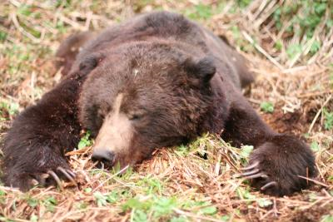
What is being done?
As of April 2018, there is a ban on all Grizzly hunting in BC, other than First Nations accordance to Aboriginal rights
it is illegal to kill a spirit bear, however, hunters may shoot a black bear that carries the crucial gene.

Slide 13
Watch the video

Slide 14
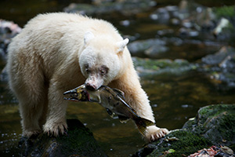
What questions Do you have about this organism?

Slide 15
Table Team Research
What are the several factors that are impacting our BC Spirit Bear?
What other living and non-living factors are part of this organisms ecosystem?
What type of jobs might work with this organism?
What limiting factors are impacting this organism?
What actions are being taken to help this population of this organism?
Remember, deep thinking questions must make connections between two bigger concepts, and not be able to be quickly answered.

Slide 16
Nature of Things
Follow a season with a bear family from the Great Bear Rainforest

