Slide 1
Simple and Compound Interest
FOM 11

Slide 2
What do we know about banking?

Slide 3
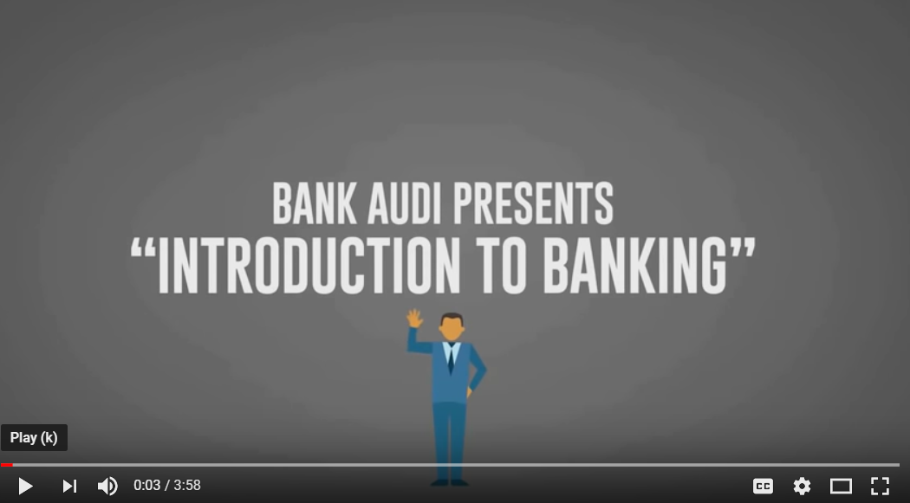
How does banking work?

Slide 5
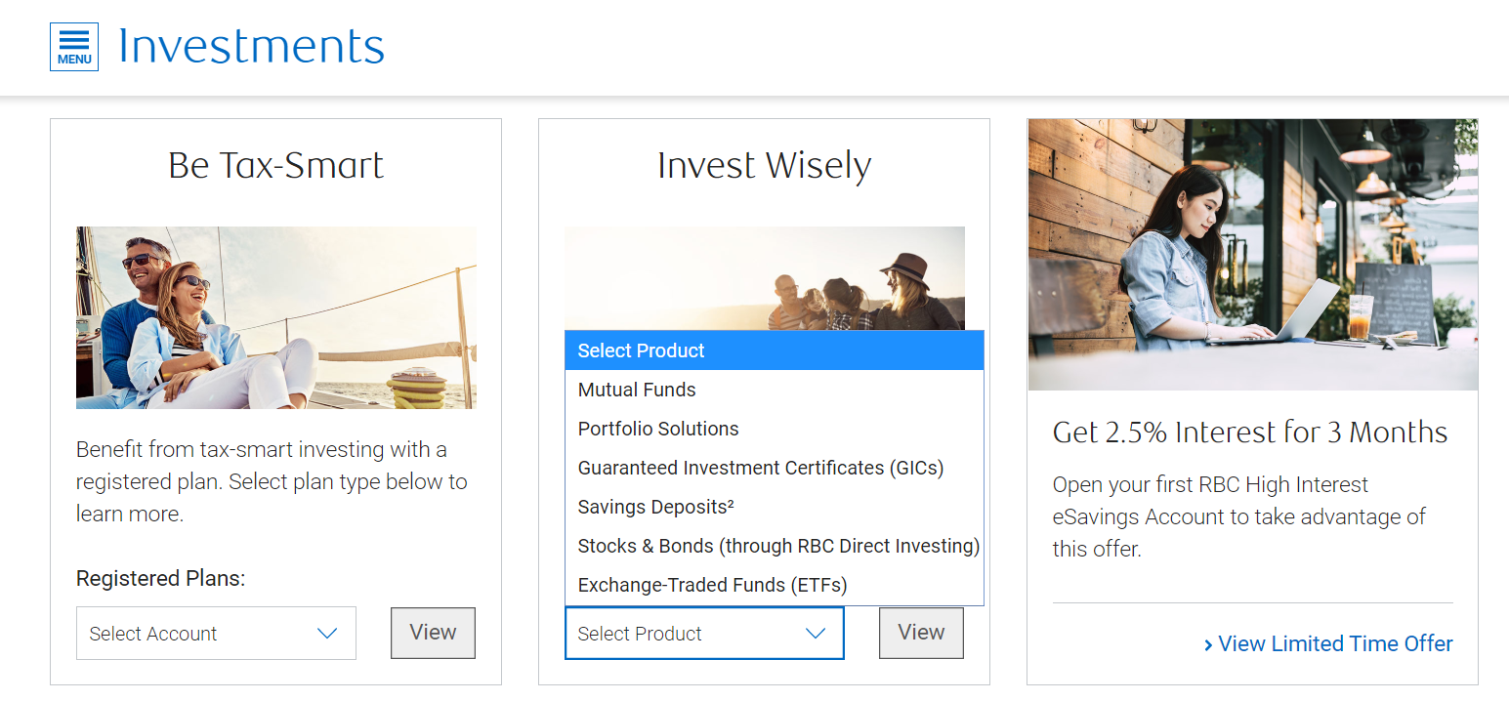

Slide 6
Types of Interest
Simple Interest → Interest that is paid on only the initial principle of the investment (used for short term investments)
Compound Interest → Interest that is paid on the initial interest AND the accumulating interest (used for long term investments)

Slide 7
How does type of interest impact my savings?
Sam and Jacquie both have $5,000 to put in the bank from their summer job. Sam’s bank offers 5% simple interest per annum. Jacquie’s bank offers 5% compound interest per annum. What are their investments after 5 years?
Investment Year | Sam’s Investment | Jacquie’s Investment
1
2
3
4
5

Slide 8
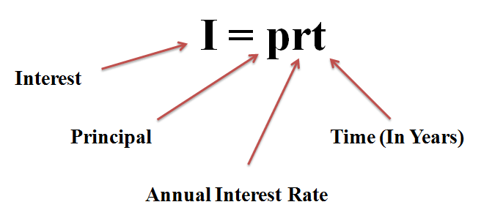
Simple Interest Formula
Millie invests $2350 at 7% per year for six months. Calculate the simple interest on Millie’s investment and the value of Millie’s investment after the 6 months. (Pg 317 in workbook)

Slide 9
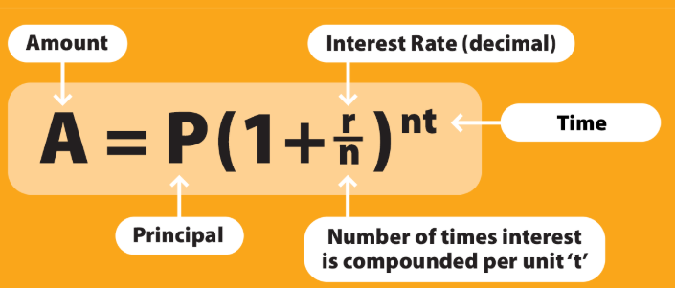
Compound Interest Formula
$4000 is invested in a 3 year GIC, compounded yearly at a rate of 3.5% per annum. Determine the value of the investment at the end of the term. (Pg 321 in workbook)

Slide 10
Practice
Geezia has invested $8000 in a 5 year bond, compounded annually at a rate of 3.2% per annum. Determine the interest earned at the end of the 5 year period.

Slide 11
Pg 322 Workbook
Amber Lynn invested $8000 in an investment for 5 years compounded annually at a rate of 7.25% per year.
Determine the value of her investment at the end of the term
Calculate the profit made on her investment
Suppose that Amber Lynn has not decided how long she will keep the investment. Let x represent the number of years that her money is invested. Write an equation of the form y = ab^{x} to represent her balance after x years

Slide 12
Pg 322 Workbook
Amber Lynn wants to know which of the following options will increase her investment more:
increasing her initial investment by $500
Finding an investment with an annual interest rate of 8%
For each of these two scenarios, write an equation to represent her balance after x years.
If Amber wants to cash out her investment after 5 years, which is the better option?
If Amber wants to cash out her investment after 10 years, which is the better option?

Slide 13
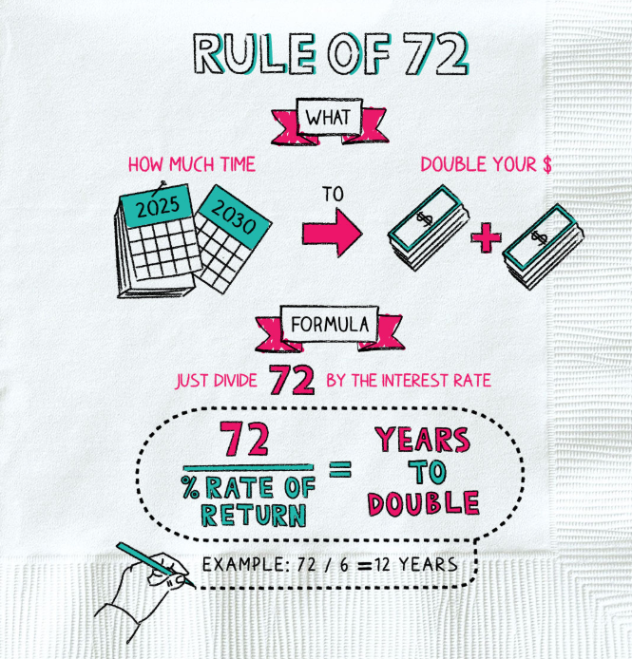
Rule of 72
72 / interest (%) = years to double
72 / years to double = Interest (%)

Slide 14
Homework
Page 325 #1 – 7 & 9
Download for Monday (on your phone)
Ex Calculator

