Slide 1
Science 10
Day 1

Slide 2
Who Am I…
Love the outdoors
Science is my passion
Asking questions and exploring possible solutions is my focus

Slide 3
As a table team….
What does great learning mean to you? | How do you know you are ready to learn?
What do you need from your teacher, your peers, and yourself to be ready to learn? | What words describe a learning community?

Slide 4
What does great learning mean to you? | How do you know you are ready to learn?
What do you need from your teacher, your peers, and yourself to be ready to learn? | What words describe a learning community?

Slide 5
Cell Phone Use
Cell phones are put away and not visible during class time
Help your brain maintain focus
Process
polite reminder to put away
Referral to office

Slide 6
Lates
Be on time for each class
Shows respect of class and respect of you learning
Ensures you are present for all material
Process
polite reminder to be on time
Referral to office

Slide 7
Competencies and Dispositions
What is a DISPOSITION?
What is a COMPETENCY?
What COMPETENCIES and DISPOSITIONS do you think you need for your future jobs and life?

Slide 8
Homework Expectations
15 - 30 minutes of study each evening
preparation for Friday Quizzes (a check in to see where you are at) will be recorded, but not for marks
study for unit tests (recorded in learning goals)
Rewrites - KEEP YOUR LEARNING GOING!

Slide 9
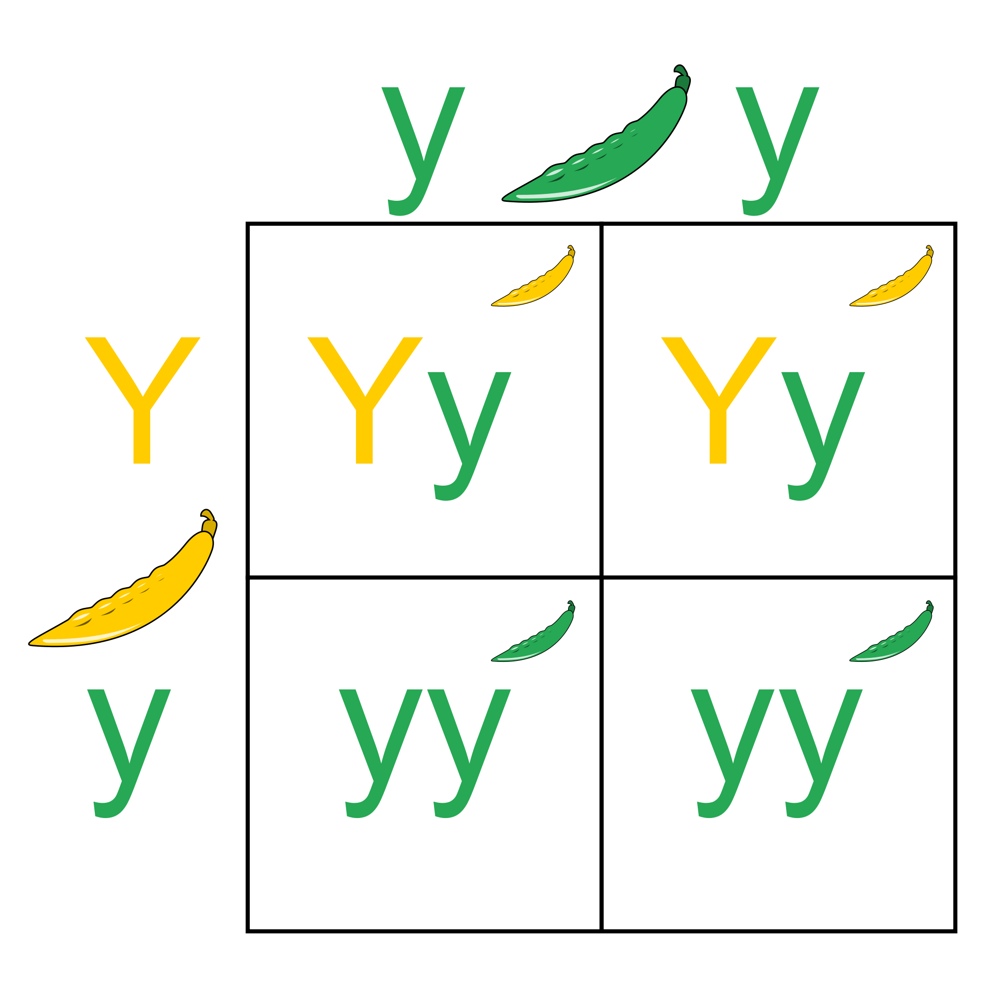
Biology – DNA, Genetics, Natural Selection

Slide 10
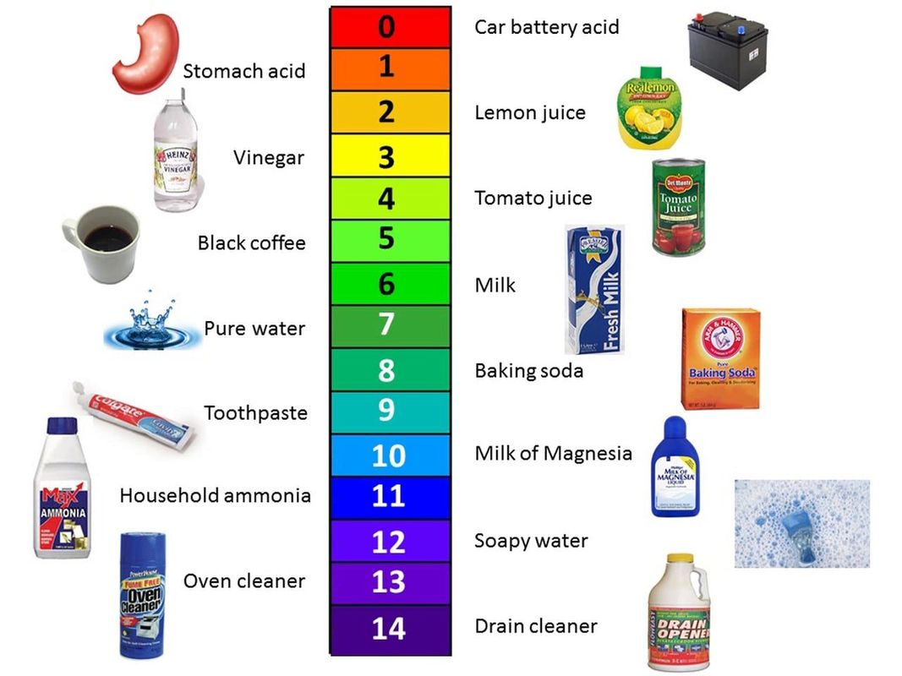
Chemistry – Acid/Base, Reaction Types, Balancing Equations

Slide 11
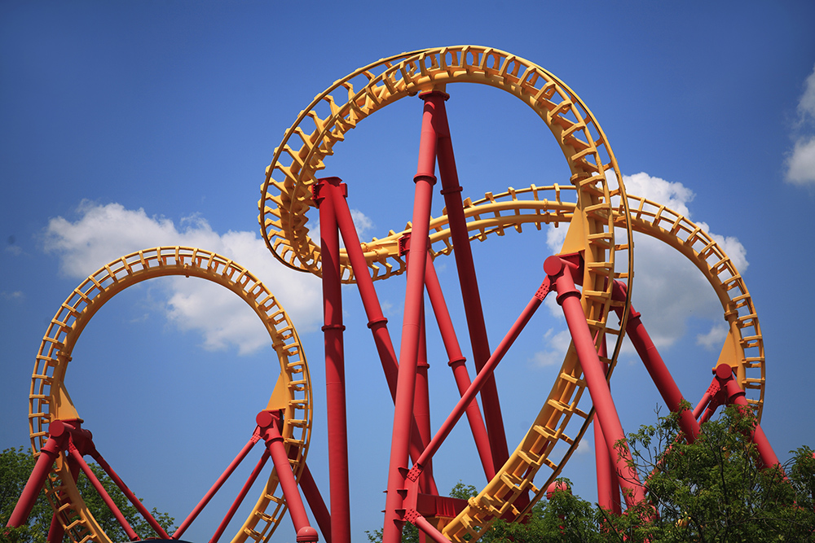
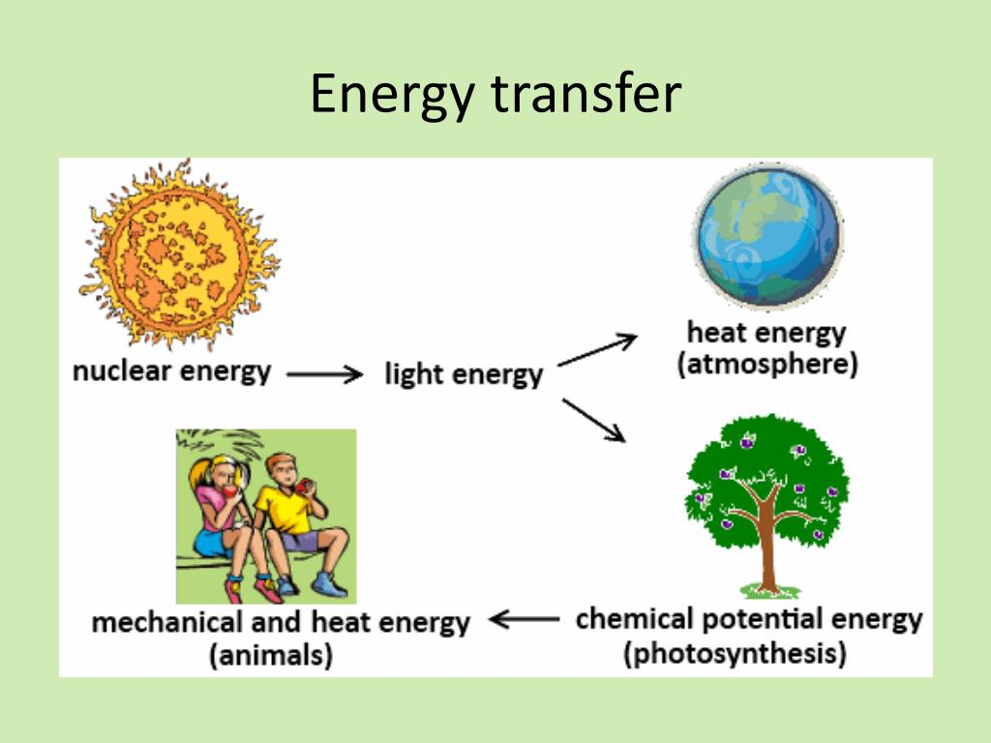
Physics – potential & kinetic energy, energy transfer

Slide 12
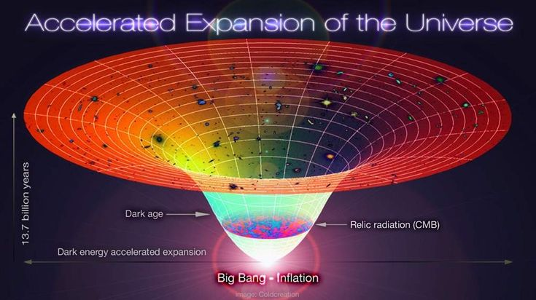
Astronomy – Big Bang, Space Science, and data collection

Slide 13
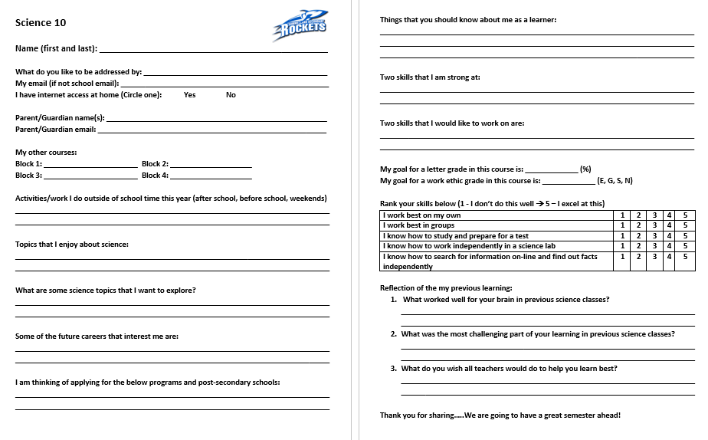
What are your goals for this course?
Complete the get to know you form (need updated emails for you and parents)

Slide 14
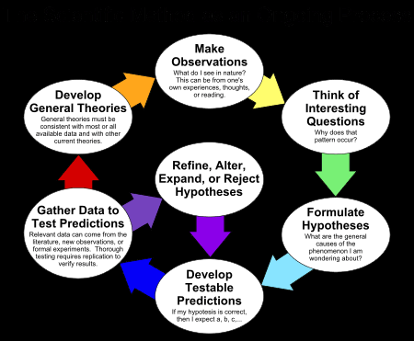
Acting Like A Scientist

Slide 15
Setting Up Your Journal
Will be marked for curricular competencies
Articles, field trips, documentaries

Slide 16
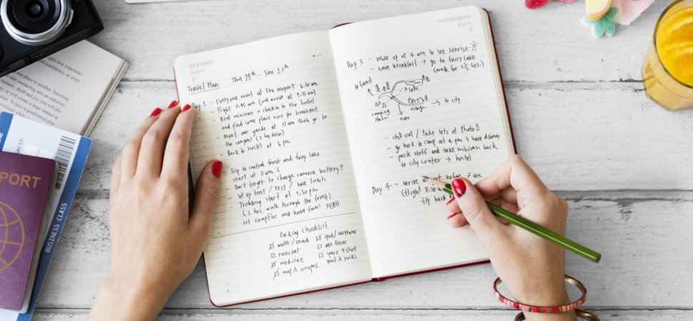
Supplies Needed
Spiral notebook for notes
Whiteboard markers
Pens/pencils, etc
Load QUIZLET onto your phone (we will be using this as a class to help with our vocabulary practice)

Slide 17
Environmental Guess Who?
Think of an ENVIRONMENTAL VOCAB WORD you know and write it on your post-it note.
Put it on your neighbours forehead. They need to walk around the room and ask YES/NO questions to see if they can guess their vocab word.

