Slide 1
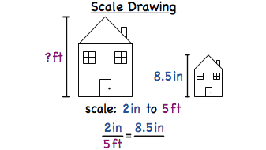
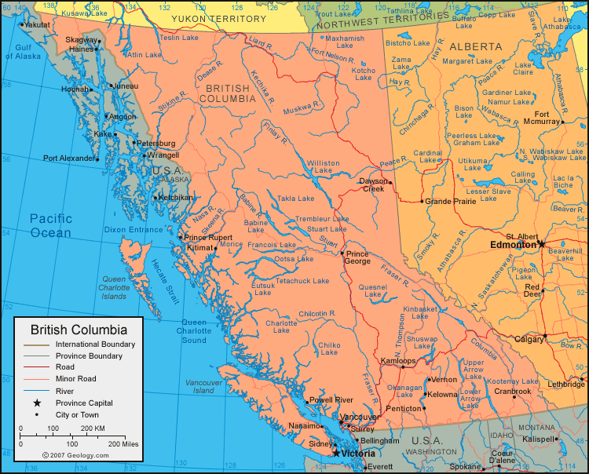
Scale Diagrams FOM 11

Slide 2
Math Talk Tuesday
Which would you choose and WHY?
What scenario would cause one wage setup to be better than the other?

Slide 3
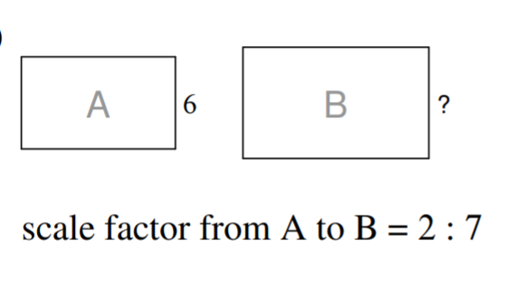
What is the missing side length?

Slide 4
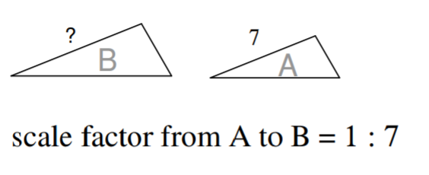
What is the missing side length?

Slide 5
Ways to Express Scale
Method | Example
Statement | 1 cm represents 0.5 m
Rate | 1cm: 0.5m (two different units)
Ratio | 1:50 (same units)
Line Graph Scale

Slide 6
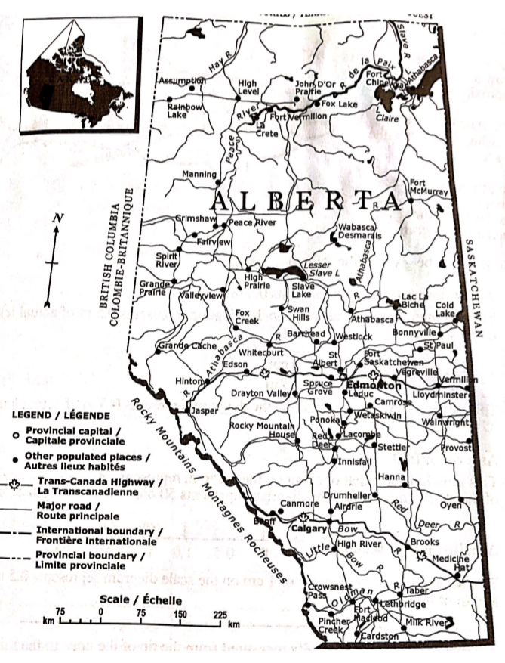
Page 10 in workbook
Use a ruler
What is the scale
Draw a straight line between Calgary and Edmonton
What is the proportion for this distance?
What is the actual distance (as the crow flies) between Calgary and Edmonton?

Slide 7
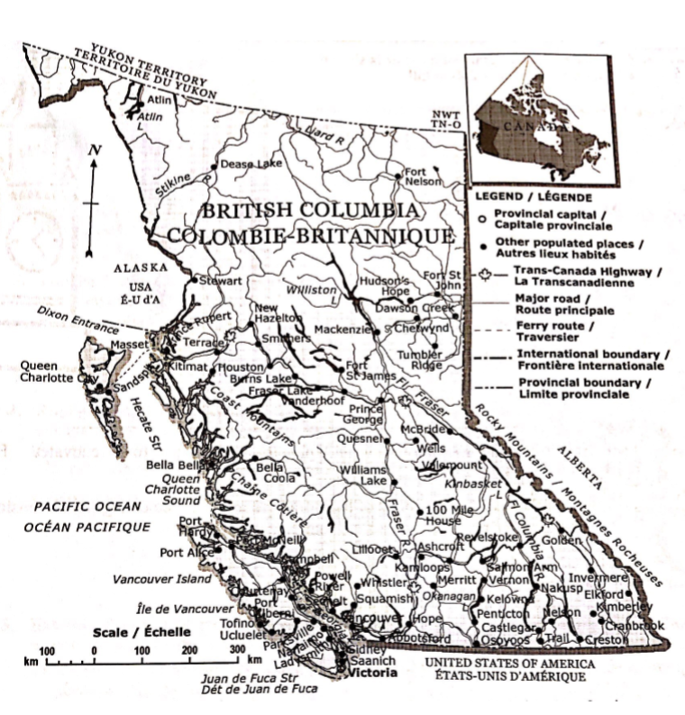
Page 11 in workbook
What is the distance between Penticton and Vancouver?
Is this accurate? Why?
Calculate the distance between New Hazelton and Prince George.
What is a method that might help with a more accurate measurement?

Slide 8
Unit Conversion (used for ratio format)
When using ratio to show scale, you need to use the same unit
Change 40m into cm
Change 2km into cm

Slide 9
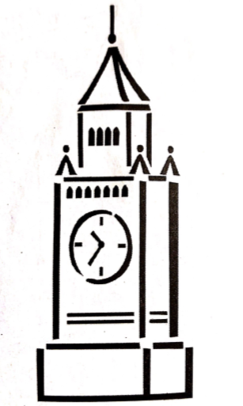
Tyler’s scale diagram of a tower is shown. The actual tower is 240m tall. Write the scale Tyler used in the various forms

Slide 10
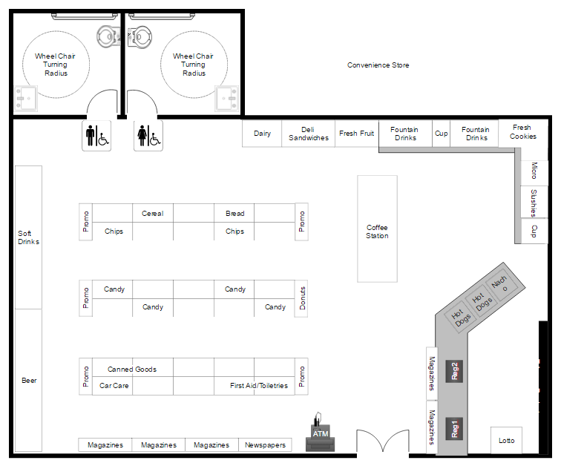
Kylie designs a plan for a candy store to be renovated. The scale drawing on the plan of the candy store is 1cm:50cm.
What are the actual dimensions of the storage room if the scale diagram dimensions are 8cm x 12cm?
What are the dimensions on the plan if the dimensions of the chocolate section of the store are to be expanded to be 3.5 m x 4.75 m?

Slide 11
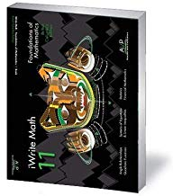
Practice
Page 13 #1 - 10

