Slide 1
Scale Models Lesson #1
FOM 11

Slide 2
I Wonder…
What math type questions could you ask about this picture/topic?
Share with your table team

Slide 3
Practice Estimation Skills..
How many seats do you think are on the plane?
What is an estimate too low?
What is an estimate too high?
Share with your table team

Slide 4
Practice Estimation Skills..
Are you happy with your estimate? Update?

Slide 5
Practice Estimation Skills..
Air Canada would like to have a First Class and an Economy Class. How many different ways can they set up the plane layout?

Slide 6
Practice Estimation Skills..
What do you think would be the best set up if you were planning the plane lay out? Justify your answer. What would you need to consider?

Slide 7
Practice Estimation Skills..
If Air Canada usually sets aside ¼ of the seats to be First Class and the remainder are Economy Class, how much revenue will Air Canada make if they sell First Class seats for $315 and Economy seats for $199?

Slide 8
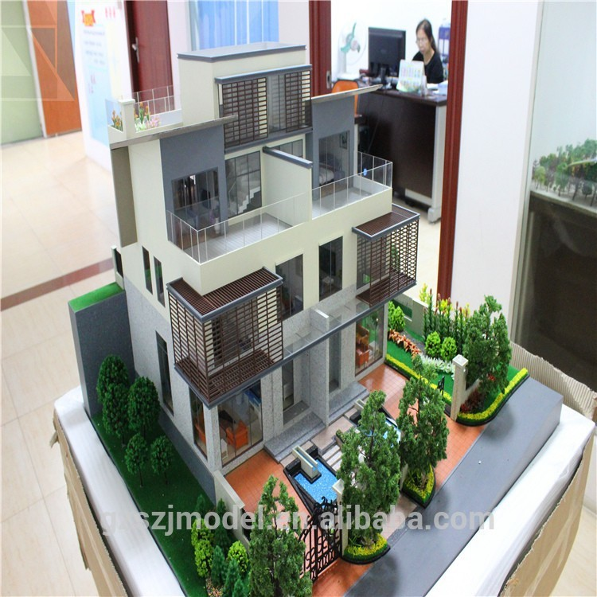
Scale Models Lesson #1
How does an architect create a model?

Slide 9
Scale Models Lesson #1
What does LINEAR mean?

Slide 10
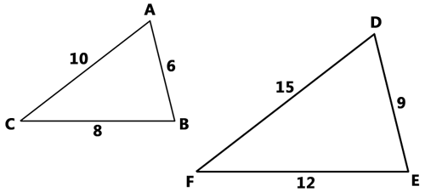
Scale Models Lesson #1
What does it mean to be similar figures?
Corresponding angles are equal and corresponding sides are proportional

Slide 11
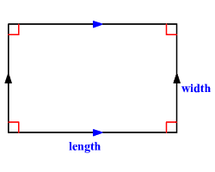
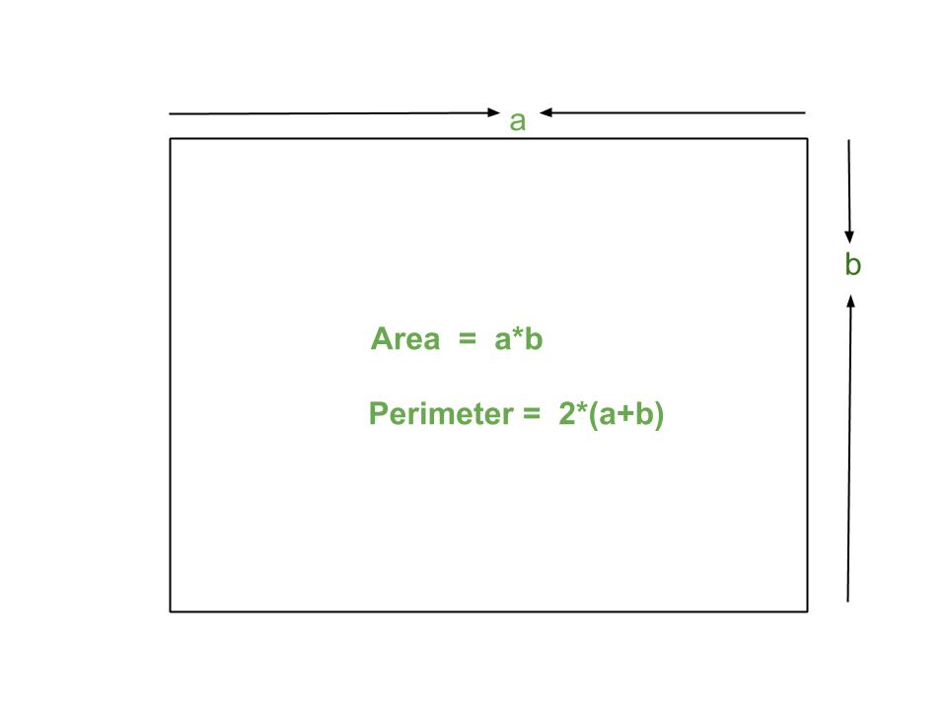
Scale Models Lesson #1
Vocab to remember

Slide 12
Scale Models Lesson #1
Page 1 in workbook
Measure using a ruler (in cm)
Lengths and widths

Slide 13
Scale Models Lesson #1
Page 1 in workbook
Scale factors can be displayed as a ratio, fraction, or percent
B from A → 2:1, or 2, or 200%
C from A → 3:2, or 1.5, or 150%
D from A → 1:2, or 0.5, or 50%

Slide 14
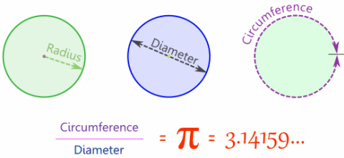
Scale Models Lesson #1
Vocab to remember

Slide 15
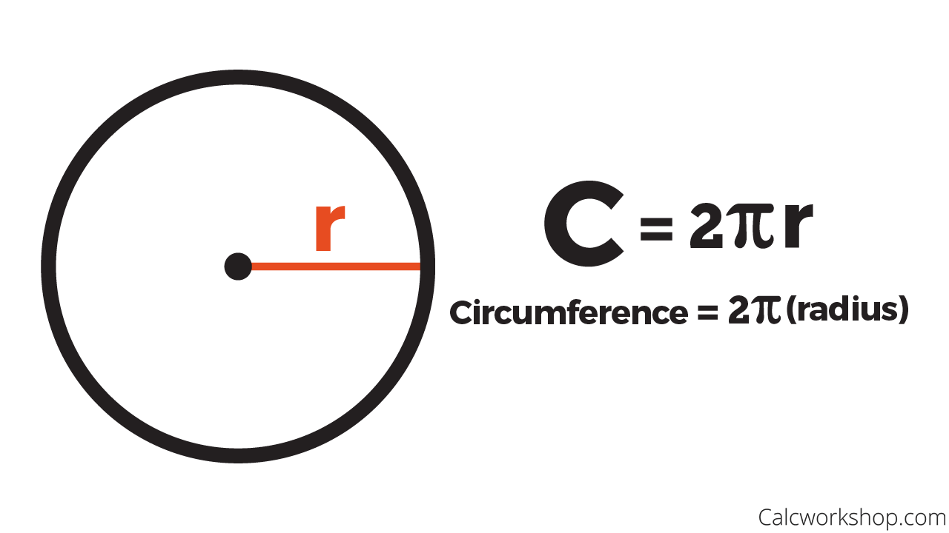
Relationship between linear scale factor and perimeter scale factor
Page 2 in workbook
Measure to the nearest cm the radius of a circle
Calculate the circumference

Slide 16
Complete the chart on Pg 3

Slide 17
Main Take Away…
Linear Scale Factor = Perimeter Scale Factor

Slide 18
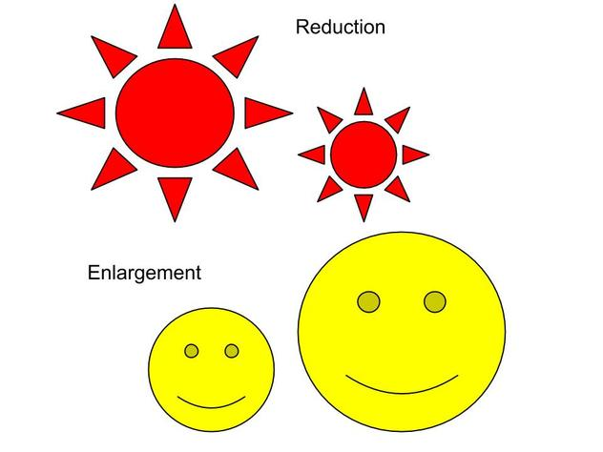
Enlargement or Reduction?
If the scale factor is greater than 1 it is an enlargement
If the scale factor is less than 1 it is a reduction

Slide 19
Determine the Scale Factor that transforms diagram P → Q
Page 4 in workbook
Determine the scale factor that will transform diagram P to Q.
Is it an enlargement or a reduction?
What is the scale factor as a:
Ratio? (new : old)
Rational Number? (new / old)
Percent? (new / old x 100%)

Slide 20
Scale Factor Ratio

Slide 21
Using Scale Factor in a situation
Original length x SF = New

Slide 22
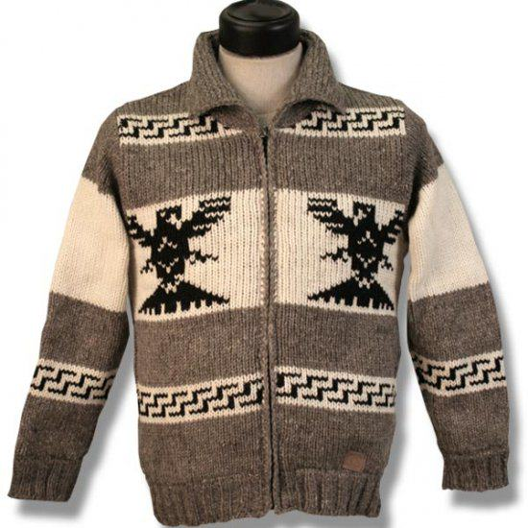
Gwaai took a picture of a Cowichan sweater. He printed the photo of the sweater on 8” x 10” matte paper. Gwaai also required another copy of the photo for future art projects, and he increased the length and width by a factor of 5:2
Page 4 in workbook
Is this an enlargement or a reduction?
Calculate the new dimensions of the picture
Show that the ratio of new perimeter to original perimeter is 5/2

Slide 23
Assignment
Page 5 in workbook #1 – 10
Complete and mark your work
30 minutes of homework at home to continue to practice your skills
Work for 25 minutes and then mark/correct

