Slide 1
Respiratory Review
Biology 12

Slide 2
Nuggets So Far….
Draw and label the respiratory system in 3 separate diagrams:
The structures
The Muscles
The Nerves

Slide 3
Nuggets So Far….
To start…
List all the important vocab words you might use to answer this question
What is the process that allows you to breathe? Draw or explain.

Slide 4
Nuggets So Far….
To start…
List all the important vocab words you might use to answer this question
How are gasses moved into and through the body? Explain each gas separately.

Slide 5
Nuggets So Far….
To start…
List all the important vocab words you might use to answer this question
What monitors the health of your breathing? How does it work? How does it solve the imbalance?

Slide 6
Nuggets So Far….
To start…
List all the important vocab words you might use to answer this question
What are the 3 types of respiration? Give as much detail as you can for each.

Slide 7
Six Windows for Respiratory System
Diagram of Respiratory System Diagram of parts Diagram of muscles Diagrams of nerves | How we breathe Brain & Nerves Muscles Graph of lung capacity Volume of tidal, inspire/expiratory reserve | The Gases Oxygen Carbon dioxide Water vapour External/internal resp. Types of haemoglobin Hypoxia (reg., <90%, <80%)
Homeostasis Baroreceptors and chemoreceptors Acidosis/alkalosis pH – breathing rate Thermoregulation - pleura | Medical Issues CF TB Bronchitis Emphysema asthma | Cellular Respiration Glycolysis Kreb’s Cycle Electron Transport Chain Aerobic and anaerobic resp ATP → ADP

Slide 8
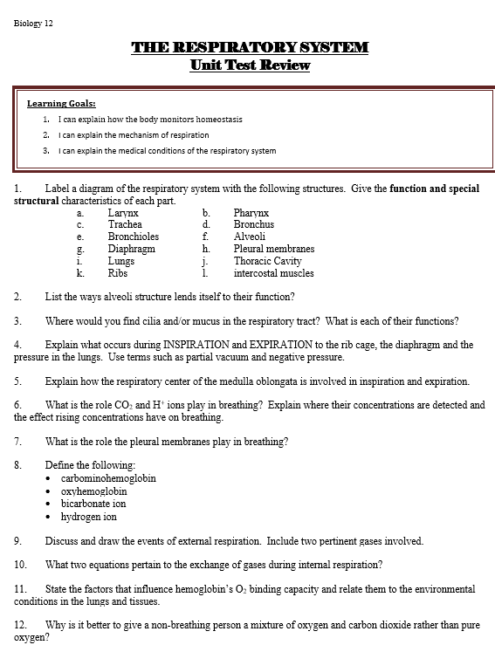
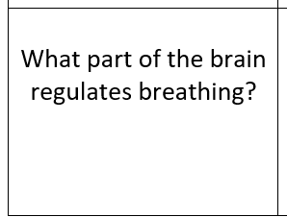
Two study options:
Review Cards or Review questions or both

