Slide 1
Renewable Resources
Enviro Sci 12

Slide 2
Refresh the brain…
What do we use fossil fuels for?

Slide 3
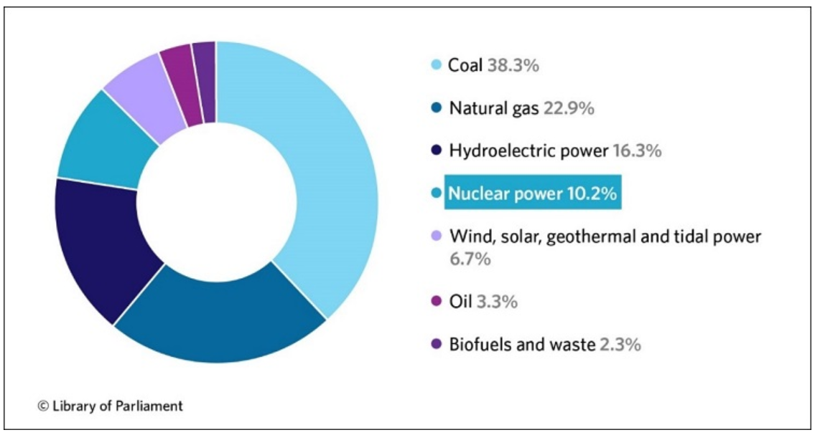
Global Power Suppliers

Slide 4
Are Fossil Fuels the only option?
What are options that you know of that could replace fossil fuels?

Slide 5
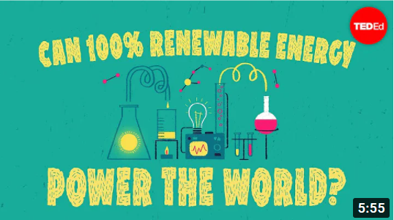
Press for video link

Slide 6
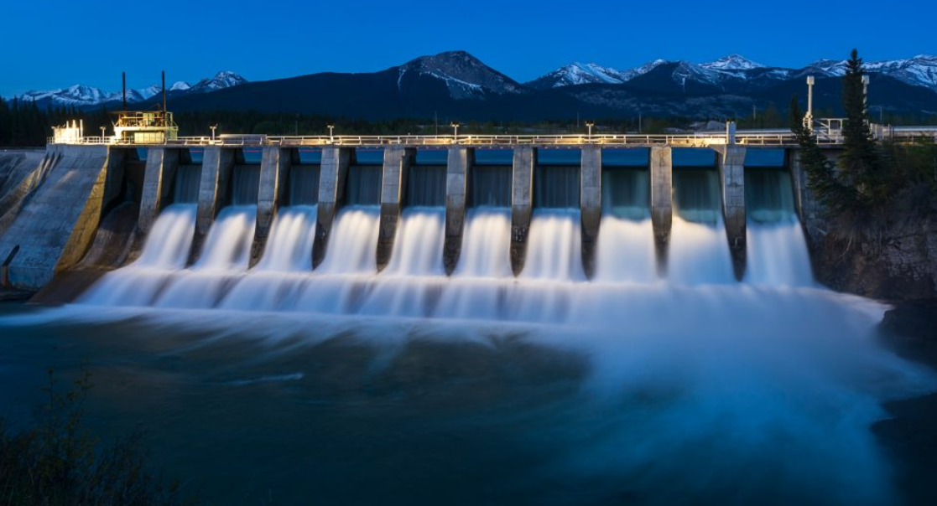
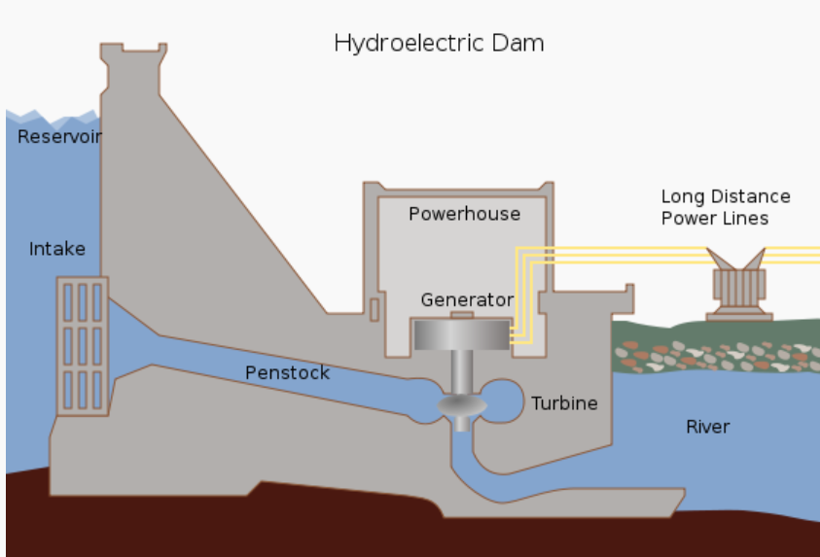
Hydro-energy
90% of BC’s energy is from hydroelectric dams
Only viable if land supported by river systems
Very expensive to build, but are long term projects and net gains
Considered green energy (no carbon emissions)
Create lakes that can be used for recreation
Destruction of fish habitat
Alter natural environment
Vulnerable for droughts

Slide 7
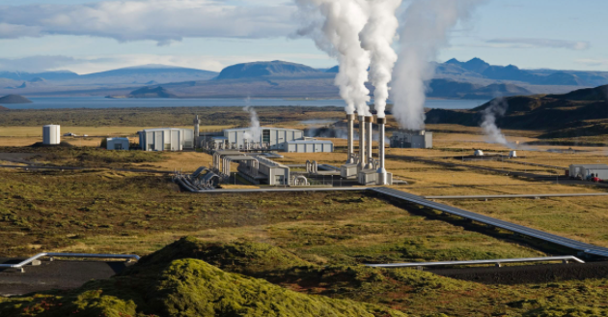
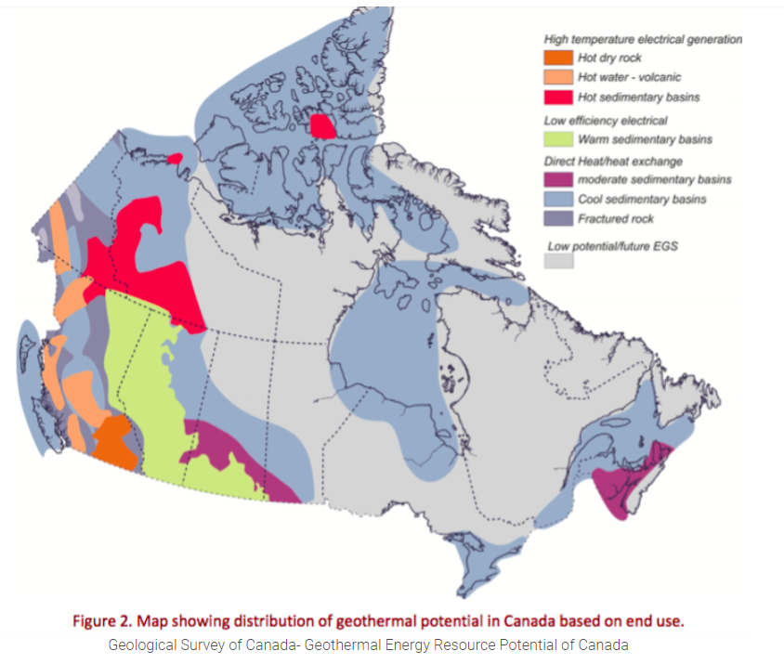
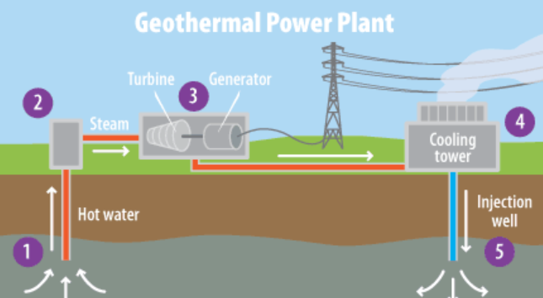
Geothermal Energy
Use steam from geothermal vents to turn turbines (similar to hydro)
Used for electricity, heating, cooling (heat pump)
Lots of potential in Canada

Slide 8
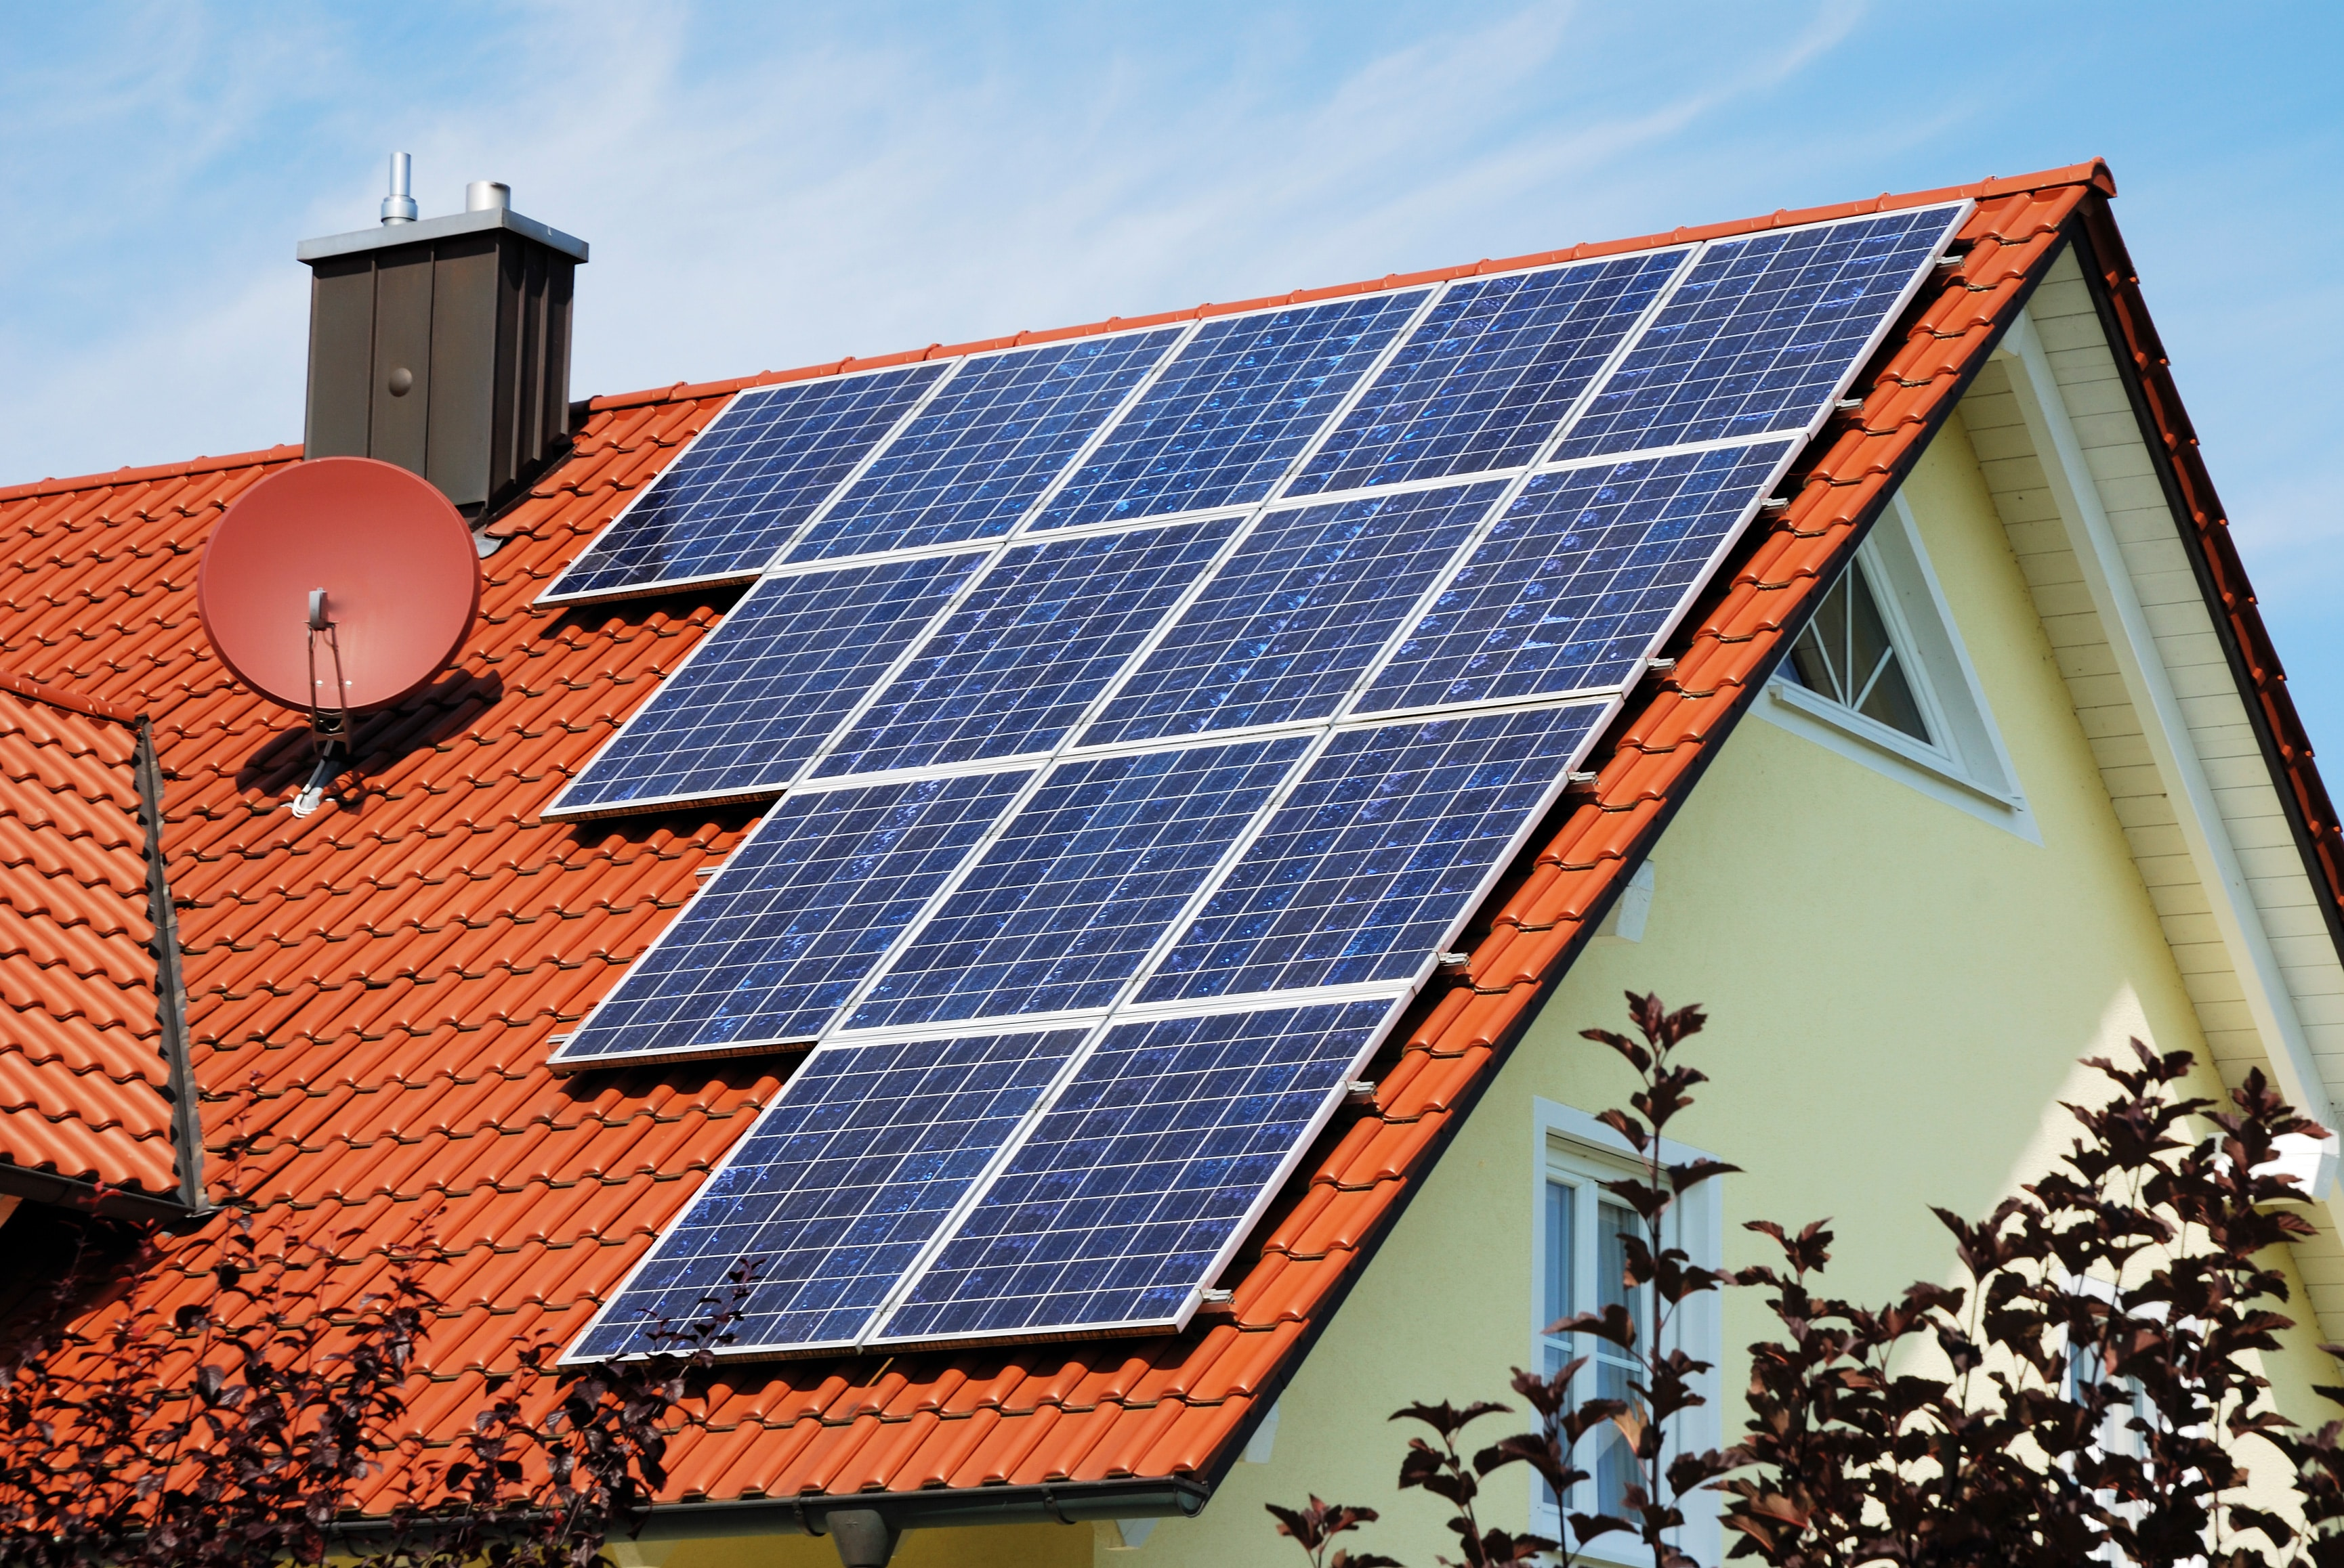
Solar Energy
Photovoltaic cells absorb suns radiation and convert to DC electricity
Positive long term energy
High initial cost, but low maintenance
Can require larger footprint, or tiered in urban areas

Slide 9
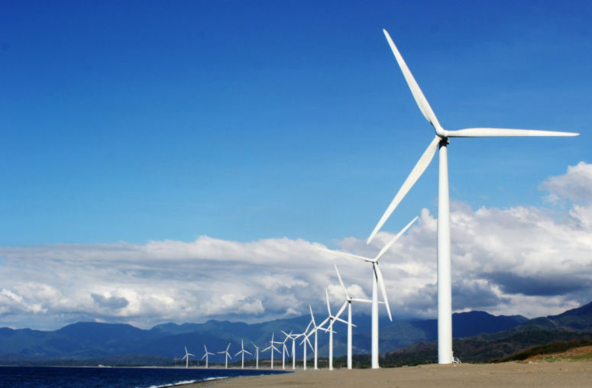
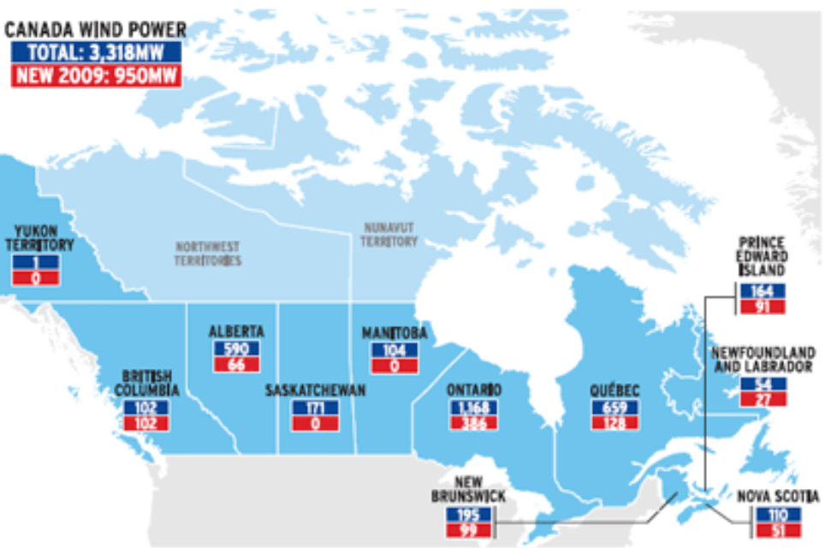
WInd Energy
Release no greenhouse gases
High cost to build, low cost to maintain
Easy to maintain
Dependent on wind, not always strong enough to turn turbines

Slide 10
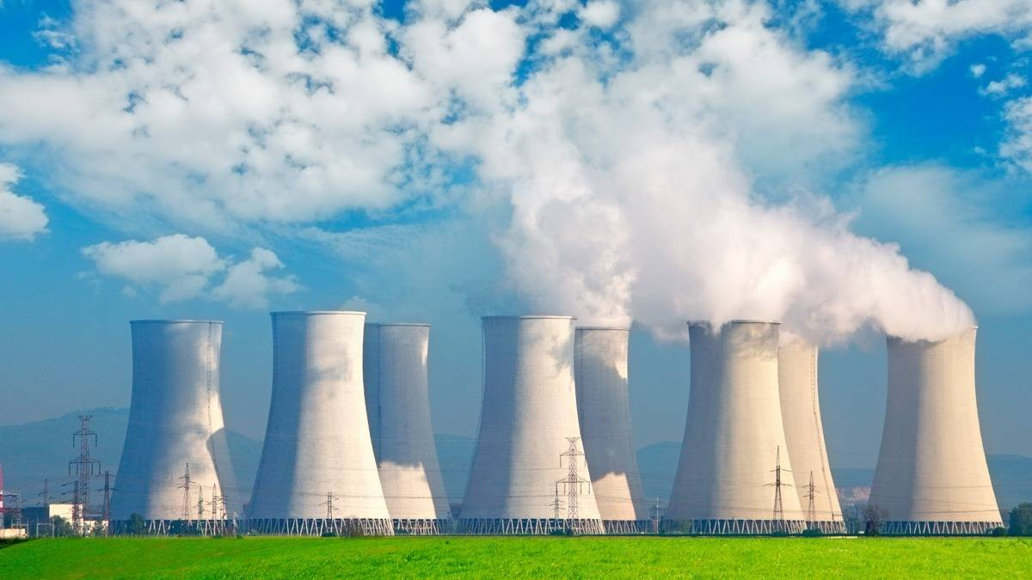
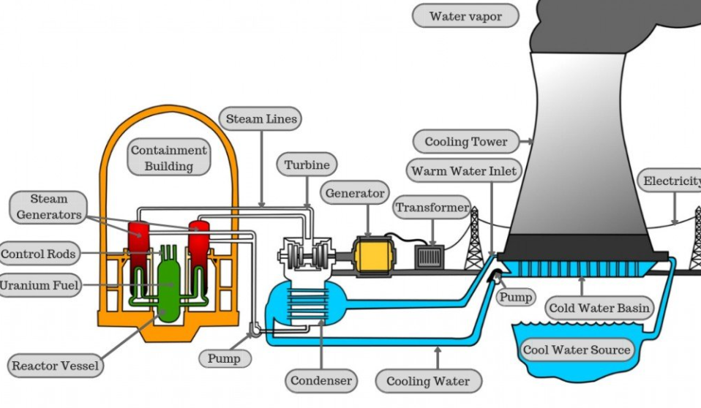
nuclear Energy
Accounts for 15% of electricity in Canada
19 reactors in Ontario
Releases water vapour
No fossil fuels used
Creates high amounts of energy
Low pollution (when working well)
High cost to build, low cost to maintain

Slide 11
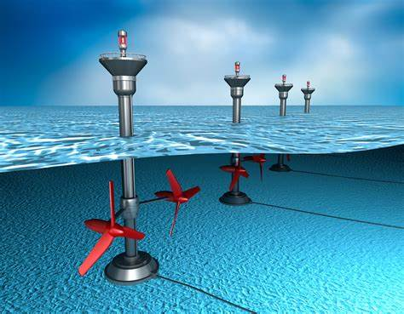
tidal Energy
Consistent power, pollution free
Predictable and continuous
Provide a storm barrier
Impact marine life
Remote locations
Restrict access to open water
Many potential sites in Canada

Slide 12
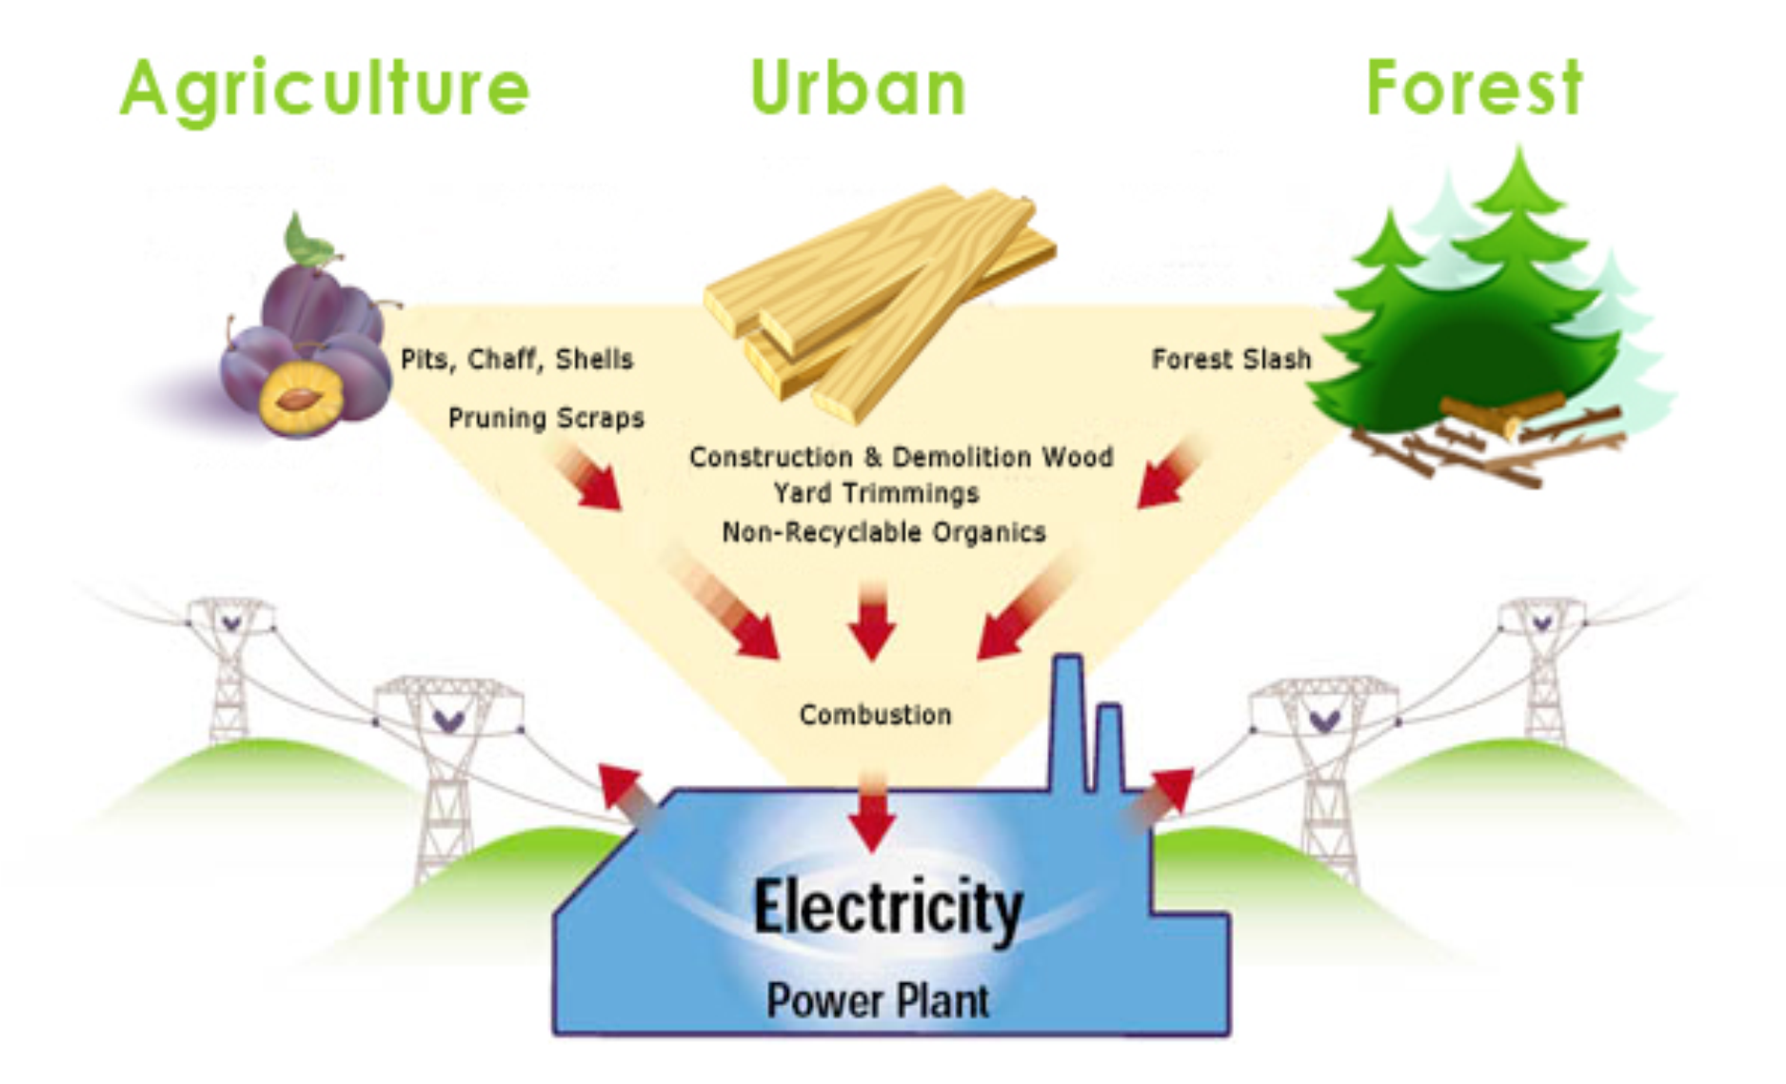
biomass Energy
Burning of trees, and crop waste
Pollutants and soot as burning waste
Used to heat homes, but limited for electricity for urban areas
Continuous biomass available

Slide 13
Reflection of thinking…
Thoughts on what you learned? Do these seem realistic to use?

Slide 14
2nd half of the documentary

