Slide 1
Quadratics Unit Review

Slide 2
Quadratics Unit Test LAST TEST OF THE YEAR!
Wednesday, June 17th
Opens at 11am
Closed Thursday, June 18th at 3pm
*** Will appear in your TEAMS classroom general page

Slide 3
Learning Goal #1: I can use technology to find important points on a parabola
Graph the following equation into desmos. Use the graph to find the below data:
f(x) = -$\frac{1}{2}$x² – x + 6
Axis of symmetry: _________________________
Vertex: _________________________________
y-intercept: __________________________
x-intercept(s): _________________________
Domain: _____________________________
Range: _______________________________

Slide 4
Learning Goal #1: I can use technology to find important points on a parabola
Graph the following equation into desmos. Use the graph to find the below data:
f(x) = 2(x - 6)(x + 10)
Axis of symmetry: _________________________
Vertex: ________________________________
y-intercept: __________________________
x-intercept(s): _________________________
Domain: _____________________________
Range: _______________________________

Slide 5
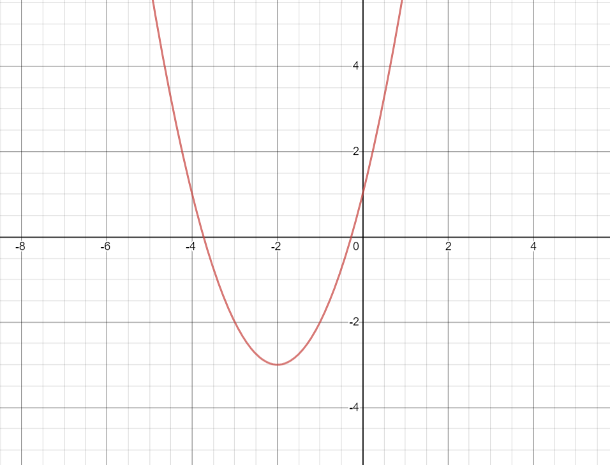
Learning Goal #2: I can create an equation to match a parabola in all three forms (vertex, factor, and general forms)
What is the equation for this parabola in VERTEX FORM?

Slide 6
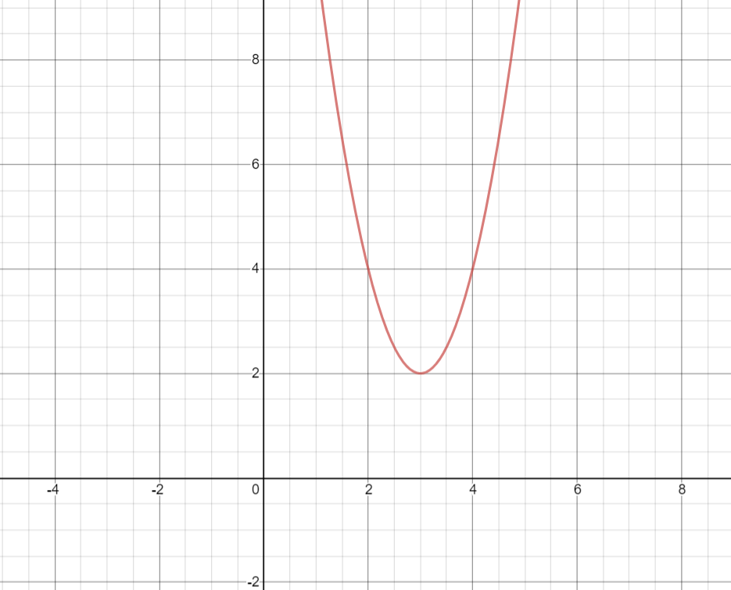
Learning Goal #2: I can create an equation to match a parabola in all three forms (vertex, factor, and general forms)
What is the equation for this parabola in VERTEX FORM?

Slide 7
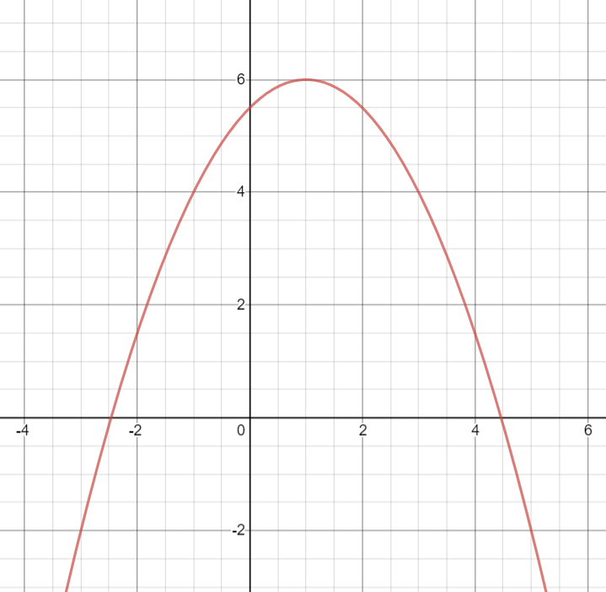
Learning Goal #2: I can create an equation to match a parabola in all three forms (vertex, factor, and general forms)
What is the equation for this parabola in VERTEX FORM?

Slide 8
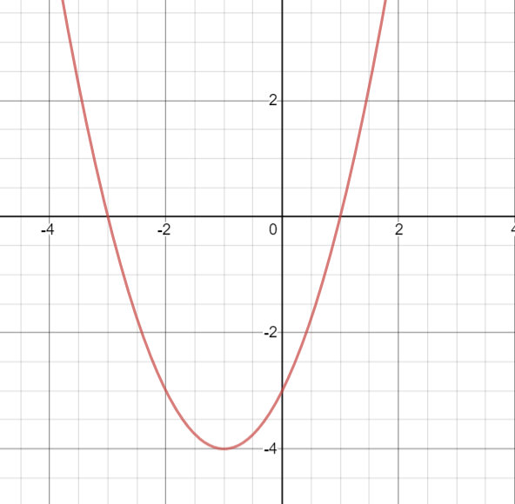
Learning Goal #2: I can create an equation to match a parabola in all three forms (vertex, factor, and general forms)
What is the equation for this parabola in FACTOR FORM?

Slide 9
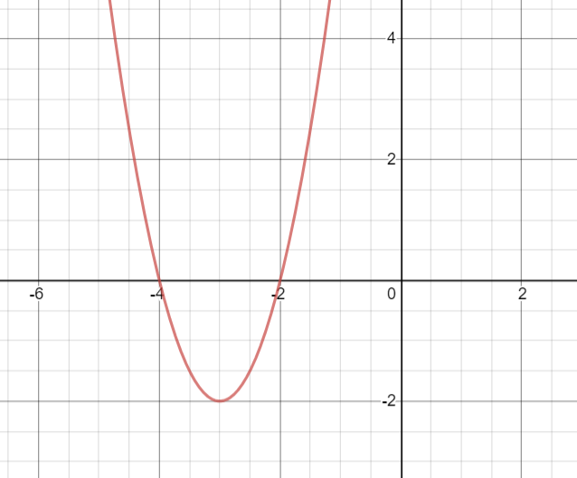
Learning Goal #2: I can create an equation to match a parabola in all three forms (vertex, factor, and general forms)
What is the equation for this parabola in FACTOR FORM?

Slide 10
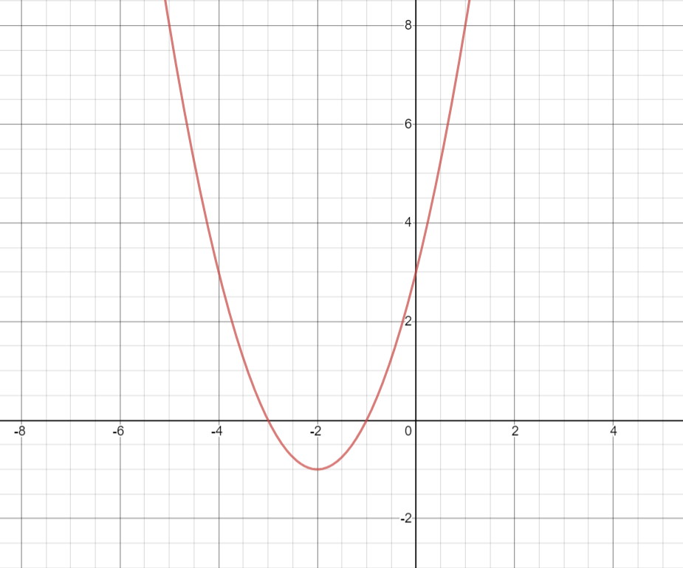
Learning Goal #2: I can create an equation to match a parabola in all three forms (vertex, factor, and general forms)
What is the equation for this parabola in GENERAL FORM?

Slide 11
Learning Goal #3: I can translate between general form and vertex and factor form in order to graph the parabola
Translate the below general form equations into factor form:
y = x² + 3x + 2 y = x² + 2x - 24

Slide 12
Learning Goal #3: I can translate between general form and vertex and factor form in order to graph the parabola
Translate the below general form equations into vertex form:
y = x² + 6x + 10 y = x² - 8x + 13

Slide 13
Learning Goal #4: I can use quadratics to solve real world situations
Some children are playing at the local splash pad. The water jets spray from the ground level. The path of water from one of these jets forms an arch with the function:
y = - 0.12x² + 3x
X = horizontal distance from the opening (m)
Y = height of the water (m)
What is the maximum height of the sprayed water?
How far from the opening in the ground can the water reach?

Slide 14
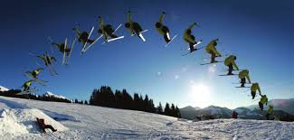
Learning Goal #4: I can use quadratics to solve real world situations
A skier’s jump was recorded frame by frame (see below). The skier’s coach used the picture to determine the quadratics function that relates to the skiers motion, with the function:
y = - 4.9x² + 15x + 1
X = time skier was in the air (s)
Y = height of the skier above ground (m)
What is the maximum height of the skier?
How long was the skier in the air?

Slide 15
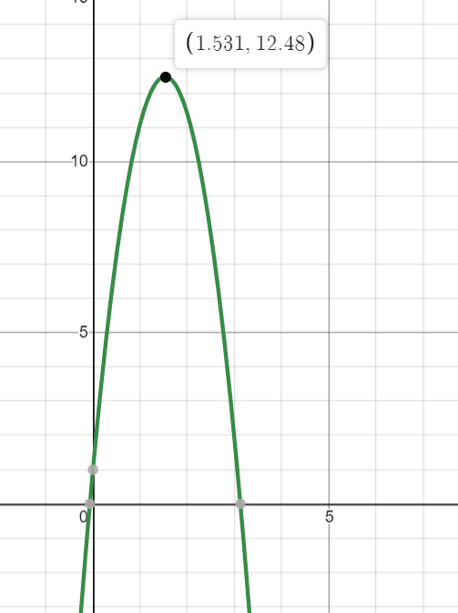
Learning Goal #4: I can use quadratics to solve real world situations

Slide 16
Learning Goal #4: I can use quadratics to solve real world situations
SSS grads hold a fundraiser every Friday night throughout the school year…a perogy dinner!
They usually charge $6 for a plate of perogies. They know from previous Fridays that 120 plates of perogies can be sold at the $6 price, but for each $1 price increase 10 fewer plates will be sold. What should the members charge if they want to raise as much money as they can for the grad class?

Slide 17
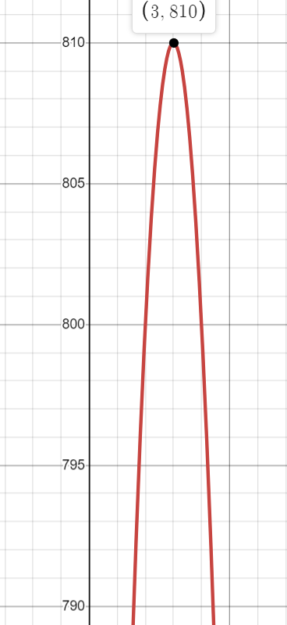
Learning Goal #4: I can use quadratics to solve real world situations

Slide 18
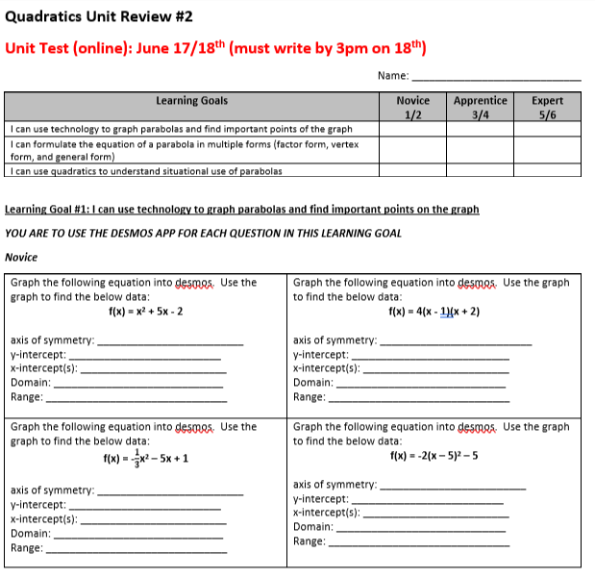
To Do TODAY/Tuesday:
Complete the Quadratics Review #2 (on TEAMS and website)
Another LIVE LESSON on Wednesday 11am just before the unit test

Slide 19
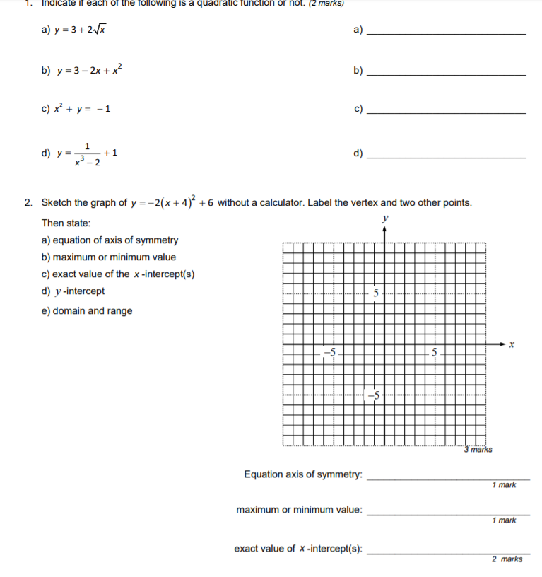
Additional Practice:
Studymatrix.net
Unit #5
Complete the Send In Assignment at the end of the chapter for some extra practice

