Slide 1
Quardatic Functions
FOM 11

Slide 2
What do you notice? What do you wonder?

Slide 3
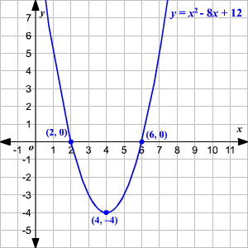
What do you notice? What do you wonder?

Slide 4
What is a quadratic?
Quadratum
In latin, quadratum means SQUARE

Slide 5
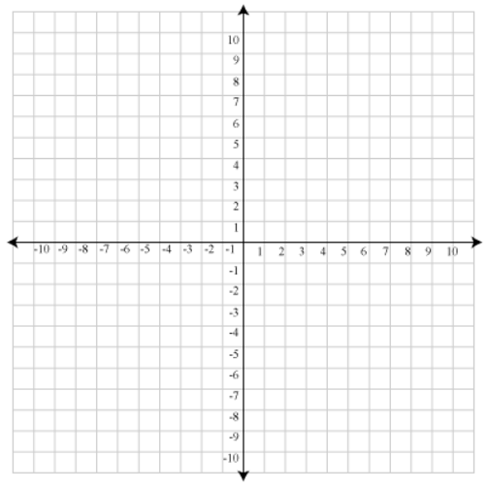
The Basic Parabola
Complete the table of values
x | y
3
2
1
0
-1
-2
-3
y = x²
Domain =
Range =

Slide 6
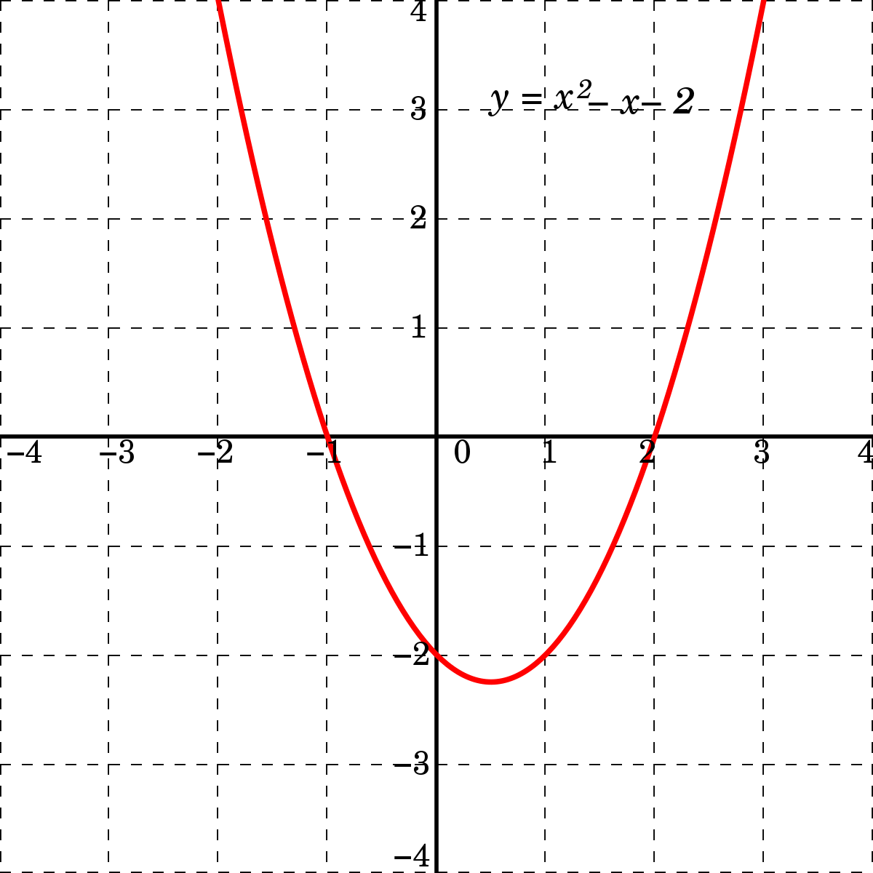
Vocab Words To Know
Parabola
The shape of a quadratic relation

Slide 7
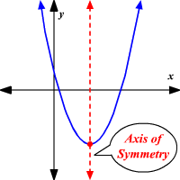
Vocab Words To Know
Axis of symmetry
The line in which you split your parabola into two mirroring sections

Slide 8
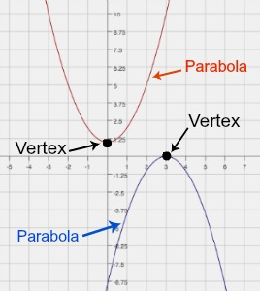
Vocab Words To Know
Vertex
The point at which the function reaches it’s maximum or minimum height (The peak of the “U”)

Slide 9
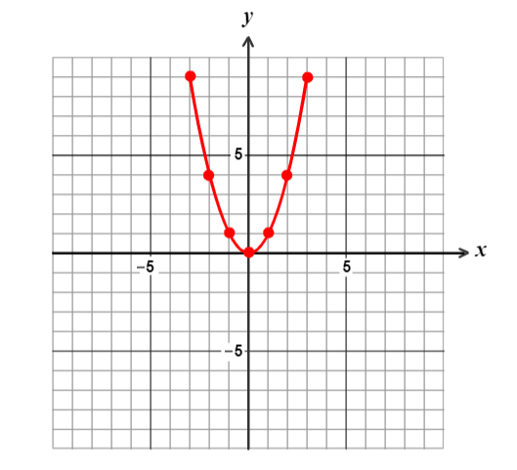
Let’s Graph Using A Table of Values
Equation: y = x² + 2
x | y
3
2
1
0
-1
-2
-3
Domain =
Range =

Slide 10
Let’s Graph Using A Table of Values
Equation: y = x² - 2
x | y
3
2
1
0
-1
-2
-3
Domain =
Range =

Slide 11
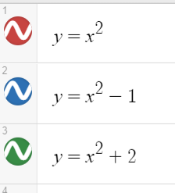
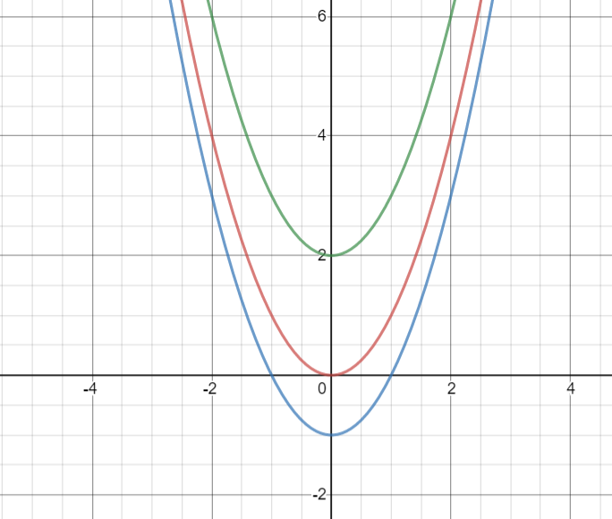
What do you notice?
Did the axis of symmetry change?
Did the domain change?
Did the range change?

Slide 12
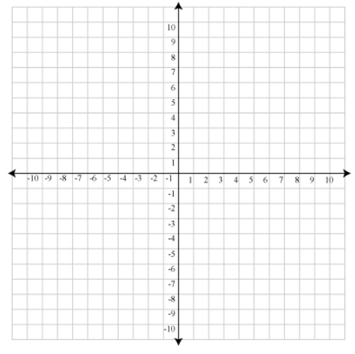
Main Take Aways for Today
Basic Parabola

Slide 13
Main Take Aways for Today
y = x² – 2
Or
y = x² +4
y = x² - k

Slide 14
To Do:
Unit Quiz Part 2
Make a Flipgrid video of you using all the vocabulary from this unit

