Slide 1
Quadratic Functions More Vertex Form & General From practice
FOM 11
May 21, 2020

Slide 2
What you need for today

Slide 3
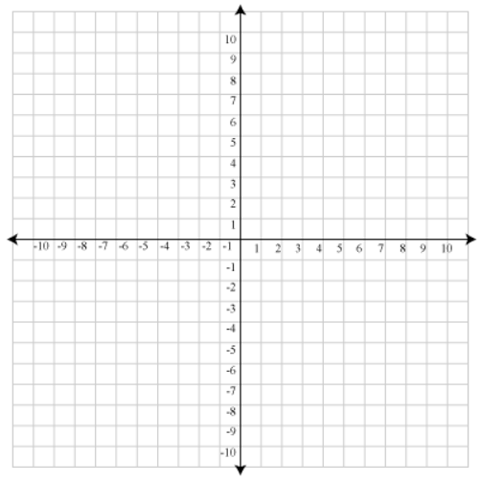
The Basic Parabola
MOST IMPORTANT!!!
Be able to graph a basic parabola without doing a table of values
y = x²

Slide 4
Reminder… VERTEX FORM

Slide 5
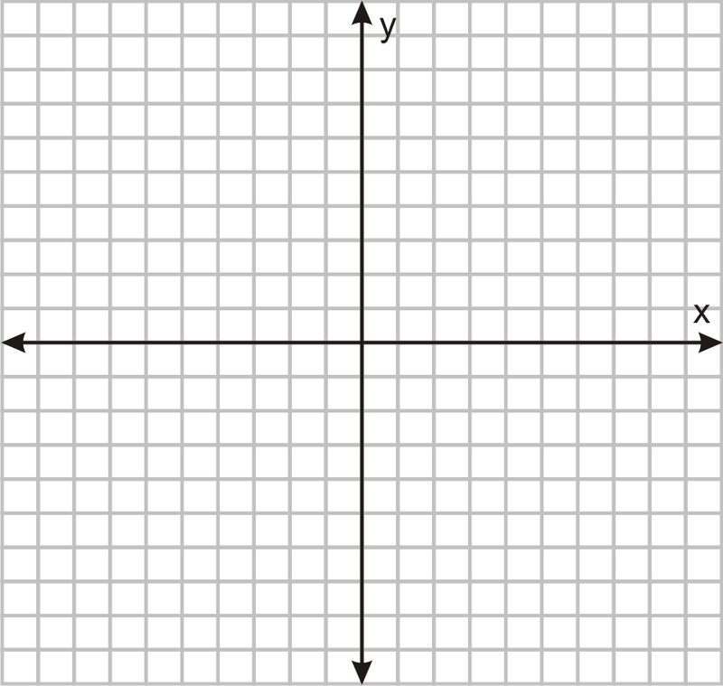
Let’s Graph
Please graph the parabola on your own graph paper at home ☺
Equation: y = (x + 2)² - 1
Vertex
Axis of Symmetry
Domain
Range
Maximum or Minimum
Y-intercept
X-intercept

Slide 6
Let’s Graph
Please graph the parabola on your own graph paper at home ☺
Equation: y = - (x + 3)² + 4
Vertex
Axis of Symmetry
Domain
Range
Maximum or Minimum
Y-intercept
X-intercept

Slide 7
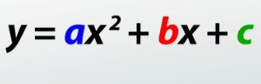
GENERAL FORM…
Easiest to write out
Can change it to other forms (we will get there in a couple weeks)
C = y-intercept

Slide 8
Let’s Graph & turn into GENERAL FORM
Please graph the parabola on your own graph paper at home ☺
Equation: y = (x - 1)² – 1
How to put into general form…

Slide 9
Let’s Graph & turn into GENERAL FORM
Please graph the parabola on your own graph paper at home ☺
Equation: y = (x - 1)² - 1
Vertex
Axis of Symmetry
Domain
Range
Maximum or Minimum
Y-intercept
X-intercept
General Form

Slide 10
Let’s Graph & turn into GENERAL FORM
Please graph the parabola on your own graph paper at home ☺
Equation: y = - (x + 2)² – 4
How to put into general form…

Slide 11
Let’s Graph & turn into GENERAL FORM
Please graph the parabola on your own graph paper at home ☺
Equation: y = - (x + 2)² – 4
Vertex
Axis of Symmetry
Domain
Range
Maximum or Minimum
Y-intercept
X-intercept
General Form

Slide 12
Let’s Graph & turn into GENERAL FORM
Please graph the parabola on your own graph paper at home ☺
Equation: y = - (x - 3)² + 1
How to put into general form…

Slide 13
Let’s Graph & turn into GENERAL FORM
Please graph the parabola on your own graph paper at home ☺
Equation: y = - (x - 3)² + 1
Vertex
Axis of Symmetry
Domain
Range
Maximum or Minimum
Y-intercept
X-intercept
General Form

Slide 14
Let’s Graph & turn into GENERAL FORM
Please graph the parabola on your own graph paper at home ☺
Equation: y = (x + 4)² - 4
How to put into general form…

Slide 15
Let’s Graph & turn into GENERAL FORM
Please graph the parabola on your own graph paper at home ☺
Equation: y = (x + 4)² - 4
Vertex
Axis of Symmetry
Domain
Range
Maximum or Minimum
Y-intercept
X-intercept
General Form

Slide 16
Your Take Aways for Today:
Vertex Form
y = (x – h)² + k → Vertex will be (h, k)
General Form
y = x² + bx + c → c will be the y-intercept

Slide 17
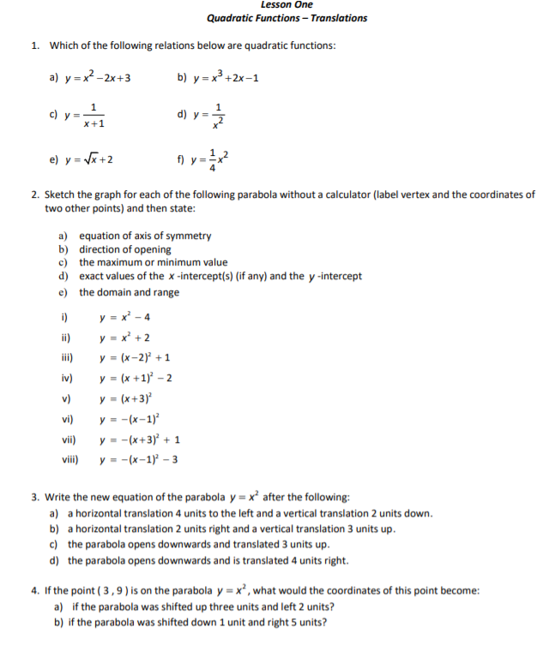
To Do:
Complete Question #1 - 4 on Studymatrix Lesson 1
You can access this both on TEAMS (as an assignment) or on studymatrix

Slide 18
For Tomorrow (Fri, May 22)
StudyMatrix
1.11, 1.12, and 1.13
Complete Question #1 - 4 in the Unit 5 Practice Assignment

