Slide 1
Quadratic Functions
FOM 11
May 19, 2020

Slide 2
What you need for today

Slide 3
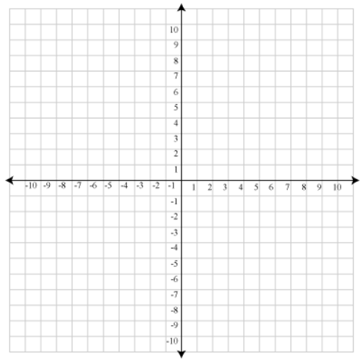
The Basic Parabola
Complete the table of values
x | y
3
2
1
0
-1
-2
-3
y = x²

Slide 4
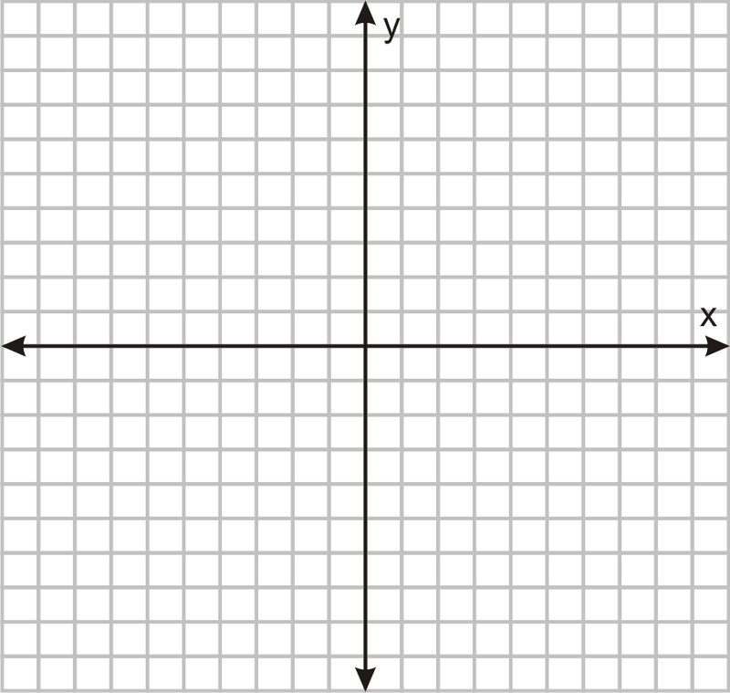
Let’s Graph
Please graph the parabola on your own graph paper at home ☺
Equation: y = x² + 4
Vertex
Axis of Symmetry
Domain
Range
Maximum or Minimum
Y-intercept
X-intercept

Slide 5
Let’s Graph
Please graph the parabola on your own graph paper at home ☺
Equation: y = x² - 2
Vertex
Axis of Symmetry
Domain
Range
Maximum or Minimum
Y-intercept
X-intercept

Slide 6
Let’s Graph
Please graph the parabola on your own graph paper at home ☺
Equation: y = (x + 1)²
x | y
3
2
1
0
-1
-2
-3
Vertex
Axis of Symmetry
Domain
Range
Maximum or Minimum
Y-intercept
X-intercept

Slide 7
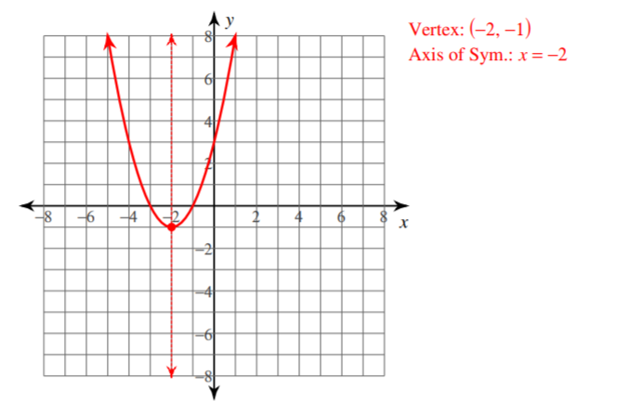
Vertex Form

Slide 8
Let’s Graph
Please graph the parabola on your own graph paper at home ☺
Equation: y = (x – 2)²
Vertex
Axis of Symmetry
Domain
Range
Maximum or Minimum
Y-intercept
X-intercept

Slide 9
Let’s Graph
Please graph the parabola on your own graph paper at home ☺
Equation: y = (x – 3)² - 1
Vertex
Axis of Symmetry
Domain
Range
Maximum or Minimum
Y-intercept
X-intercept

Slide 10
Let’s Graph
Please graph the parabola on your own graph paper at home ☺
Equation: y = (x + 1)² - 5
Vertex
Axis of Symmetry
Domain
Range
Maximum or Minimum
Y-intercept
X-intercept

Slide 11
Let’s Graph
Please graph the parabola on your own graph paper at home ☺
A negative in front of the x will FLIP parabola upside down
Equation: y = - (x + 1)²
Vertex
Axis of Symmetry
Domain
Range
Maximum or Minimum
Y-intercept
X-intercept

Slide 12
Let’s Graph
Please graph the parabola on your own graph paper at home ☺
Equation: y = - (x - 1)² +3
Vertex
Axis of Symmetry
Domain
Range
Maximum or Minimum
Y-intercept
X-intercept

Slide 13
Let’s Graph
Please graph the parabola on your own graph paper at home ☺
Equation: y = - (x + 2)² + 6
Vertex
Axis of Symmetry
Domain
Range
Maximum or Minimum
Y-intercept
X-intercept

Slide 14
Your Take Aways for Today:
Vertex Form
y = (x – h)² + k → Vertex will be (h, k)
A NEGATIVE x will flip parabola upside down

Slide 15
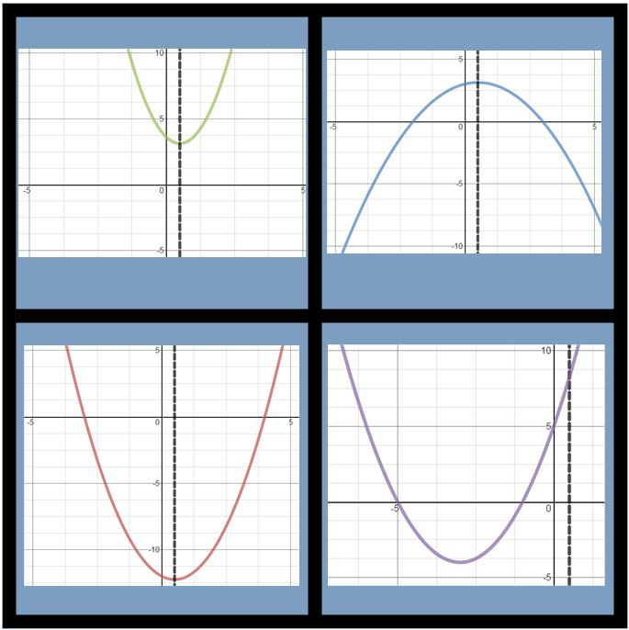
Which One Doesn’t Belong and WHY?
Use and practice proper vocabulary
Share with the class which graph DOESN”T BELONG and WHY

Slide 16
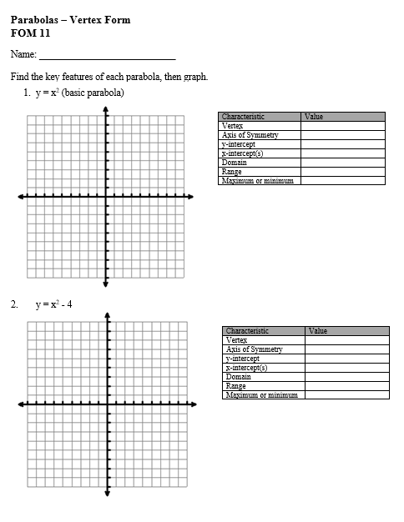
To Do:
Graphing Quadratics worksheet
Once you are done, check the ANSWER KEY on my website

Slide 17
For Tomorrow
StudyMatrix
1.8, 1.9, and 1.10
Complete Question #1 and 2 in the Unit 5 Practice Assignment

