Slide 1
Proteins
Biology 12

Slide 2
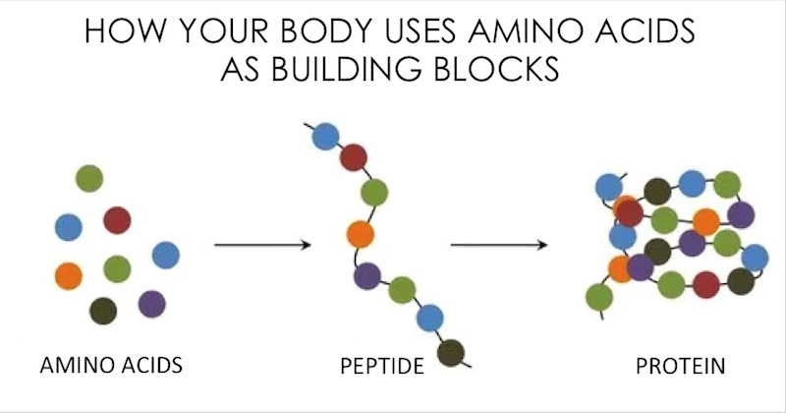
What is a protein?
Structural component of cells and body
Hormones
Enzymes
Transport in blood stream
Antibodies

Slide 3
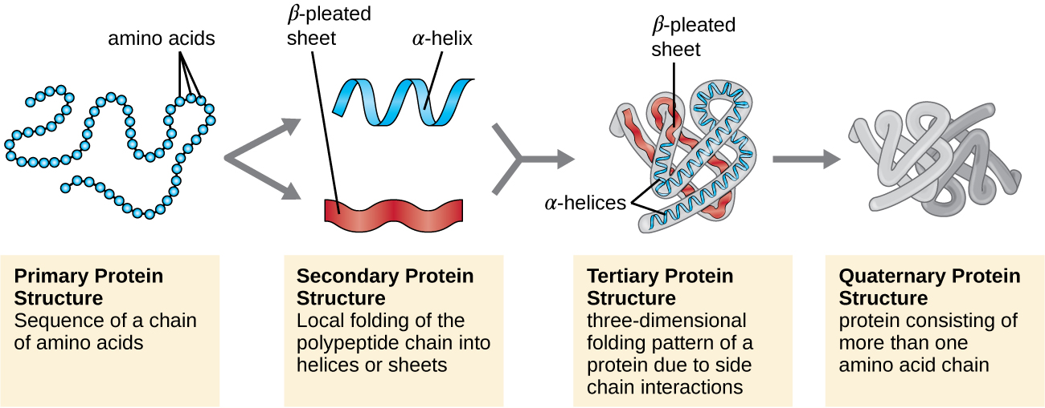
Peptides
Monomer of protein – amino acid
Polymer of protein – polypeptide
Primary → Secondary → Tertiary → Quaternary

Slide 4
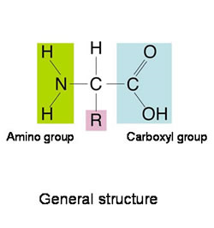
Amino Acids
Made up of 3 parts
Carboxyl group
Amine group
R group
20 amino acids
10 non-essential (you can make)
10 essential (MUST eat, you can’t make yourself)

Slide 5
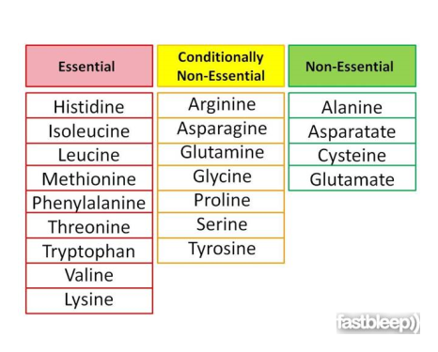
Our Diet
Unlike lipids and carbohydrates, we can NOT store protein
We must eat each amino acid every day
Focus on essential amino acids

Slide 6
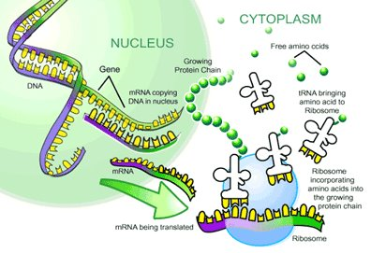
How do you build proteins
DNA → RNA → amino acid coding → protein

Slide 7
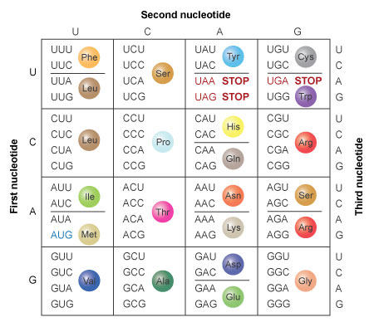
RNA code → Amino Acid Code

Slide 8
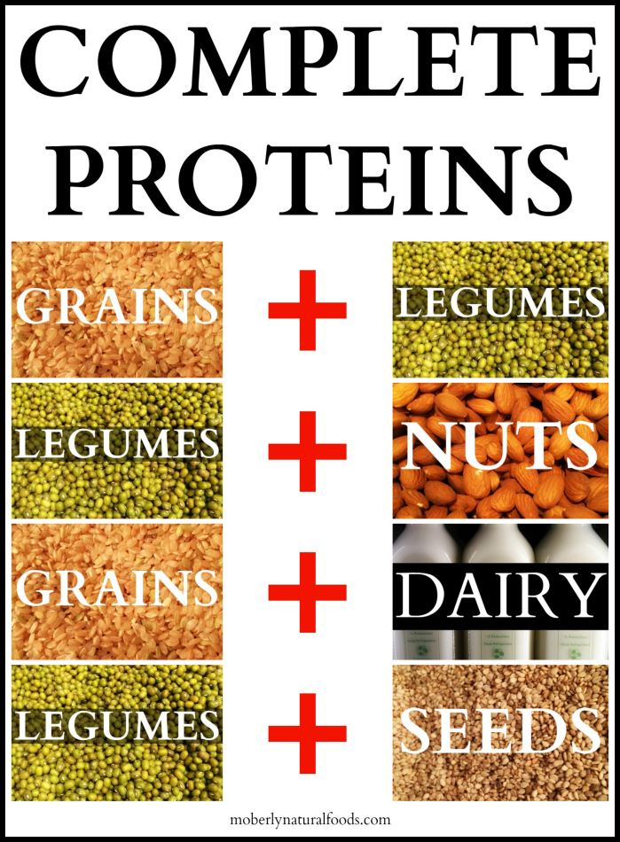
Complete Proteins
Contains all 10 essential amino acids

Slide 9
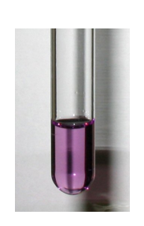
How Do You Test for the Presence of Protein?
Biuret Solution
The biuret test is a chemical test used for detecting the presence of peptide bonds.
In the presence of peptides, a copper(II) ion forms violet-colored solution
the concentration of protein increases proportionately to the intensity of colour

Slide 10
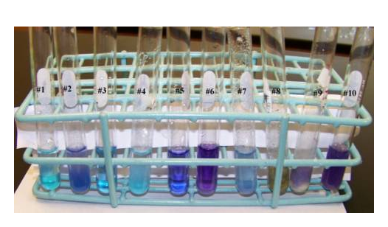
Data for Protein?
How could we record this data?
How do I prevent cross contamination?
How many trials should I do?
What is a positive and negative control?

