Slide 1
Okanagan Pollinators

Slide 2
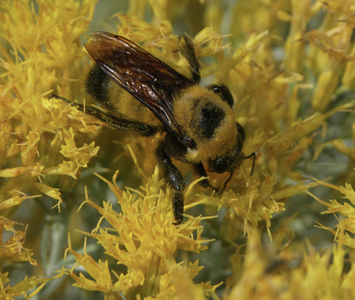
What would happen without bees video?
What is happening to all the bees?

Slide 3
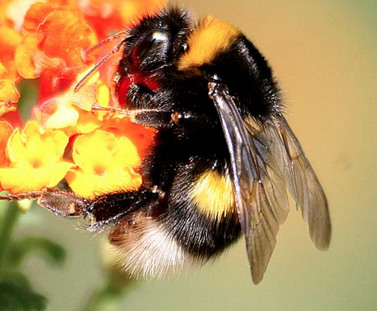
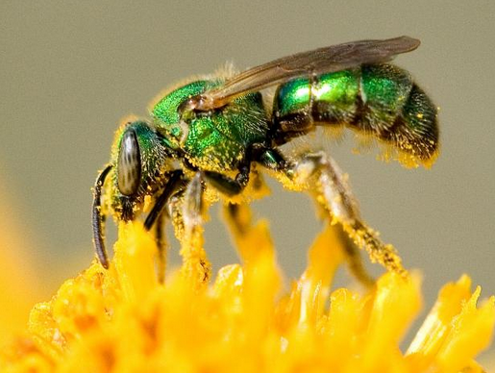
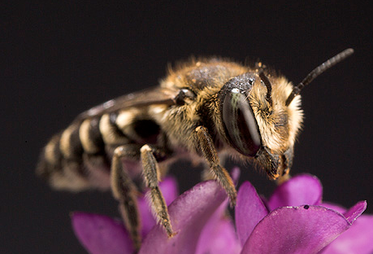
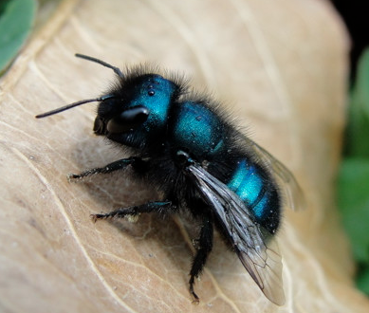
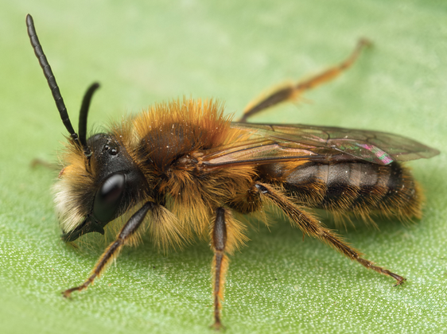
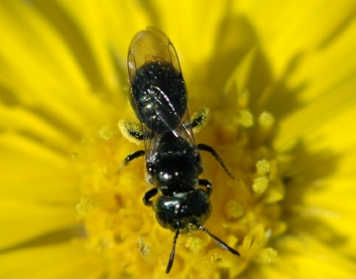
What are Native Pollinators? (Not honeybees!)
NATIVE BEES: over 450 different species in BC
Bumblebees
Sweat bees
Leafcutter bee
Mason bee
Mining bee
Small carpenter bee

Slide 4
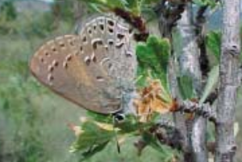
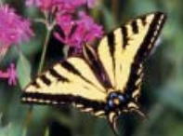
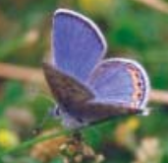
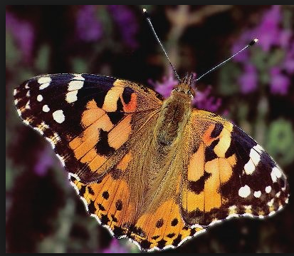
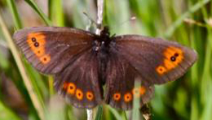
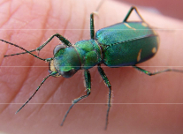
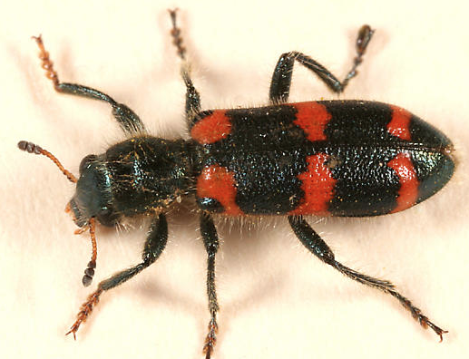
BUTTERFLIES
Behr’s Hairstreak
Western Tiger Swallowtail
Acmon Blue
Painted Lady
Common Alpine
BEETLES
Tiger Beetle
Checkered Beetle

Slide 5
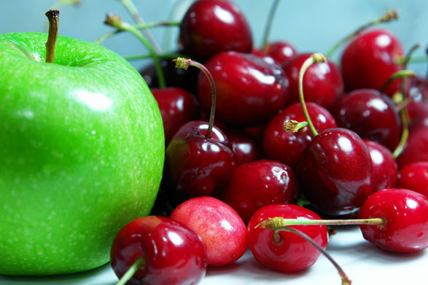
Why are native pollinators important?
Native bees are more efficient at pollination than honey bees.
For example, the Mason Bee is 5 to 10 times more efficient than the honey bee
You can thank native pollinators for 1/3 of all the food you eat

Slide 6
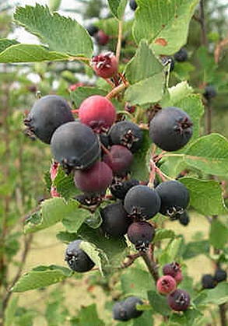
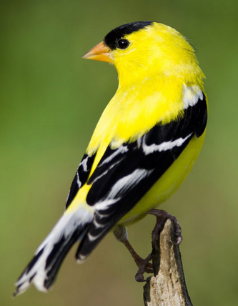
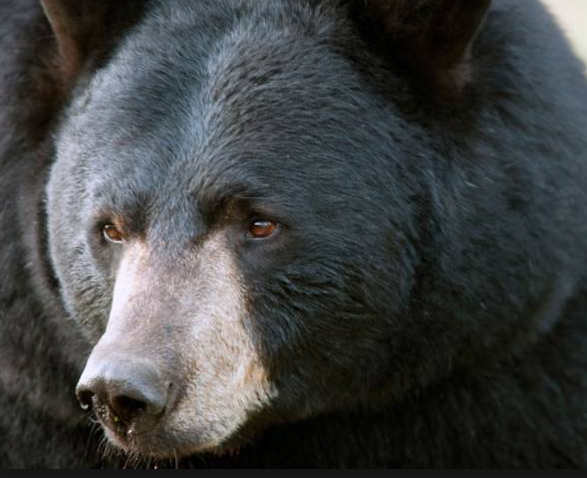
ESSENTIAL TO LOCAL ECOSYSTEMS
Wild bees and other native pollinators are essential to our ecosystems because they pollinate plants that produce fruit, nuts and seeds for animals like birds and bears that rely on them for survival
All the elements of the ecosystem, including the plants and pollinators, have evolved together.

Slide 7
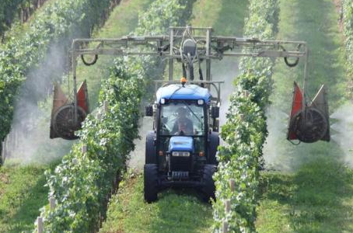
Why do we need to plant a pollinator garden?
Native pollinator populations are declining at a rapid rate:
50% loss in last century
Habitat loss, degradation and fragmentation
Climate change

Slide 8
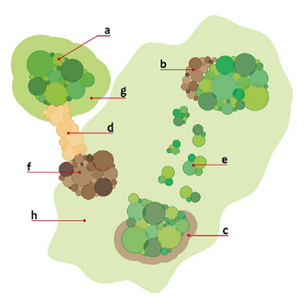
What can we do: create a habitat stepping-stone

Slide 9
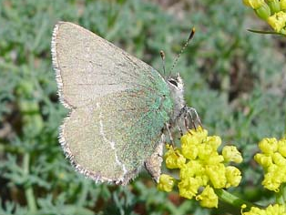
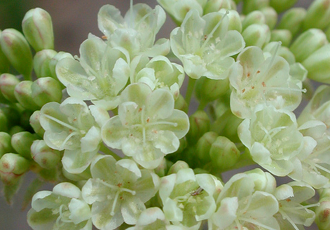
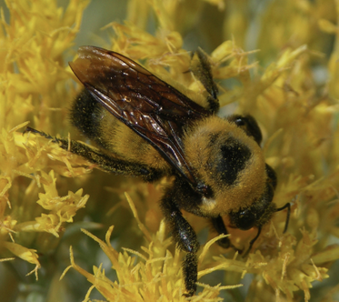
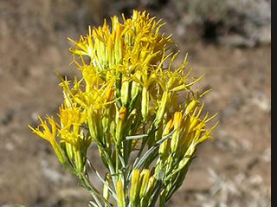
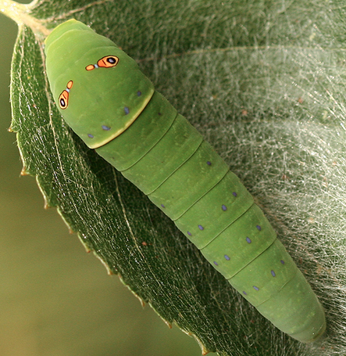
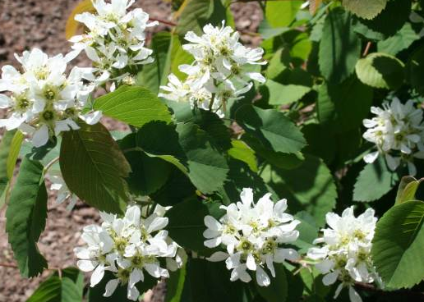
How COULD WE do this?
Need to choose native plants that will fulfil all insect life stages with overlapping nectar periods
Sheridan’s Hairstreak
Lays eggs on parsnip-flowered
buckwheat
Bumblebee
Feeds on late-season Rabbitbrush nectar
Early spring food source for mining bees, etc.
Saskatoon Berry
Host plant for Western Tiger Swallowtail caterpillar

Slide 10
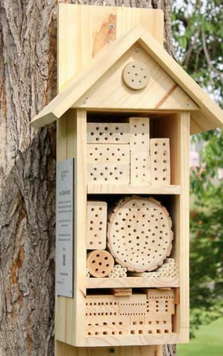
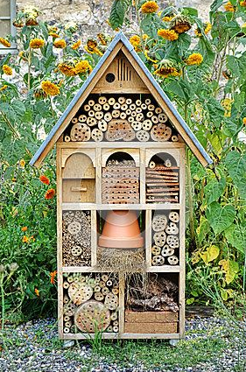
Provide Nesting Sites
1. Leave bare patches of earth for ground nesters: sweat bees, mining bees
2. Make a stumpery: artfully arrange dead stump to make a cozy hibernaculum for bumblebee queens
3. Construct a bee hotel! (mason bees, leaf-cutter bees, solitary wasps)

Slide 11
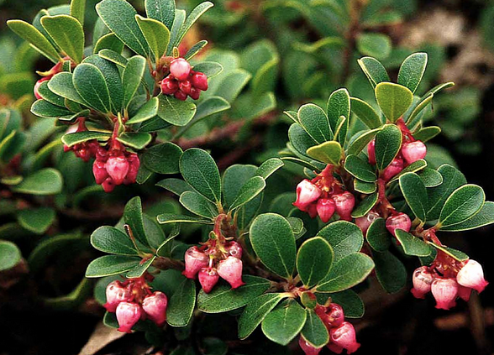
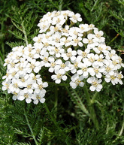
Plants Important to the Syilx People of the Okanagan Nation
Many plants important to pollinators also have traditional
food and medicinal values
Decoction of leaves drunk as a general blood tonic
Important nectar plant for bumblebees, mason and mining bees.
Kinnikinnick
Tea from flowers used to treat coughs, cold, sore throats and bladder issues. Roots ground and used as poultice for toothache. Whole plant used as a wash for arthritis or sore eyes.
Important early nectar plant for all pollinators, especially mining bees and sweat bees.
Yarrow

Slide 12
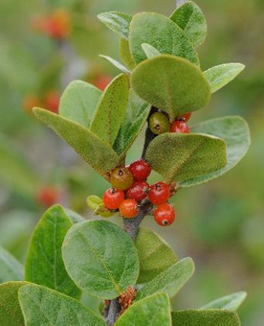
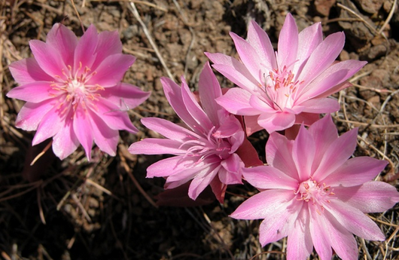
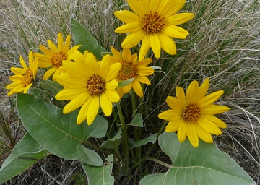
The ’ice-cream’ is a health food being very high in vitamin C and iron. The berries, shoots and leaves were used to treat everything from indigestion and constipation to heart attacks, acne and boils.
Flowers are another early source of nectar.
Soopolallie
The Chief of all roots or everything underground. It is associated with relationships. It is also an important food plant. The roots were baked, boiled, steamed or dried.
Good, early nectar source
Bitterroot
Most versatile of the food plants: roots, young shoots, bud-stems and seeds were all popular foods.. Young Okanagan boys walked with leaves wrapped around their feet, preparing them to walk silently. Poultices of leaves were used to treat burns.
Attractive to native bees and butterflies.
Arrow-leaved Balsamroot

Slide 13
Other important Syilx plants
Saskatoon: The Saskatoon was the most important and widely used berry for the Okanagan. One of the four food chiefs.
Tall Oregon-grape: berries widely eaten. Bark and wood used as a tonic and blood purifier.
Prairie Rose: The petals were eaten and the leaves, branches and inner bark was used to make a tea.
Big Sagebrush: Valued for its aromatic scent and was often used as incense or to fumigate a dwelling

