Slide 1
Okanagan Biogeoclimatic Zones
Environmental Sciences 11/12

Slide 2
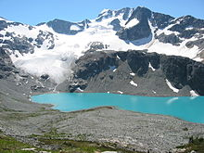
BC’s Biogeoclimatic Zones
BC has 14 biogeoclimatic zones
a geographic area having similar patterns of energy flow, vegetation and soils as a result of a broadly homogenous macroclimate

Slide 3
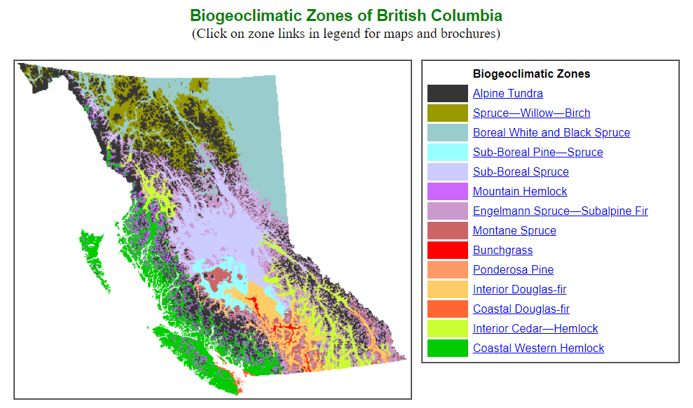

Slide 4
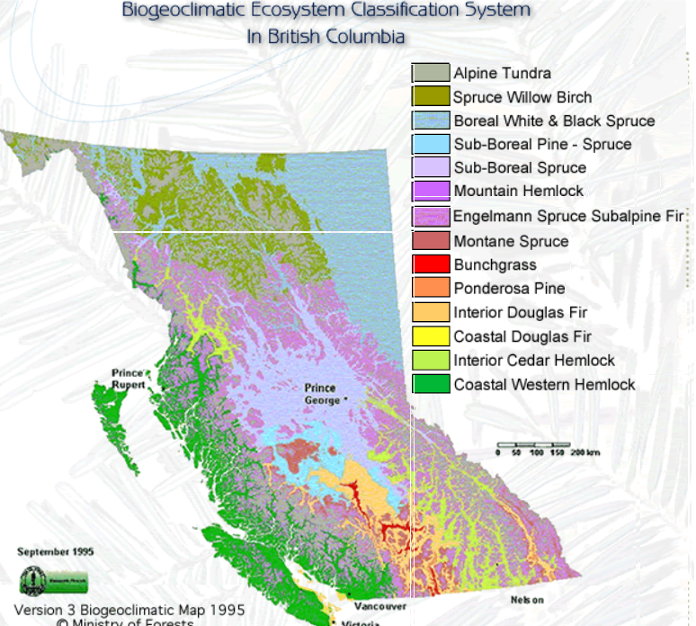
Interactive BC Map

Slide 5
Okanagan Valley includes 4 Biogeoclimatic zones
Interior Douglas Fir zone
Montane Spruce zone
Ponderosa Pine zone (Summerland)
Bunchgrass Zone

Slide 6
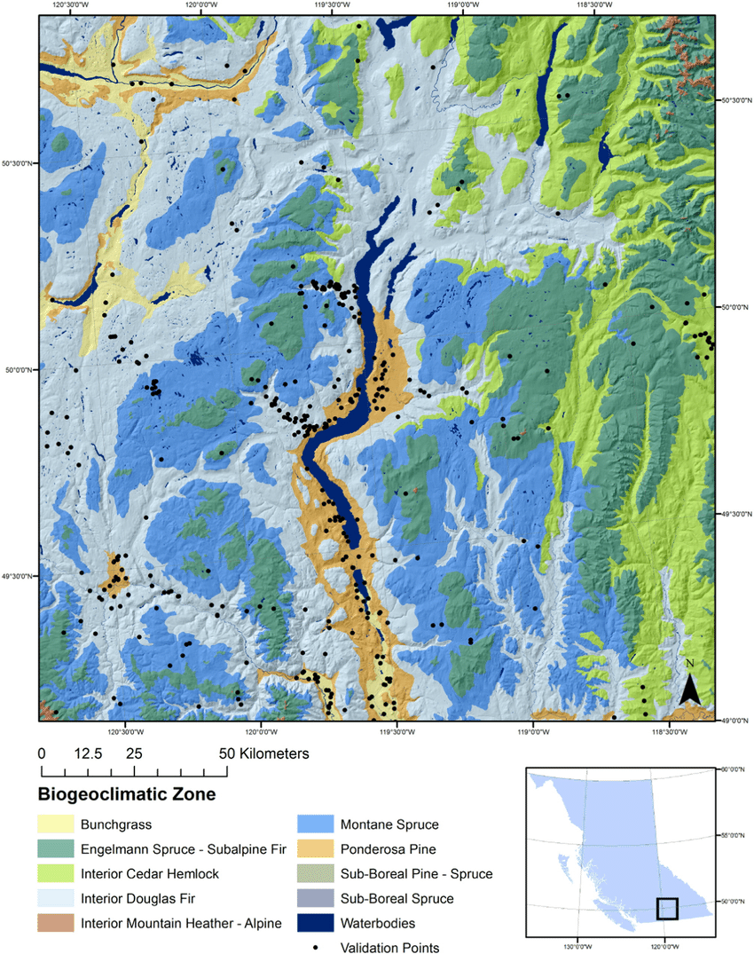
Aerial view of Lake Okanagan with various zones

Slide 7
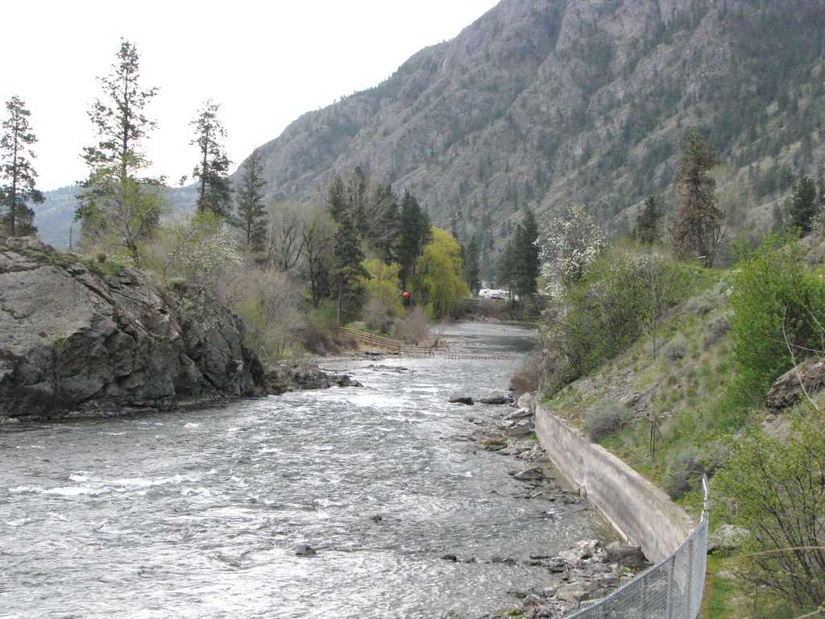
Okanagan Ecosystem
2% of Okanagan is wetlands (soil is saturated all year round)
Riparian zones (the area of land next to water – creek, stream, river)

Slide 8
The Unique Okanagan Ecosystems
Dr. Lael Parrott from UBCO talks about our unique Okanagan ecosystem

Slide 9
Become An Expert

Slide 10
Become An Expert
As a group of 4 students, make a whiteboard poster with important information about your zone
The class will come and learn from the poster (and take notes from it)
Be detailed and precise with your information

