Slide 1
Ocean impacts and Marine Mammals
Enviro Science 12

Slide 2
Last Days Nuggets
What is causing ocean acidification? What is the chemical equation that is leading to this situation in our oceans? What organisms is it impacting and how (be specific for each organism).

Slide 3
Last Days Nuggets
What is aquaculture? What are two issues that are negatively impacting BC aquaculture? What are some possible solutions?

Slide 4
Last Days Nuggets
What are 3 factors that are changing in our oceans due to climate change and how is it impacting organisms?

Slide 5
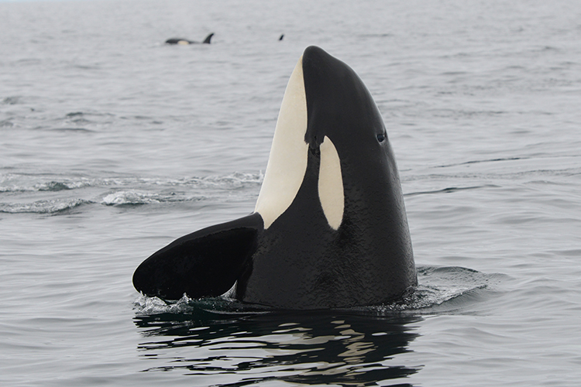
BC Orca whales
Cetacean: is the name for the group of mammals that are whales, dolphins and porpoises.
Remember that mammals:
Are able to keep their internal temperatures constant (they are homeothermic)
Give birth to fully developed young
Nurse their young
Have lungs

Slide 6
BC Orca whales
There are 3 eco-types of killer whales:
Offshores
Transients
Residents
2 resident populations in BC: northern residents and southern residents (no cross over)
different languages stop them from mating between populations
transients have more pointed dorsal fins and offshores appear to be smaller animals.
Not much is known about the offshores yet as they are not often seen close to the coast of British Columbia.

Slide 7
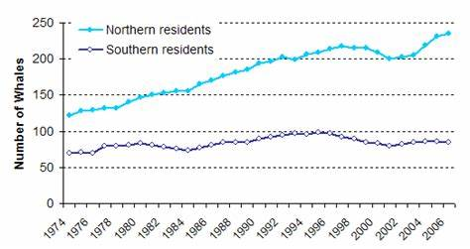
What do you notice? What do you wonder?

Slide 9
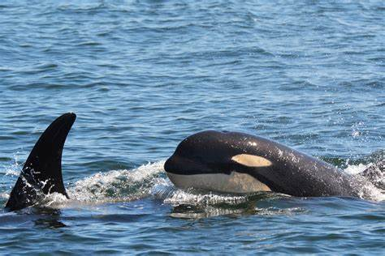
Where are resident orca’s?

Slide 10
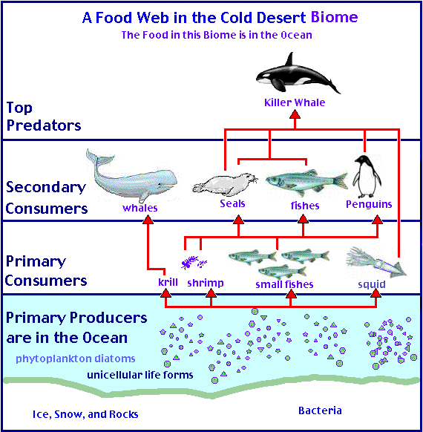
Important vocabulary to know

Slide 11
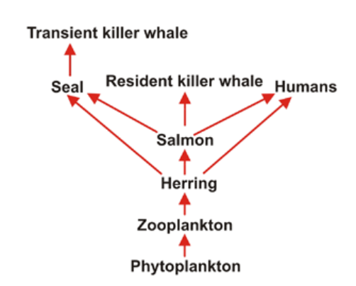
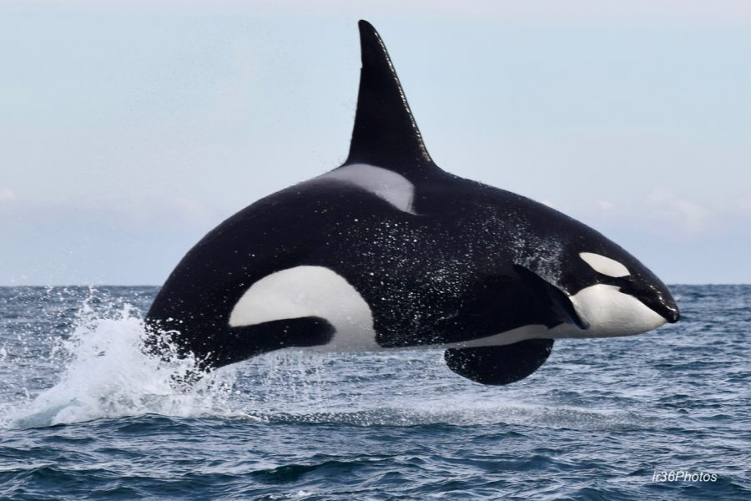

Slide 12
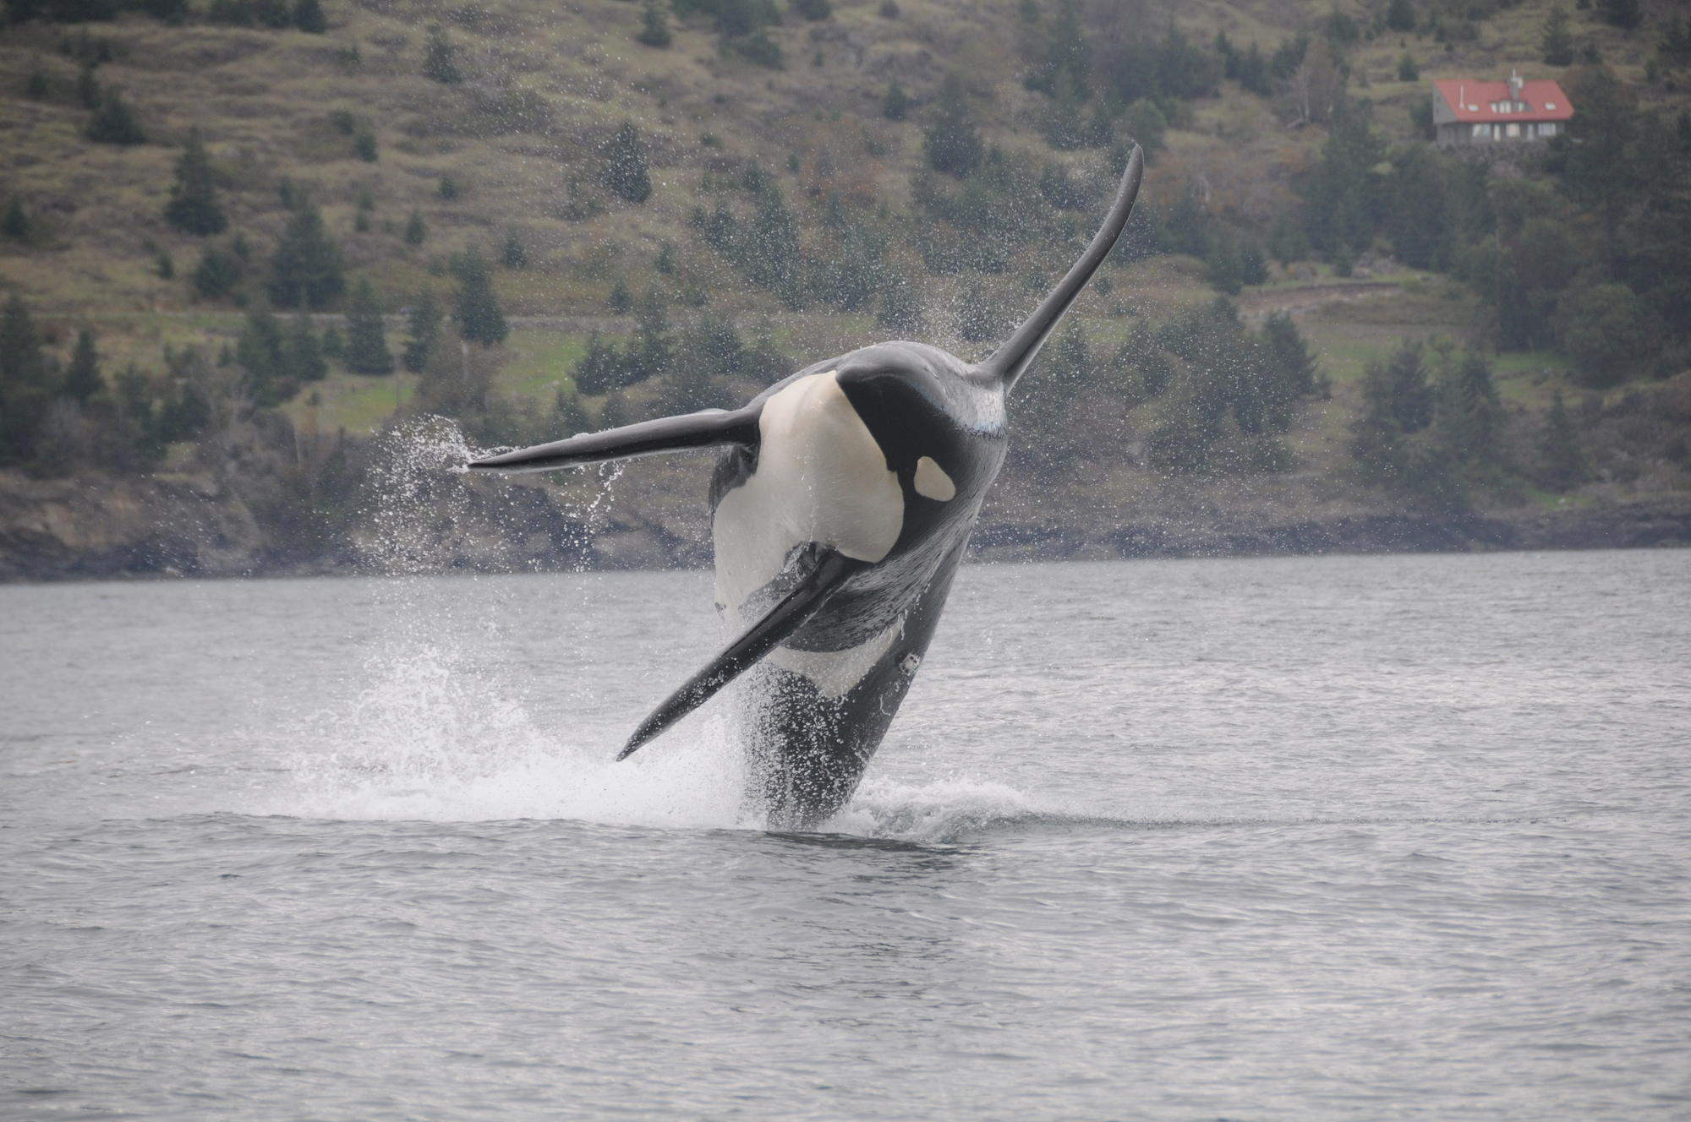
Orca’s at risk
In 2001, the Committee on the Status of Endangered Wildlife in Canada determined:
southern resident killer whale are "endangered"
northern resident killer whales are "threatened"
transient killer whales are "threatened"
offshore killer whales are "of special concern“
The transient population and both resident populations are listed in Schedule 1 of the Species at Risk Act (SARA), Canada's law to protect wildlife species from becoming extinct.

Slide 13
Species at risk act (SARA) June 2003
The Species at Risk Act (SARA) was created to protect wildlife species from becoming extinct in two ways:
by providing for the recovery of species at risk due to human activity
by ensuring through sound management, that species of special concern don't become endangered or threatened
It includes prohibitions against killing, harming, harassing, capturing or taking species at risk.

Slide 14
How does a species get on SARA list?
Species are designated "at risk" by the Committee on the Status of Endangered Wildlife in Canada (COSEWIC)
COSEWIC is an independent body of experts that assesses wildlife populations

Slide 15
Designations
Extinct: no longer found anywhere on the planet.
Extirpated: no longer in the wild in Canada, but existing in the wild elsewhere.
Endangered: a wildlife species facing imminent extirpation or extinction. (The species could soon become extirpated or extinct).
Threatened: likely to become endangered if nothing is done to reverse the factors leading to its extirpation or extinction.
Special concern: a wildlife species that may become a threatened or endangered species because of a combination of biological characteristics and identified threats.

Slide 16
Threats to orca’s
3 main threats
environmental contamination
reductions in the availability or quality of prey
disturbance - both physical and acoustic disturbance
Historic threats
Culling
being taken for captivity.
both southern and northern resident population declines coincided with a decline in Chinook salmon stocks. The effect was more pronounced in the southern resident population
With less food, toxins are more likely to metabolize and stresses such as noise and boat traffic are likely to have a greater impact as they reduce the chance of catching limited prey.

Slide 17
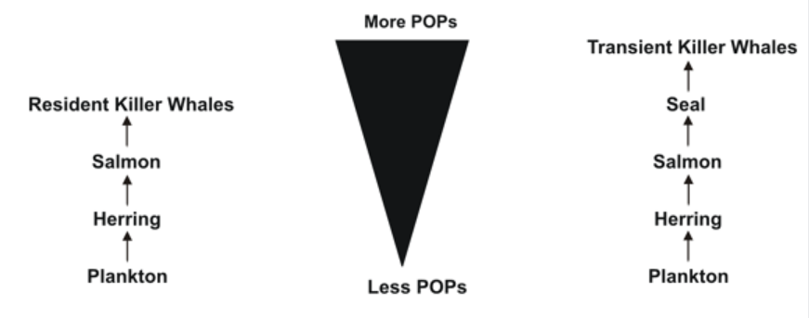
POP increase

Slide 18
What are toxins?
Many chemicals we use in our daily lives are toxic. Toxic chemicals include pesticides, engine products and many household cleaners.
Some of these toxins are persistent. This means that they do not break down and as a result they build up in the food chain
build up in the fat of organisms & mother's milk
The build up of toxins in organisms is called bioaccumulation.
Persistent toxins are also known as Persistent Organic Pollutants (POPs).

Slide 19
Persistent Toxins Impacts
reproductive failure
birth defects
immune system disorders (cancers and weakness to disease)
Death
The more toxins an organism has, the greater its problems.
We may use toxins on land, but they go through the soil to the groundwater and into the ocean. All persistent toxins eventually end up in ocean food chains.

Slide 20
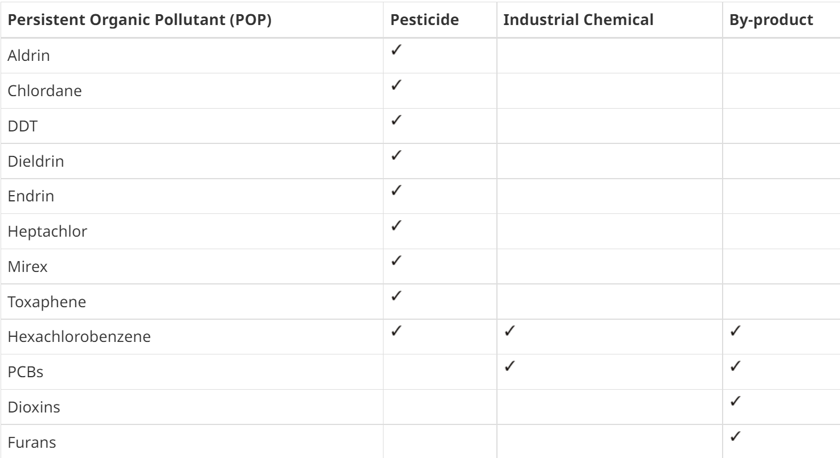
The Dirty Dozen

Slide 21
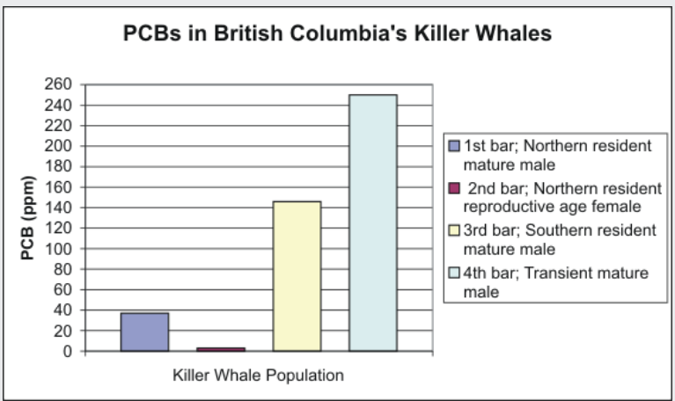
PCB’s above 50 ppm’s is considered toxic

Slide 22
