Slide 1
Nucleic Acid
Biology 12

Slide 2
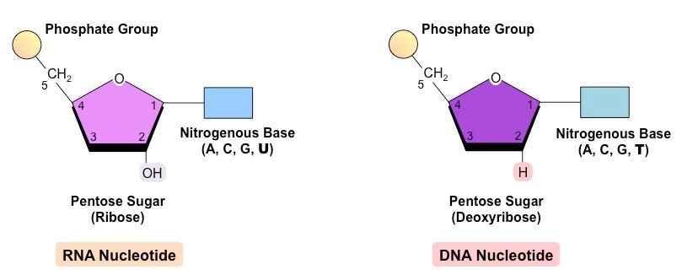
What is a nucleic acid?
Monomer is nucleotide
Consists of 5 carbon sugar, nitrogen base, and phosphate group
Repeating unit that makes up DNA, RNA, and ATP (energy for cells)

Slide 3
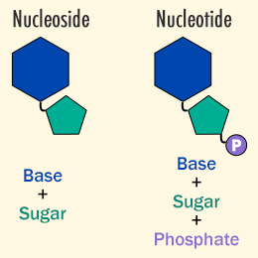
Role of a nucleic acid
Store genetic material (DNA)
Transfer genetic code (RNA)
Energy for cell (ATP)

Slide 4
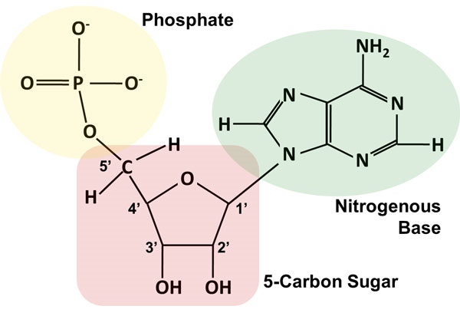
Elements in nucleic acid
Carbon
Oxygen
Hydrogen
Nitrogen
phosophate

Slide 5
DNA vs RNA
DNA
Deoxyribose sugar
Double stranded
Stays in nucleus
Alpha helix shape
Hydrogen bond between nitrogen bases
A, G, C, T
Anti-parallel strands (3’ → 5’ and 5’ → 3’)
RNA
Ribose sugar
Single stranded
Made in nucleolus and moves to ribosome
Alpha helix shape
A, G, C, U

Slide 6
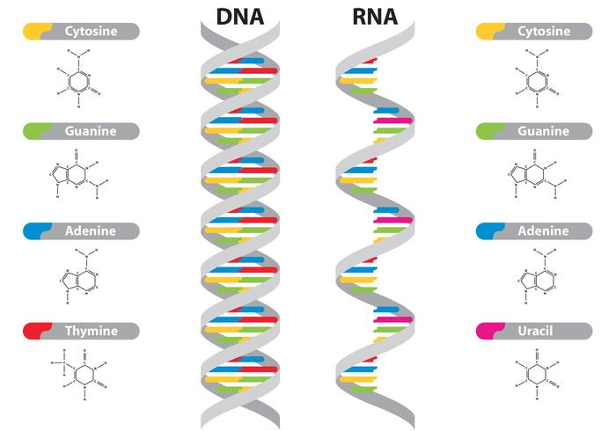

Slide 7
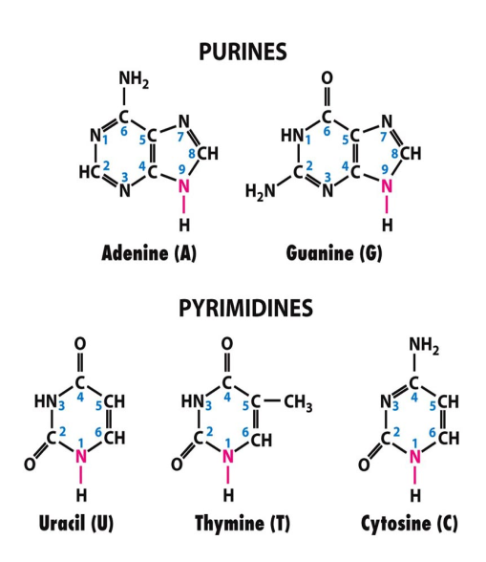
Nitrogen Bases
Must maintain a 3 ring consistent rung of the DNA ladder

Slide 8
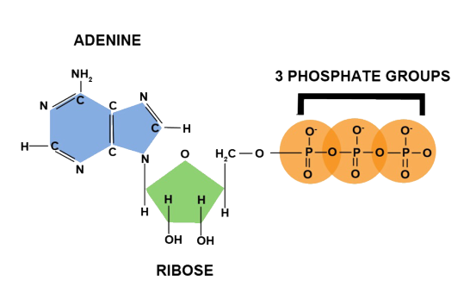
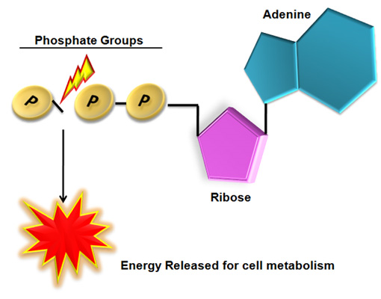
ATP
Inside cells
The energy currency of the cell (due to phosphate groups)
Made in the mitochoria of the cell (every cell)

Slide 9
Case Study
As a table team, read the case study details
Answer the questions through research and investigation
Hand in a summary of your findings by the end of todays class

Slide 10
Biomolecules

Slide 11
Caffeine
Rhonda started her research with Caffeine. She discovered that:
small to moderate amounts (50-300 mg) of caffeine act as a mild stimulant.
Caffeine increases heart rate and blood pressure.
Athletes have taken advantage of the stimulant effect of caffeine for many years.
Rhonda also discovered that individuals differ in their sensitivity to caffeine. Some are sensitive to the effects of caffeine at very small doses, and pregnancy and age can affect this sensitivity. Even in people who consume caffeine regularly, the stimulant effect is not always consistent. This suggests that we may actually become less sensitive to the effects of caffeine over time.

Slide 12
Caffeine
Rhonda discovered that energy drinks typically contain large doses of caffeine. In fact, she learned that energy drinks may contain as much as 80 mg of caffeine, the equivalent of a cup of coffee. Compared to the 37 mg of caffeine in a Mountain Dew, or the 23 mg in a Coca-Cola Classic, that's a big punch!
She also found that many energy drinks add other legal stimulants like ephedrine, guarana, and ginseng.

Slide 13
If you were an athlete, what would you drink?

