Slide 1
Normal Distribution
FOM 11

Slide 2
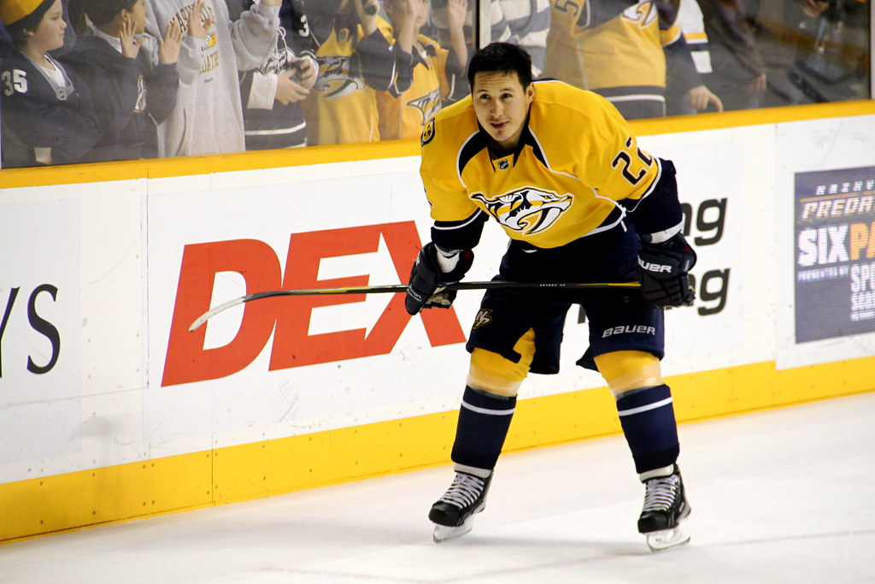
Warm Up
Jordin Tootoo played with the NHL from 2003 – 2010. Below are his points for those 6 seasons. Find the mean and standard deviation for his total game points during his NHL career.
Year | Points
2003-2004 | 8
2005-2006 | 10
2006-2007 | 9
2007-2008 | 18
2008-2009 | 16
2009-2010 | 16

Slide 3
Below is the height of Canadian males (n=1000)
Height (in) | Frequency
61 or shorter | 3
61-62 | 4
62-63 | 10
63-64 | 18
64-65 | 30
65-66 | 52
66-67 | 64
67-68 | 116
68-69 | 128
69-70 | 147
70-71 | 129
71-72 | 115
72-73 | 63
73-74 | 53
74-75 | 29
75-76 | 20
76-77 | 12
77-78 | 5
Taller than 78 | 2
Graph the data using a histogram
What do you notice about the shape of the graph?

Slide 4
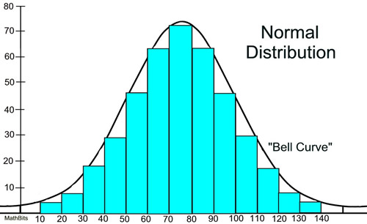
Normal Distribution Curve
What is the bar that represents the average of this data?

Slide 5
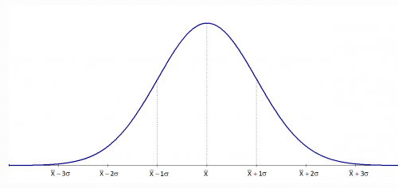
Normal Distribution Curve

Slide 6
The weights of adult male huskies are normally distributed. The mean weight is 52.5 lb with a standard deviation of 2.4 lb. How would these values appear on the below distribution curve?

Slide 7
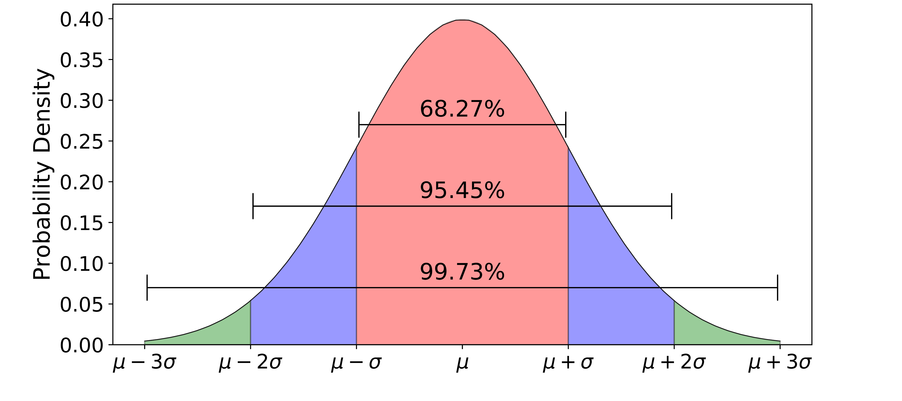
68-95-99.7 Rule

Slide 8
What percent of adult male dogs would you expect to have a weight between 47.7 lb and 54.9 lb?
45.3
47.7
50.1
52.5
54.9
57.3
59.7

Slide 9
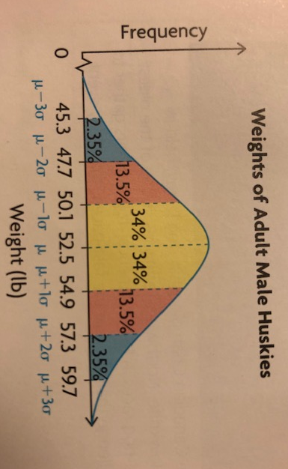
What percent of adult male dogs would you expect to have a weight between 47.7 lb and 54.9 lb?

Slide 10
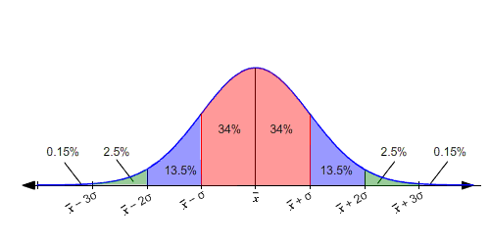
What does each section of the curve represent?
Page 266 of your workbook

Slide 11
There are 500 people waiting for pancakes at the SSS breakfast. The average wait time to get your pancakes is 10 minutes with a standard deviation of 2 minutes. How many people expect to wait for less than 8 minutes?

Slide 12
What is the mean and standard deviation if 40 and 50 are one standard deviation away from the mean?

Slide 13
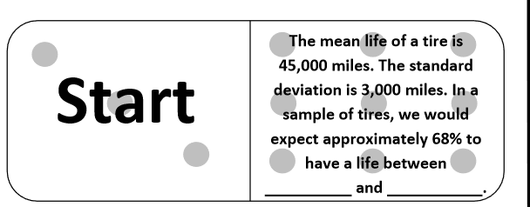
To Do:
Dominoes activity as a table team

