Slide 1
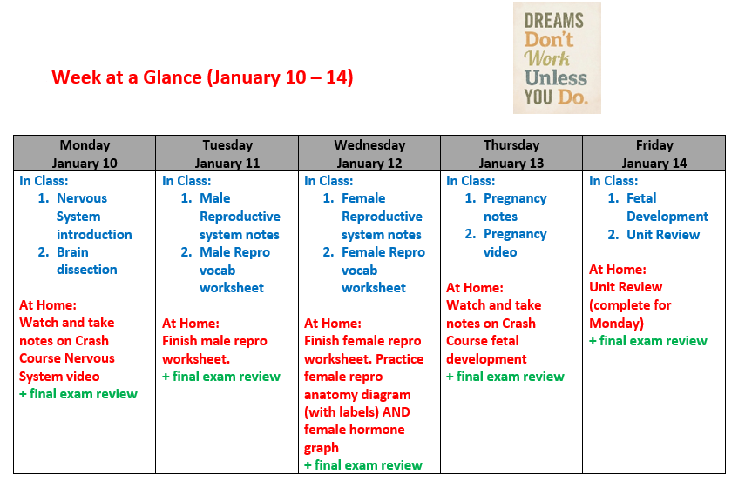

Slide 2
Let’s get ready for our Final Exam

Slide 3
Some ideas for studying…

Slide 4
Topics to revisit…

Slide 5
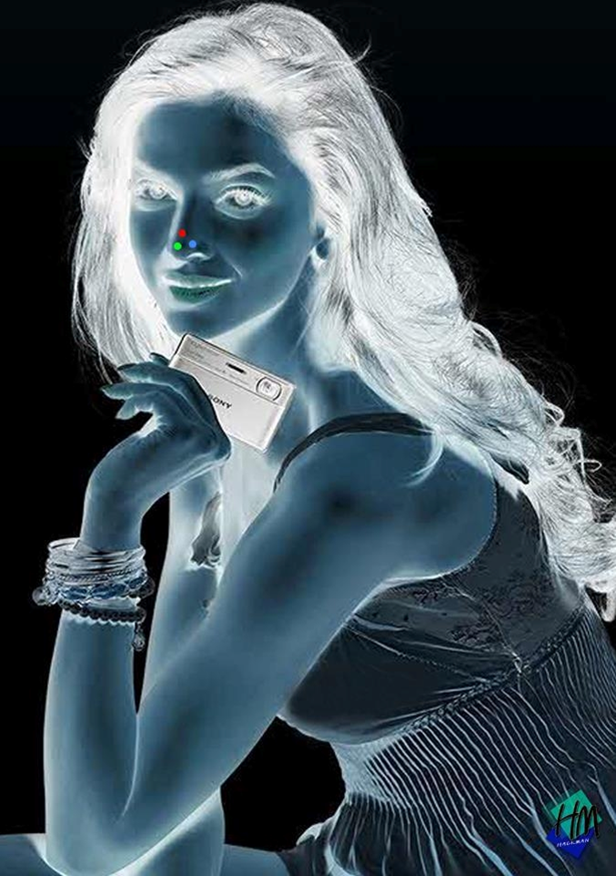
Stare for 30 seconds,then look at ceiling

Slide 6
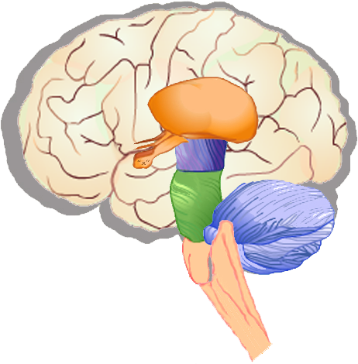
Nervous System

Slide 7
THE BRAIN SONG

Slide 8
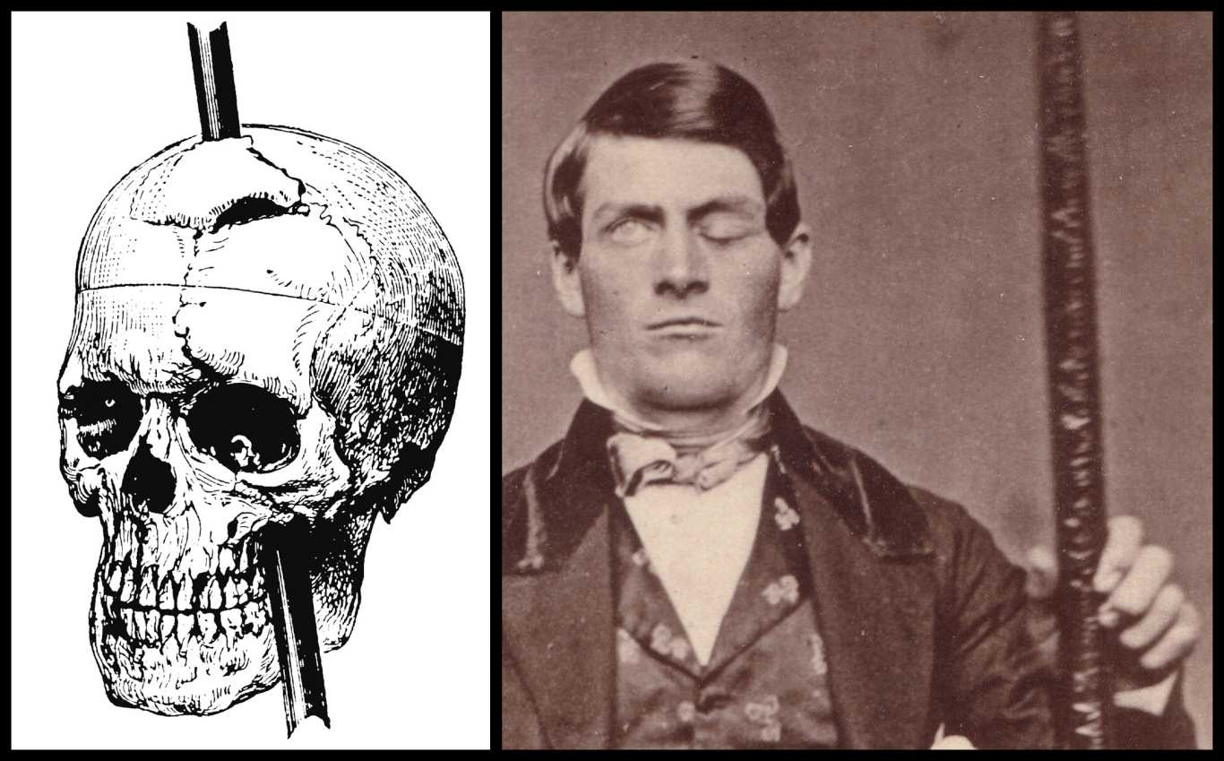
Phineas Gage
The start of Neuroscience....
Phineas survived a tamping tool through his frontal lobe. He was fine, but his personality changed greatly. Why?

Slide 9
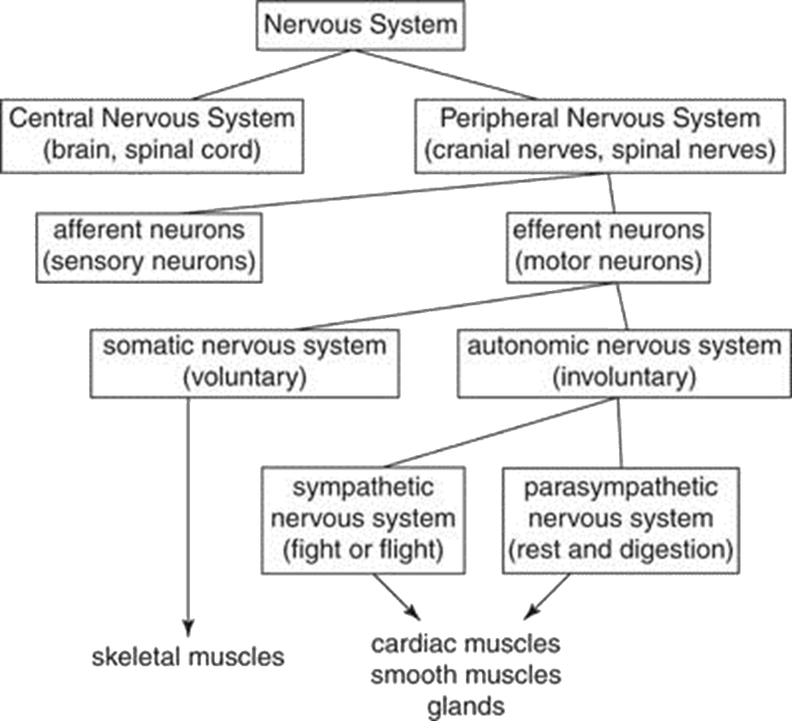
Divisions of the Nervous System

Slide 10
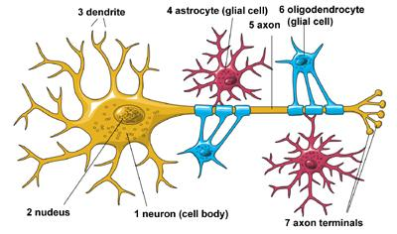
What type of cells make up your nervous system?
There are two main types of neural cells:
Neurons
2. glial cells (lots of different types)

Slide 11
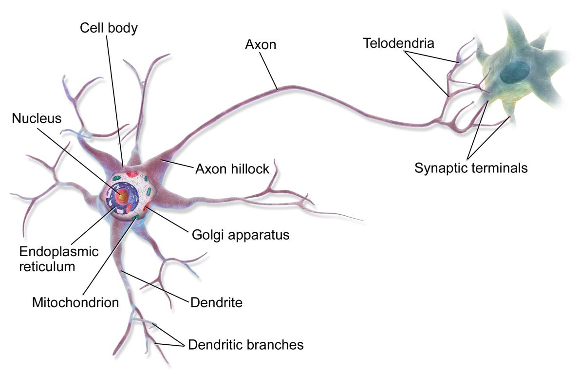
Your Nervous System is made up of specialized cells called neurons

Slide 12
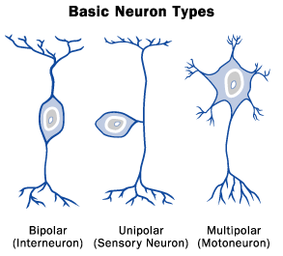
Your Nervous System Functions
Inter neurons are found only in the CNS (spinal cord and brain). The link between sensory and action. Have short dendrites and short axons
Sensory neurons relay message from the receptor to the CNS. Have long dendrites and short axons
Motor neurons relay message from interneuron to the effector (the muscle). Have short dendrites and long axons

Slide 13
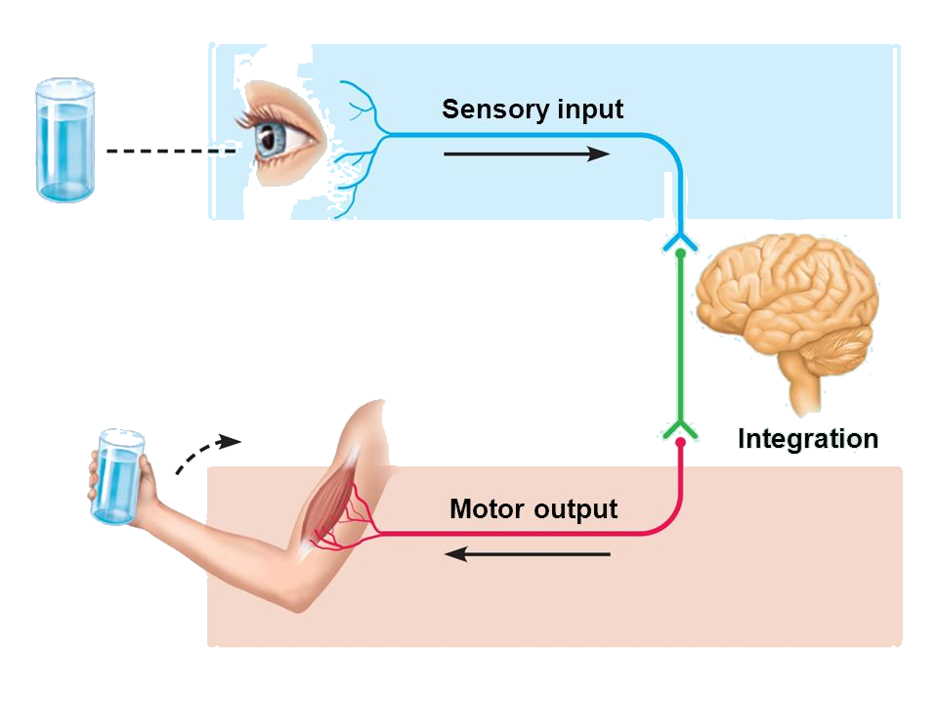
Your Nervous System Functions
1. Sensory Input
3. Motor Output
2. Integration
(Thinking & Processing)
Typically the message goes to the neurons in your brain to process and “decide” how to take action. This is then relayed down to your muscles for action

Slide 14
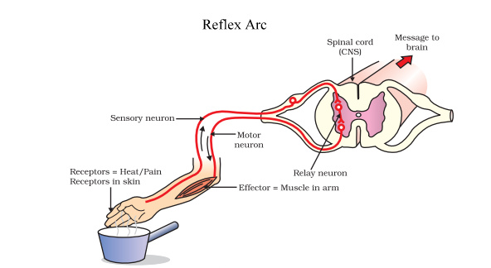
Reflex Arc
Receptor
Sensory neuron
Interneuron
Motor neuron
effector

Slide 15
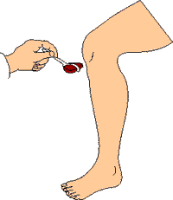
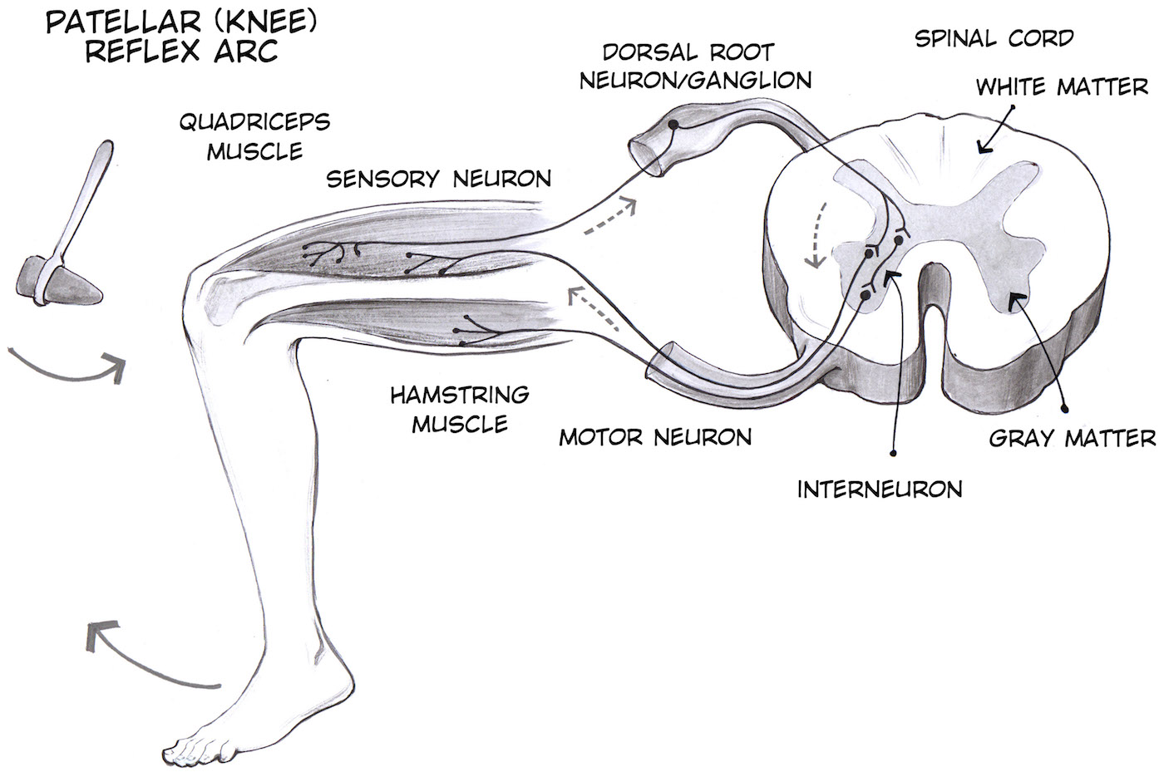
Test Your Reflexes
With a partner, test your patella reflex arc
Sit on the desk (leg needs to be hanging)
Use rubber hammer to tap below knee cap)
Leg should automatically move due to contraction of hamstring

Slide 16
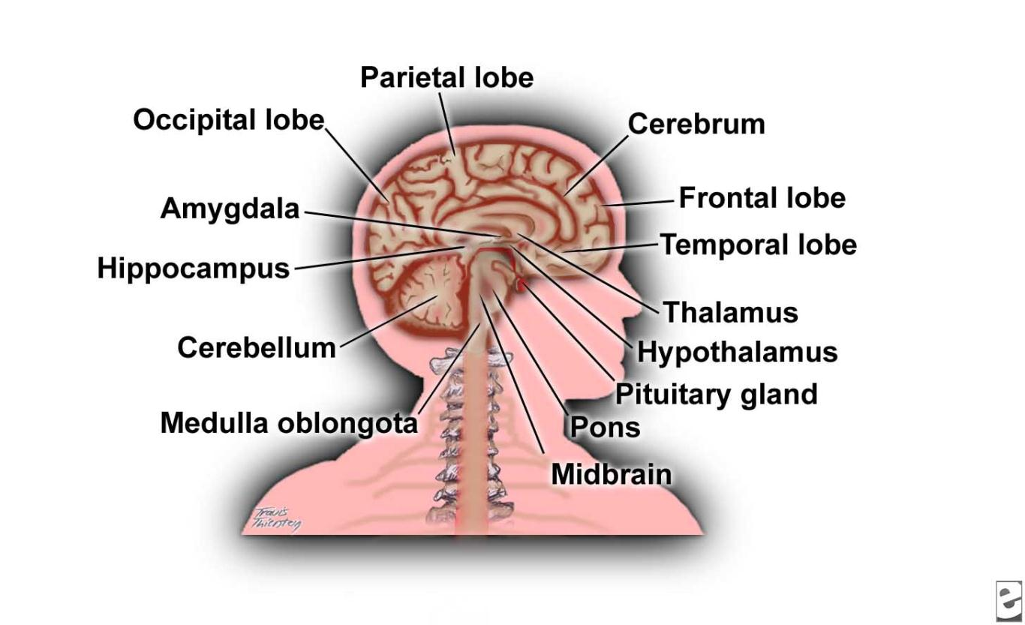

Slide 17
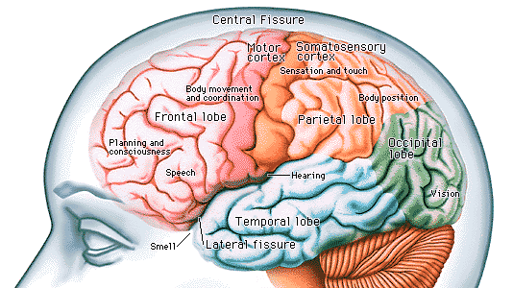
The Cerebrum
main part of brain
associated with thought and action
made of 4 lobes

Slide 18
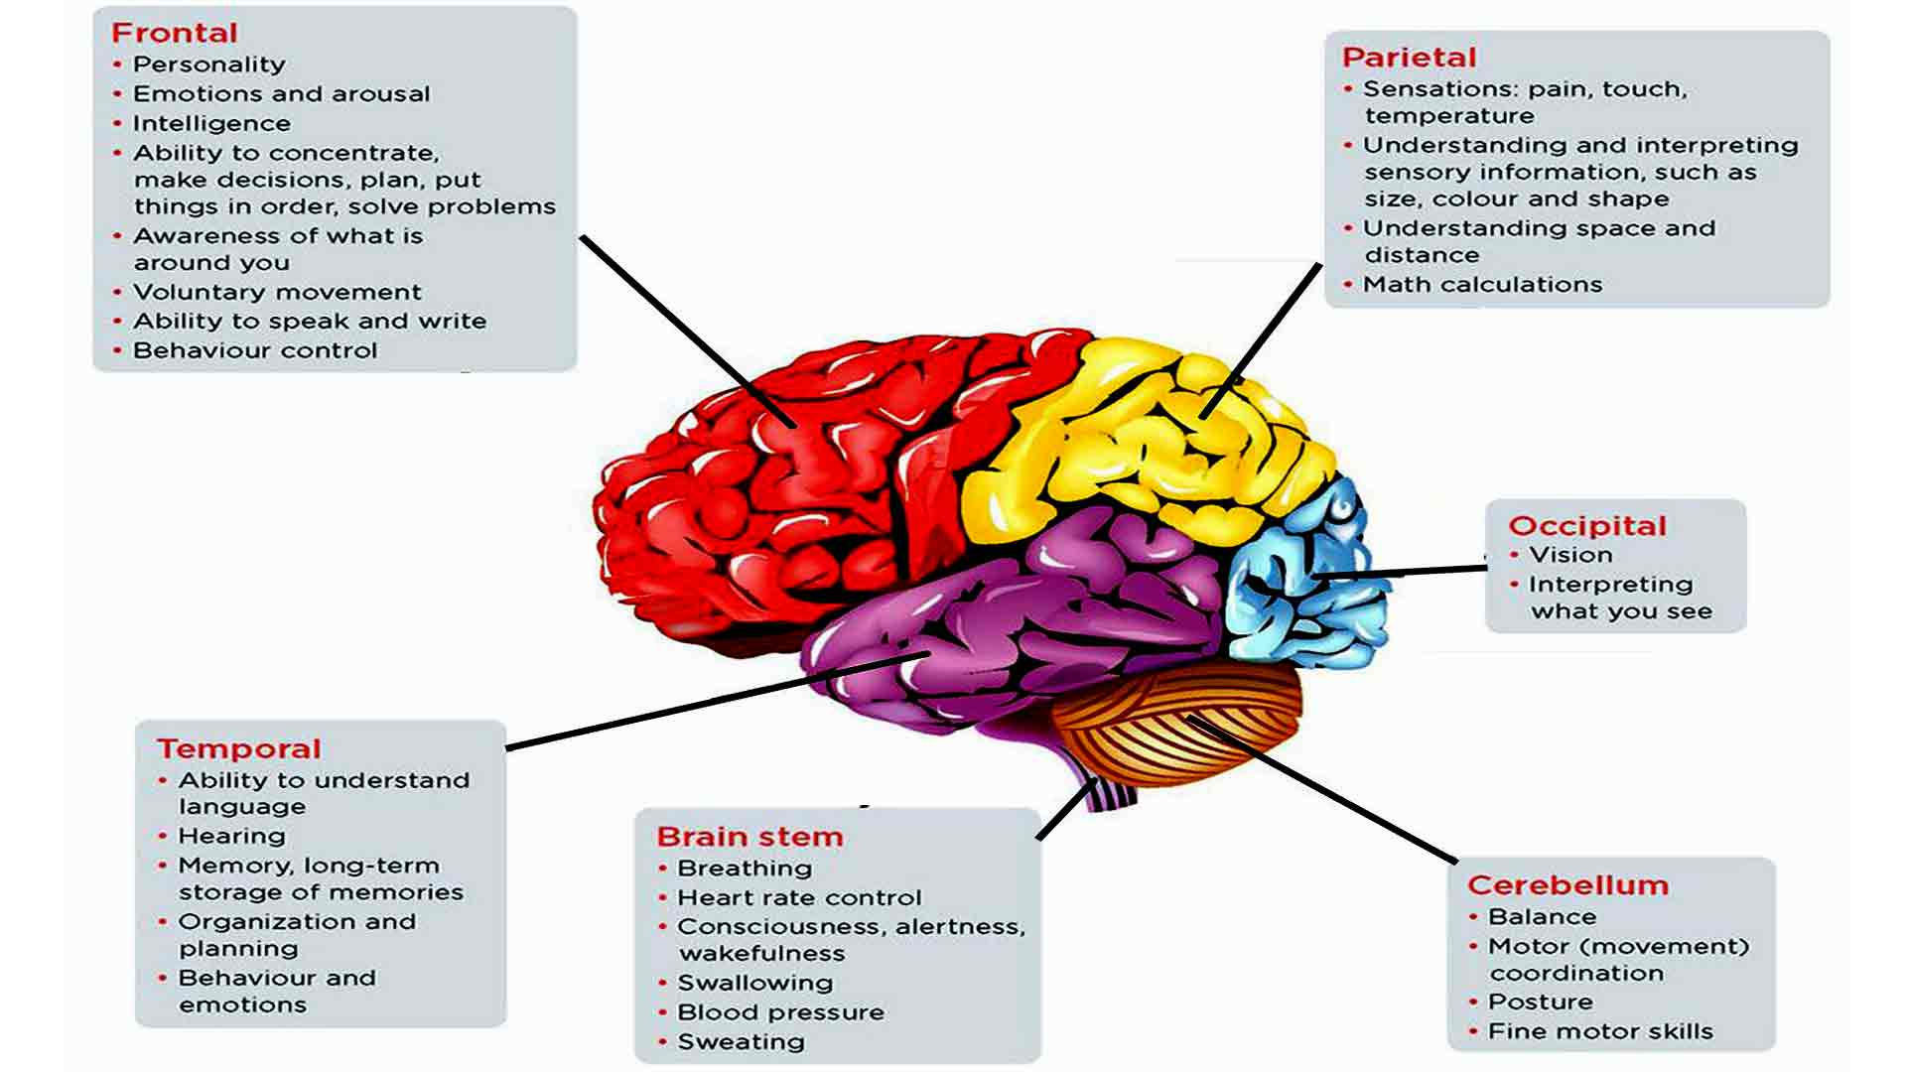
The Cerebrum
Parts and Function

Slide 19
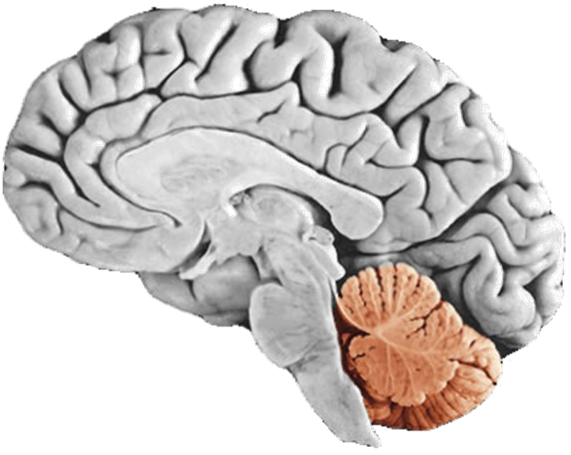
Cerebellum
connected to the brainstem
center for body movement and balance.

Slide 20
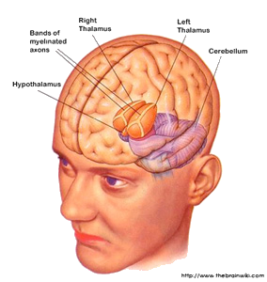
Thallamus
at top of brain stem
two lobes that relay sensory and motor messages to cerebrum
regulation of sleep and consciousness

Slide 21
Hypothallamus
below thallamus
homeostasis
regulated blood pressure, body temperature and water balance

Slide 22
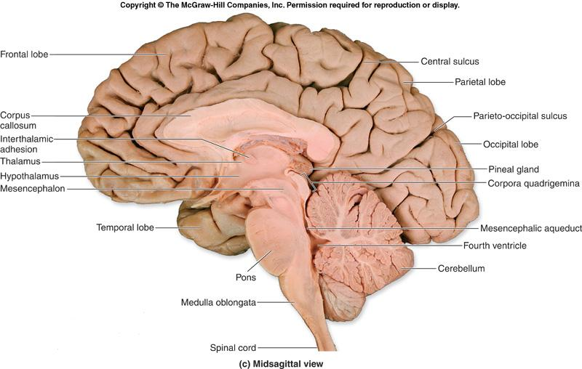
Medulla Oblongata
reflex centre of the brain
swallowing, sneezing, coughing
respiration and circulation

Slide 23
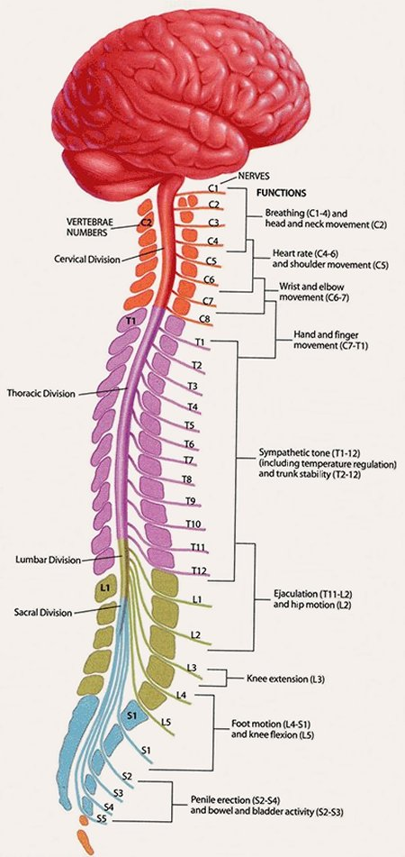
Spinal Cord
nerves branch out from main cord to the various parts of the body
physios can tell what vertebrae has been damaged based on nerve sensations

Slide 24
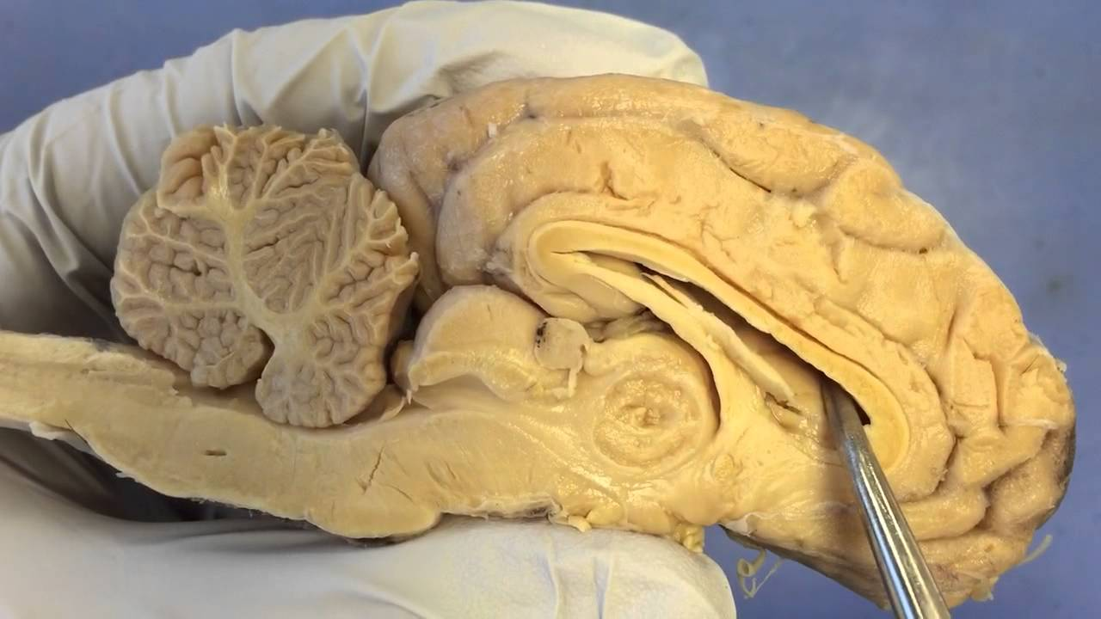
Sheep’s Brain Parts
In table teams, complete the worksheet and identify all the listed parts of the brain.
Use the picture guide to help
Use the ipads to look up the function of each of these brain parts

Slide 25
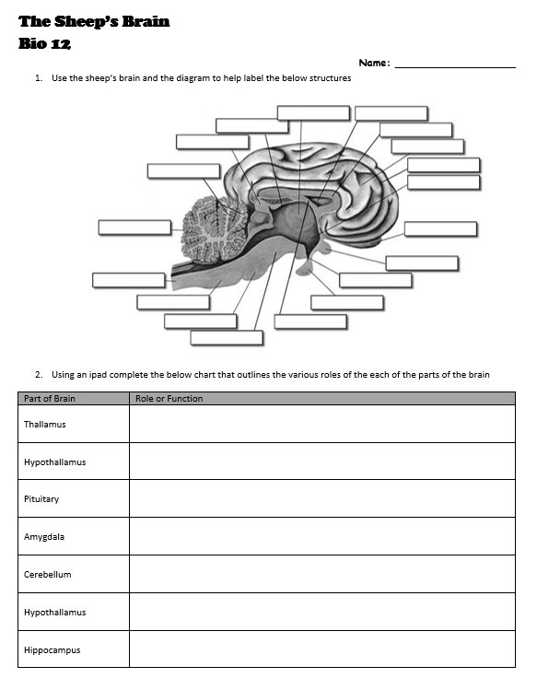
Sheep’s Brain Parts
Class Dissection

