Slide 2
Gene Mutation
Gene mutation is the change in the order of the A,G,C,T bases in a gene (on DNA strand)
These altered genes can have a positive, negative or no effect on the organism

Slide 3
Types of Mutations
Point Mutation- does not change any other codons downstream, just 1 codon changed
THE FAT CTT ATE THE RAT
Frameshift - the one change impacts all the codons downstream
THF ATC ATA TET HER ATC

Slide 4
Causes of Mutations
Deletion- One base is missing
The Gene should be ACTGCGT
But instead is ACGCGT
Addition- One extra base is added
The Gene should be ACTGCGT
But instead is ACTGTCGT
Substitution- One base is substituted for another
The Gene should be ACTGCGT
But instead is ACGGCGT

Slide 5
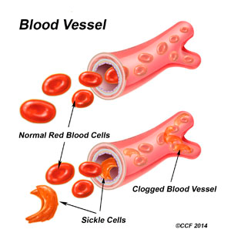
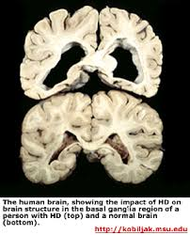
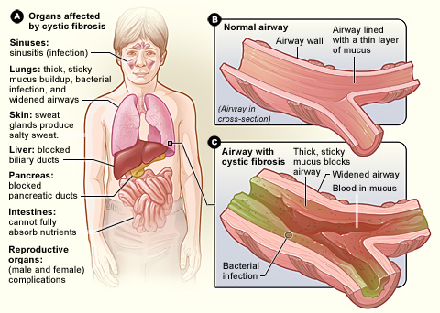

Slide 6
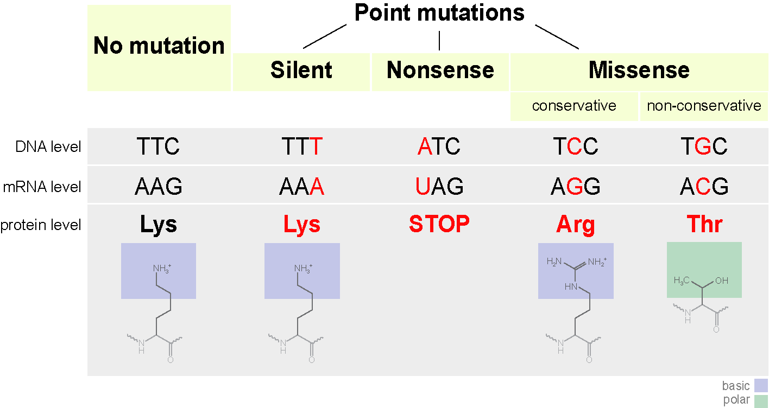

Slide 7
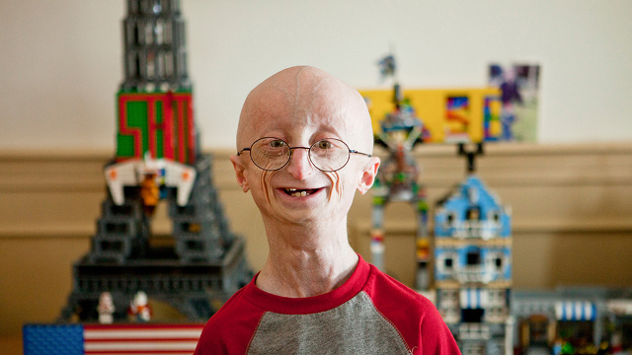
Progeria
Accelerated aging
mutation in the LMNA gene

Slide 8
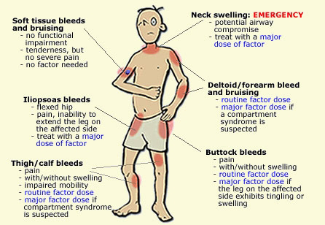
Hemophilia
mutation in a gene that impacts clotting factor

Slide 9
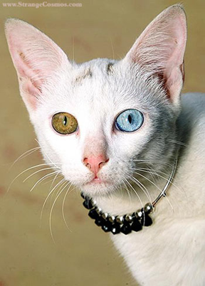
Would the following mutations be harmful, beneficial, or have no impact?
Heterochromia
two different genes that express different colours in eyes

Slide 10
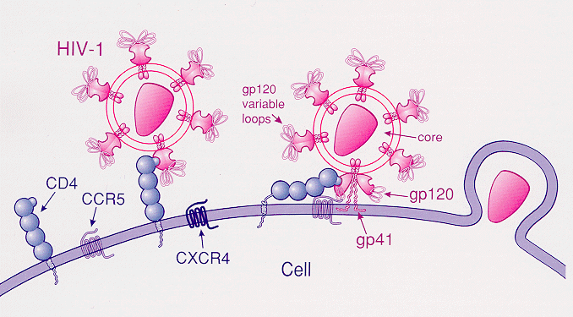
Positive Mutation
The mutation of a gene has a positive impact on the organism
Ex) Mutated gene that creates a protein that prevents HIV from infecting the organism

Slide 11
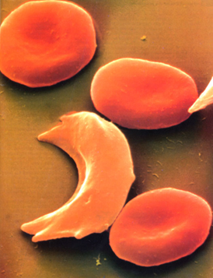
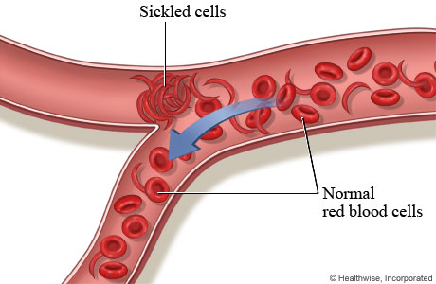
Negative Mutation
Small changes in certain genes have harmful affects on the organism
Ex) Sickle cell anemia

Slide 12
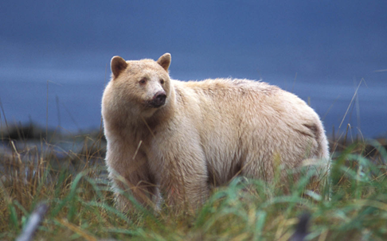
Neutral Mutation
The mutation has no impact on the organism
Ex) Spirit Bear

Slide 13
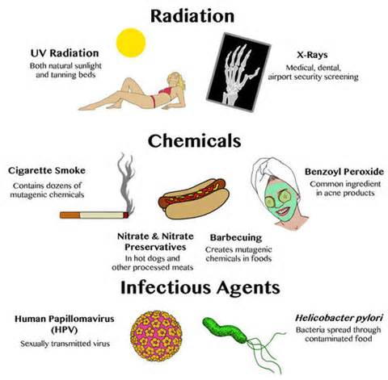
Mutagens
Substances or factors that cause mutation in DNA
Ex) UV Light, x-rays, pollutants and other harmful chemicals

Slide 14
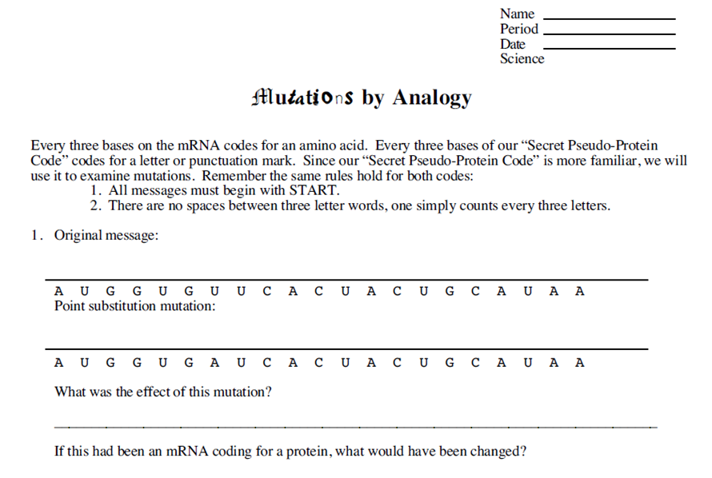
Worksheet

Slide 15
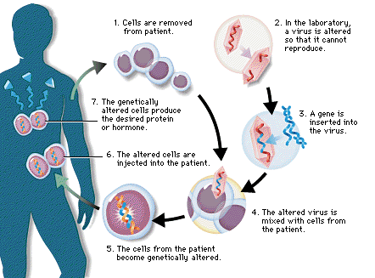
Possible Treatments
Gene Therapy- replace a mutated gene with a healthy copy
Complicated and highly experimental

Slide 16
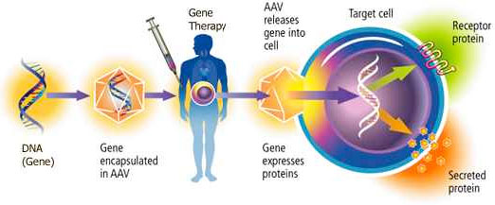
Possible Treatments

Slide 17
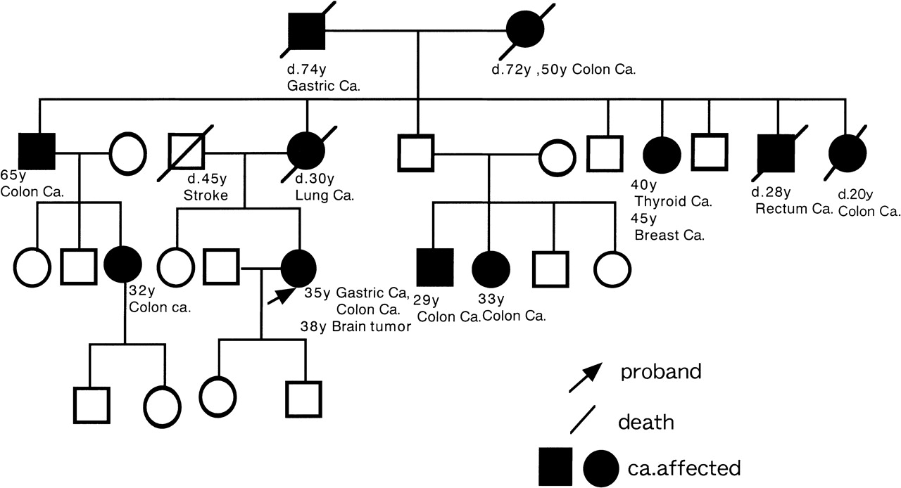
Mutation Case Study
A Family In Need: In-Class Case Study on Cancer Genetics
Part 1: Genetic Testing - Pedigree

Slide 18
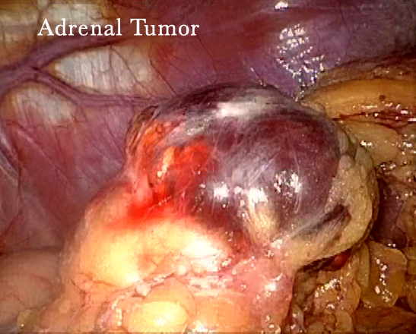
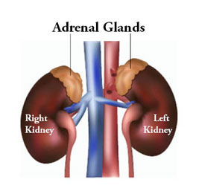
Mutation Case Study
A Family In Need: In-Class Case Study on Cancer Genetics

Slide 19
Words to Know
A Family In Need: In-Class Case Study on Cancer Genetics
Part 1: Genetic Testing - Pedigree
Phenotype - The physical attributes of a gene (for example brown hair)
Allele - The possible forms of a gene (on the DNA)
Autosomal chromosome - A "regular" chromosome, not a sex-linked chromosome (#1 - 22)
X-Linked chromosome - An X or Y chromosome (#23), X = female, Y = male
Recessive - you need to have two of the chromosomes in order for it to show. Trumped by the dominant gene
Dominant - you only need one of the chromosomes to have the gene

Slide 20
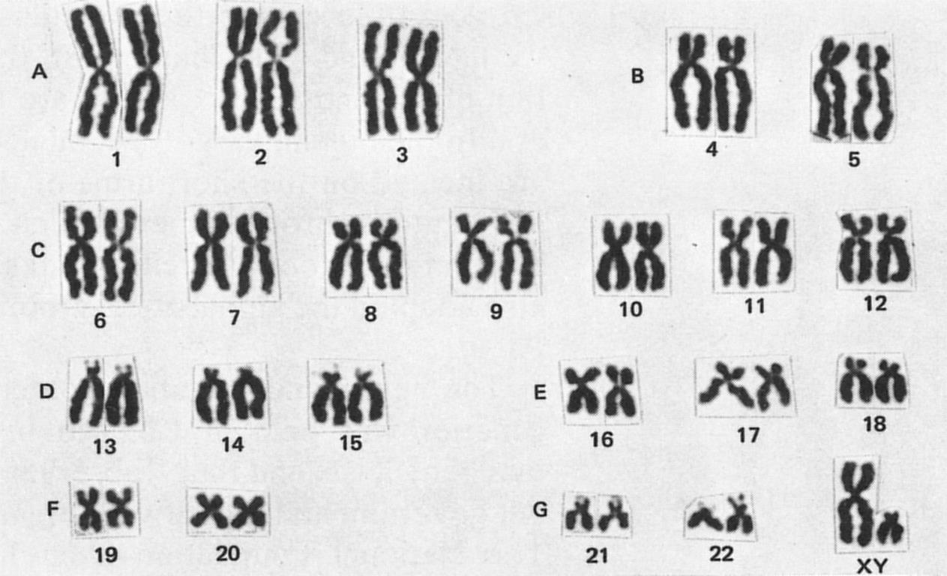
What is a Karyotype?

Slide 21
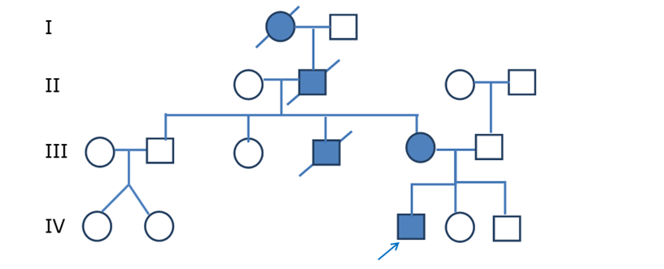
KEY
A Family In Need: In-Class Case Study on Cancer Genetics
Part 1: Genetic Testing - Pedigree

Slide 22
KEY
A Family In Need: In-Class Case Study on Cancer Genetics
Part 1: Genetic Testing - Pedigree

Slide 23
KEY
A Family In Need: In-Class Case Study on Cancer Genetics
Genetic Testing

Slide 24
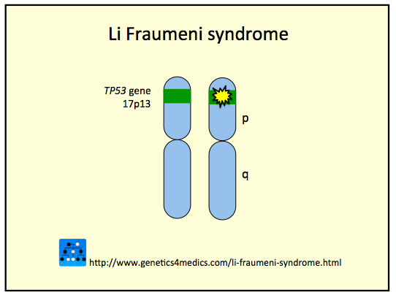
KEY
A Family In Need: In-Class Case Study on Cancer Genetics
Lee has Li Fraumeni syndrome

Slide 25
Homework
Video Notes for Mutation Bozeman Science video

