Slide 1
Statistics
Lesson #1
Central Tendencies

Slide 2
Last DaY
43rd figure has 990 cubes
Methods:
1. + (n+1) until you’ve added 44
2. Make square (2x2), and (3x3) and then subtract missing
3. $\frac{1}{2}(n+1)(n+2)$

Slide 3
Brain Warm Up
What equation models the growth of the pattern?
How many blocks are in the 43rd figure?

Slide 4
Measures of Central Tendencies
Mean
Population - µ
Sample - ×
Add up all the data values and divide by the number of data values
Median
Sort the data into numerical order
Find the middle number
If two middles, find the average of the two values
Mode
The data value which occurs most often
It is possible to have multiple modes or no modes

Slide 5
What Central Tendency to use?
Use MEAN when you have no outliers in your data
Use MEDIAN – when there are outliers (most preferred)
Use MODE – when you are interested in how often something occurs

Slide 6
You test your classmates resting heart rates. What are the measures of central tendency of the below data?
Resting Heart Rate:
68, 71, 80, 92, 81, 72, 70, 56, 63, 72, 65, 87, 74, 70, 67

Slide 7
If the mean of the data is 7, what is the value of x?
10, 4, 7, 12, 9, 4, x, 6

Slide 8
Jake is looking at his number of goals he has scored over the start of the hockey season. Represent the data in a frequency table.
0, 1, 2, 0, 1, 4, 3, 1, 3, 1, 0, 2, 2
What might a frequency table look like?
How could you use this to find mean, median, and mode?

Slide 9
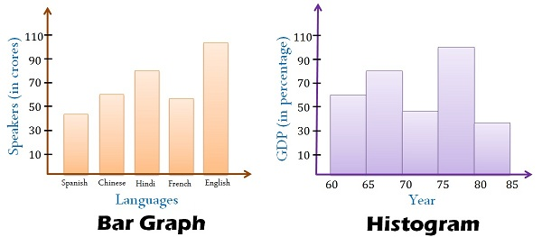
Frequency Histogram
Make a frequency GRAPH (histogram)
0, 1, 2, 0, 1, 4, 3, 1, 3, 1, 0, 2, 2
Important Aspects of histogram:
Title
X axis label
Y axis label
Bars together (to show continuous data)

Slide 10
Frequency Table and Histogram
Make a frequency GRAPH (histogram)
Below are the number of laps that your PE class could run. Make a frequency chart and a frequency table to show the data below
Number of laps run:
4, 6, 7, 5, 6, 4, 5, 6, 7, 6, 9, 8, 7, 6, 5, 6 ,7, 8, 5, 6, 7, 5 ,6, 5
Important Aspects of histogram:
Title
X axis label
Y axis label
Bars together (to show continuous data)

Slide 11
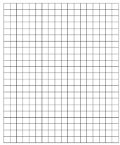
Number of laps run:
4, 6, 7, 5, 6, 4, 5, 6, 7, 6, 9, 8, 7, 6, 5, 6 ,7, 8, 5, 6, 7, 5 ,6, 5
Important Aspects of histogram:
Title
X axis label
Y axis label
Bars together (to show continuous data)

Slide 12
Range

Slide 13
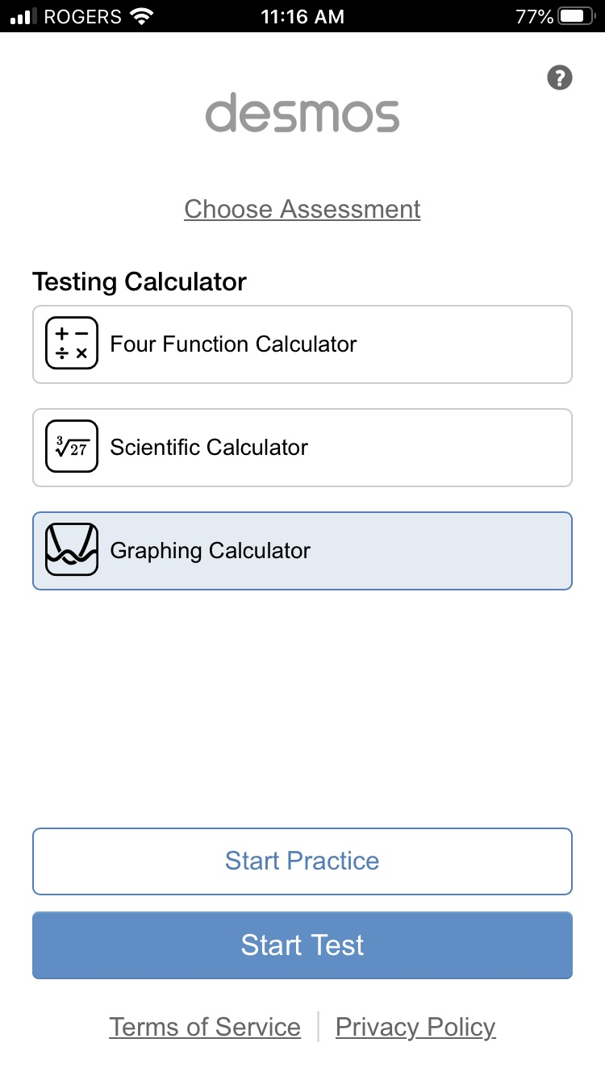
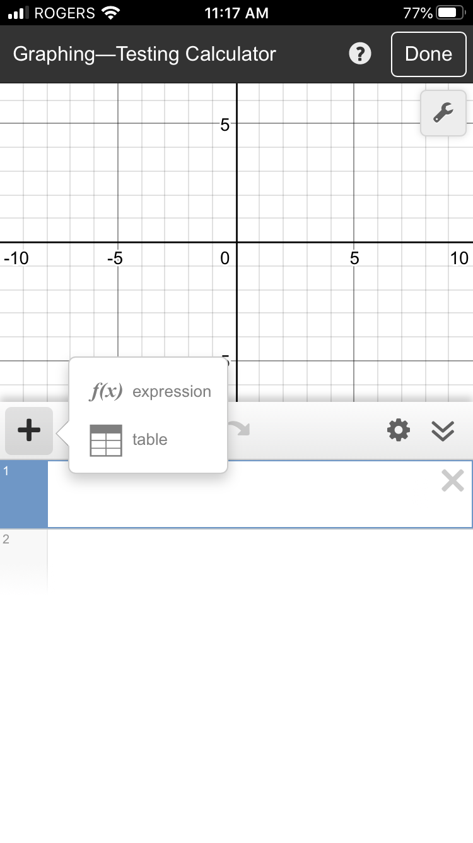
Using Desmos for Mean and Median
Enter data into X₁ column
Unclick Y₁ column
Data to enter:
6, 5, 7, 4, 4, 7, 8, 3, 4, 3, 8, 8, 7

Slide 14
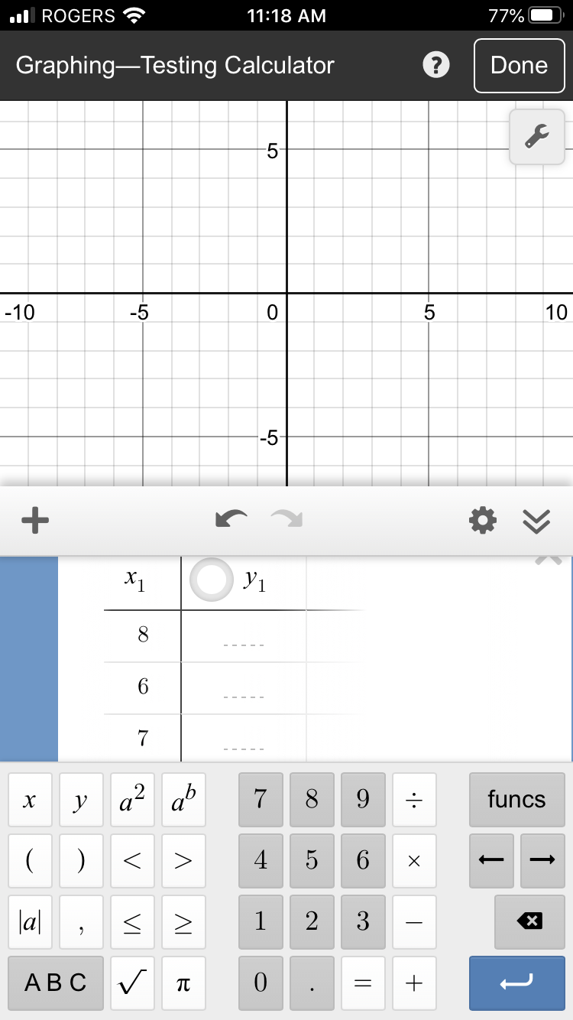
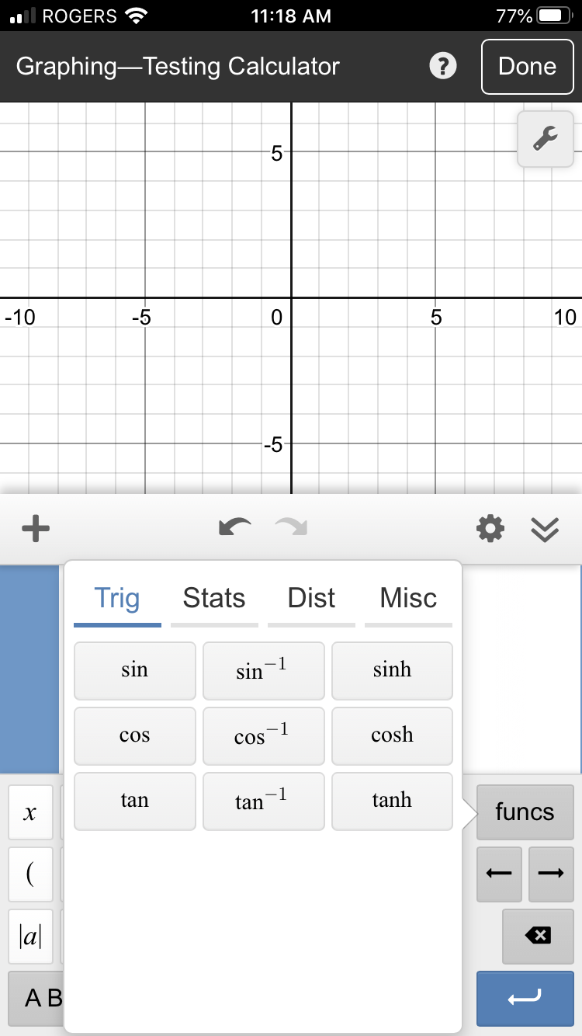
Using Desmos for Mean and Median
Click on X₂ and enter stats you are wanting
ie. Mean (X₁)

Slide 15
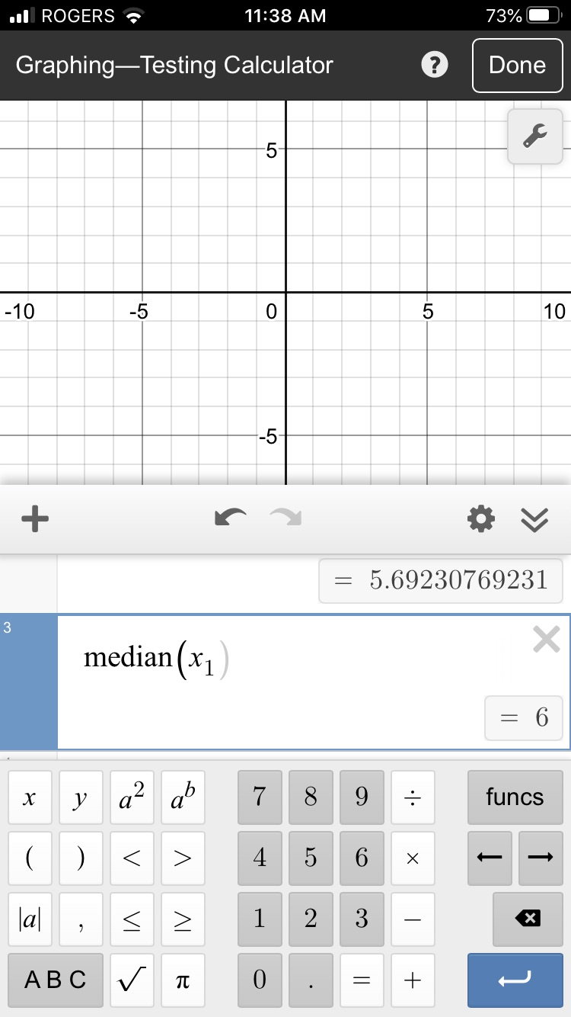
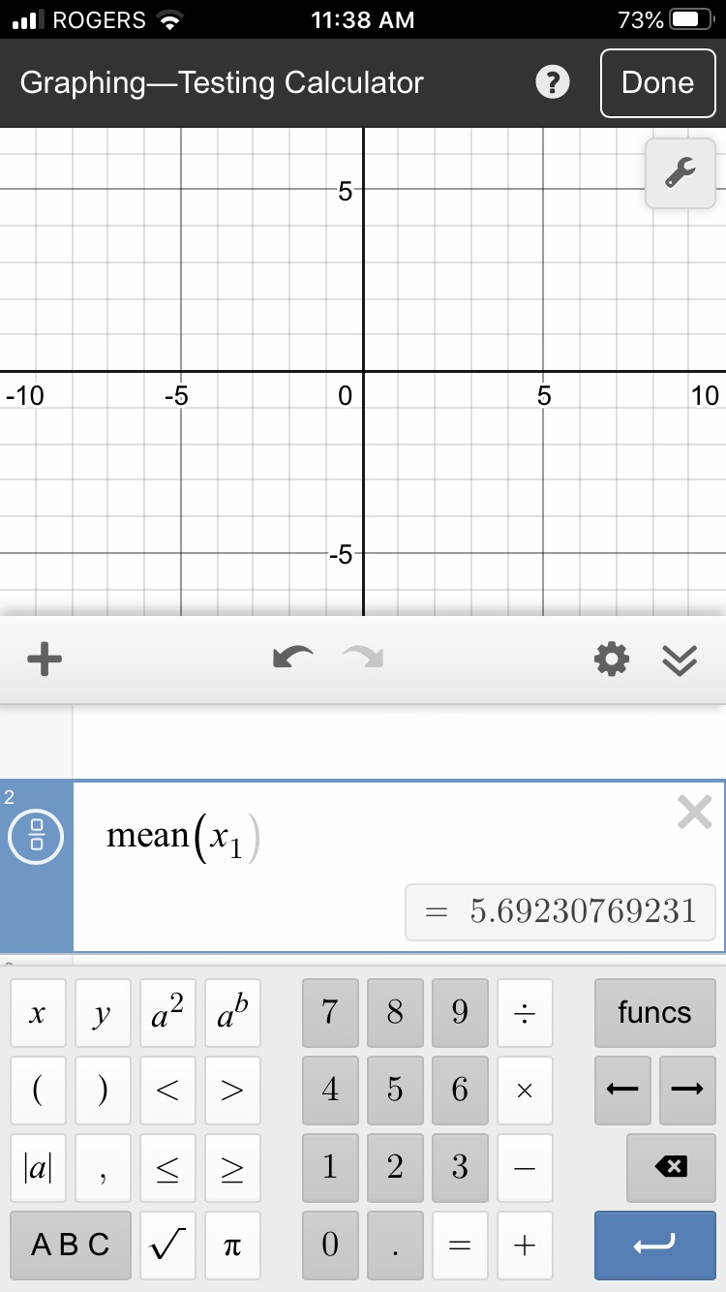
Using Desmos for Mean and Median
Mean = 5.6923
Median = 6

Slide 16
Thirty AA batteries were tested to determine how long they would last. The results, to the nearest minute, were recorded as follows: 423, 369, 387, 411, 393, 394, 371, 377, 389, 409, 392, 408, 431, 401, 363, 391, 405, 382, 400, 381, 399, 415, 428, 422, 396, 372, 410, 419, 386, 390
Use Desmos to find the mean and median number of how long a AA battery would last.

Slide 17
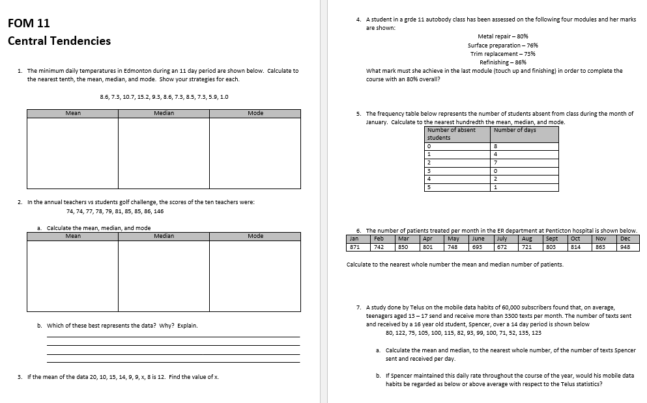
To Do:
Finish for homework if not done

