Slide 1
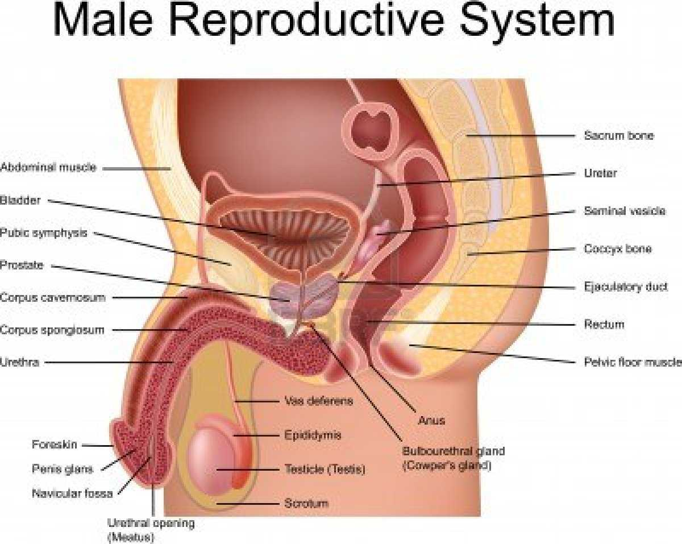
Reproduction
Male Reproductive System

Slide 2
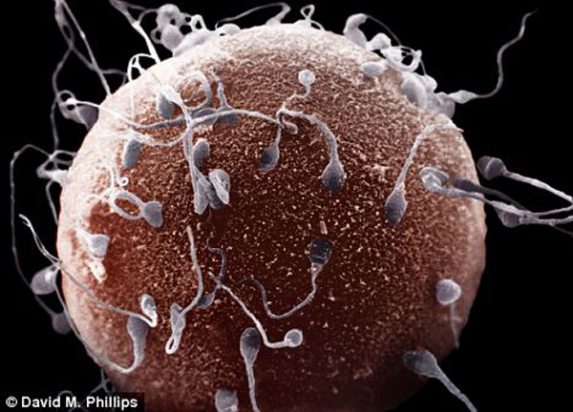
Is reproduction necessary?

Slide 3
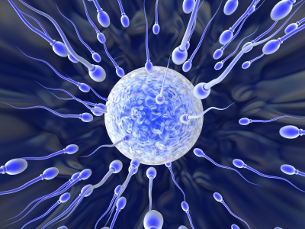
The purpose of the reproductive system is to pass on your genes to the next generation
Fitness in animals is about passing on your genes to the most babies (not necessarily in humans though...)
Reproduction is about making and spreading gametes

Slide 4
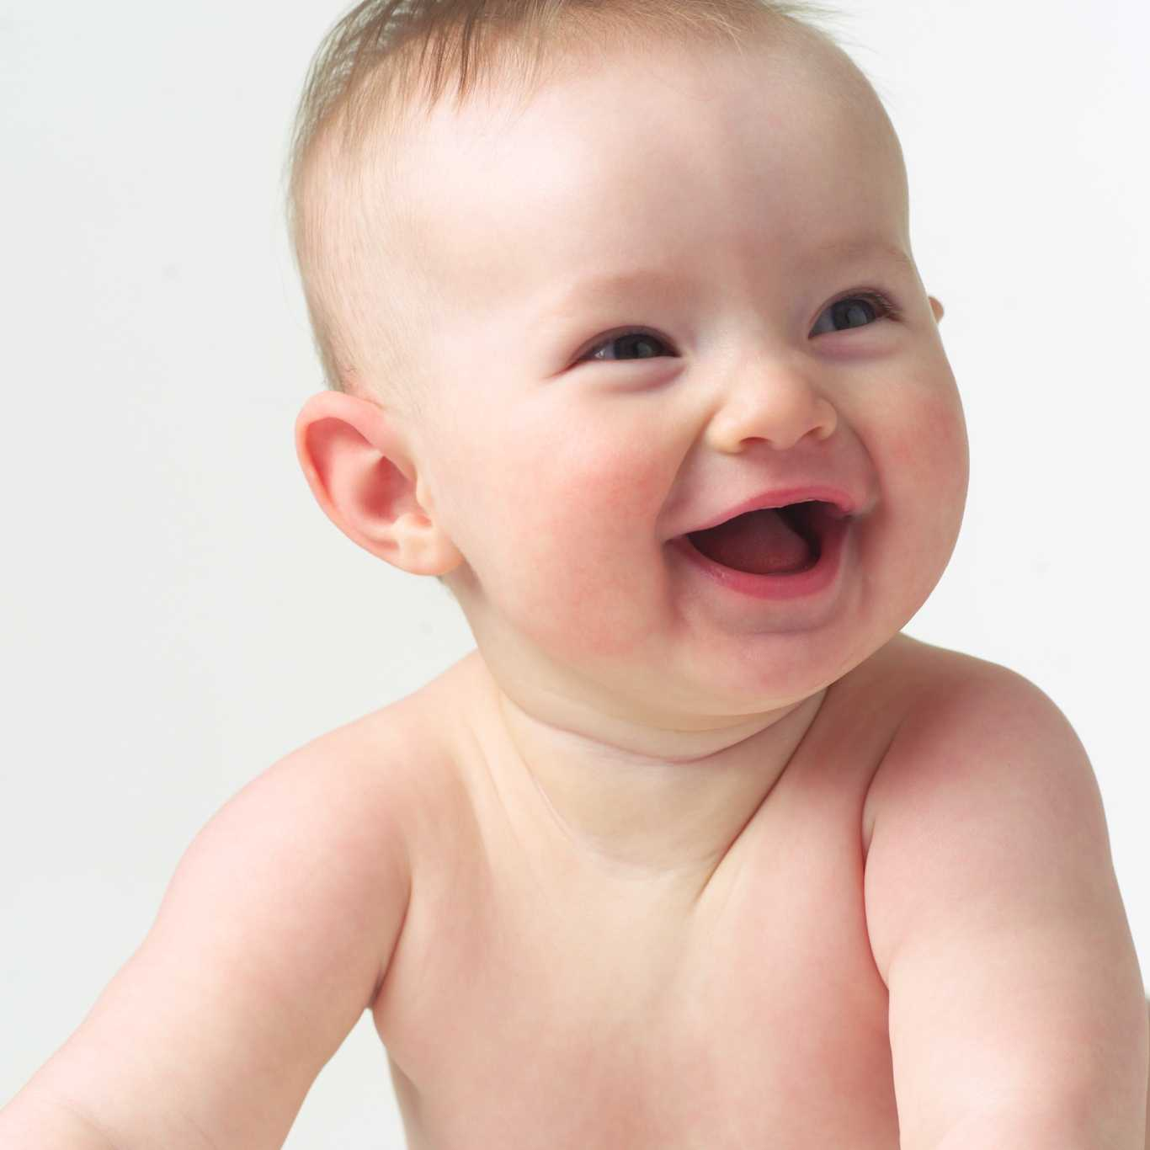
The health of your reproductive system is important so that you are able to reproduce (when you make that decision)

Slide 5
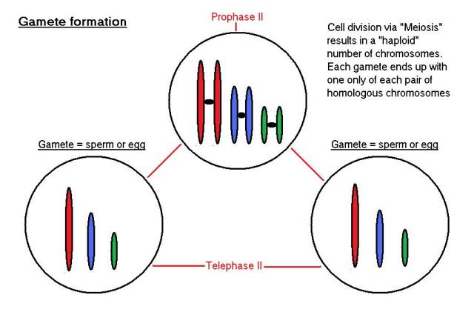
Mitosis vs meiosis?
When does your body do each process and why?

Slide 6
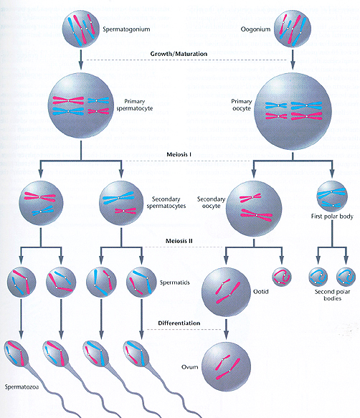
Male vs. female meiosis?
What is the difference?
Why might this be?

Slide 7
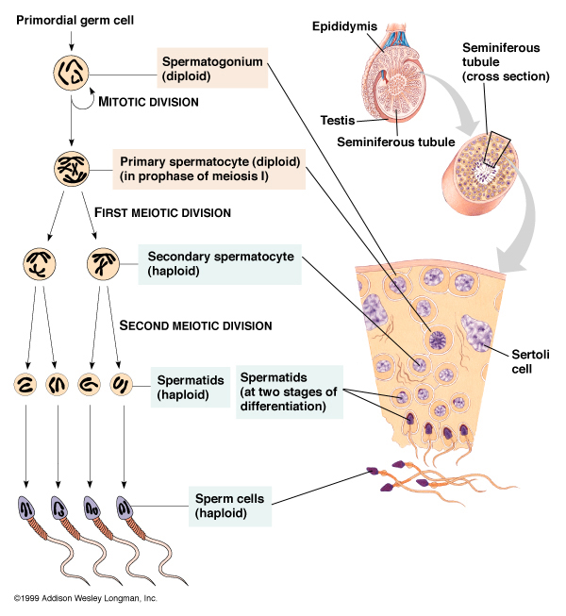
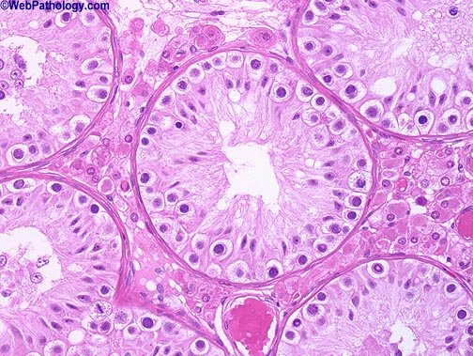
Spermatogenesis
BETWEEN the sertoli cells of the seminiferous tubules in the testes
Which is a sertoli cell and which is a leydig cell? Why do you think?

Slide 8
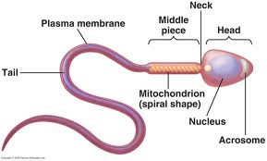
Gametes - Sperm
1. Head of sperm houses nucleus with chromosomes
2. Acrosome houses the enzymes needed to break through the covering the ovum
3. Mitochondria will create ATP for energy for the sperm to be able to move
4. Tail creates a whip-like motion for the sperm to move and find the ovum

Slide 9
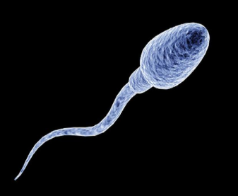
Facts About Sperm
Sperm stay alive for 24 - 48 hours inside female reproductive tract
tails of sperm have "odour receptors" and scientists now believe that they "smell" towards the egg as a sensing of which fallopian tube to travel up
50 - 500 million sperm per ejaculate

Slide 10
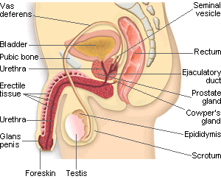
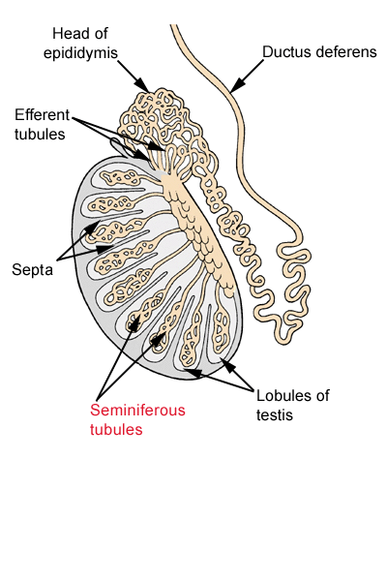
Path of the Sperm
Why might a longer tube for sperm production be an evolutionary advantage?

Slide 11
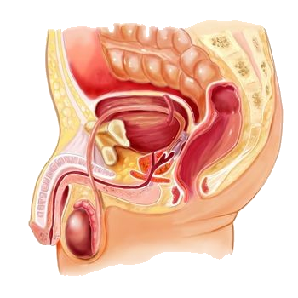
3 accessory Glands of the Male Reproductive System
1. Seminal vesicle
a. makes up 65% of the seminal fluid
b. makes the semen an alkaline solution (neutralize acidity of vagina)
c. adds citrate (for Kreb's cycle) to make ATP
d. adds fructose (for glycolysis) to make ATP
e. adds prostaglandins (causes muscle contractions in vagina)
2. Prostrate Gland
a. makes up 30% of seminal fluid
b. adds zinc (stabilizes health of DNA)
3. Cowper's Gland (also called bulbourethral gland)
a. makes up less than 1% of the seminal fluid
b. pre-ejaculate
c. neutralizes the urine that might be left in the urethra

Slide 12
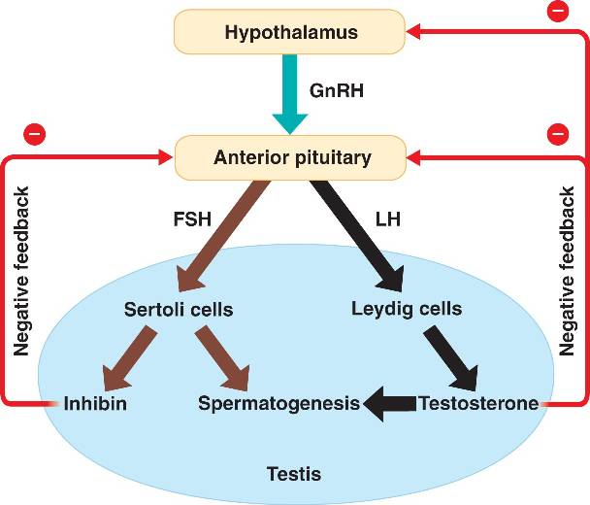
Hormones of Male Reproductive System

Slide 13
Hormones of Male Reproductive System
FSH (from pituitary gland)
Follicle Stimulating Hormone
GnRH (from hypothallamus)
Gonadotrophic Releasing Hormone
Stimulates the pituitary gland to release LH and FSH hormones
stimulates the testis to start making sperm
Testosterone
(from interstitial cells in testis)
maintains the secondary sex characteristics that develop at puberty
LH (from pituitary gland)
Luteinizing Hormone
Controls the release of testosterone

Slide 14
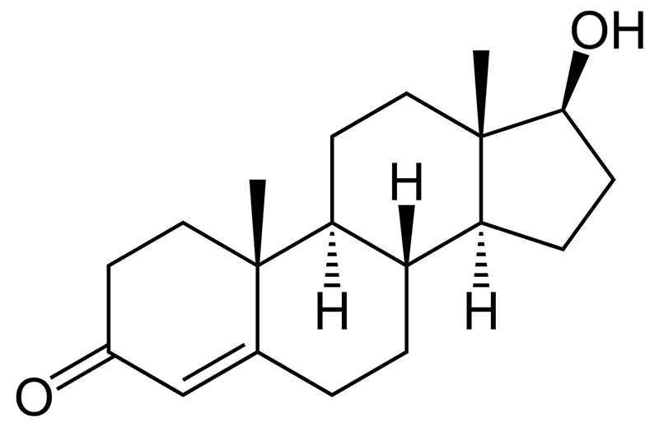
Testosterone
What type of macromolecule does this look like?

Slide 15
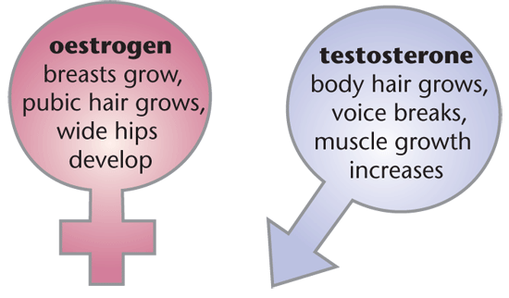
Secondary Sex Characteristics of Males
1. increased muscles
2. increased height growth
3. deeper voice
4. increase in hair growth (body and pubic hair)
5. receding hair line and pattern baldness

Slide 16
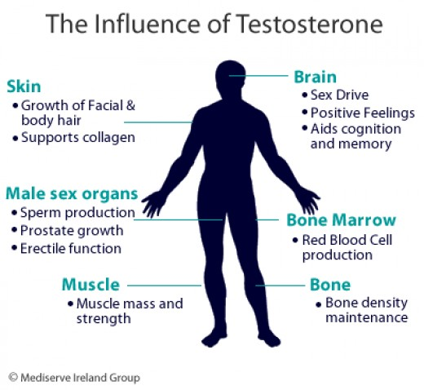

Slide 17
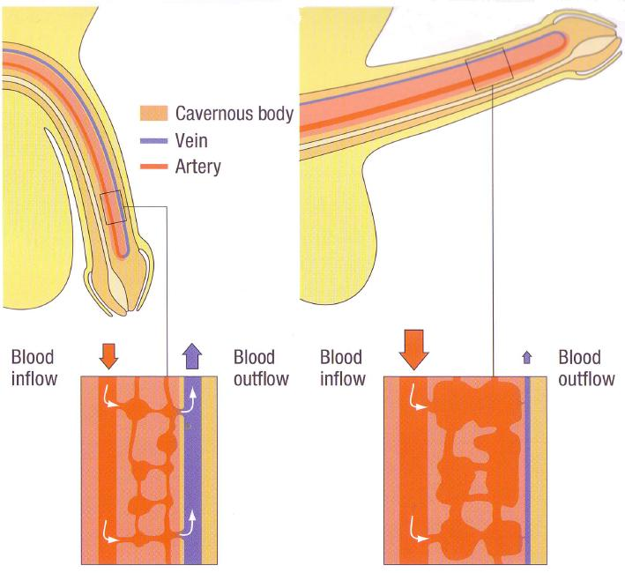
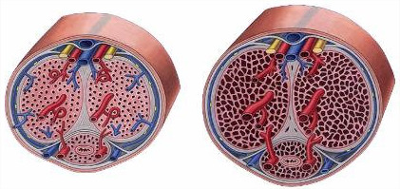
How does an erection occur?
Increase inflow of arterial blood
Decrease outflow of venous blood

Slide 18
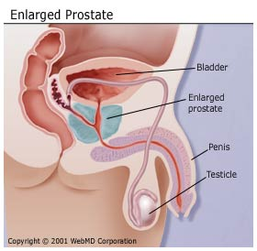
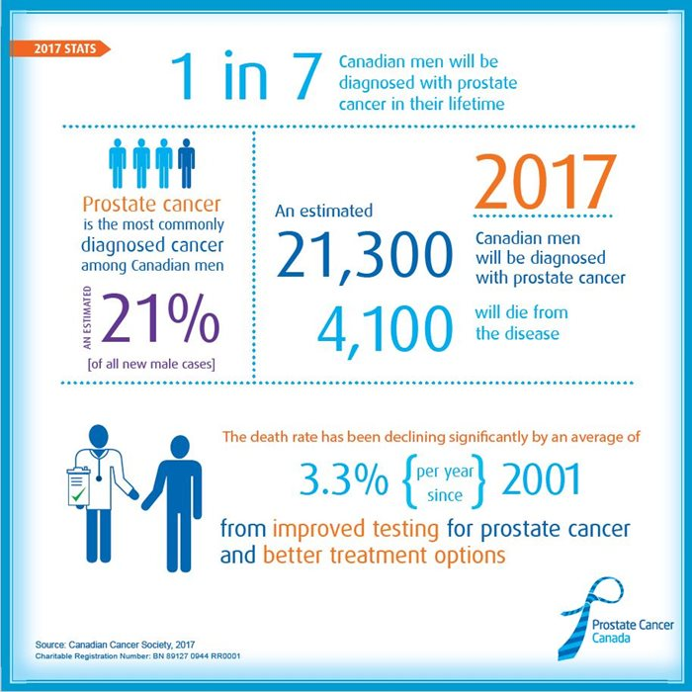
Health Issues Related to Male Reproductive System
Prostrate Issues
symptoms include inability to urinate
Swollen prostate can pinch urethra

Slide 19
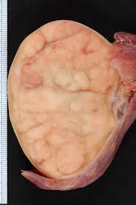
Health Issues Related to Male Reproductive System
Testicular Cancer
symptoms include a lump or swollen testicle and/or aching of abdomen or groin
do an ultrasound of testicle
occurs most often in men age 20 - 39
men do self testicular exams

Slide 20
1. Draw the various parts of the male reproductive system:
seminiferous tubules
epididymus
vas deferens
seminal vesicle
prostrate gland
ejaculatory duct
cowpers gland (bulbourethra)
urethra
2. Draw the male hormone feedback loop for the following hormones:
GnRH
LH
FSH
Testosterone

Slide 21
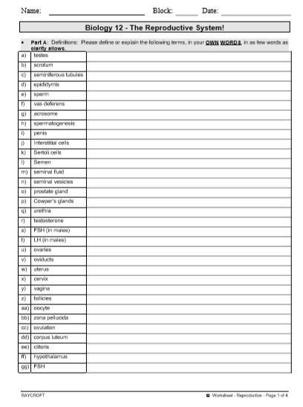
Worksheet of structure and function

