Slide 1
Loans
FOM 11

Slide 2
What is a loan?
When you borrow money from a financial institution.
The loan could be for:
A car
A house
Personal
Business
When you play back the loan (in smaller payments) you have to may an interest on the money you borrowed
The longer you owe the money, the more you pay

Slide 3
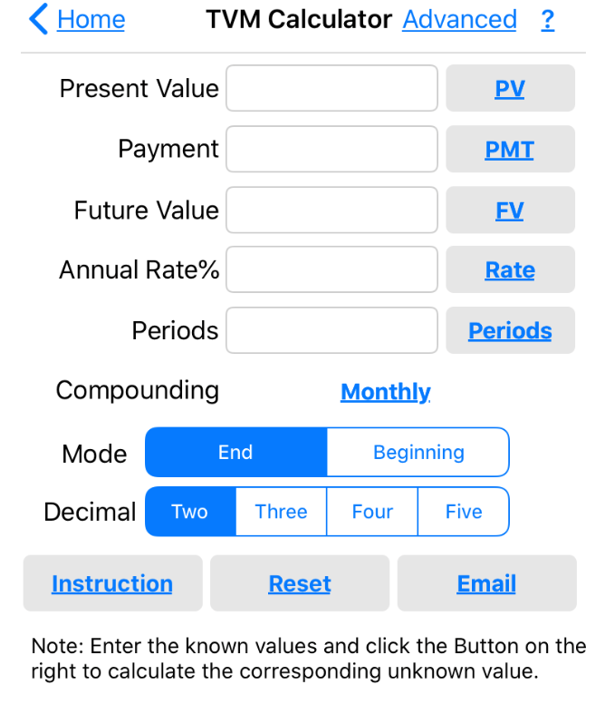
Sam borrows $7500 from a bank to buy a used car. The bank issuing him the loan charges 8.25% interest per year compounded monthly. If Sam makes $175 monthly payments at the end of the month for 4 years, how much of the loan does he have left to repay?
How much does Sam owe after the 4 years?
If Sam wanted to pay it all off, how long will it take him?
How much did the car really cost Sam?

Slide 4
Darma applied for a loan to have her basement renovated. The contractor has estimated it will cost her $13,700 for the renovation. She had already saved $7000 so she would only have to receive a loan for the remaining amount. She paid the loan off in 4 years with payments of $175 at the end of each month.
What was the annual rate of interest if the interest was compound quarterly?

Slide 5
Consumer Credit
When you purchase an item from a store, but don’t pay for it outright.
You pay for it in smaller installments
Interest charges apply
You end of up paying MORE than the price tag, but in small increments

Slide 6
Susie buys a couch from the Brick. She arranges to pay for it in 24 monthly installments of $170.
How much did Susie pay for the couch?
How much did Susie pay for the couch?

Slide 7
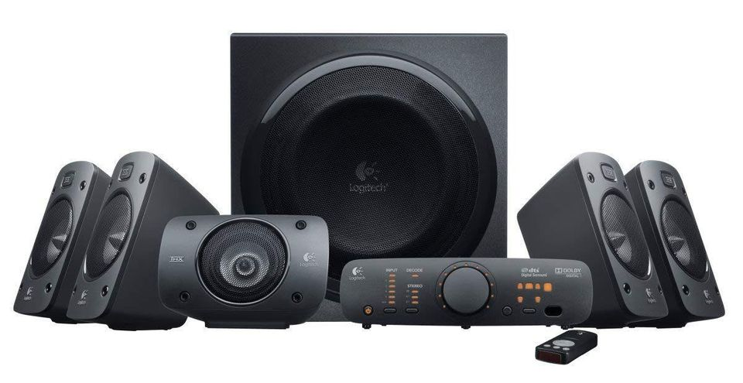
You see the following advertisement. You want to buy the home system, but you only have $1000. Which is your best option and WHY?
Purchase a new home theatre audio system!
Option A: pay $5000 now
Option B: No payment for 12 months, then 36 months of $205
Option C: 12.5% down plus 48 payments of $130

Slide 8
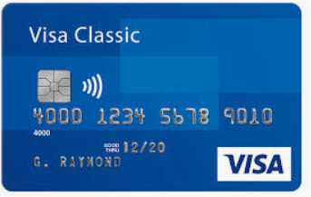
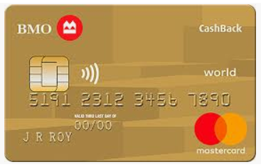
Credit Cards
A form of consumer credit
Usually managed by banks
The bank will pay your bill to the store for you, and in exchange, you will pay it back to them with interest (usually large interest→ 12 - 38%)
Terms of credit card company:
No interest is charged if the entire balance is paid by the payment due date
Cash advances – payment due is 21 days after statement date
Interest on balance owing is calculated from the date the transaction was poste until the current statement date
Usually the minimum monthly payment is 3% of the statement, or $10, whichever is greater

Slide 9
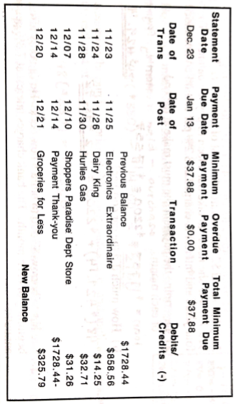
What is the $1728.44 mean?
What is the current balance owing?
Why is the “date of post” different than the “date of transaction”?

