Slide 1
Lipids
Biology 12

Slide 2
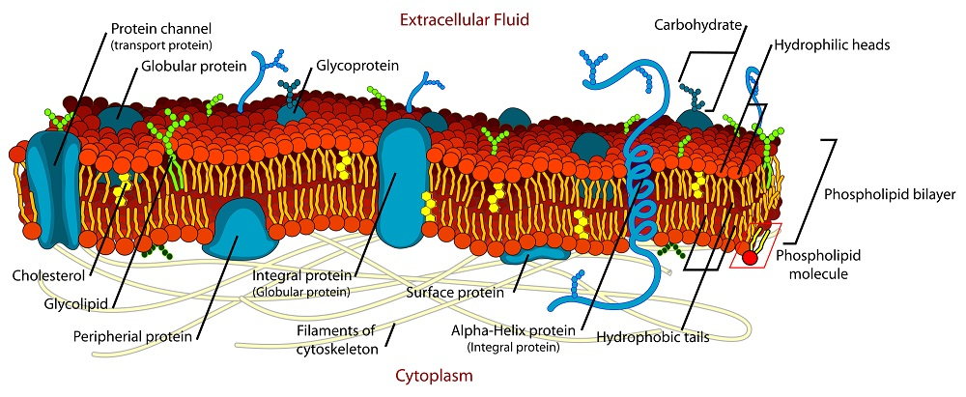
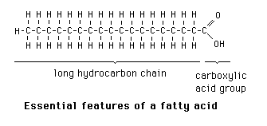
Role of lipids
Make up fats, oils, and waxes
Provide energy for cells
Cell structure (make up the cell membrane) – phospholipid bilayer
Nervous system myelin sheath
Insulation
Cholesterol in membrane
Have C, H, O, and sometimes P
Hydrophobic (repel water)

Slide 3
Fats are very energy dense

Slide 4
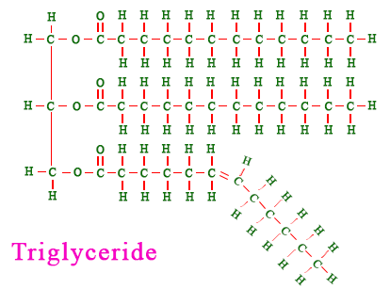
Vocab To Know
Monomer: fatty acid and glycerol
Polymer: Triglyceride

Slide 5
Saturated and Unsaturated Fatty Acid

Slide 6
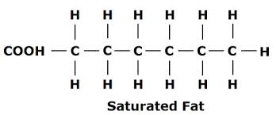
Saturated Fatty Acid
“full” or saturated with hydrogen atoms
Only single bonds
Stackable molecule
Solid at room temperature
Typically animal fats (bacon, hamburger meat, etc), but also coconut oil

Slide 7
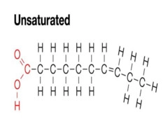
Unsaturated Fatty Acid
Has at least 1 double bond
The double bond causes a “kink” in the molecule
liquid at room temperature
Typically plant fats (olive oil, corn oil, etc)

Slide 8
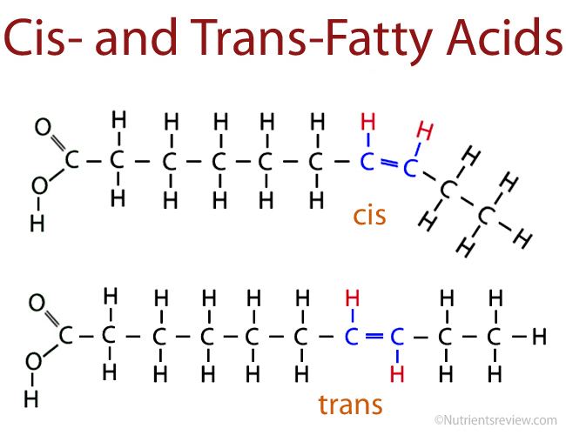
Unsaturated Fatty Acid

Slide 9
Trans Fat
Trans fats come from adding hydrogen to vegetable oil (unsaturated fats) through a process called hydrogenation.

Slide 10
Omega 3
Double bond is at C3
Essential fatty acids
Fatty acid that we can not make on our own
Must eat it
fish

Slide 11
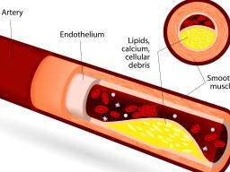
Atherosclerosis

Slide 12
What questions do you have about lipids in your diet?

Slide 13
Become the Expert
You and your table team will choose a question that interests you
You will create a 5 slide KEYNOTE that looks at BOTH SIDES of the equation

