Slide 1
Buying, Renting, Leasing
FOM 11

Slide 2
What is a lease?
An alternative to purchasing an expensive product is to lease it
Monthly payments are made to the leasing company to cover depreciation, taxes, and interest
When you are done your “lease” the vehicle is not owned, and a buy out is offered
The lease-end value is what is left to pay in order to own the vehicle

Slide 3
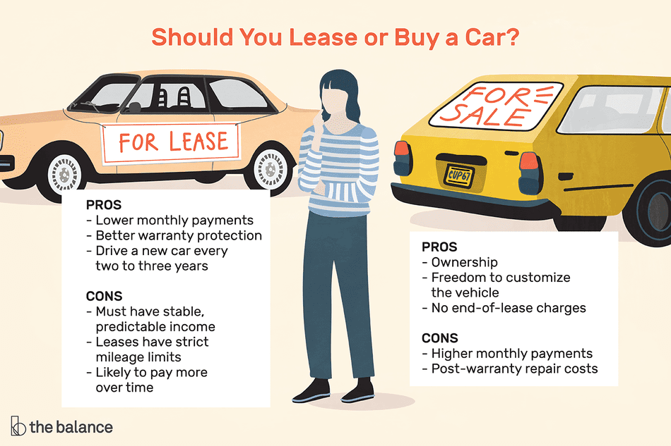
Watch video
Consumer Report

Slide 4
Why a Lease?
Positives
Results in lower monthly payments than a loan
Works well for people who incomes are not large enough to afford monthly payments
Works well if you want a new vehicle every few years
This is good for work vehicles
Negatives
You do not own the vehicle at the end

Slide 5
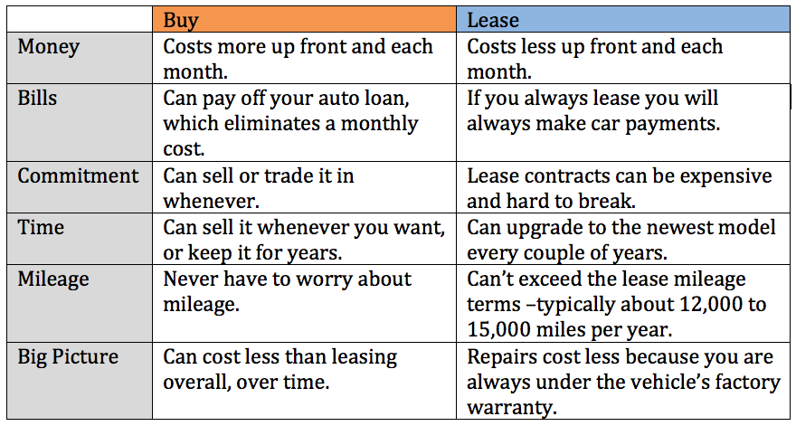

Slide 6
Using a TVM Solver for Leases
Set the mode to BEGINNING
The Future Value is the residual value
The Future Value is negative

Slide 7
Rules of Leasing
GST (5%) and PST (7%) is calculated on the deposit and then divided by the number of payments in the lease (add this to the monthly lease payment)
May or my not require a low payment
There is a pre-agreed buyout options

Slide 8
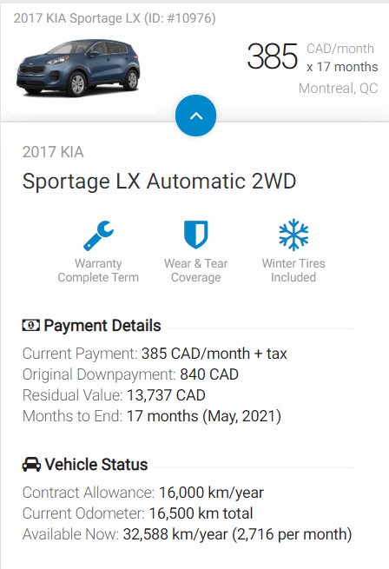
Leasing Example #1
You are buying a new car. You decide for a lease option. You are leasing to own. How much is this car going to totally cost you?
Steps:
Calculate tax on down payment (divide by # months and add to payment)
Calculate total payment (with 12% tax)
Total payment amount ($ x months)
Add down payment & residual value (amount left to own)

Slide 9
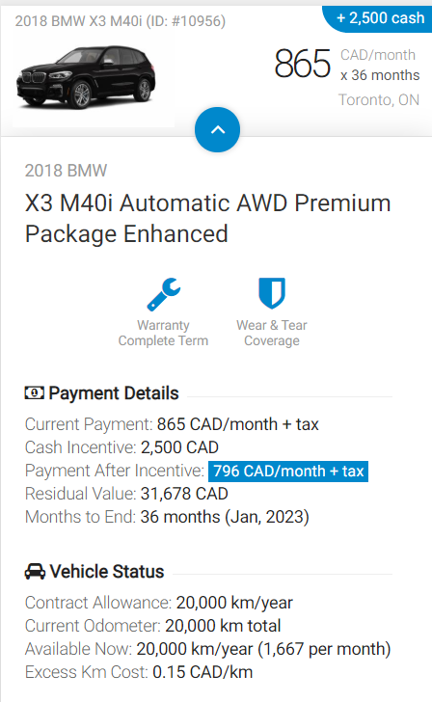
Leasing Example #2
You want a used BMW. You find this deal. How much will this used vehicle cost you in the end?
Steps:
Calculate tax on down payment (divide by # months and add to payment)
Calculate total payment (with 12% tax)
Total payment amount ($ x months)
Add down payment & residual value (amount left to own)

Slide 10
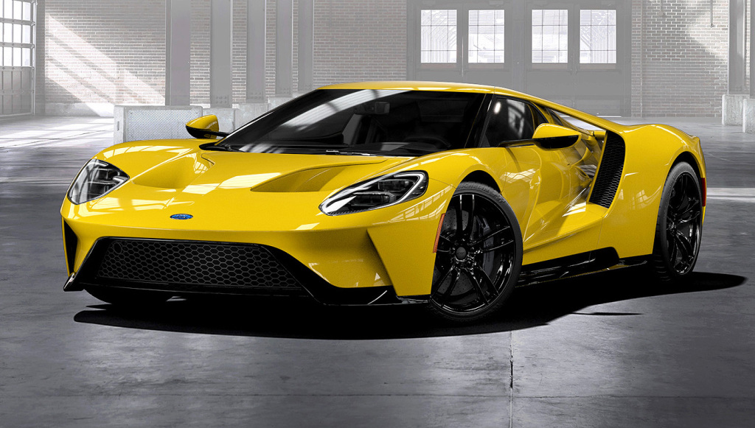
Leasing Example #3
Remember:
Set to BEGINNING
Residual Value is FV
Residual Value is negative
A sports car with a purchase price of $42,000 is leased for 4 years. Interest is 4.5% per annum, compounded monthly and the residual value is $15750. A down payment of $3000 is made. What is the monthly payment? How much have you paid for the car in order to own it?
Taxes on down payment →
Taxes on down payment per month →
Taxes on monthly payment →
Total monthly payment ($ + taxes + down payment taxes) →
Total $ → Down payment + total payments + residual value

Slide 11
A SUV is advertised with a purchase price of $32,000. You are considering the following options to buy the vehicle.
Option #1 → Purchase the vehicle with a loan
Down payment $5000
Interest rate on the loan is 5.5% per annum, compounded monthly
Monthly payments are made for 3 years
Option #2 → Lease the vehicle
No down payment required, but you choose to put a down payment of $5000
The lease payment is $449.68 per month + taxes for 3 years
Buy out option is $16, 865. 72
Which will you choose and WHY?

Slide 12
You decide you are going to buy a new truck with a lease. You decide you are not going to pay a deposit. The truck is priced at $34800 and the lease is calculated at 6.9% compounded monthly for four years.

Slide 13
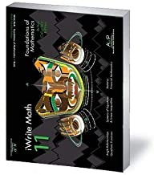
Workbook Practice
Page 360
#1 - 6

