Slide 1
Montreal, Kyoto, & Paris Agreements
Environmental Sciences 11/12
June 3rd, 2020

Slide 2
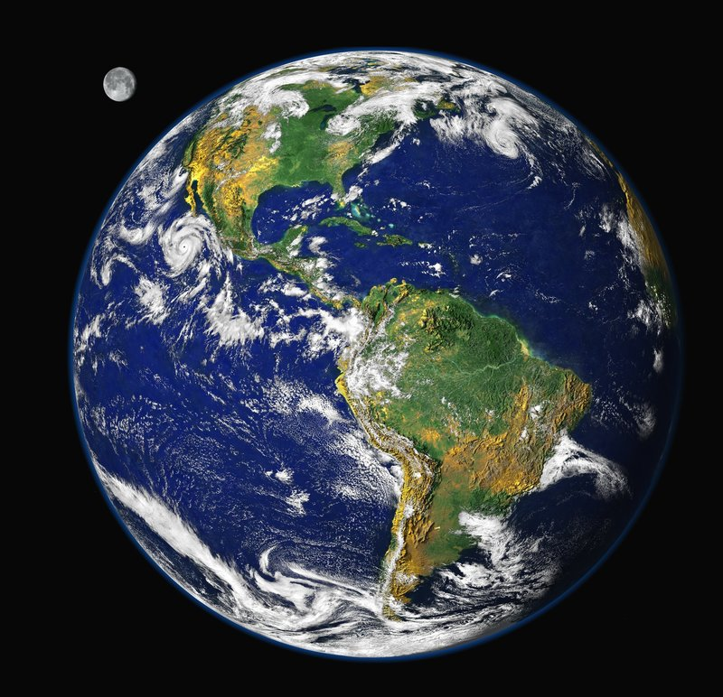
Three main global agreements focused on our environment and atmosphere
Montreal Protocol (1987) – CFC’s
Kyoto Protocol (1997) – GHG’s
Paris Protocol (2016) - 2ºC

Slide 3
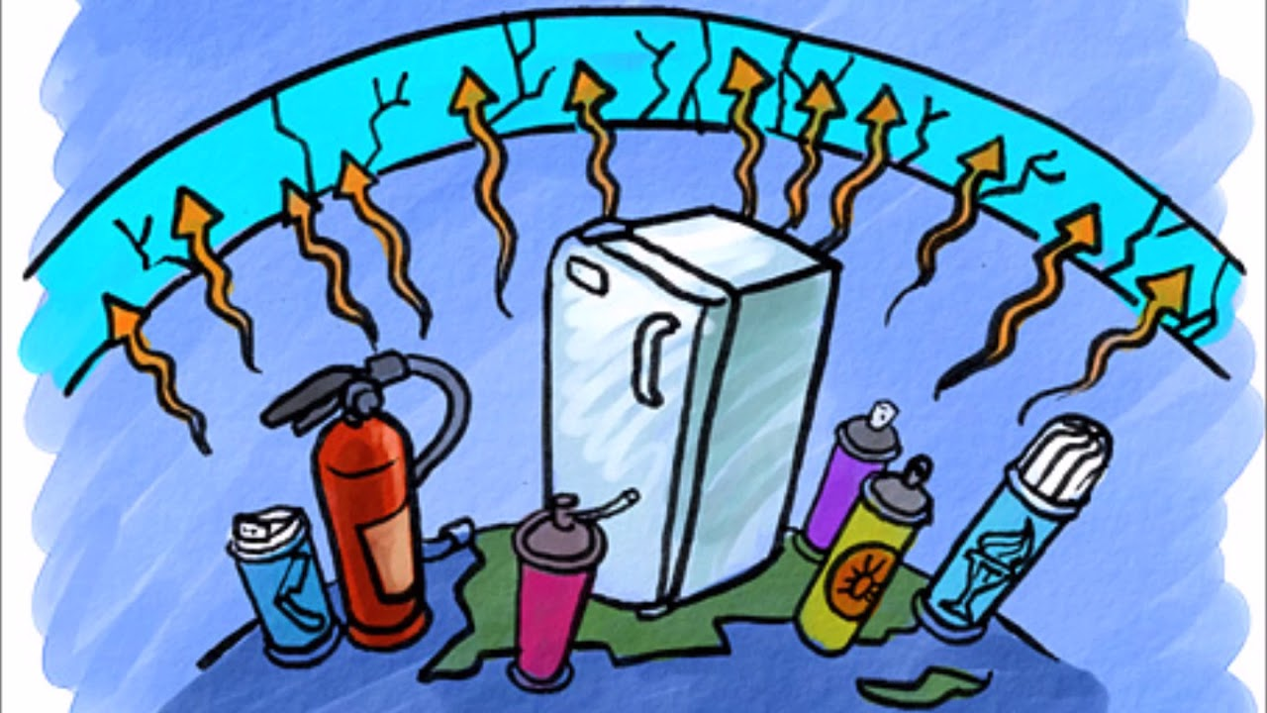
Chlorofluorocarbons
Created to be used for aerosols and coolants

Slide 4
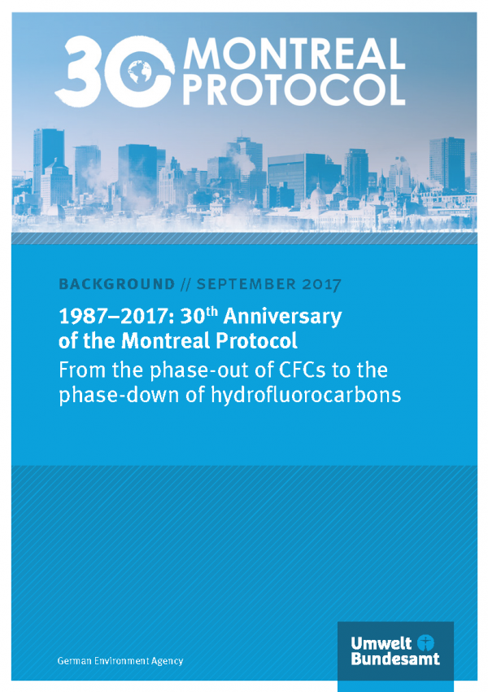
Montreal Protocol (1987)
In 1985 discovered that there was a hole in the ozone over the Arctic
1987 – 30 countries signed Montreal Protocol
Since, now signed by 197 UN countries
Created a list of controlled substances (CFC focused)

Slide 6
Montreal Protocol (1987)
Ban on the production of CFC’s and halons
Timelines for both developed and developing countries
Countries met often and added new banned and restricted substances
Signs that the ozone layer is healing (expected to be completely healed by 2050)

Slide 7
Montreal Protocol (1987)
Developed countries to reduce their consumption of HCFCs and will completely phase them out by 2020.
Developing countries agreed to start their phase out process in 2013 and are now in a phase-out of HCFCs by 2030.

Slide 9
U.N.F.C.C.C. (1992) United Nations Framework Convention on Climate Change
stabilize greenhouse gas concentrations in the atmosphere at a level that would prevent dangerous anthropogenic interference (human produced GHG) with the climate system

Slide 10
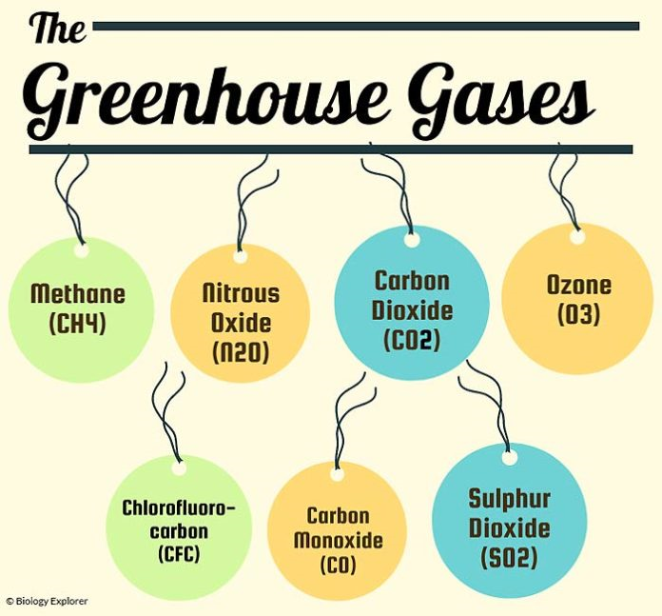
Green house Gases
Methane
Nitrous oxide
Carbon dioxide
Bad ozone
Hydrochlorofluorocarbon
Sulphur dioxide

Slide 11
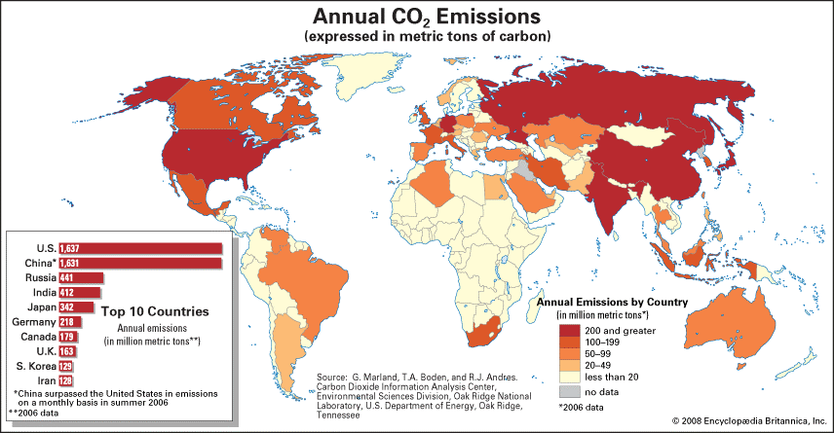

Slide 12
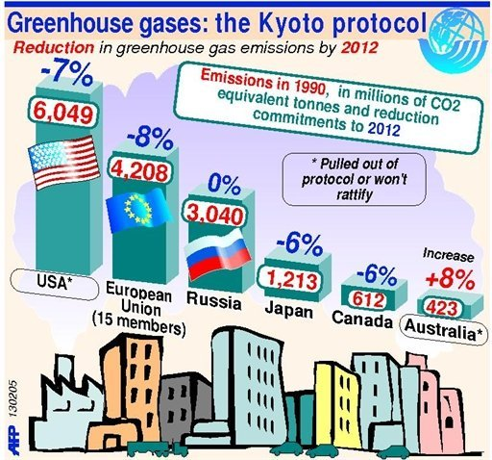
Kyoto Protocal
Main objective:
Reduce greenhouse gasses in developed countries
25-40% decrease of emissions for developed countries

Slide 13
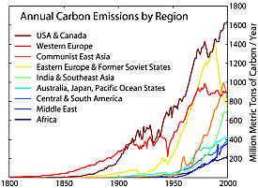
Kyoto Protocal
international plan to slow global warming (signed Dec 1997)
try to reduce global greenhouse gas to 5.2% below 1990 levels.
use a carbon credit system to balance production of carbon dioxide with reduction programs
Agreement went into force in February of 2005, fees to be paid if not reached goal in 2012
Not ratified by only two developed countries:
U.S. and Australia

Slide 14
Kyoto Protocal (Canada)
Canada's Kyoto target was a 6% total reduction in greenhouse gas (GHG) emissions by 2012
greenhouse gas emissions increased approximately 24.1% between 1990 and 2008
Canada withdrew 2012

Slide 16
Why Canada Left Kyoto in 2012
Actions were never taken to limit CO₂ in industry, so not near 2012 targets
Focus recently on oil industry
Would have received over $14 billion in penalties if not reach targets

Slide 18
Paris agreement
Focus on reducing fossil fuel use
Large contributor to release of CO₂ into atmosphere
Divide up responsibility between developed and developing countries
Developed countries provide $$ to developing countries to help support clean energy use

Slide 19
Paris agreement
December 2015 (ratified Sept 2016)
195 countries
Hold temperature increase to below 2º C (for 2030)
Aim for 1.5ºC
All countries have to cut emissions by they are allowed to set own national objectives
Check in every 5 years
No financial penalties if do not reach goal
US withdraw

Slide 20
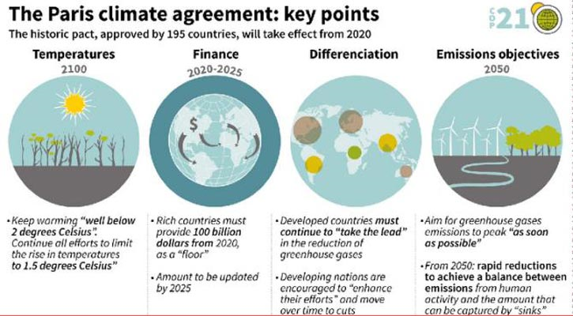

Slide 21
Paris agreement – Canada’s Actions
Committed to giving $2.65 billion of climate finance to developing countries
Help developing countries to transition to low carbon options
By 2030 cut emissions by 30% from 2005 levels
Phase out coal-fired powerplants
Alberta and NS are main two provinces in Canada with Coal-fired powerplants
BC has 0 coal pp, but we produce coal for export
30% of all passenger vehicles sold by 2030 will be zero-emissions
100% of all passenger vehicles sold by 2040 will be zero-emissions

Slide 22
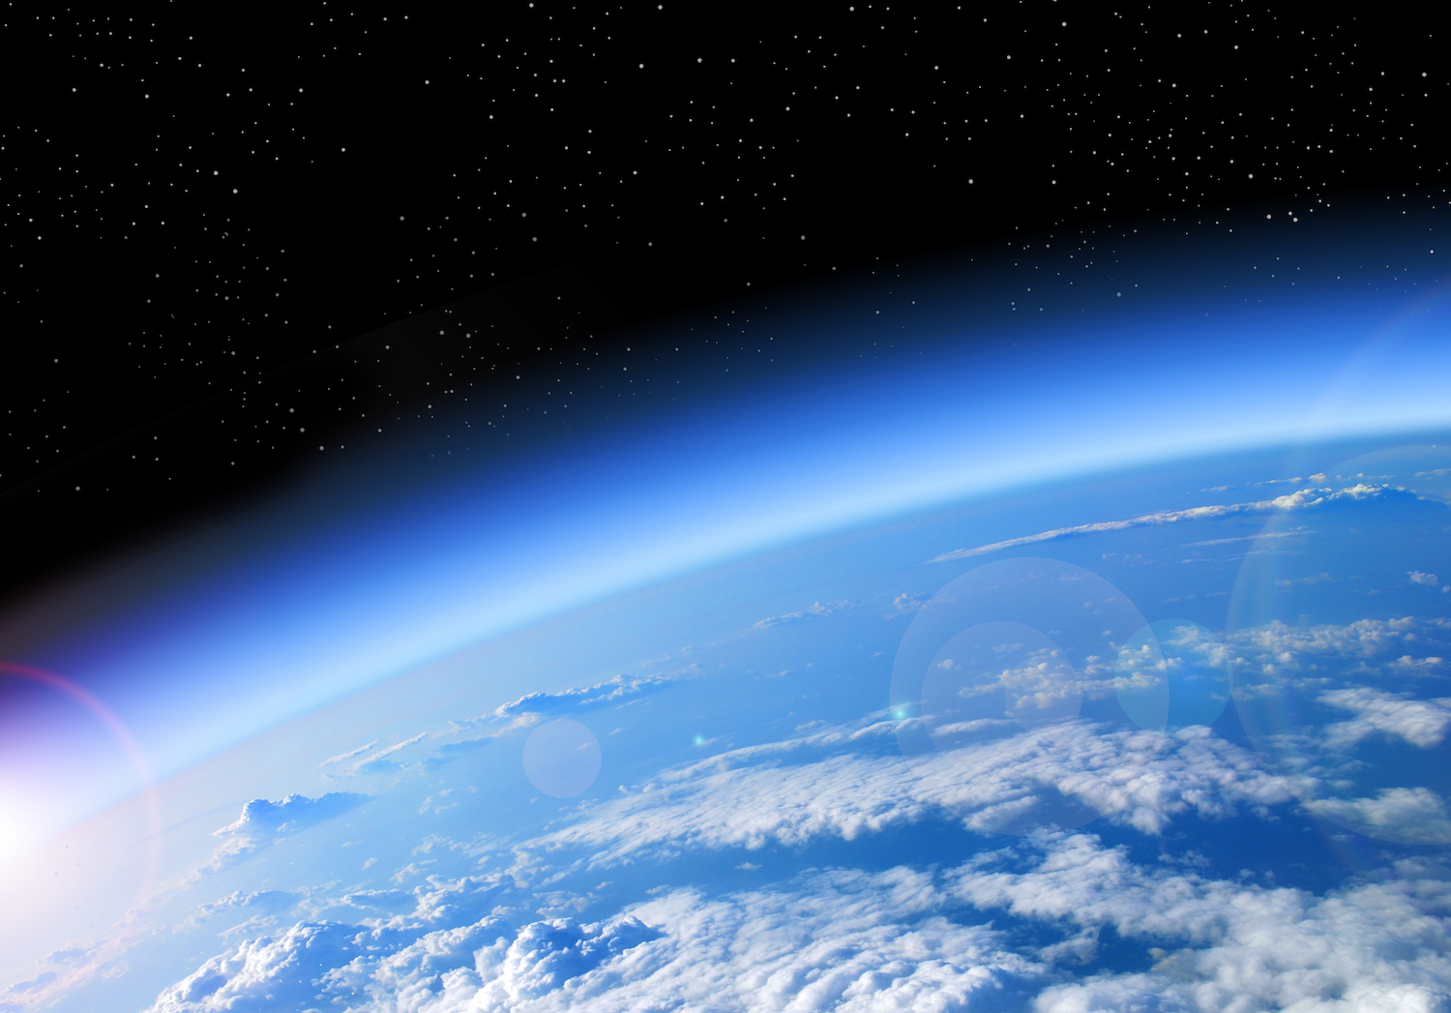
Our Atmosphere Project
Due June 12th (two week project)
Choose 1 of the 4 options
Extreme Weather
Food Security
Local Action Options
Take Action

Slide 23
Our Atmosphere Project
Due June 12th (two week project)
Choose 1 of the 4 options
Weather

Slide 25
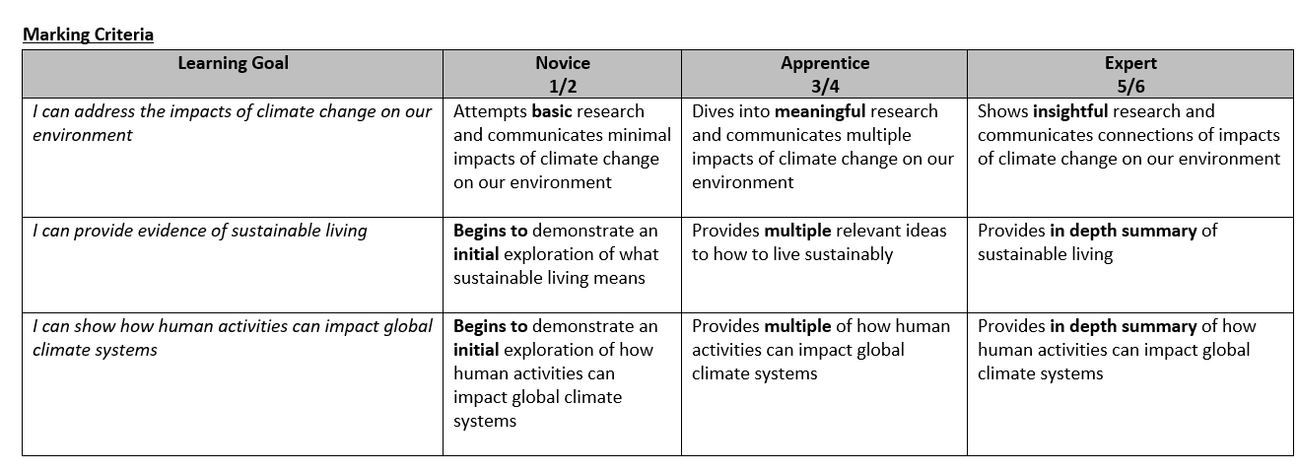

Slide 26
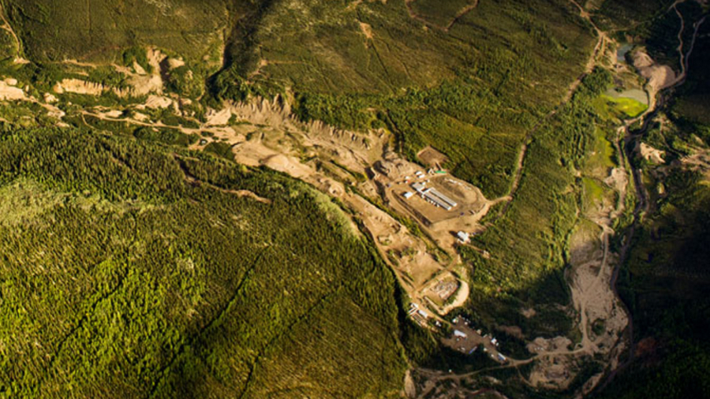
Guest Speaker Gold Mining and Gold Exploration
Taylor and Riley Ledoux
Working for Mining Company to explore and discover gold in Yukon and Whitehorse
UBC Vancouver Geology (undergrad and masters)
Thursday, June 4th
1pm – 1:30pm
Look for invite in your school email

Slide 27
Rest of the Year
2 more projects
No final exam
2 more lessons
2 more guest speakers
June 8 – 12: Carbon Recapture Technologies
Atmosphere Project Due June 12th
June 15 – 19: Final Project (Course Big Ideas)
You give input on your grade (%) based on evidence of Term 3 and 4 projects and participation
June 22 – 24: “I” Days for anyone who has not completed projects (in school)

