Slide 1
The Circulatory System
Bio 12

Slide 2
Last Days Nuggets
Draw the 3 steps of cellular respiration. What is made and used in each step?

Slide 3
Let’s Ready the Brain…
What do you already know about the circulatory system?

Slide 4
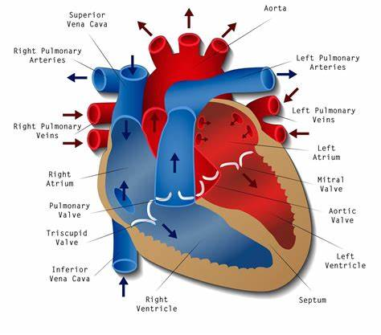
The Heart
Three main tissues that make up heart:
Endocardium (membrane lining inside)
Myocardium (muscle tissue of the heart)
Pericardium (membrane sac surrounding the heart)

Slide 5
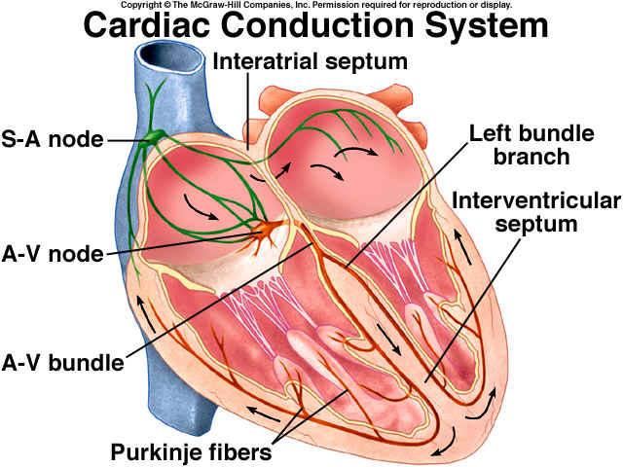
Heart Beat Video
What do you notice?
What do you wonder?

Slide 6
Regulation of the heartbeat
The heartbeat is controlled both intrinsically and extrinsically:
Intrinsic means that the beat is regulated by mechanisms within the heart and not by the brain.
Extrinsic means that it also can be slowed down or sped up by brain impulses.

Slide 7
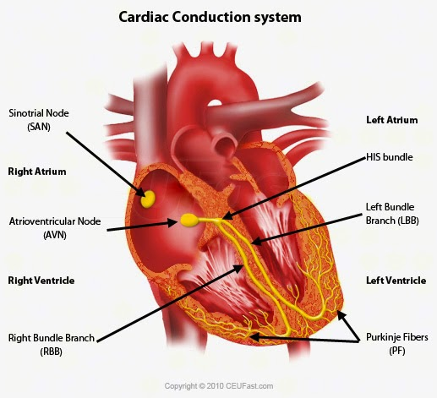
Intrinsic Heart Control
The heart has special nerve tissue imbedded within the cardiac cells (myocardium)
This includes the:
AV node – Atrioventricular
SA node – Sinoatrial node
Purkinje Fibers

Slide 8
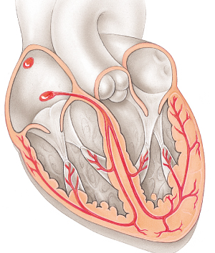
Sinoatrial (SA) node
SA node is the Pacemaker of the heart.
It starts an impulse every .85 seconds or 70 beats a minute
Once it triggers an impulse the heart contracts in an orderly fashion:
Triggers contraction of atria
Stimulates the AV node

Slide 9
Atrioventricular (AV) node
DELAY box
Once the impulse reaches here it is delayed a moment to wait for atria to empty
The impulse is sent down the septum to the Purkinje fibers
These fibers trigger ventricular contraction from the bottom up moving the blood out of the heart toward the exits

Slide 10
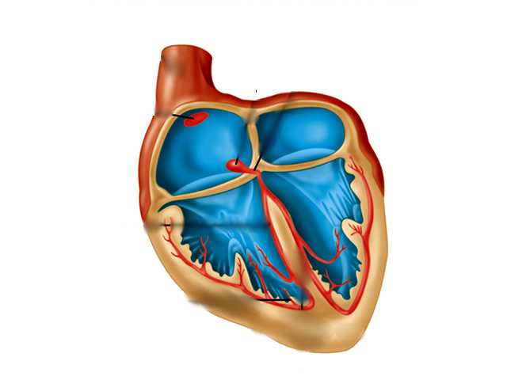
The special conducting system
Atrioventricular node
DELAY BOX
PACEMAKER
Bundle of His
Sinoatrial
node
Right
Bundle Branch
Purkinje
Fibres
RAPID CONDUCTION SYSTEM

Slide 11
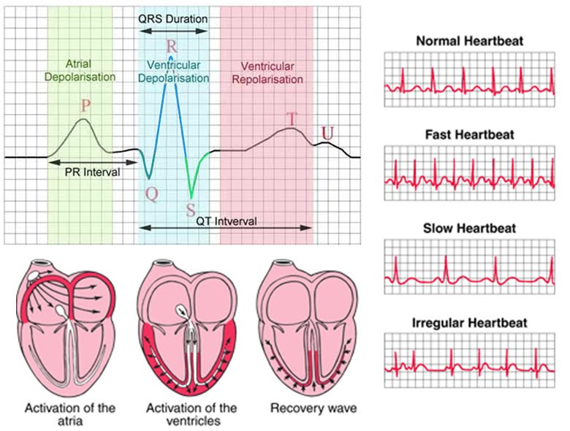

Slide 12
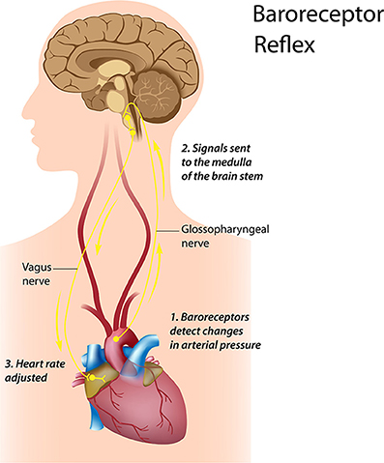
Extrinsic Heart Control
Impulses from the brain control speed of the heartbeat
They are sent from the Cardiac centers which lie within the Medulla Oblongata
It is part of the ANS (autonomic nervous system) control system

Slide 13
Parasympathetic innervation
“rest and digest” slows heart rate
Neurotransmitter Acetylcholine is used (Ach)
Neurons from the medulla release this chemical at the SA & AV node which slow the heart rate.

Slide 14
Sympathetic innervation
speed up the heart rate
Neurotransmitter Norepinephrine is used
Neurons from the medulla release this chemical at the SA & AV node which speed the heart rate.

Slide 15
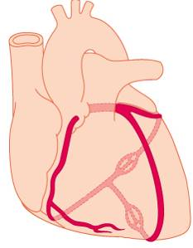
Coronary circulation
You need to supply the heart cells with lots of quick high oxygenated blood so that it can make lots of ATP using the O₂
Left coronary artery
Right coronary artery
It is when these 2 are blocked that you get a heart attack
Both come immediately from ascending aorta

Slide 16
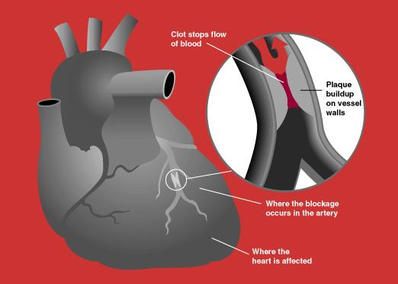
Heart Attack

Slide 17
What foods/nutrients should be limited and specifically what foods/nutrients are beneficial and why?
Diets that are high in cholesterol, fats, and oils greatly increase the risk of atherosclerosis or hardened arteries, high blood pressure, and obesity (more than 20% over one's ideal weight).
Saturated fats damage the arteries, raise blood cholesterol and triglyceride levels, and expedite plaque formation.
High salt intake and excessive alcohol consumption can increase blood pressure, which in turn strains the heart muscle.
Recommended daily doses:
i. Limit daily saturated fat intake to less than 10% of total calories. ii. Limit daily fat intake to less than 30% of total calories. iii. Limit daily cholesterol intake to less than 300 mg. iv. Limit daily sodium intake to less than 2400 mg.

Slide 18
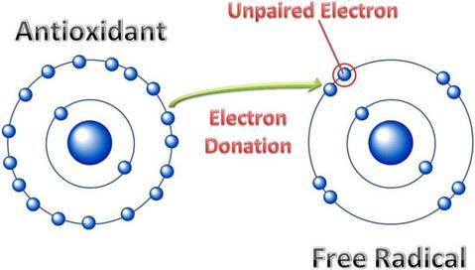
Anti-oxidants
Antioxidants are substances that protect cells from free radical oxidative damage and lessen the effects of LDLs and cholesterol in causing atherosclerosis.
Beta-carotene (vitamin A), vitamin C, vitamin E, and selenium are key antioxidants in a heart-healthy diet.

Slide 19
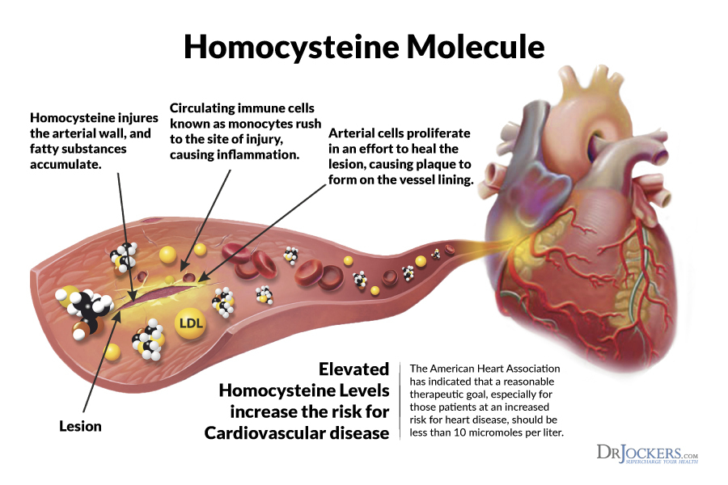
Vitamin B’s
Three B-vitamins have been identified as aids in reducing heart disease because of their ability to lower homocysteine levels and increase the arterial response to the body's need for more oxygen-rich blood: vitamin B-6, vitamin B-12, and folic acid

Slide 20
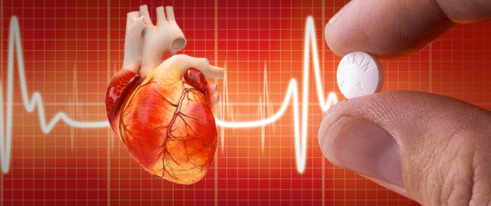
Aspirin
lessens inflammation and risk of blood clots in the arteries and reduces the stickiness of platelets, which can lead to plaque formation.
According to new research, taking a daily low-dose of aspirin (75-150 mg) cannot only lower risk of a repeat heart attack, but it can lower the odds of a first-time attack as well

Slide 21
Blood Work After Heart Attack
Troponin is a protein that is used in cardiac and muscle cells
When heart cells are damaged it releases troponin into the blood as the cell dies
A blood test measuring the amount of troponin tells doctors if you have had a heart attack within the last 10 – 14 days

Slide 22
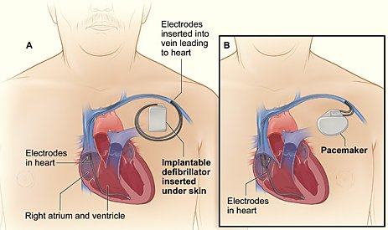
Pacemaker

Slide 23
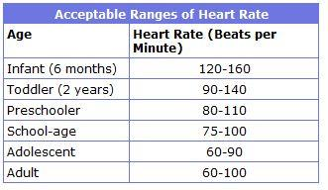
How fast is your heart beating?

Slide 24
Bradycardia/Tachycardia
Tachycardia – faster than 100 beats a minute
Bradycardia less than 60 beats a minute
Arrhythmia – irregular heart beat

Slide 25
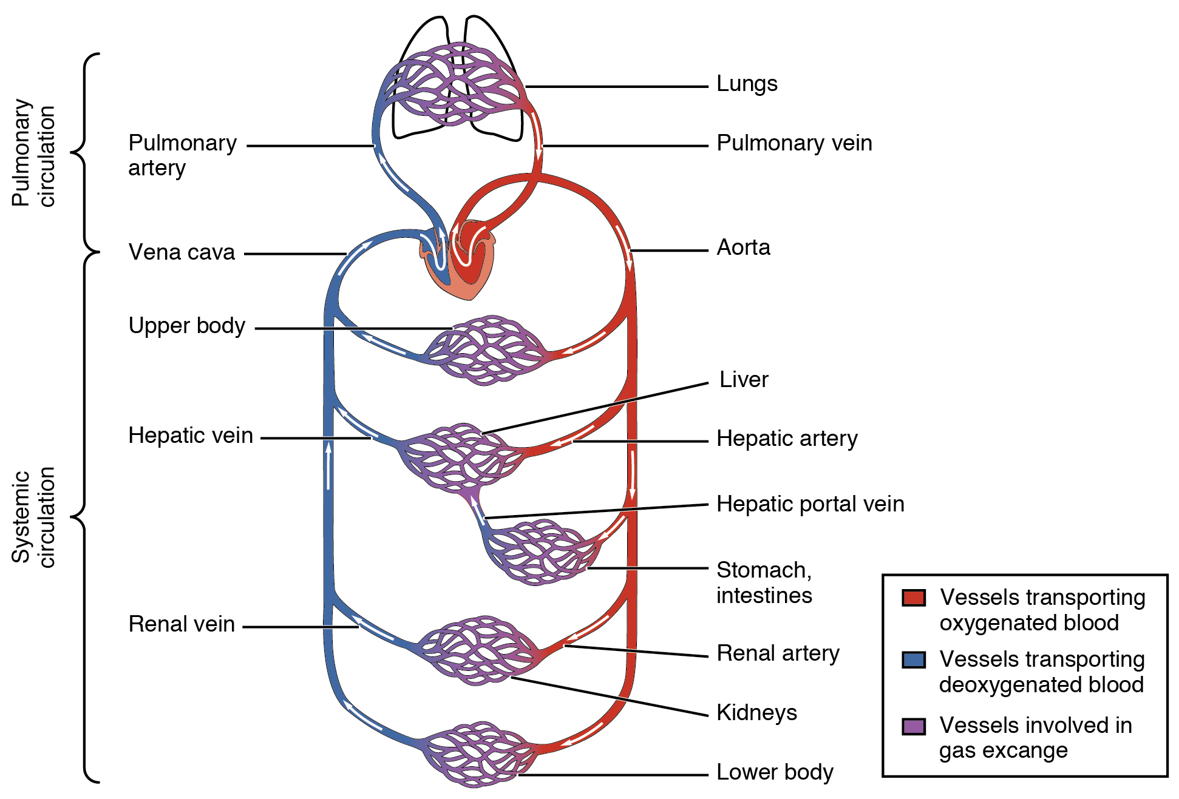
The Body
What do you notice?

Slide 26
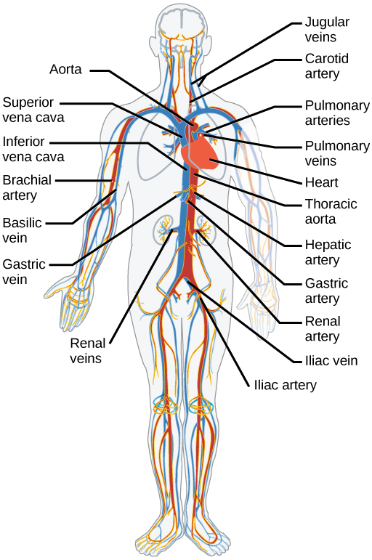
The Body

Slide 27
Arteries and Arterioles

Slide 28
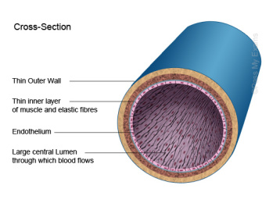
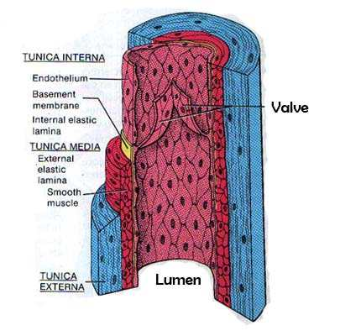
Veins and Venules

Slide 29
Comparison of arteries and veins
Arteries
Veins

Slide 30
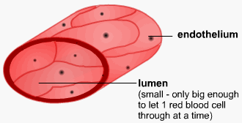
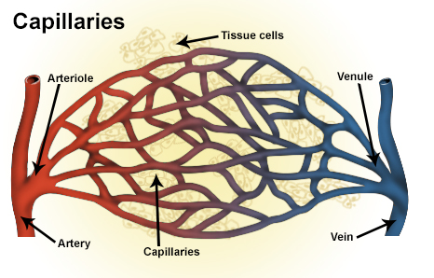
Capillaries

Slide 31
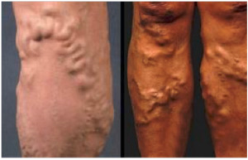
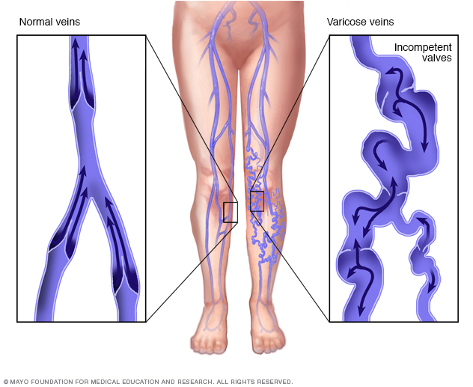
Vessel Health Varicose veins

Slide 32
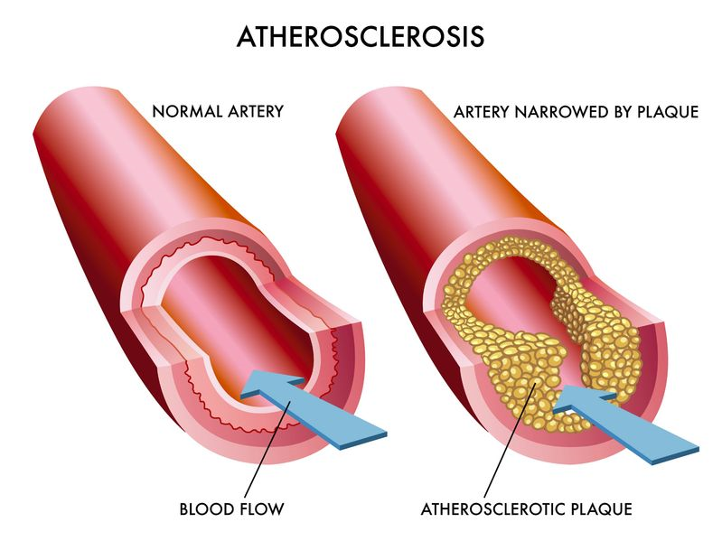
Vessel Health Atherosclerosis
How would this impact pressure in the vessel?

Slide 33
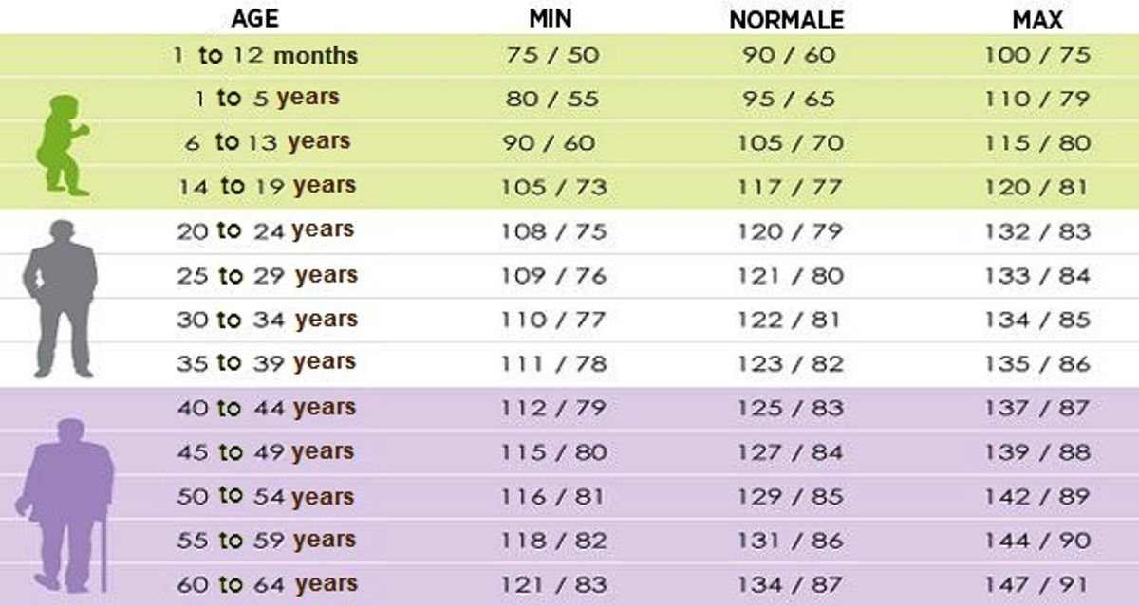
What is a normal Blood pressure?

Slide 34
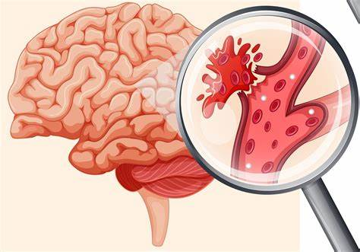
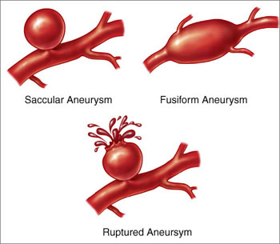
Stroke
Stroke – death of brain cells due to lack of oxygen
Embolism – blood clot that prevents blood from flowing downstream
Aneurysm – weakening and bulging of blood vessel

Slide 35
Photo metaphors
The mailbox is like a heart, you can drop things off to get mailed (deoxygenated blood), and receive mail (oxygenated blood)

Slide 36
Photo Metaphors
Your job is to take a photo of something that is similar to the following:
An artery/arteriole
A vein/venule
A capillary
Varicose veins
Artherosclerosis
You are working in groups of 2 or 3
On the photo app, write one sentence that states what vessel it represents and WHY
Must get 3 of the 5
Be back in the classroom by 9:40am – set your phones!

