Slide 1
Ecosystems
Environmental Sciences 11/12

Slide 2
Unit #1: Ecosystems Learning Goals
Ways that you will show your learning this unit:
Asking questions during class discussions and presentations (Burrowing Owl and SORCO)
Friday quizzes
Red list/Blue list species expert presentation (individual project)
Ecology Unit Test (at end of unit)
Field trip – Ecommunity to harvest winter ghost berries for E’Nowkin Centre
I can connect the roles of species in the local Okanagan ecosystems
I can explain ecosystem stability and the factors that influence sustainability
I can explain how humans can be a factor of change within an ecosystem
I can discuss unsustainable and sustainable human practices
I can explain First Peoples and traditional ecological knowledge

Slide 3
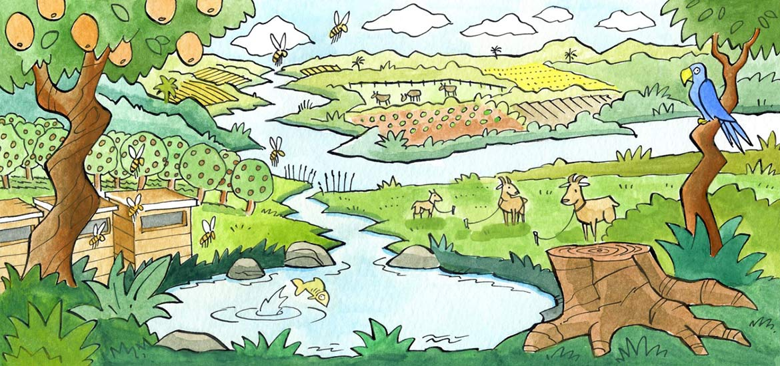
What is an Ecosystem?
A biological community of living and non-living things

Slide 4
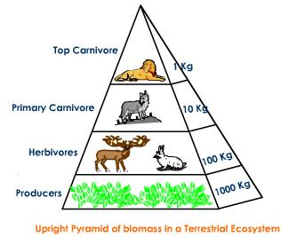
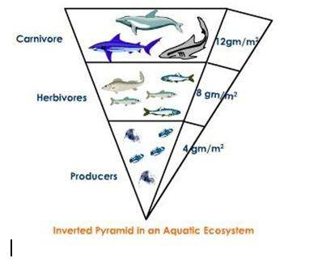
Ecosystem Biomass
the mass of living biological organisms in a given area or ecosystem at a given time
Terrestrial biomass decreases as you move up trophic levels
Aquatic biomass increases as you move up tropic levels

Slide 5
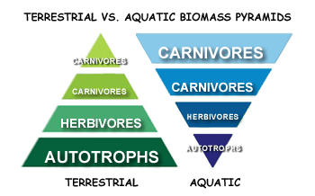
Ecosystem Biomass

Slide 6
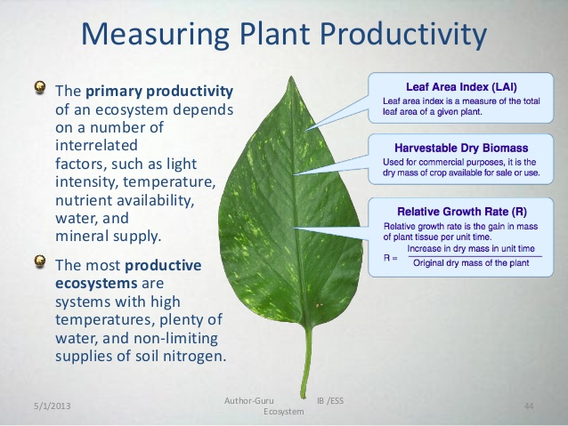
Ecosystem Productivity
The rate of generation of biomass in an ecosystem
How fast are plants and animals reproducing health offspring?
The amount of organic matter accumulated over a period of time
Units of mass per unit of surface area

Slide 7
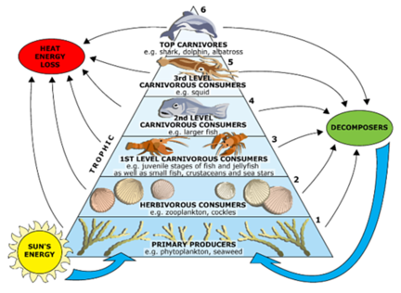
Energy Flow in an Ecosystem
Energy can not be created or destroyed, only transferred
Trophic levels (nutrition)
Primary Producers:
Autotrophs (make own energy)
Consumers
Heterotrophs (must consume energy)
Saprotrophs (decomposers – detritovores)
Organisms only hold on to 10% of the energy they ingest
Limiting factors: water and temperature

Slide 8
Ecological Niche
The role of the organism in it’s environment
Habitat
When it is active
What it uses for resources

Slide 9
Ecosystem Biodiversity
Genetic diversity allow for ecosystem stability

Slide 10
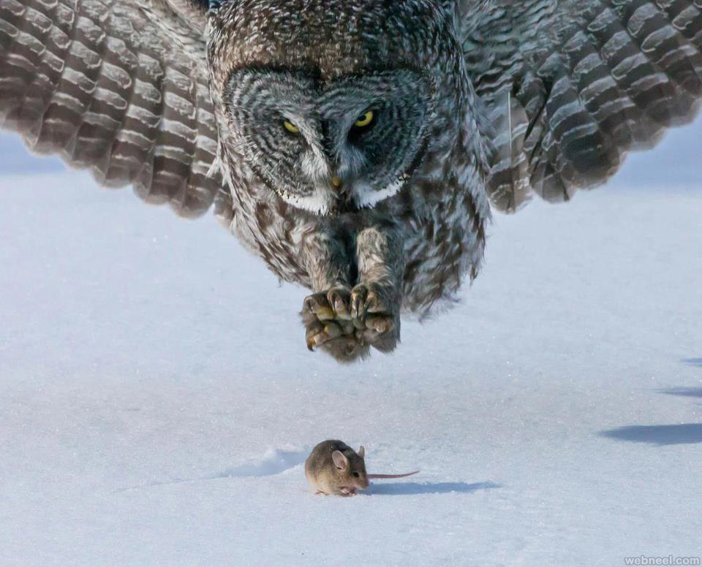
Ecosystem Relationships
Predator – an organism that actively preys or hunts other organisms in the ecosystem
Prey – the organism that is hunted or eaten by another

Slide 11
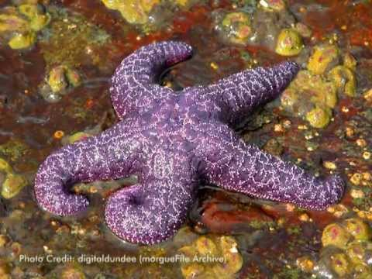
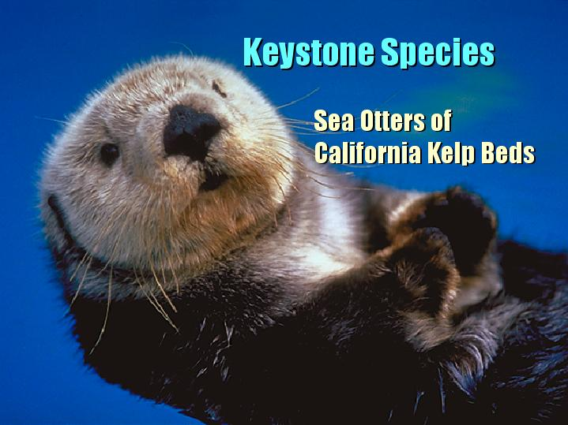
Keystone Species
A keystone species is a plant or animal that plays a unique and crucial role in the way an ecosystem functions.
Without keystone species, the ecosystem would be dramatically different or cease to exist altogether.
The role that a keystone species plays in its ecosystem is analogous to the role of a keystone in an arch.

Slide 12
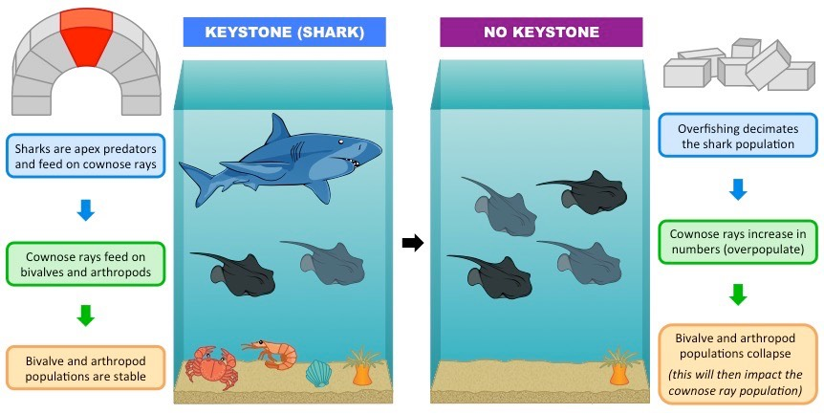

Slide 13
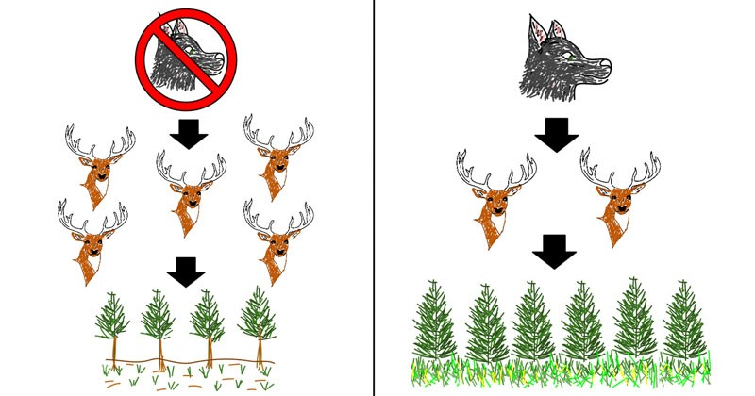
Trophic Cascade
powerful indirect interactions that can control entire ecosystems
when predators in a food web suppress the abundance of their prey, it allows the next trophic level to thrive
the addition or removal of top predators causes changes in the populations of predator and prey through a food chain

Slide 14
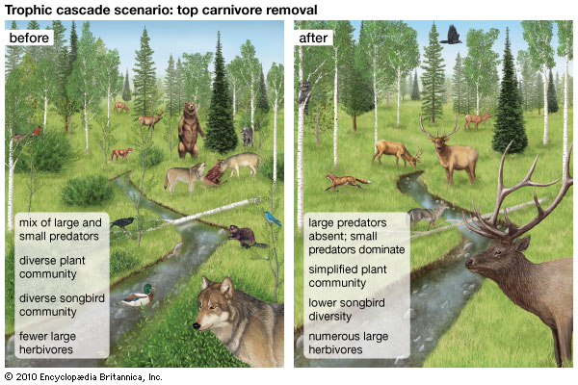

Slide 15
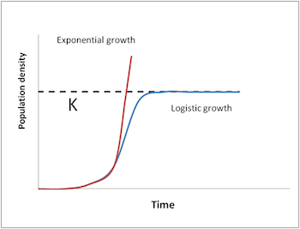
Carrying Capacity (K)
Populations will have a carrying capacity
Max number of organisms the community can handle
There will be increased deaths as you approach “K”
Due to density dependent limiting factors
restrictions on food, shelter, disease

Slide 16
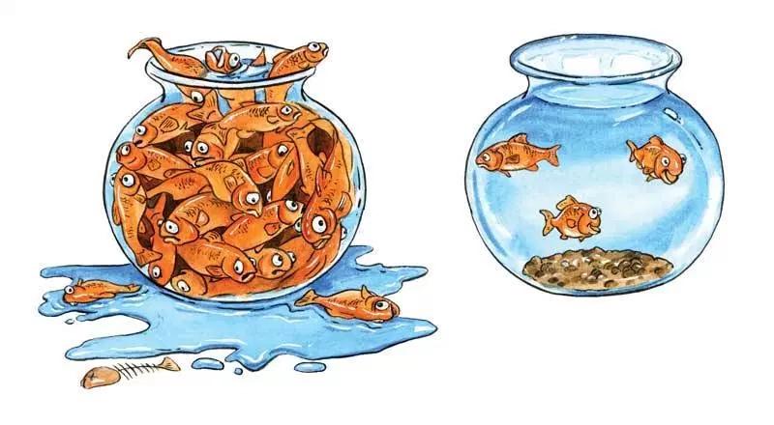
Which bowl will have more successful organisms? Why?

Slide 17
Wolf Reintroduction Case Study
As a table team, take turns reading “Background”
Using the ipads, research some pro’s and con’s for the reintroduction on wolves to Yellowstone
Make a list using a white board marker on your desk

Slide 18
Wolf Reintroduction Case Study
Pro’s of Wolves in Ecosystem
Con’s of Wolves in Ecosystem

Slide 19
Read Part 1 – Wolf #9
Read as a team
Questions:
Why did they reintroduce wolves back into Yellowstone?
Explain what a keystone species is, and why they thought the wolf was one? How did the absence of the wolf impact Yellowstone?
Wolf #8 showed a rare type of social behaviour by adopting offspring that were not his own. Why would this behaviour be rare in mammals> How is this a beneficial behaviour?

Slide 20
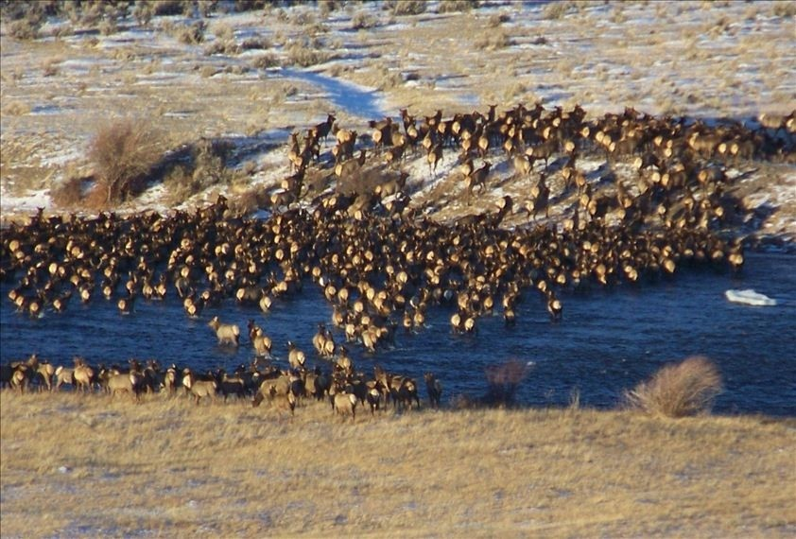
Read Part 1 – Wolf #9
re-introduction of wolves into Yellowstone was to stabilize the ecosystem
elk were overpopulated because of the absence of their main predator
the aspen and cottonwood trees were decreasing dramatically because of overgrazing

Slide 21
Read Part 2 – Wolf #21
Read together as a team
Questions:
Wolf #21 was very success at reproducing. Come up with a couple hypothesis as to what made him this successful. How do you think we was able to hold his alpha status for so long?
His pack of 37 wolves did not last. Knowing what you know about factors that limit population growth, why was this so? What is the difference between interspecific and intraspecific competition?

Slide 22
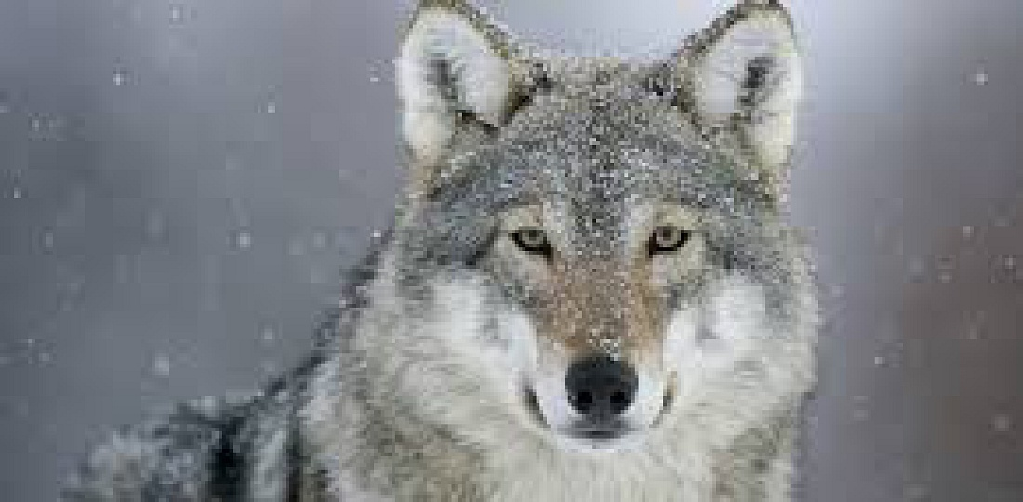
Read Part 2 – Wolf #21
Wolf #21 was described as a large wolf, which would have helped him in fending off potential alpha males
take down an elk when others could not, which is an indication that he was strong and fit
population reached the carrying capacity for that particular area (more wolves in the pack than the pack itself could support)
wolves were at greater risk of disease and starvation
Interspecific competition is competition between two different species (i.e., grizzly bears, black bears, coyotes, and mountain lions)
Intraspecific competition refers to competition within the same species (fighting for alpha, competition for food)

Slide 23
Read Part 3 - Data
Look at each of the charts
What information can you get from this?
What trends or connections do you see?
What is the difference between density-dependent and density-independent factors that might impact the wolf population?
What do you think the carry capacity for the wolves in Yellowstone might be?

Slide 24
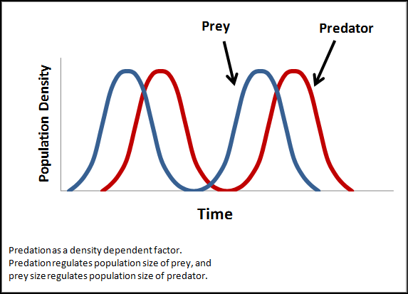
Read Part 3 - Data
Density-dependent factors can limit population growth
food, water, shelter, the ability to find a mate, and the transmission of diseases.
If the wolf population is too high for a given area, the chance for finding food decreases…survival decreases.
Density-independent factors do not depend on the size, or density of the population
climate, disease outbreak, and natural disasters
Possible hypotheses for trends:
wolves dropped slightly from 2003–04 and then dramatically from 2007–11 may be because there may have been more wolves in Yellowstone than resources to support them
some wolves may have simply left the GYE because of overcrowding and thus may not have been counted
there may have been disease outbreaks that killed wolves
diseases like canine distemper, canine parvovirus, or mange are discussed as causing declines in wolf population numbers.

Slide 25
Journal Reflection
Do you think that the re-introduction of wolves into Yellowstone will stabilize the community?
Do you think that wolves are a keystone species for Yellowstone? Why or why not? What is your evidence?
List some reasons for the ups and downs of the wolf population in Yellowstone. Are these reasons intraspecific or interspecific? Explain for each.

