Slide 1
Our Atmosphere
Environmental Sciences 12

Slide 2
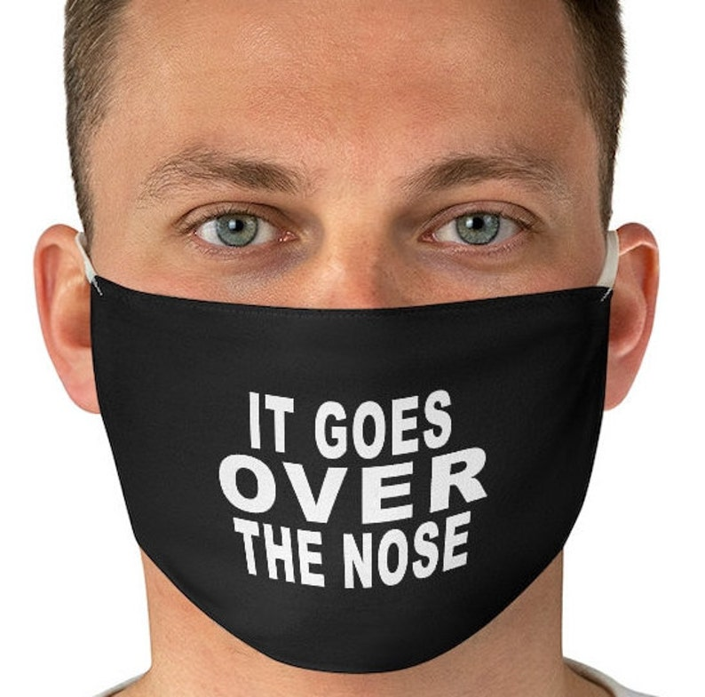
Current HEALTH protocols
Keep your MASKS ON and over nose and mouth
Hand sanitize on your way IN and OUT of the classroom
Stay home if you are not feeling well
Limit eating/drinking in the classrooms
Hallways are for movement to and from (not gathering or visiting)

Slide 4
Table Team Brainstorm
What do I KNOW about our atmosphere?
What do I know WANT TO KNOW about our atmosphere?

Slide 5
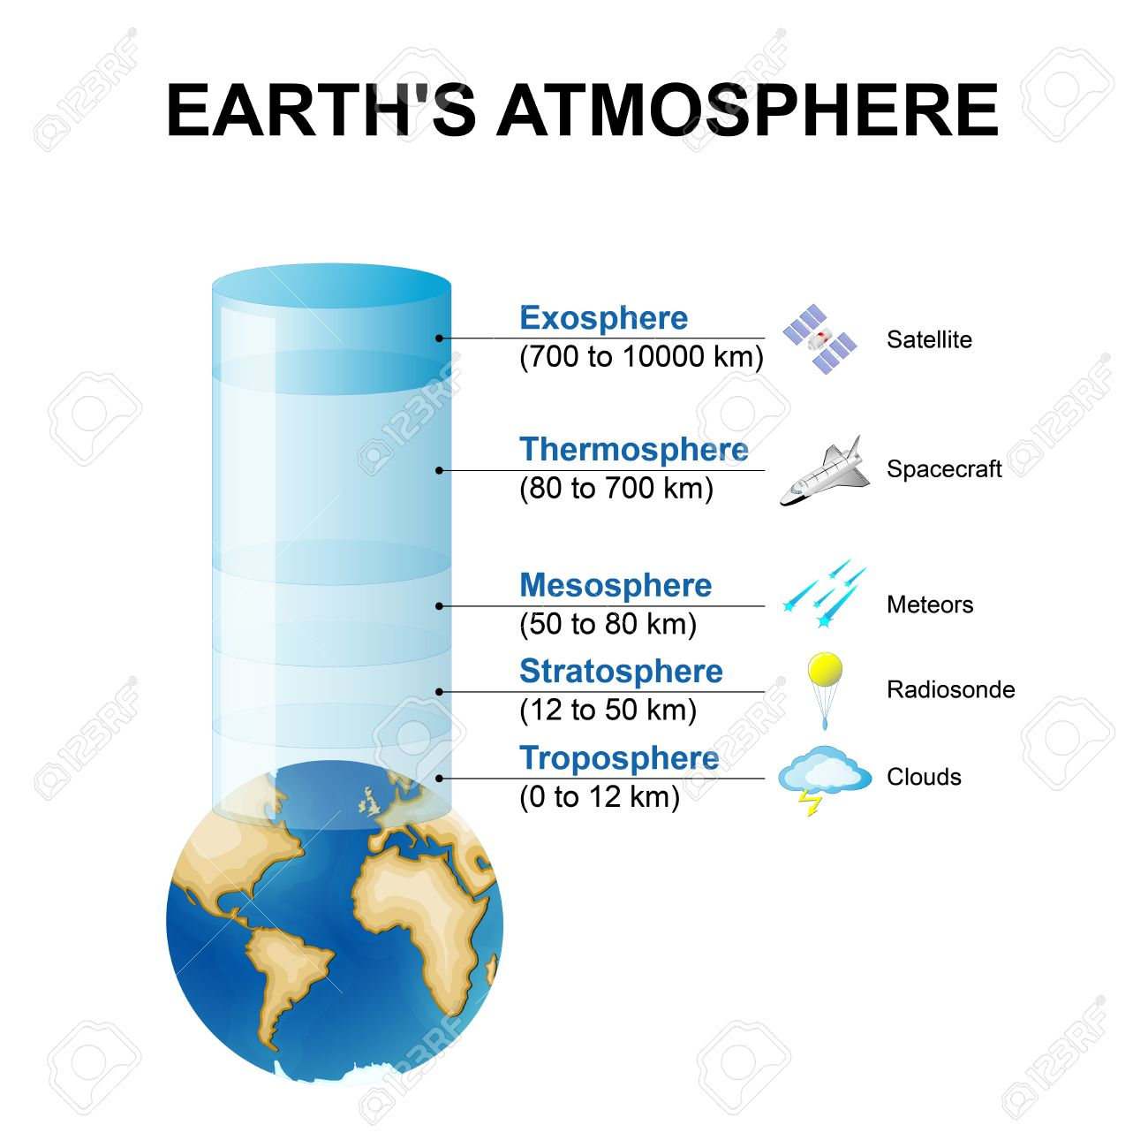
Earth’s Atmosphere
Earth is the only planet in the solar system that has an atmosphere that can sustain life
An atmosphere is a layer of gasses that surround a planet. The gasses are held close to the planet
Earth’s atmosphere has five layers:
Troposphere – where weather occurs
Stratosphere – contains ozone layer
Mesosphere – protects Earth from being hit by meteoroids
Thermosphere – hot layer, where space crafts circulate
Exosphere – where satellites circulate

Slide 6
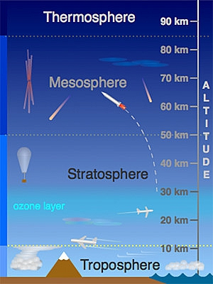
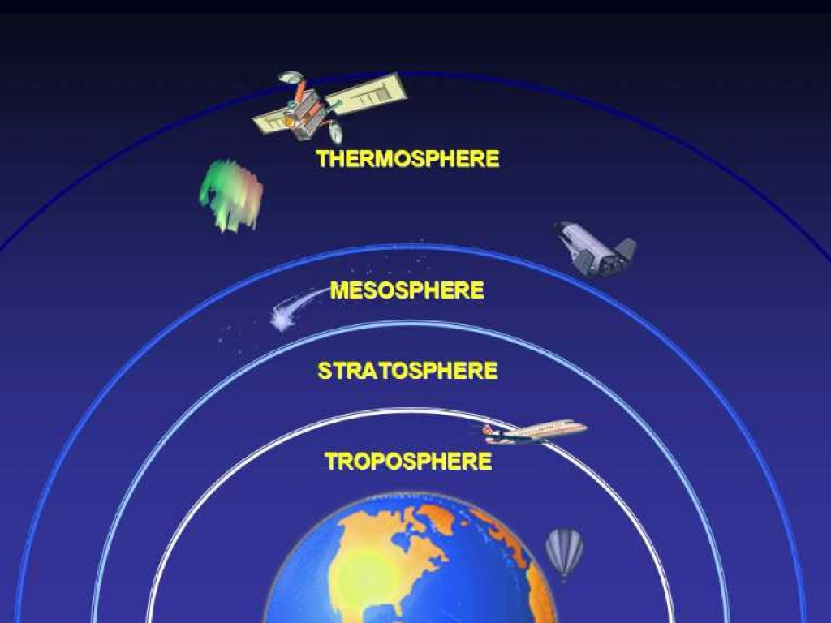

Slide 7
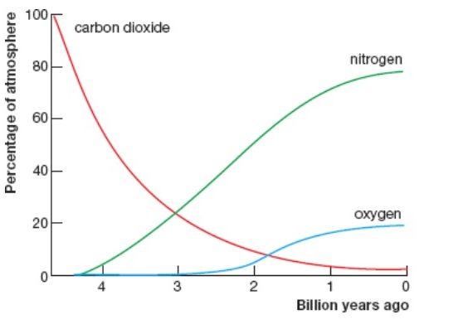
Earth’s Early Years & Gasses
Earth got atmosphere 4.5 billion years ago
What did the atmosphere do for our planet?

Slide 8
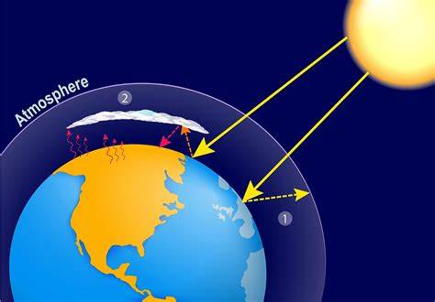
Role of the Atmosphere
UV Radiation shield (ozone layer)
Keeps earth at the “just right” temperature
Prevents surface heat from escaping
Keeps water cycle in
Gives us our weather patterns (wind, snow, rain)
Protect us from outer space debris
Facilitates plant life growth
Keeps gas (air) molecules so that we can make/hear sound

Slide 9
What Gasses Are In Our Atmosphere?
Nitrogen — 78 percent
Oxygen — 21 percent
Argon — 0.93 percent
Carbon dioxide — 0.04 percent
Trace amounts of neon, helium, methane, krypton and hydrogen, as well as water vapor

Slide 10
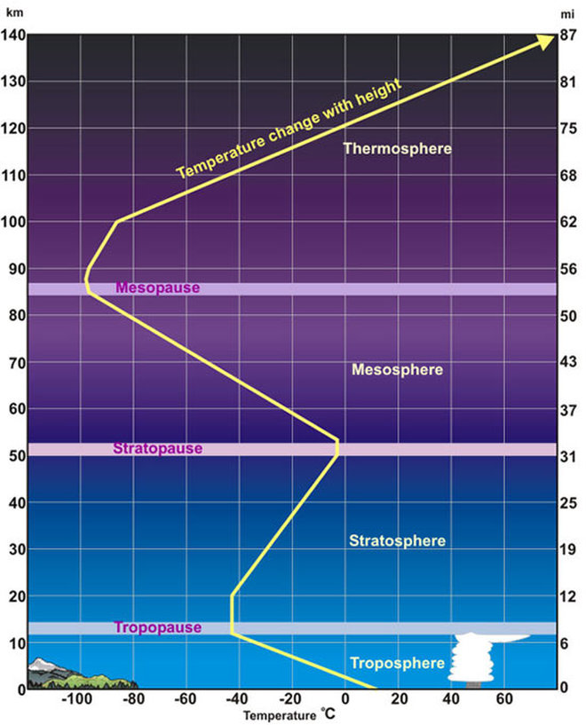
Temperature of our Atmosphere

Slide 11
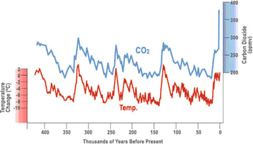
Let’s Look at the Data…
What does this data tell us?

Slide 12
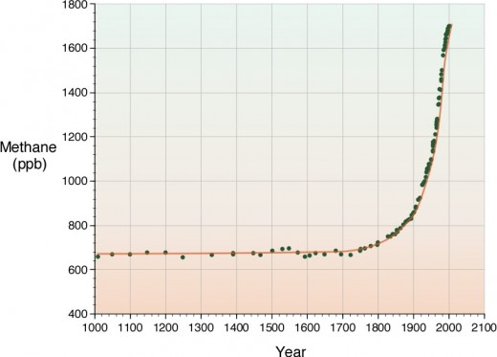
Let’s Look at the Data…
What does this data tell us?

Slide 13
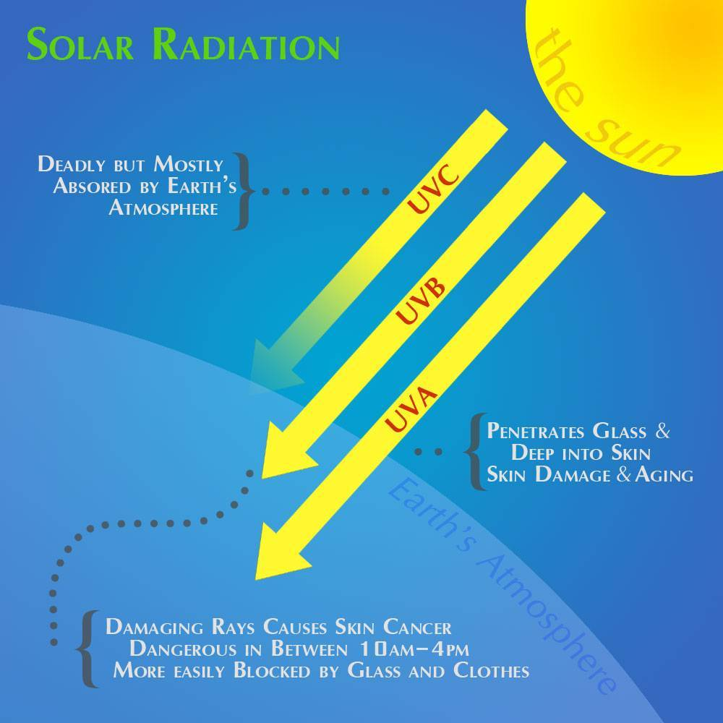
Our Atmosphere protects us from UV radiation

Slide 14
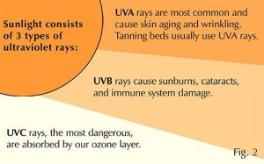
Type of UV Light from the sun
UV-A
Most common
Can cause skin aging and wrinkles
UV-B
Causes sunburns and plays a role in vitamin D broducion
UV-C
Dangerous rays
Absorbed by ozone layer

Slide 15
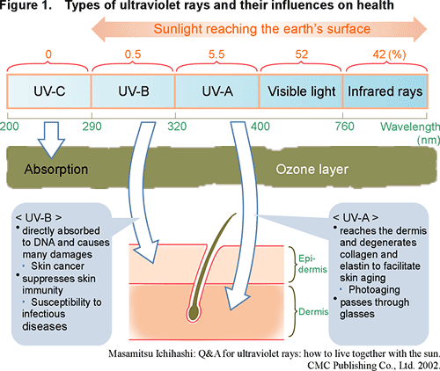
UV Impact
What do you notice?
What do you wonder?

Slide 16
Ozone – O3
There are two types of ozone:
1. Bad ozone (tropospheric ozone)
causes smog, traps dense molecules close to Earth
2. Good ozone (stratospheric ozone)
filters out UV-B and UV-C

Slide 18
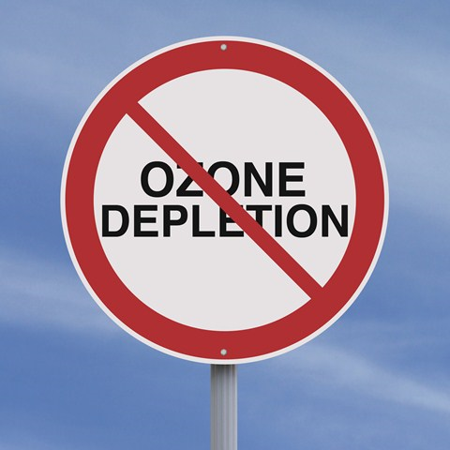
Montreal Protocol
An international agreement to decrease the use of CFC’s (Choroflourocarbons)
Created in 1987 and started in 1989
Set limits on the production of any materials that use CFC’s, halons, bromine and chlorine
First global agreement to protect the Earth’s atmosphere

Slide 19
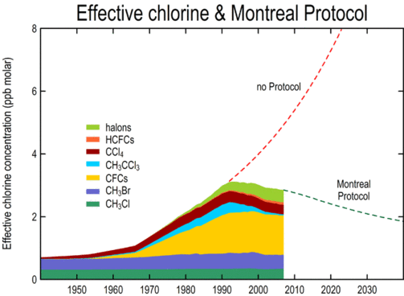
Montreal Protocol
What do you notice from this graph?
What do you wonder about this graph?

Slide 20
Can the Ozone Hole Repair Itself?

Slide 21
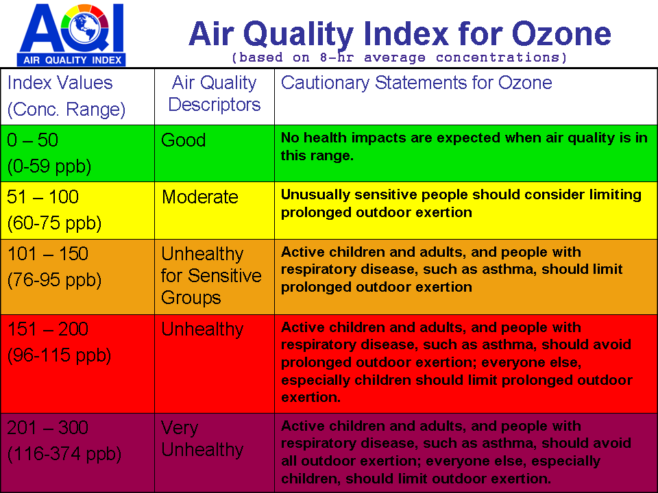
Ozone Index

Slide 22
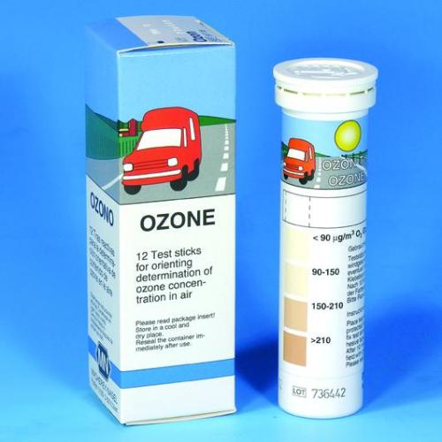
Making an Ozone Indicator Strip

Slide 23
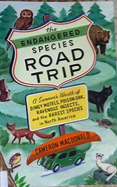
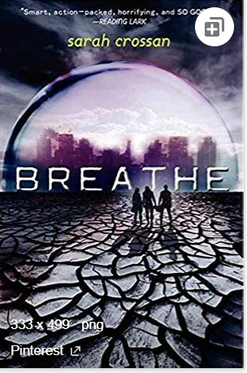
Novel Project
Step #1: Finish your book (by Wednesday at the latest)
Step #2: Research 3 questions
Step #3: Using Flipgrid (link is on my website), make a 5 minute video where you:
1. review book (1 minute)
Characters, plot, environmental issues
2. Discuss your three questions and the research you found (4 minutes)
Should include local policy, global issues, actions for change

Slide 24
To Do today:
Finish reading book (MUST BE DONE BY WEDNESDAY)
Start brainstorming questions
3 questions you want to explore about the environmental topic discussed in the novel

