Slide 1
Heart & Exercise Lab
Biology 12

Slide 2
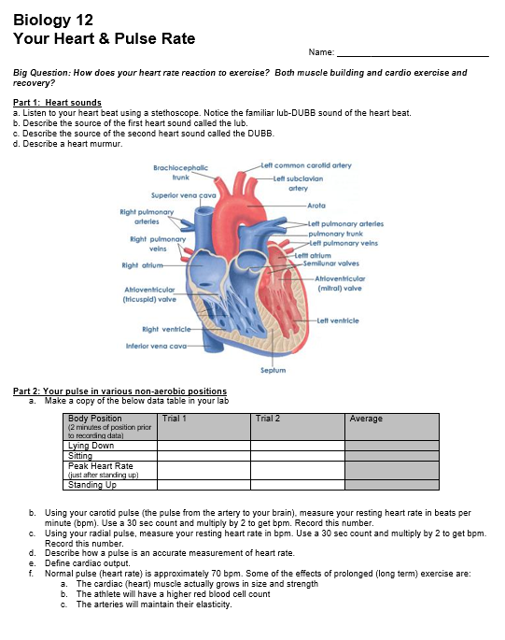
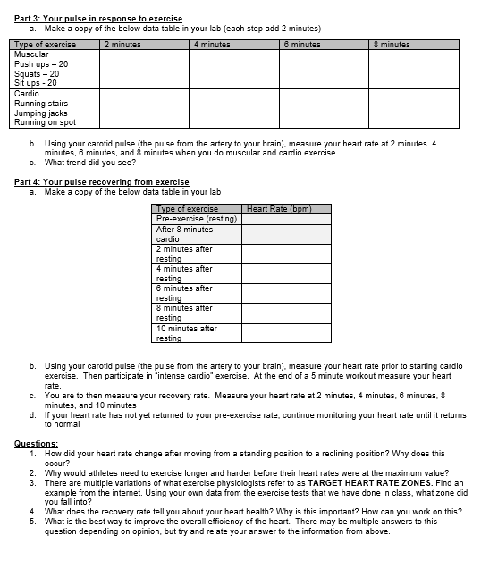

Slide 3
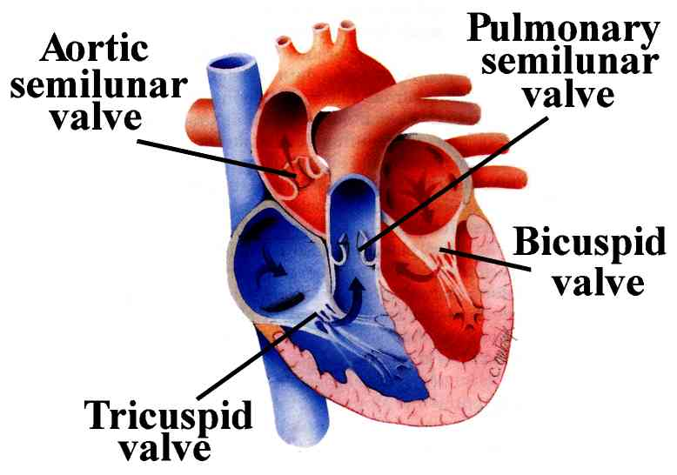
Listen to Your Heart
Lub – sound of the tricuspid and mitral valves closing
Dub – sound of the pulmonary and aortic valves closing

Slide 4
Using a Stethoscope

Slide 5
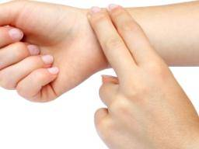
Pulse: Standing, Sitting, lying down
WHAT WERE YOUR HEART RATES?
Why do you think you saw this trend?

Slide 6
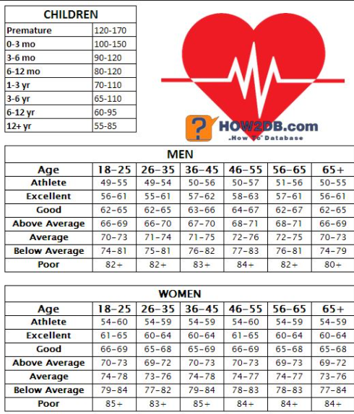

Slide 8
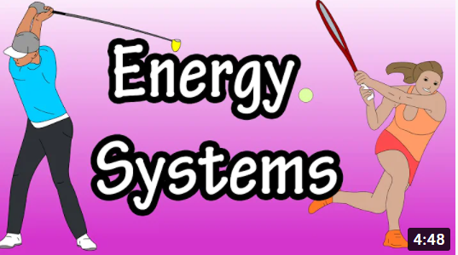
Types of ATP Production

Slide 9
Your Muscles Used for Exercise
You have 640 skeletal muscles
They include fast twitch (use ATP-PCR) and slow twitch (use aerobic oxidative) muscle cells
Actin and myosin connections require ATP for a muscle contraction
This need for ATP production for muscle contraction causes lots of CO₂ to be produced, which causes acidic blood → increase breathing rate

Slide 10
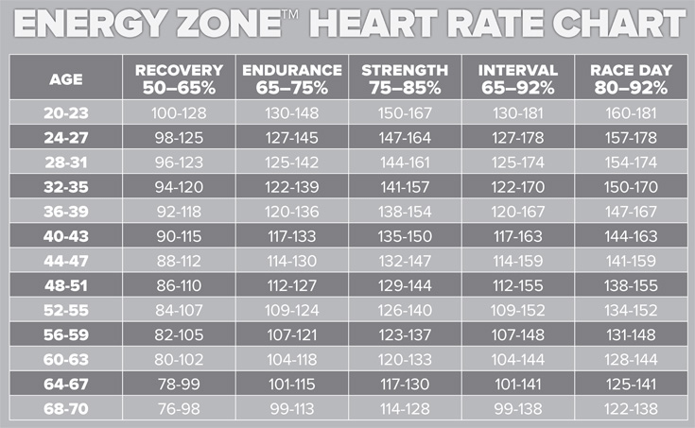
Pulse: Exercise & Heart Rate

Slide 11
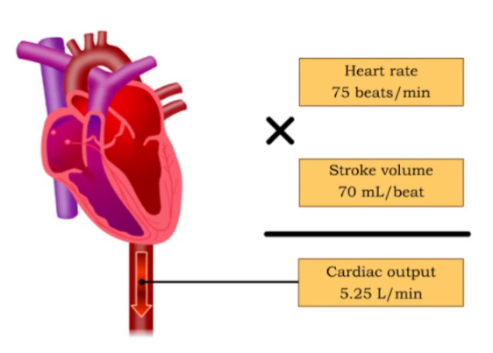
What can lead to different heart rates
Stroke volume
Amount of blood ejected from ventricles in one contraction
Athletes have a higher stroke volume, which causes a lower resting heart rate

Slide 12
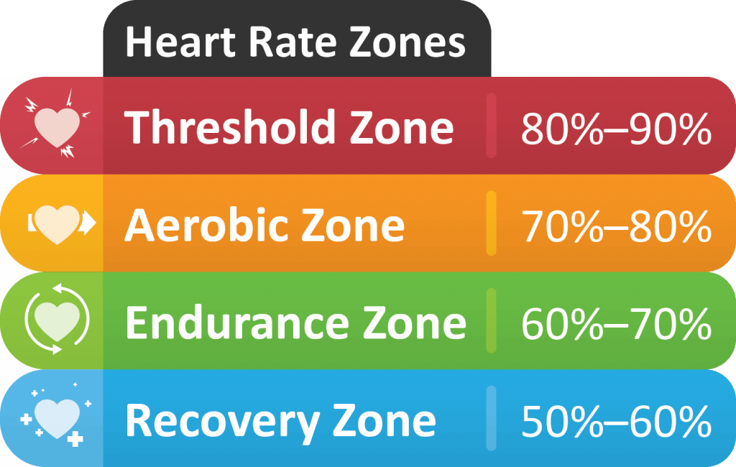
Maximum Heart Rate vs Target Heart Rate
This is the rate that you do not want to exceed
220 – age = a
Target Heart Rates

Slide 13
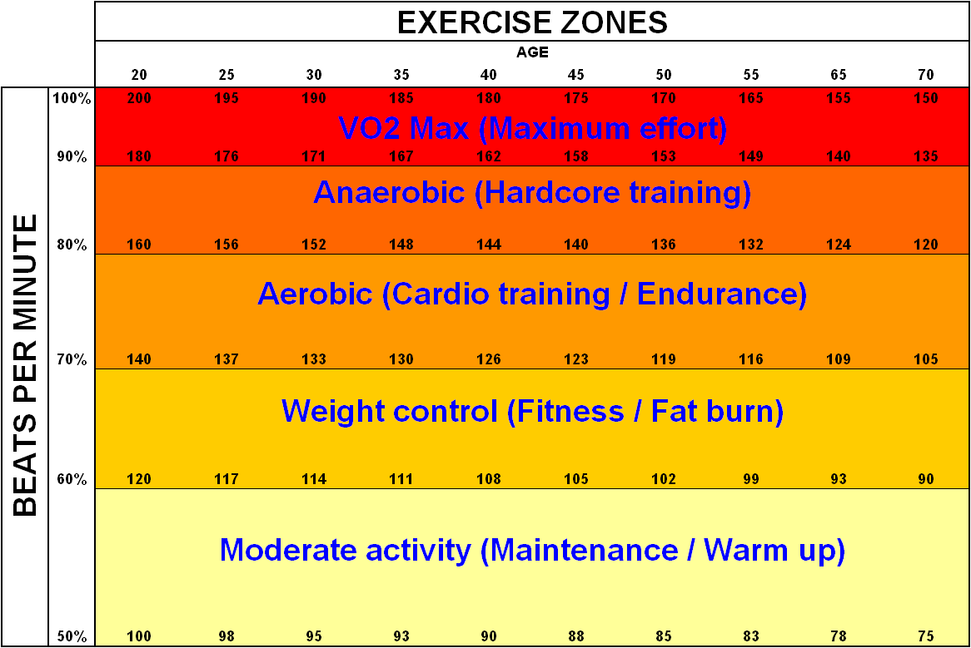

Slide 14
Let’s Calculate your Numbers…
Maximum Heart Rate
220 - age
Muscle building workout
(Max) x 0.6
Cardio
workout
(Max) x 0.8

Slide 15
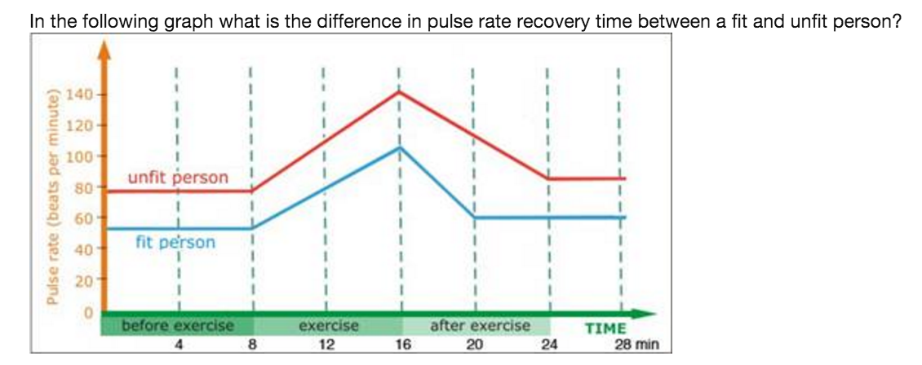
Recovery Rate
You want your heart rate to drop on average 12 bpm in the first minute AFTER exercise
Nervous system shift from sympathetic to parasympathetic systems
Biggest predictor of cardiovascular disease

Slide 17
Lab Process
Listen to your heart
Supine, sitting, immediately after standing, standing pulse (15 seconds x 4)
Workout
Muscular (8 minutes) – large muscle groups only
Cardio (8 minutes) – high intensity quick movements
Recovery
Take your pulse every minute for 5 minutes after workout

