Slide 1
Biology
Respiration
Gas Exchange

Slide 2
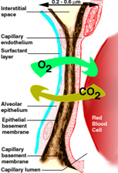
Diffusion
Movement of solute from high concentration to low concentration
Oxygen DIFFUSE to capillary
Carbon dioxide DIFFUSE to alveoli

Slide 3
Gas Exchange
Gas | Inhaled | Exhaled
Oxygen | 21% | 15%
Carbon Dioxide | 0.04% | 4%
Water | 1.3% | 6%

Slide 4
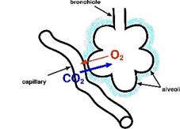
External Respiration
Movement of gas from alveoli of the lungs to the capillaries of the circulatory system
Pco2 (partial pressure of carbon dioxide) and Po2 (partial pressure of oxygen) refer to amount of each gas
Move from high partial pressure to area of low partial pressure

Slide 5
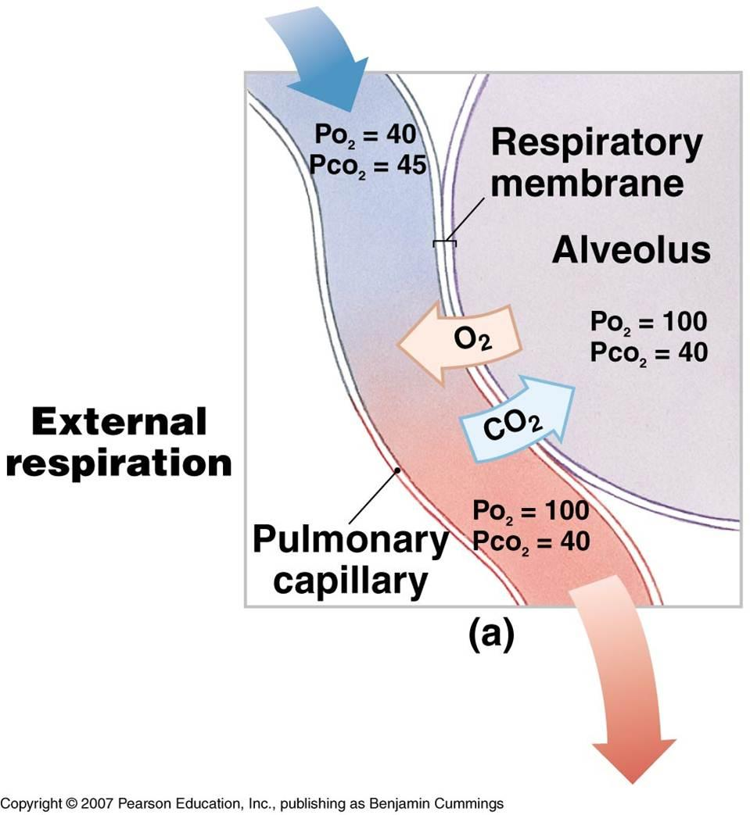
Carbon Dioxide exchange in alveoli
Blood in capillaries have higher Pco2 than the alveoli
CO2 diffuses out of the blood into the lungs
Oxygen exchange in alveoli
The alveoli have higher Po2 than the capillaries
O2 diffuses out of the lungs into the blood

Slide 6
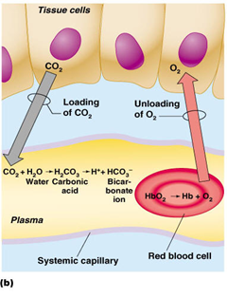
Internal Respiration
Movement of gas from the capillaries of the circulatory system to the all cells of the body

Slide 7
Internal Respiration
Carbon Dioxide exchange at tissues
Cells have higher Pco2 than the capillaries
CO2 diffuses out of the cells into the blood
Oxygen exchange at tissues
Blood in capillaries have higher Po2 than the cells
O2 diffuses out of the blood into the cells

Slide 8
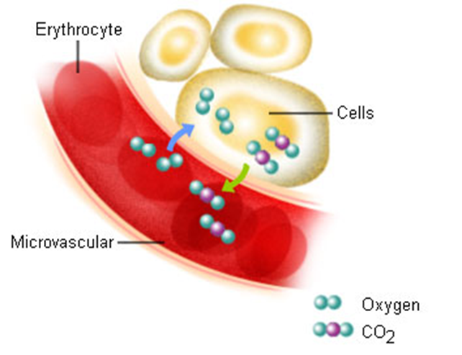

Slide 9
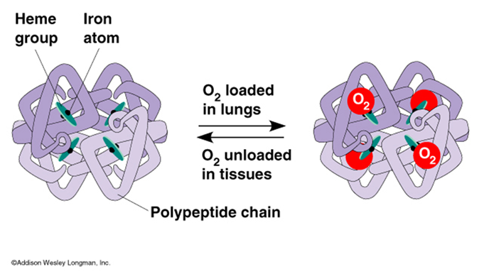
Haemoglobin....
the oxygen carrier

Slide 10
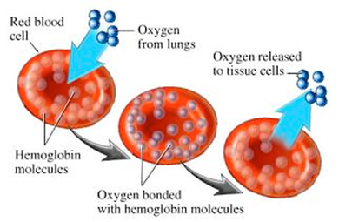
How does the gas travel between the lungs and the cells?
Oxygen attaches to hemoglobin on red blood cells
Oxyhemoglobin (HbO2 )

Slide 11
How does the gas travel between the lungs and the cells?
Carbon Dioxide
Dissolved in the plasma (minimal)
2) Attached to hemoglobin (minimal)
-Carbaminohemoglobin (HbCO2 )
3) As bicarbonate ion (HCO3- ) (majority)
CO2 + H2O → H2CO3 → HCO3- + H+
(first step uses Carbonic Anhydrase enzyme)

Slide 12
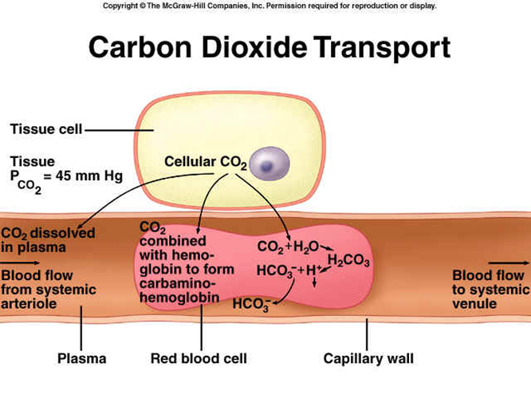

Slide 13
H+ Buffer
The blood needs pH to be constant ~7.4
What can happen?
Alkalosis- Result of hyperventilation
High pH ….. decrease in H+
Dizziness and twitching

Slide 14
H+ Buffer
Acidosis- Hypoventilation
Increase in H +
Coma and die
Can also bind to hemoglobin
Decrease in HHb (reduced hemoglin)

Slide 15
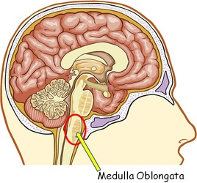
Medulla Oblongata
Respiratory Centre
data to medulla oblongata are hormonal, chemical, and neural in nature
Carotid body - in thymus and detects Po2 levels
Aortic bodies - measures Po2, Pco, and pH

Slide 16
Magic...or science?

