Slide 1
Freshwater Issues
Environmental Sciences 11/12

Slide 2
Inquiry Stations
Wonder through the 4 stations
Make note
what do you notice?
What do you wonder?

Slide 3
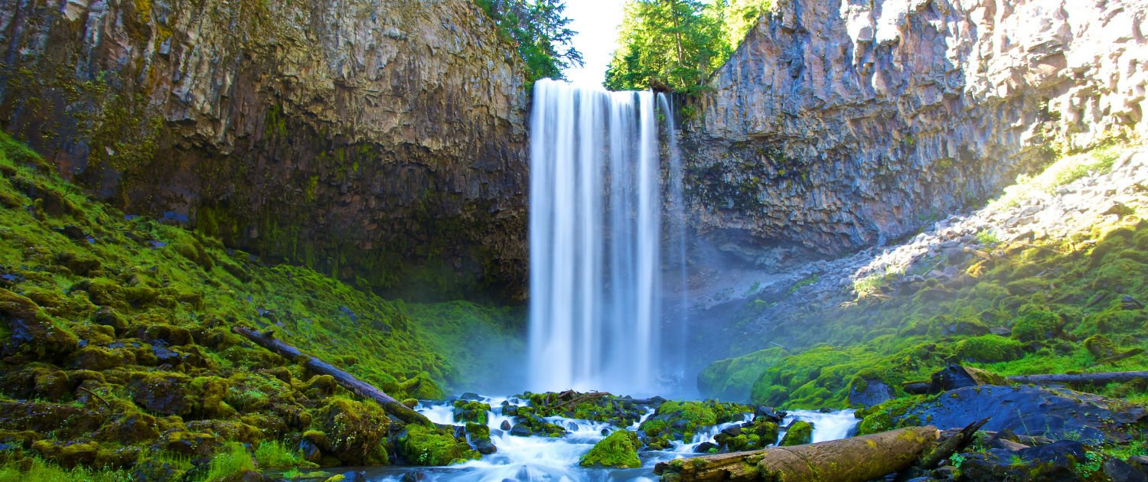
Watch video What do you notice? What do you wonder?

Slide 4
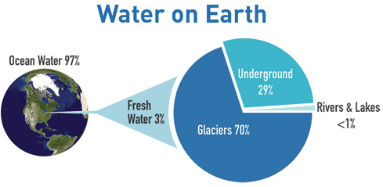
How much freshwater is available?
3% of Earth’s water is freshwater
Of the freshwater less than 1% is accessible for use

Slide 5
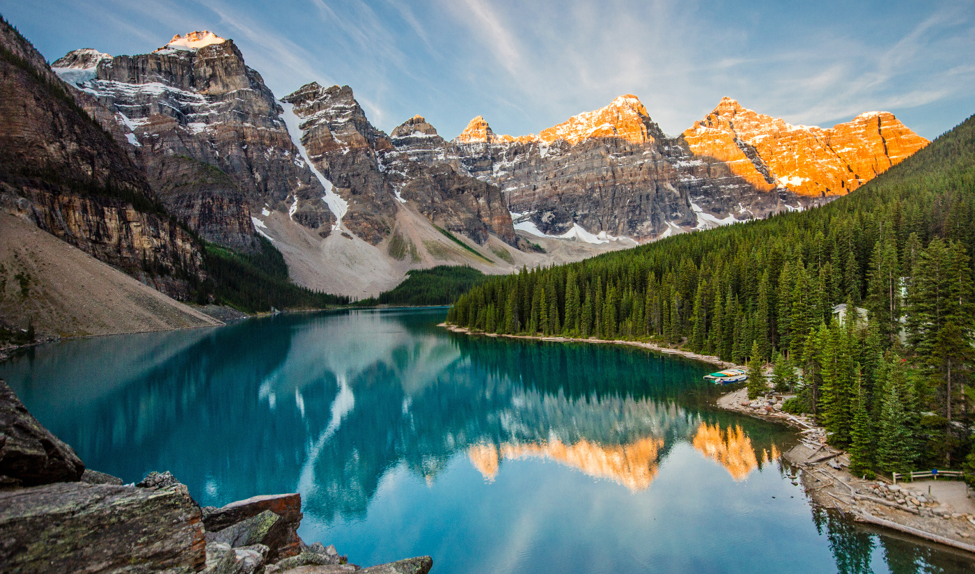
Where do we get our water?
As you watch the video, write down 3 statements you learned. Be prepared to share with your classmates.

Slide 6
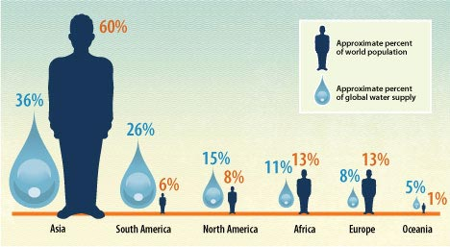
What does this graphic tell us?
What are 3 statements or questions you have based off this graphic?

Slide 7
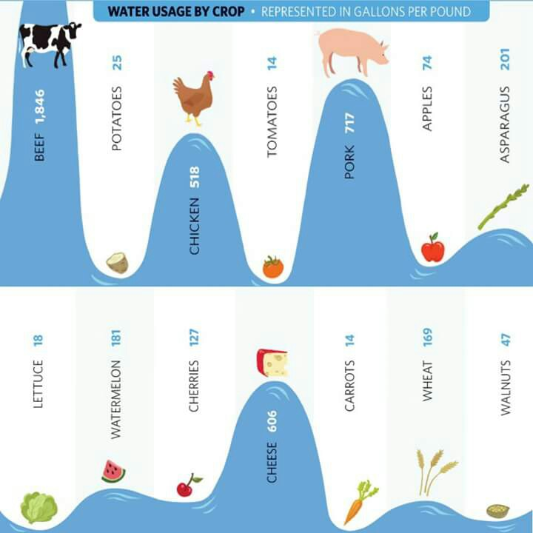
What does this graphic tell us?
What are some statements or questions you have about this graphic?

Slide 8
What data do we need to manage our lake and river system?
Temperature
Increased water temperature can cause an increase in the photosynthetic rate of plants and algae
lead to algal blooms, which can cause eutrophication
Increase in temperature can impact larvae cycles
Increase in temperatures can change dissolved gases
More gas dissolved in colder waters
Temperature Range (◦C) | Organism
5 – 20 | Trout
5 – 28 | Smallmouth Bass
10 – 25 | Mayfly Larvae
10 – 25 | Mosquito
10 – 25 | Carp
20 - 25 | Catfish

Slide 9
What data do we need to manage our lake and river system?
pH of freshwater
Basic pH can cause algal blooms
Aquatic species very sensitive to changes in pH
Can impact skin and increase fungal infections
Increase in acidity (decrease in pH) cause an release of heavy metals into the water
Accumulated on gills and cause deformaties
pH Range | Effect
3 – 3.5 | Unlikely that fish can survive for more than a few hours in this range
3.5-4 | Known to be lethal to salmonids
4 – 4.5 | All fish, most frogs, insects absent
5 – 5.5 | Bottom dwelling bacteria begin to die. Metals normally trapped in sediments are released into the acidification water in forms toxic to aquatic life
6 – 6.5 | Freshwater shrimp absent
6.5-8.2 | Optimal for most organisms

Slide 10
What data do we need to manage our lake and river system?
Dissolved Oxygen
Oxygen is key for aquatic animals for cellular respiration
Dissolved oxygen is the main indicator of water quality
Biodiversity is greatest at higher DO
DO impacted by temperature, stream flow, aquatic plants, human activities
DO fluctuate during day due to photosynthetic activity of plants
Organism | Minimum dissolved oxygen (mg/L)
Trout | 6.5
Small mouth Bass | 6.5
Caddisfly Larvae | 4.0
Mayfly lArvae | 4.0
Catfish | 2.5
Mosquito larvae | 1.0

Slide 11
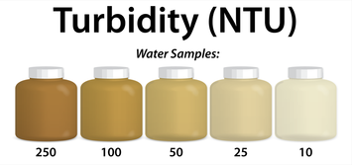
What data do we need to manage our lake and river system?
Turbidity
Measure of water clarity
The cloudiness is produced by light reflecting off particles in the water
Run off will create high turbidity
High turbidity will decrease the amount of sunlight able to penetrate and decrease the photosynthetic rate of plants
High turbidity will increase water temperature as heat absorbed by sediment

Slide 12
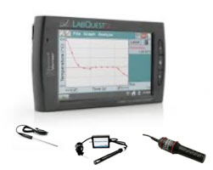
Water Lab
You have three samples of test

