Slide 1
Finance Project
FOM 11

Slide 2
Brain Starter
Marcel deposits $250 at the beginning of every month into a saving account which earns an annual interest rate of 4.3% compounded monthly. How long (in years) will it take for Marcel to accumulate savings of $45,000?

Slide 3
Brain Starter
Marcel deposits $250 at the beginning of every month into a saving account which earns an annual interest rate of 4.3% compounded monthly. How long (in years) will it take for Marcel to accumulate savings of $45,000?

Slide 4
Lease Practice
A new truck with a purchase price of $33,000 is leased for 4 years, with an annual interest rate of 3.9% monthly. If the down payment is $2,600 and the residual value is $16,000, what are the monthly payments? How much does the truck cost after buy out?

Slide 5
Lease Practice
A new truck with a purchase price of $33,000 is leased for 4 years, with an annual interest rate of 3.9% monthly. If the down payment is $2,600 and the residual value is $16,000, what are the monthly payments? How much does the truck cost after buy out?

Slide 6
Loan and Lease Project
A summary of the positives and negatives of loans and leases
What are the characteristics and details you are looking for in a vehicle (be specific)
Find advertisements of three cars that you are interested in
Used (loan from bank) – 5.1% from bank
New (loan from dealership) – 6% from dealership
New (lease from dealership) - 4.49% for 48 months from bank
Reflect on the deals and which makes the most sense. Are you saving money? Which is realistic for you now? Is it realistic for you in the future?

Slide 7
How Are Interest Rates Set?
Banks and credit unions usually set their rates according to the Bank of Canada’s benchmark rate, which is also known as “prime rate”.
Prime Rate as of March 2, 2020 is 3.95%
“Defaulting” refers to when a borrower doesn’t honor their loan agreement in some way, whether it’s by making a late payment, a short payment, or missing one entirely.

Slide 8
How Are Interest Rates Set?
All lenders want to be sure you’ll be able to pay them back on time and in full.
when you apply for a credit product, one of the first things they’ll examine will be the health of your credit and finances.
Some elements that they’ll look at include, but aren’t limited to your:
Credit report
Credit score
Credit rating
Credit history
Employment record (past and present)
Gross monthly/yearly income
Assets (collateral)

Slide 9
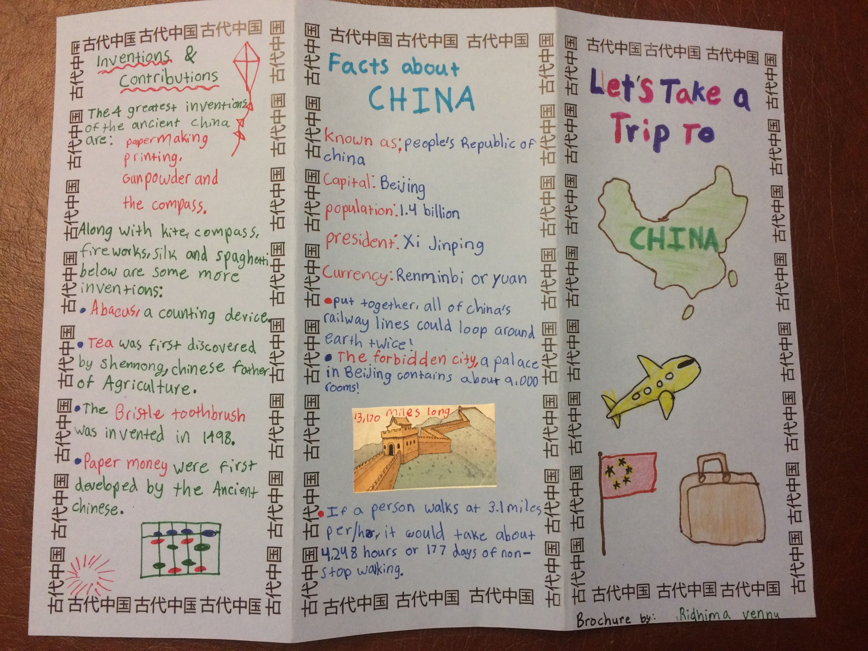
Loan and Lease Project
Learning Goal | Novice 1/2 | Apprentice 3/4 | Expert 5/6
I can show reasoning of the positive and negatives of loans and leases
I can apply mathematical understanding to show how to find LOAN payments
I can apply mathematical understanding to show how to find LEASE payments
I can reflect on the mathematical outcome

Slide 10
Pro’s and Con’s Lists Loan and Lease
Pro’s Loan | Con’s Loan
Pro’s Lease | Con’s Lease

Slide 11
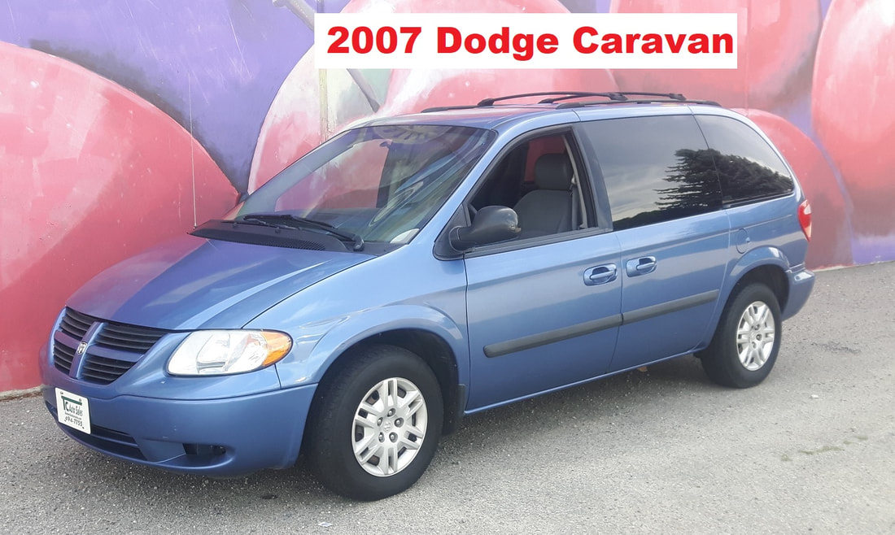
Used Car (bank loan)
5% GST tax on all USED CARS
Add tax
What is your interest from your bank?
TVM information
Total cost

Slide 12
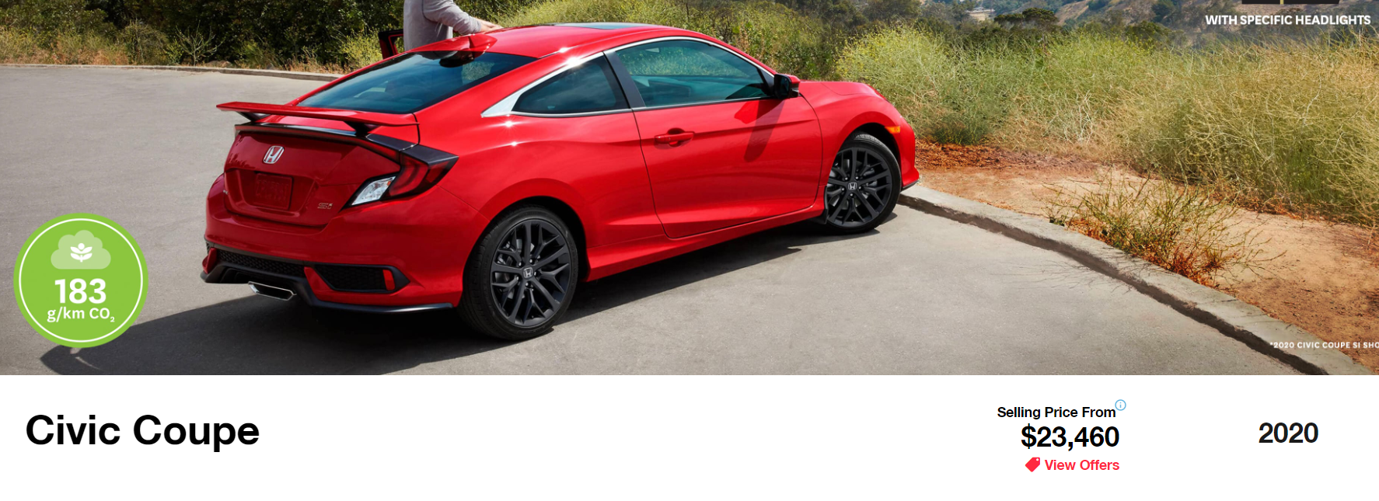
New Car LOAN (dealership loan)
12% GST tax on all NEW CARS
Add tax
What is your rate from the dealership?
TVM information
Total cost

Slide 13
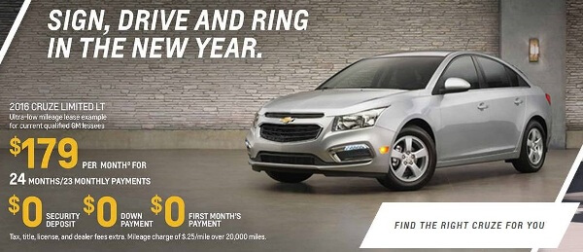
New Car LEASE (dealership lease)
12% GST tax on your downpayment
12% tax on your monthly payment
Add taxes
What is your interest rate from the dealership?
TVM information
Total cost at end of buy out

Slide 14
To Do Today
Due Thursday, Feb 17th
1. Find a USED car to purchase – print off advertisement
Look up current bank interest rates for a loan
Work through used loan TVM
Calculate final cost of car
2. Find a NEW car to purchase – print off advertisement
Look up current bank interest rates for a loan
Work through used loan TVM
Calculate final cost of car
3. Find a NEW car to lease– print off advertisement
Look up dealership lease prices and terms
Work through used loan TVM
Calculate final cost of car

Slide 15
Websites to Use
https://www.rbcroyalbank.com/personal-loans/index.html
https://www.ford.ca/
https://autookanagan.com/used

