Slide 1
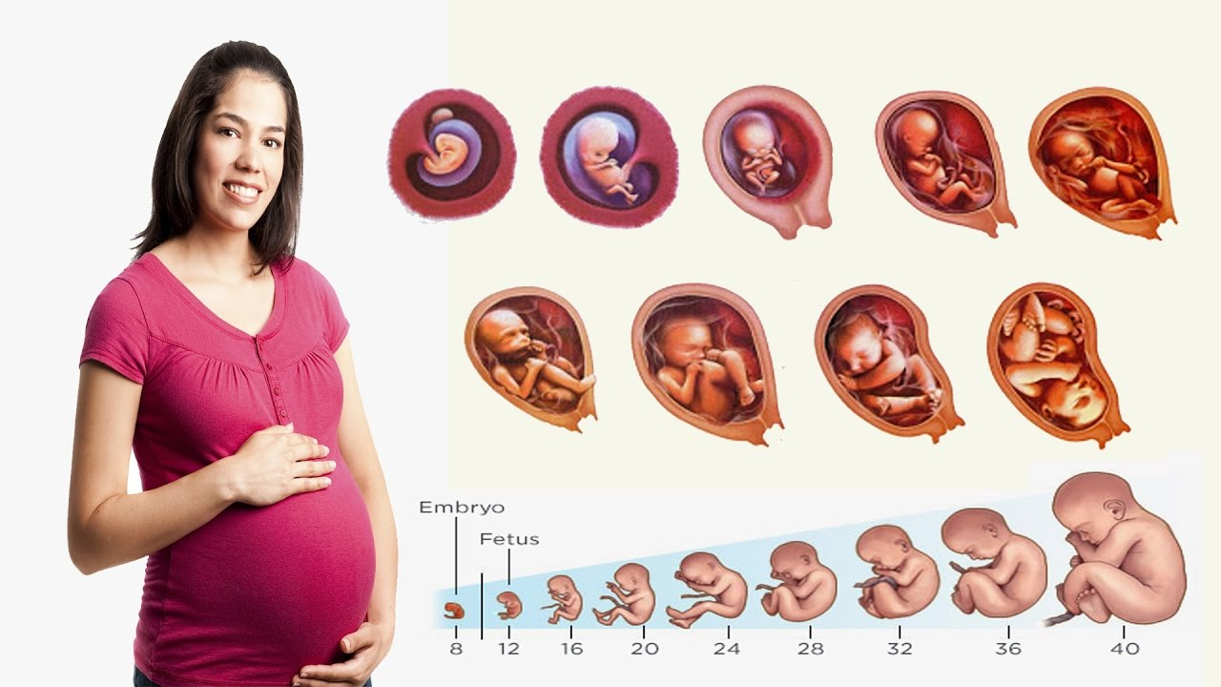
Fertilization
&
Pregnancy

Slide 2
What is Fertilization?
fertilization is when the haploid (N) sperm connects and "mixes" chromosomes with the haploid (N) ovum
occurs in the fallopian tube
occurs following ovulation
egg is only viable for about 24 hours after ovulation
sperm can live inside the body for 3 days

Slide 3
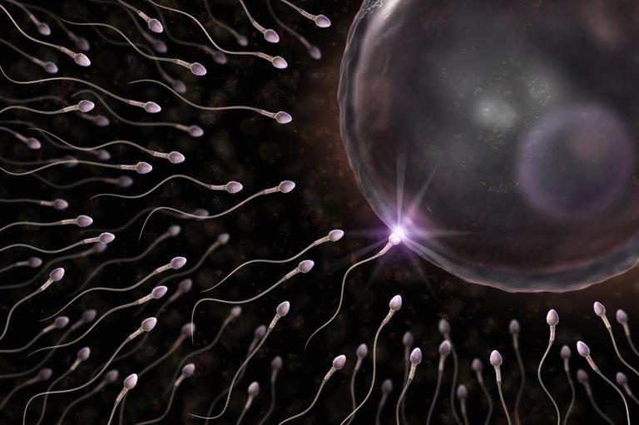
Ovum Fertilization
Watch fertilization video

Slide 4
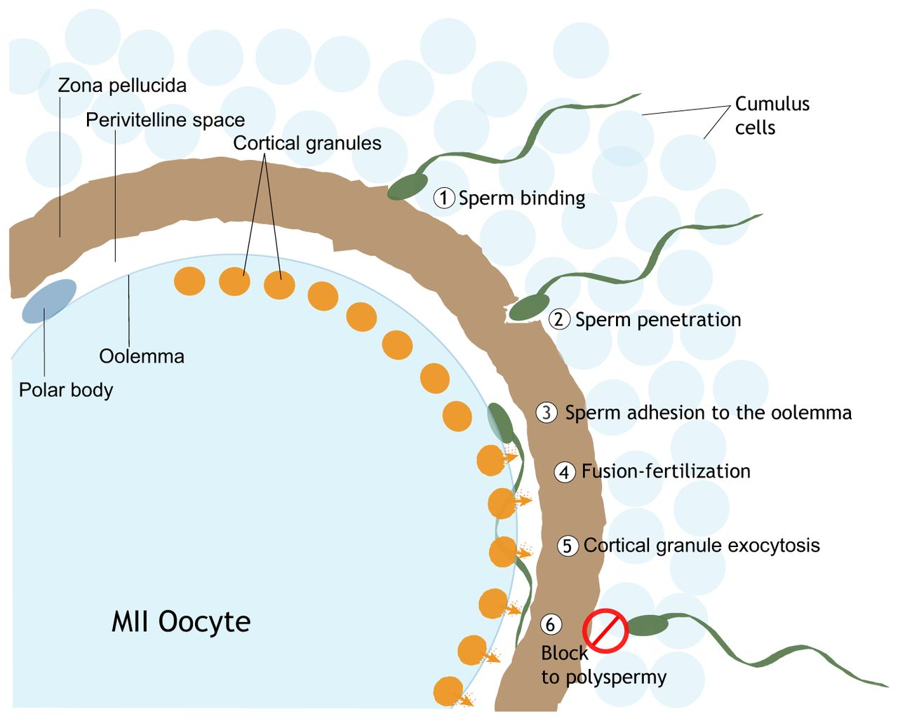
4 steps of fertilization
Sperm binding (to zona pellicida)
Acrosome reaction (sperm enzymes)
Cortical reaction (prevent polyspermy)
Genetic transfer (male DNA to ova)

Slide 5
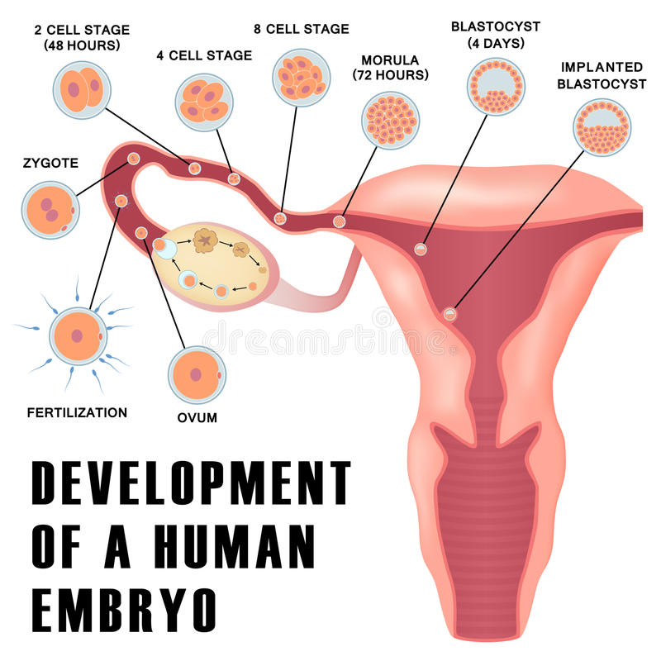
Development of a
Zygote to Embryo
Ova → Zygote → Cleavage → Morula → Blastula → Gastrula → Embryo → Fetus

Slide 6
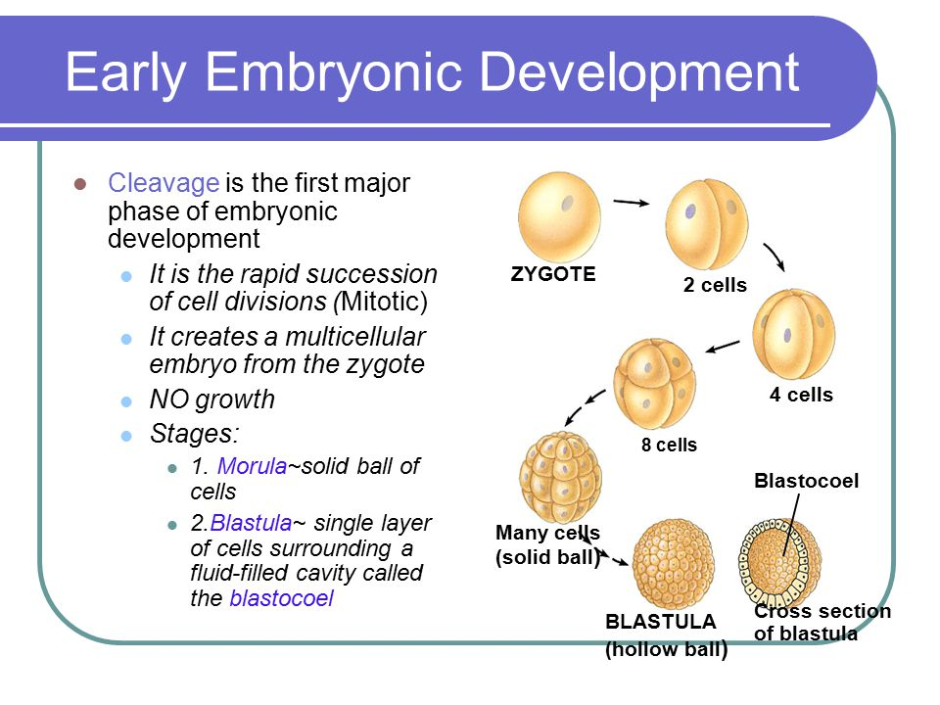
Early Embryology

Slide 7
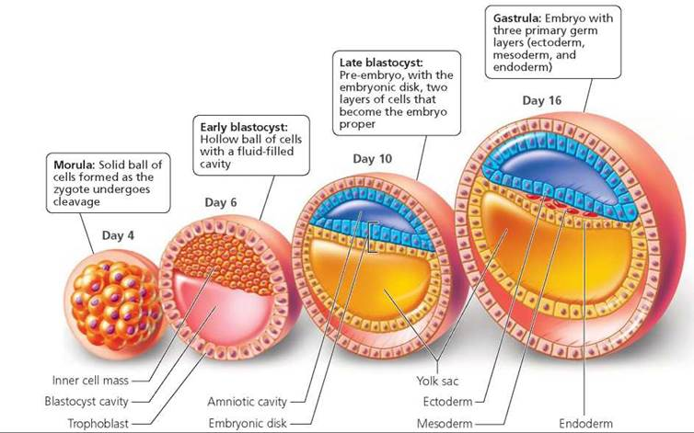
Gastrulation
The process where the single layers blastula folds into a three layers gastrula.
Ectoderm becomes skin and nervous system.
Mesoderm becomes skeletal system, heart, circulatory vessels
Endoderm becomes digestive system

Slide 8
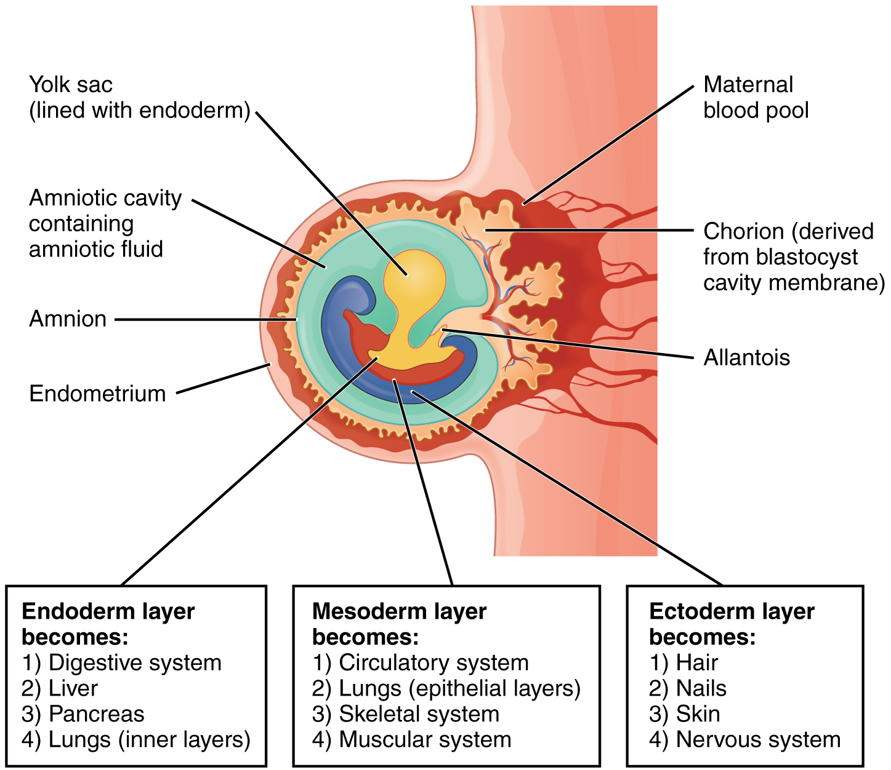
Gastrulation

Slide 9
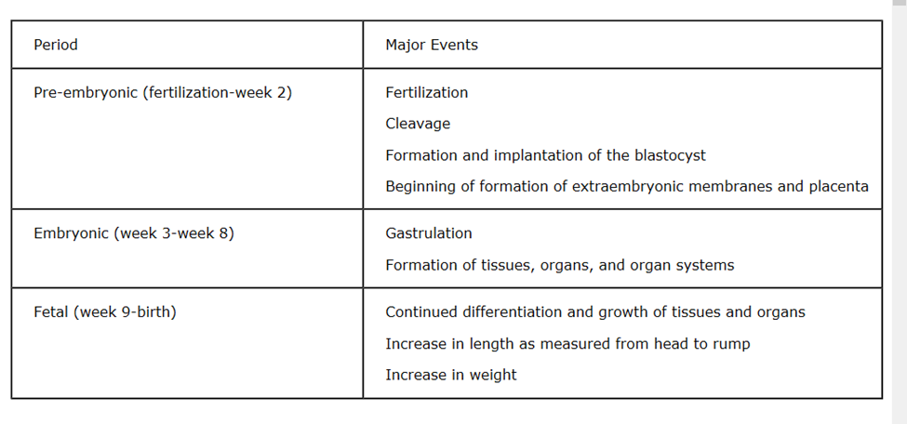
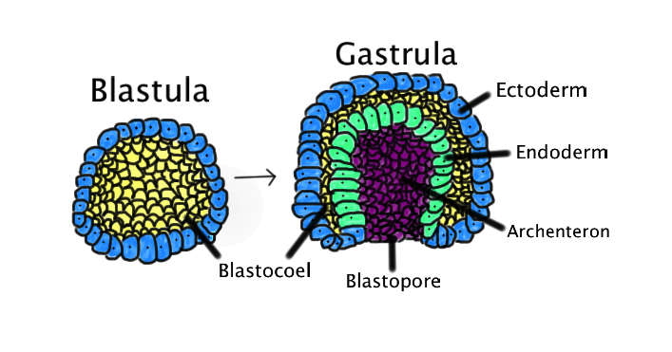
Gastrulation

Slide 10
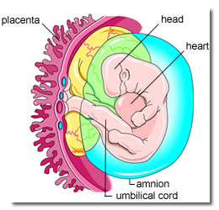
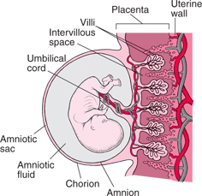
Zygote forms half the placenta

Slide 11
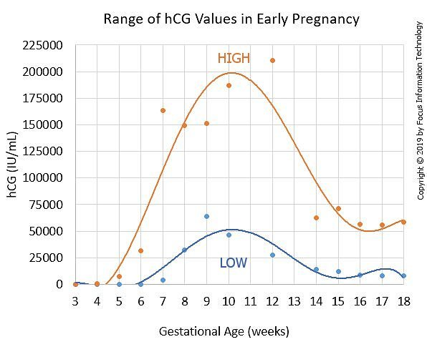
Hormone Changes After Fertilization
Human Chorionic Gonadotropin hormone (HCG) is produced by placenta as soon as embryo implants in wall
HCG tells corpus luteum to continue to make Estrogen and Progesterone
hormone tested for in pregnancy tests (will be in urine and blood)
HCG is also what can cause morning sickness

Slide 12
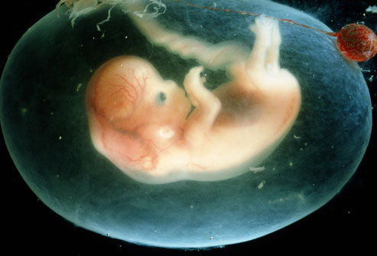
Development of fetus
(Week 1 – 9)
What do you notice?
What do you wonder?

Slide 13
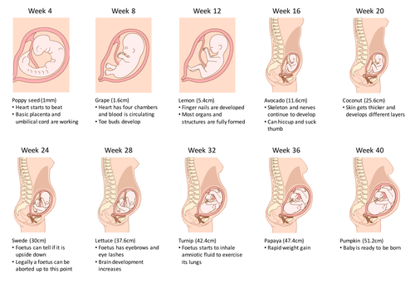
What do you notice?
What do you wonder?

Slide 14
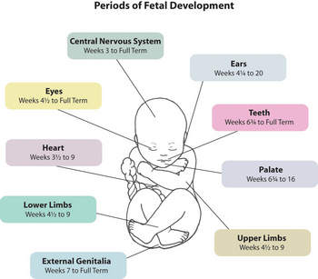

Slide 15
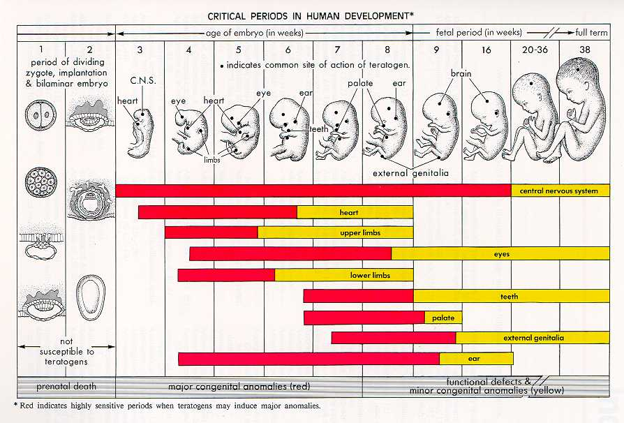
What do you notice?
What do you wonder?

Slide 16
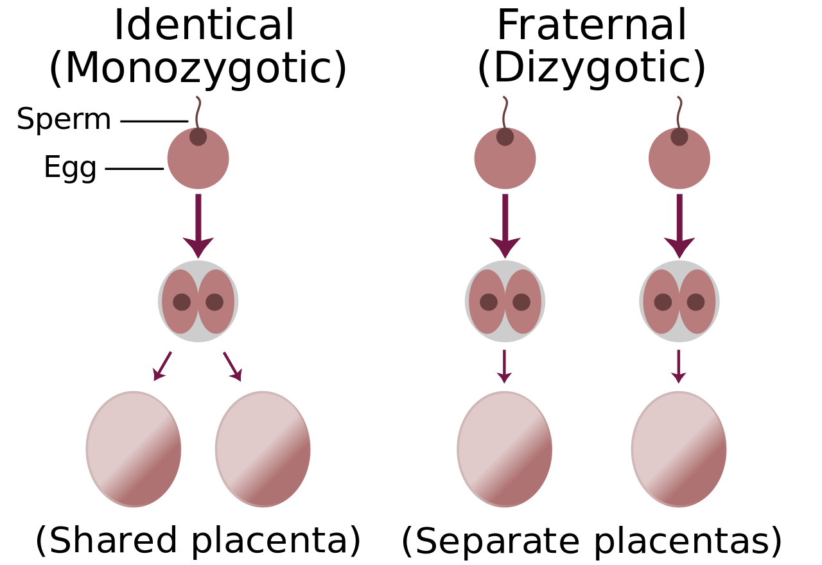
Identical versus
Fraternal Twins

Slide 17
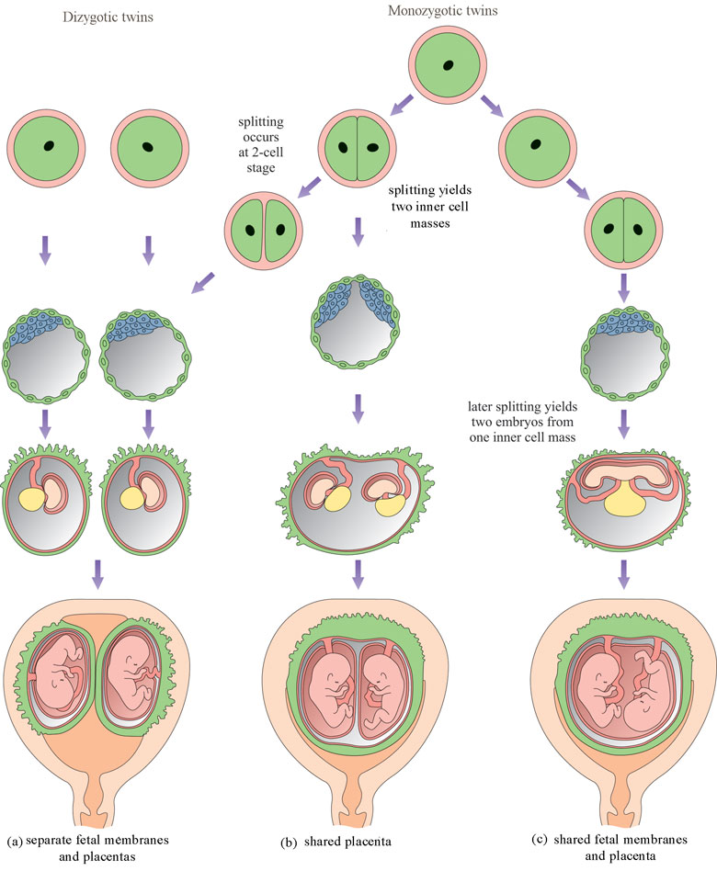
One Placenta or two?
One Membrane or two?

Slide 18
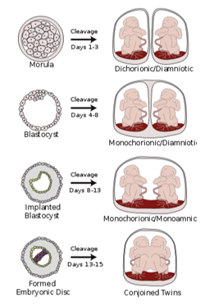
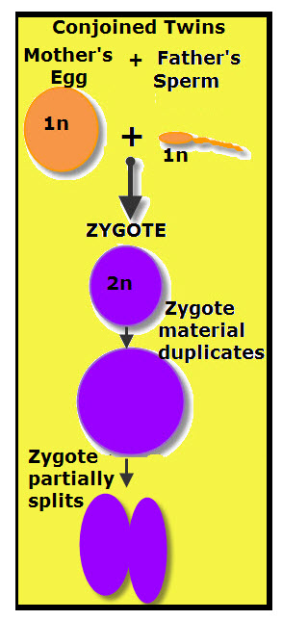
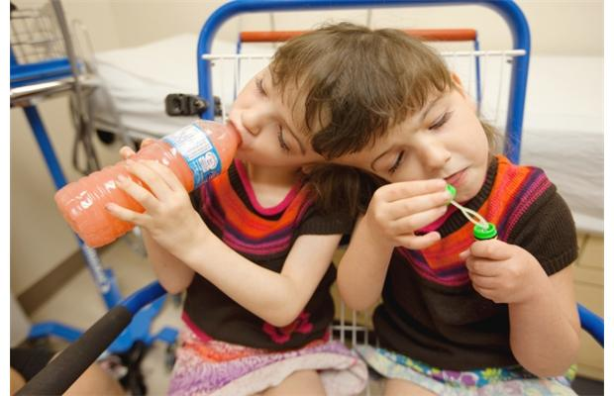
Coinjoined Twins

Slide 19
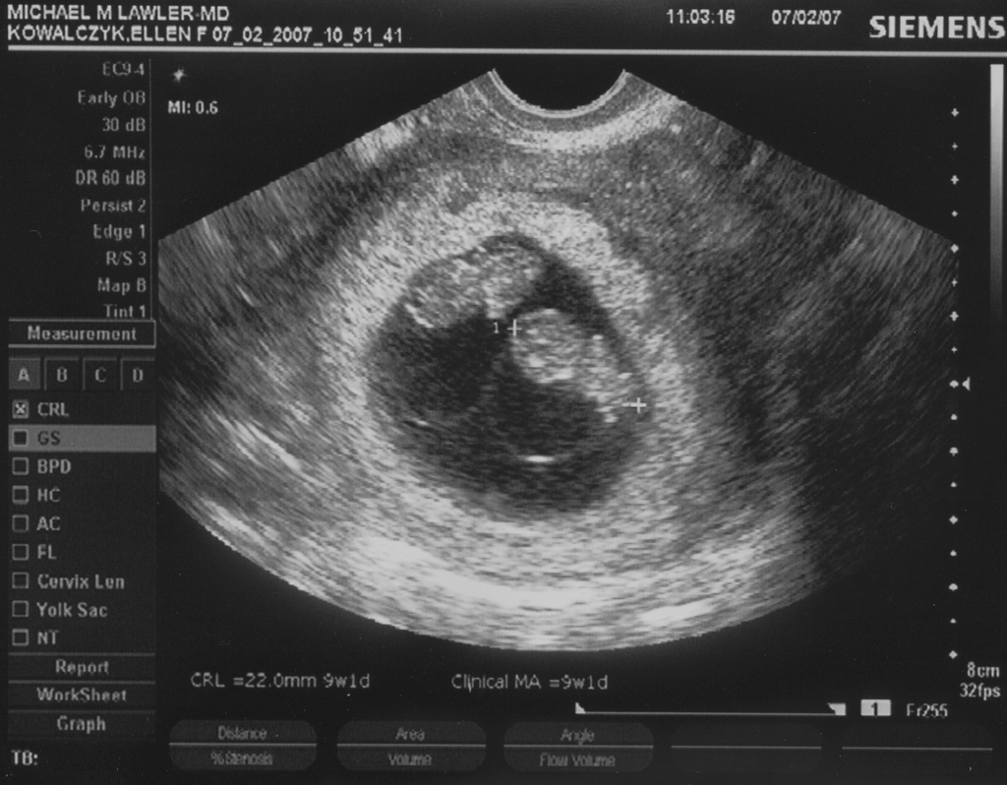

Slide 20
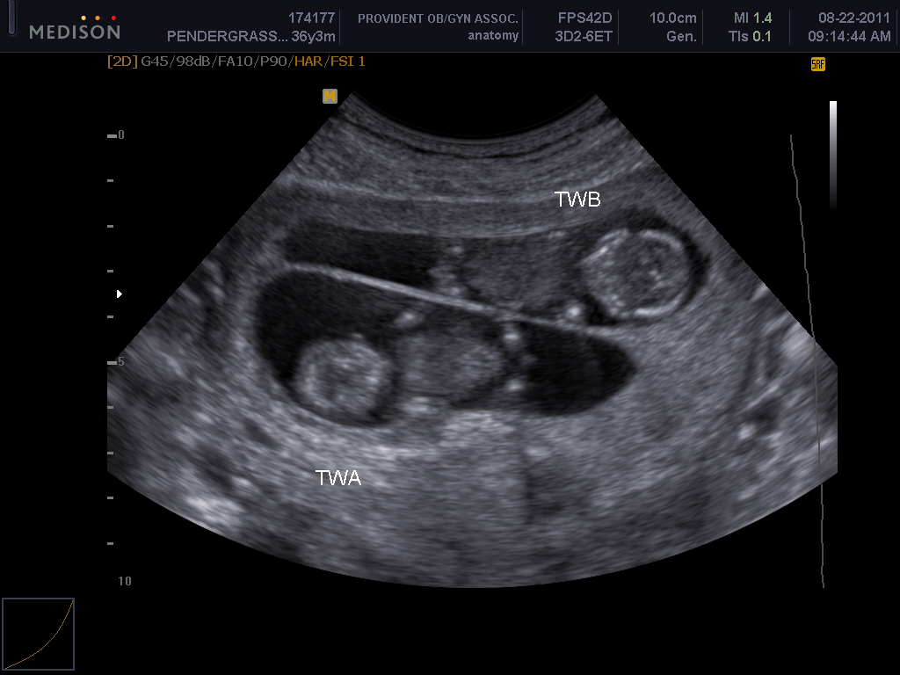

Slide 21
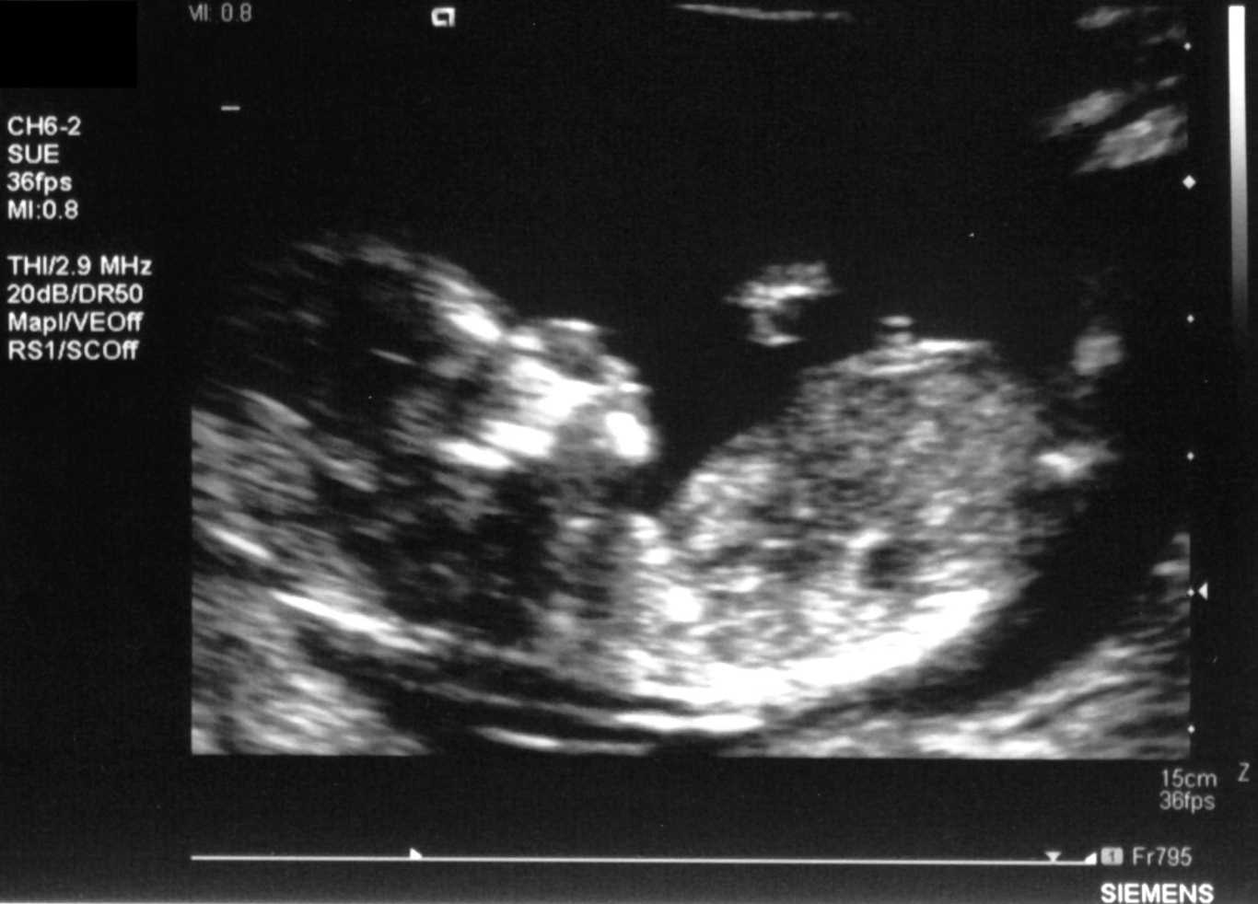
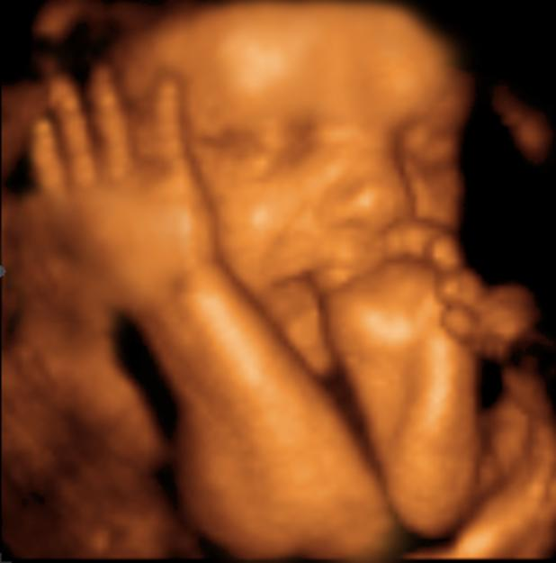
Ultrasounds

Slide 22
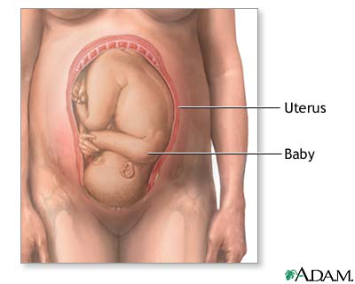
At the end of the 40 weeks...
now what??
baby is head down in pelvic cavity
pressure of head on cervix causes release of oxytocin hormone
produced in hypothalamus and stored and released by pituitary

Slide 23
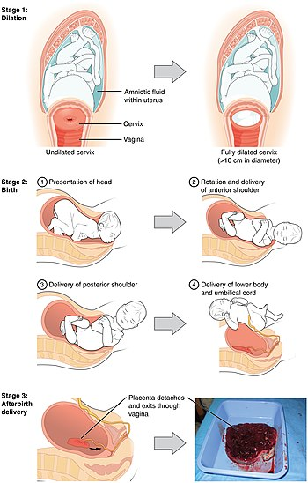

Slide 24
At the end of the 40 weeks...
now what??
This causes contractions of myometrium
this causes extra pressure on cervix, which causes extra release of oxytocin...positive feedback loop

Slide 25
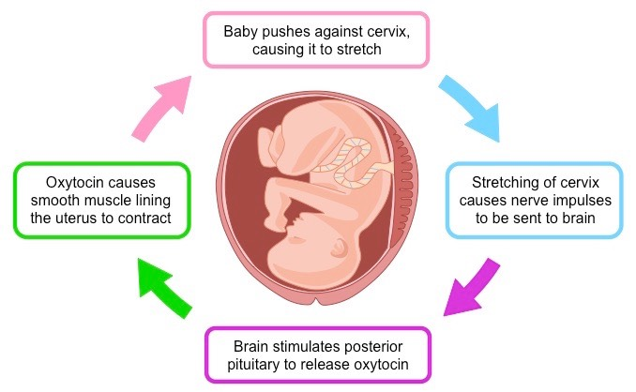
Positive Feedback Loop

Slide 26
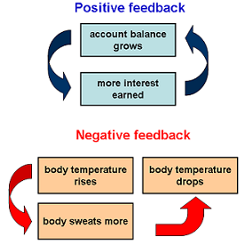
Positive Feedback Loop vs Negative Feedback Loop

Slide 27
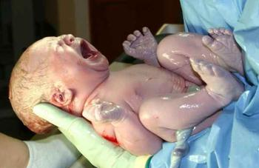
Labour and Delivery
What do you notice?
What do you wonder?

Slide 28
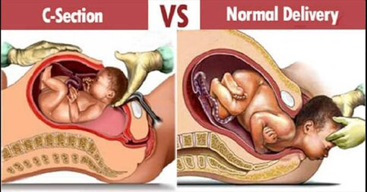
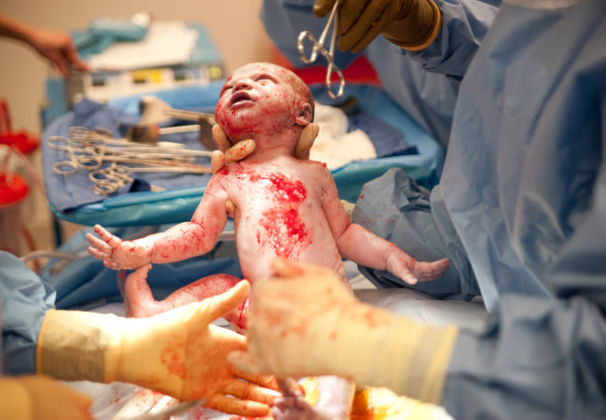

Slide 29
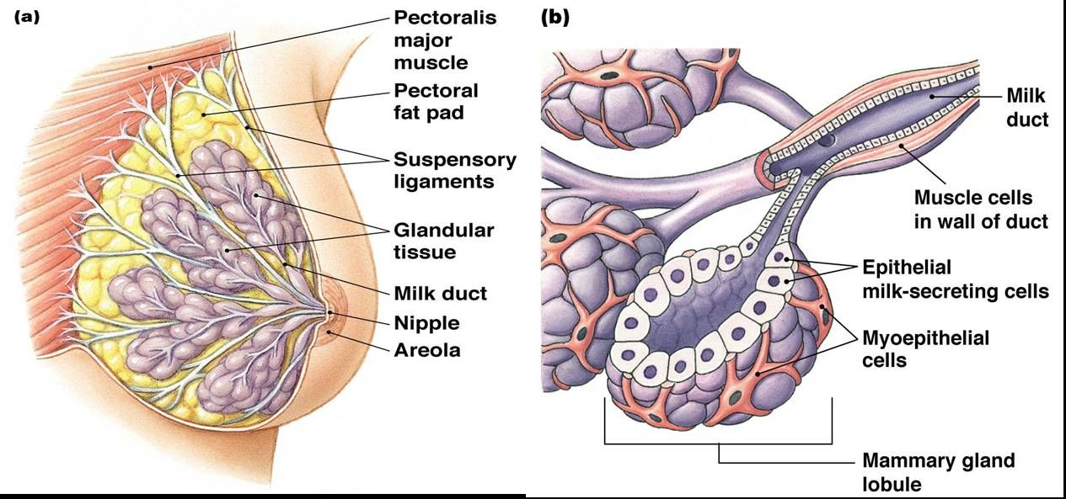
Mammary Gland Development
A mammary gland is an exocrine gland
that produces milk to feed young offspring.
Breasts develop after puberty due to estrogen
Prolactin is the hormone that helps produce milk, produced in pituitary
Prolactin is suppressed by the progesterone made in pregnancy
Estrogen and prolactin cause the production of milk in lobes
15 lobes and milk ducts that bring milk to the nipple

Slide 30
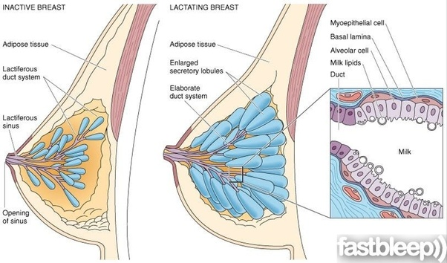
Mammary Gland Development
Mammary glands are modified sweat cells
The areola contains secretory glands that help during nursing
Glands connected with lymphatic system to help drain extra tissue (antibodies in breast milk to develop fetal immunity)

Slide 31
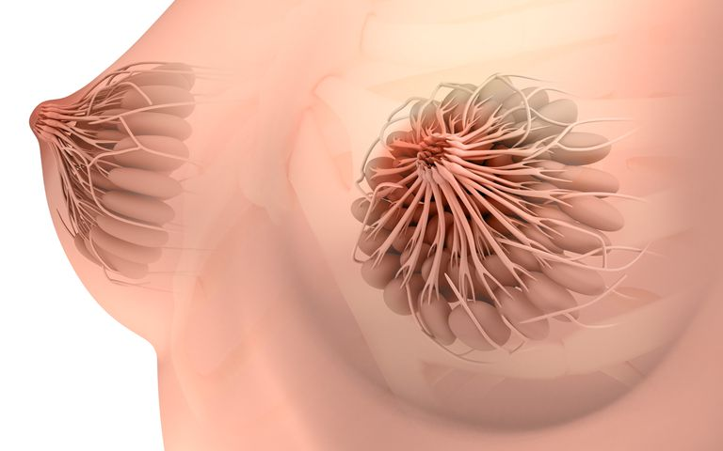
Mammary Gland Development
Oxytocin is the hormone involved in milk release
Colostrom is the fluid released in the first couple nursing let downs and contain high antibodies and protective proteins
Suckling of the baby causes a release of oxytocin from the posterior pituitary to create pressure in milk lobes and release milk.

Slide 32
Keeping Your Reproductive System Healthy
STI Prevention
Viral and bacterial infections can scar and harm reproductive system
Choose a barrier contraception method prevents genital tissues from touching
Pregnancy Prevention
Preventing gametes from fertilizing
Choose either a barrier or chemical method that prevents fertilization

Slide 33
Types of Contraception
Barrier Method:
Stops gametes from meeting
Condom (male and female)
Diaphragm
Cervical cap
Sponge
Sterilization
Chemical Method:
Prevents ovulation and thickens cervical mucous
Mini Pills (Prog only)
Combo Pills
IUD
Injection
Patch
Implant
NO STI protection

Slide 34
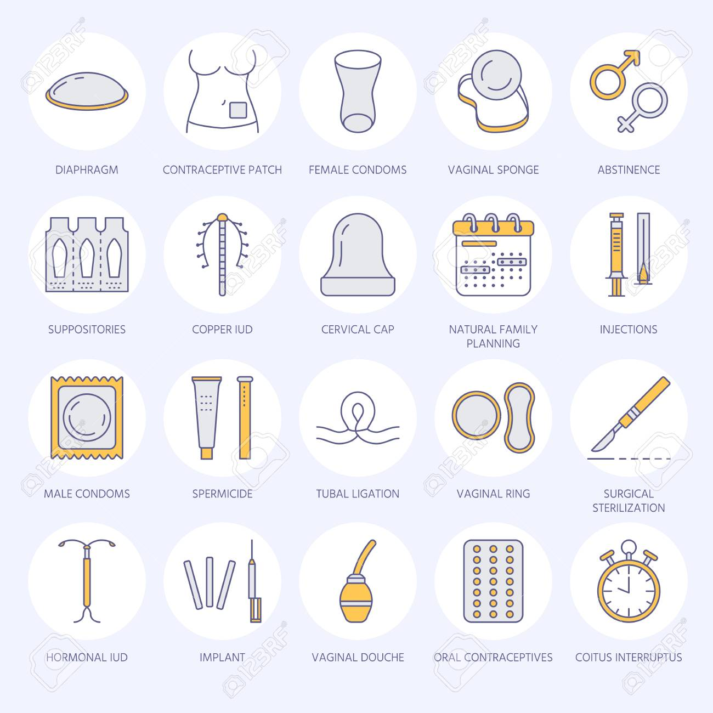
Types of Contraception
Watch video

Slide 35
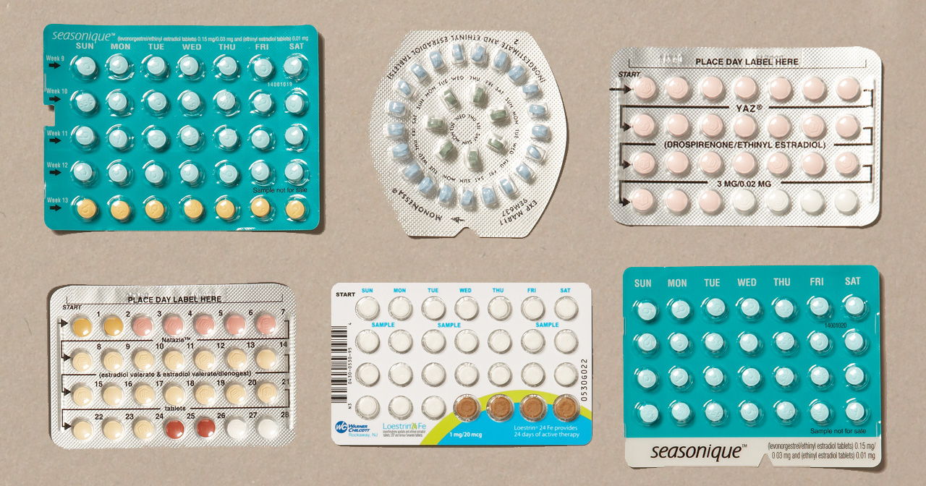
Birth Control Pills
Watch video

Slide 36
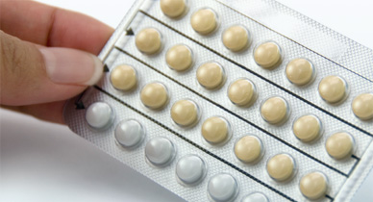
Mini Pills (Progestin only)
Progestin-only birth control pills, sometimes called “mini-pills,” have several effects in the body that help prevent pregnancy:
The mucus in the cervix thickens, making it difficult for sperm to enter the uterus and fertilize an egg
They stop ovulation, but they do not do so consistently. About 40% of women who use progestin-only pills will continue to ovulate
They thin the lining of the uterus
NO STI Protection!!!

Slide 37
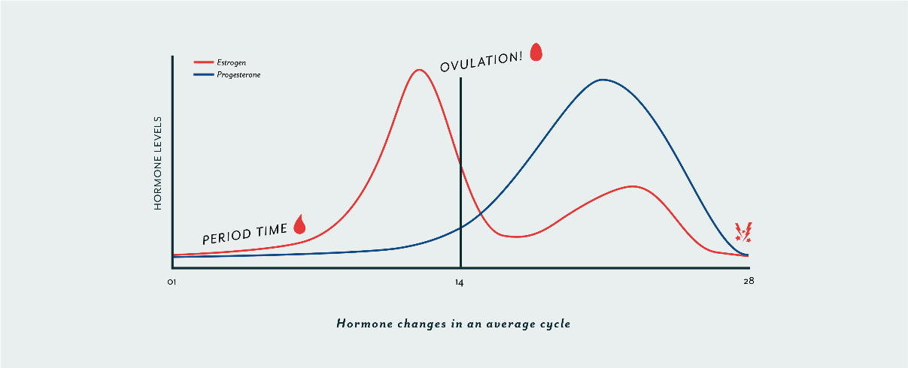
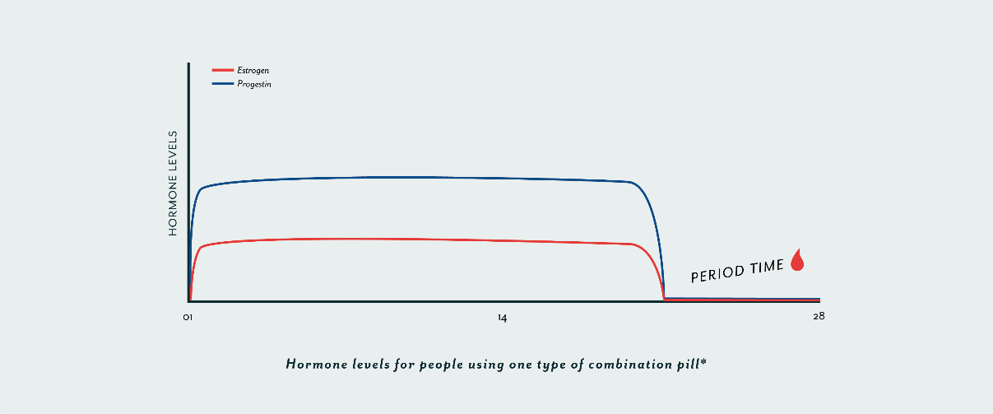
Combination Pills (Progesterone and Estrogen)
The heightened levels of progesterone and estrogen suppress FSH and LH from maturing and releasing another ova…no ovulation

Slide 38
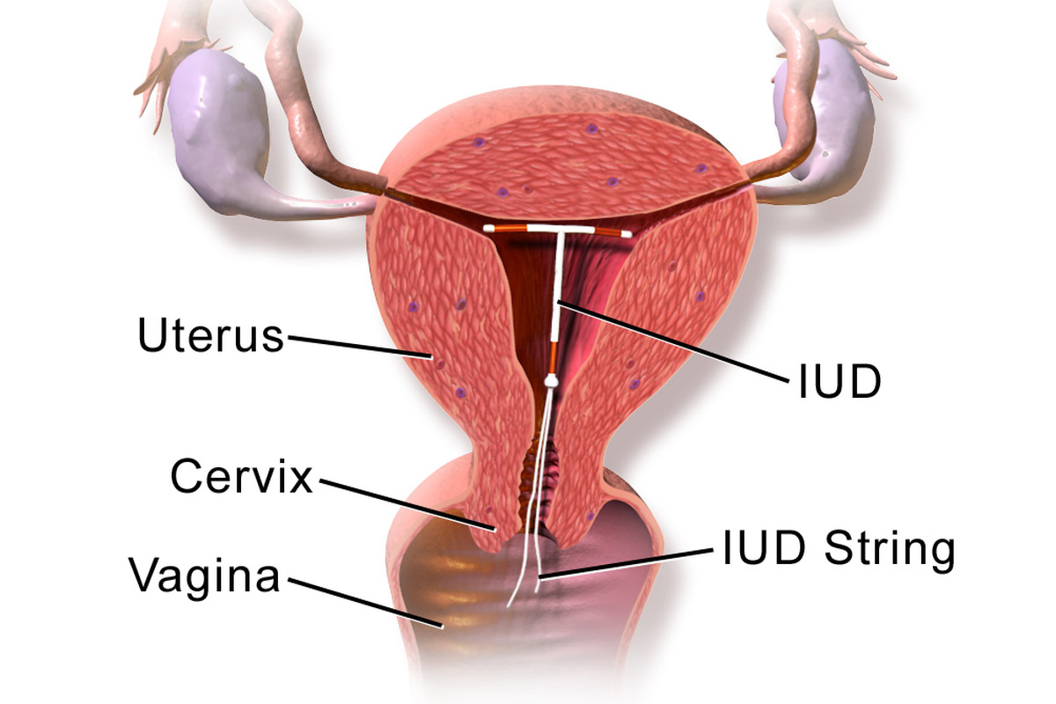
I.U.D
99% effective
Can be plastic with hormone release or copper
Prevent sperm from successfully making it through the uterus
Copper kills sperm
NO STI Protection!!!

Slide 39
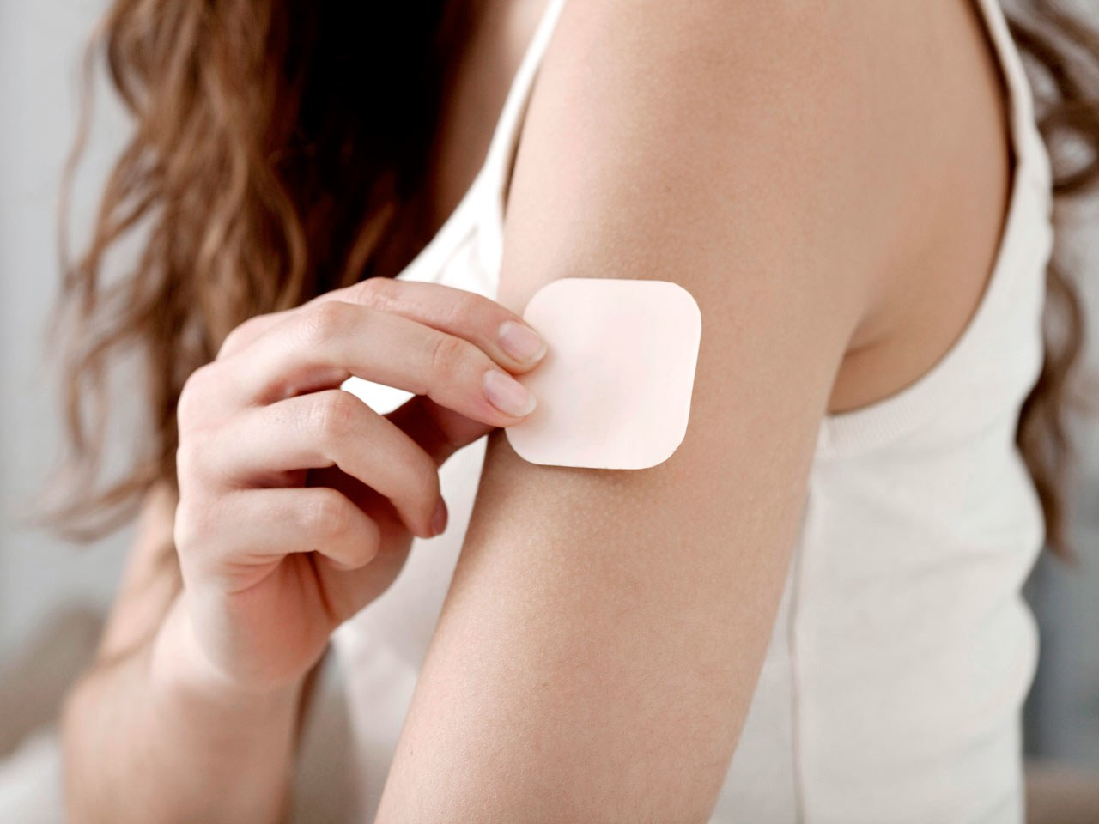
Birth Control Patch
Releases hormones through the skin
Contains estrogen and progesterone
Prevents ovulation and thickens cervical mucous
Put on new patch each week
NO STI Protection!!!

Slide 40
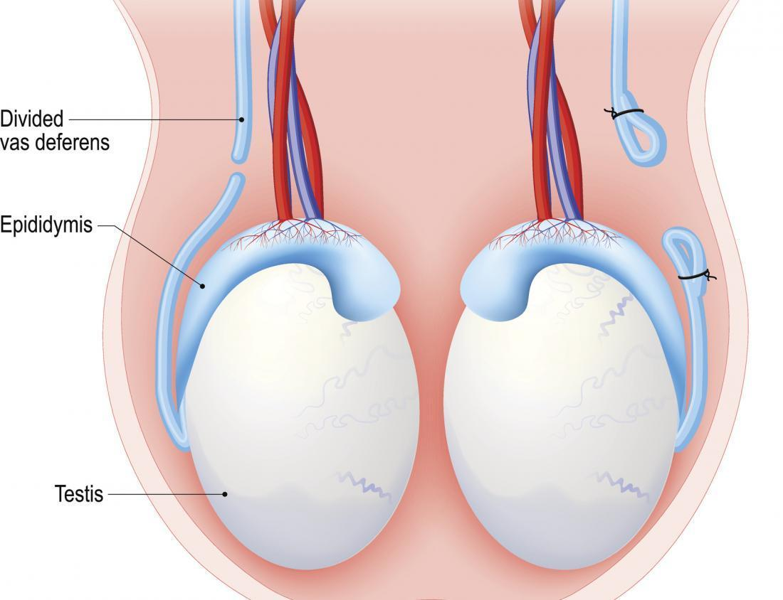
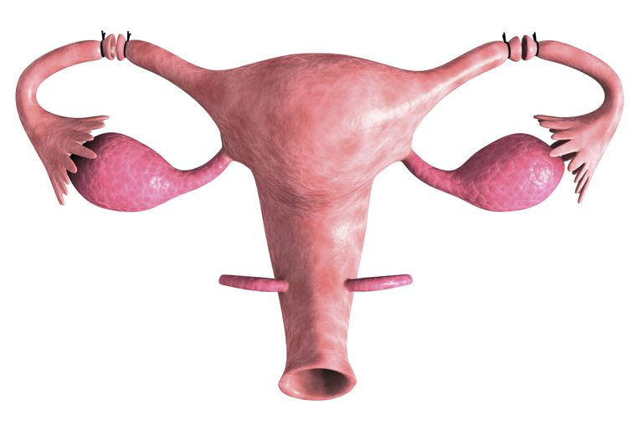
Sterilization
NO STI PROTECTION
Vasectomy
Males
Tubal Ligation
Females

Slide 41
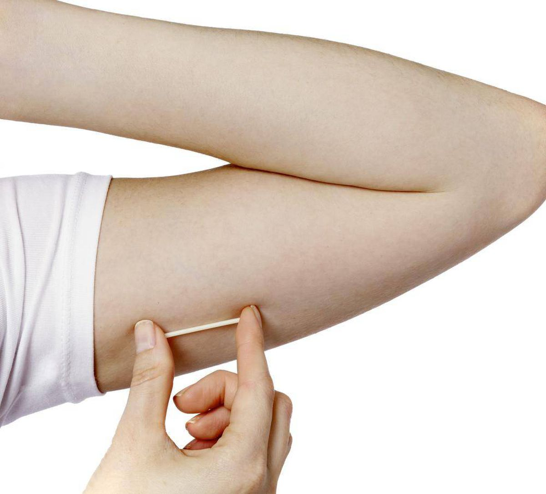
Nexplanon
Implant in the arm
Releases progestine
Lasts 5 years
Doctor implants
NO STI Protection!!!

Slide 42
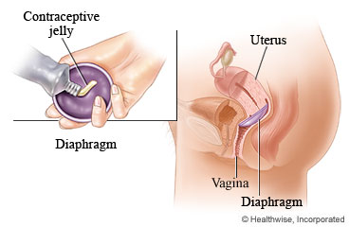
Diaphragm
Acts as a barrier to prevent sperm from going up uterus
Used in conjunction with spermicidal jelly which contains a chemical which will kills sperm
NO STI Protection!!!

Slide 43
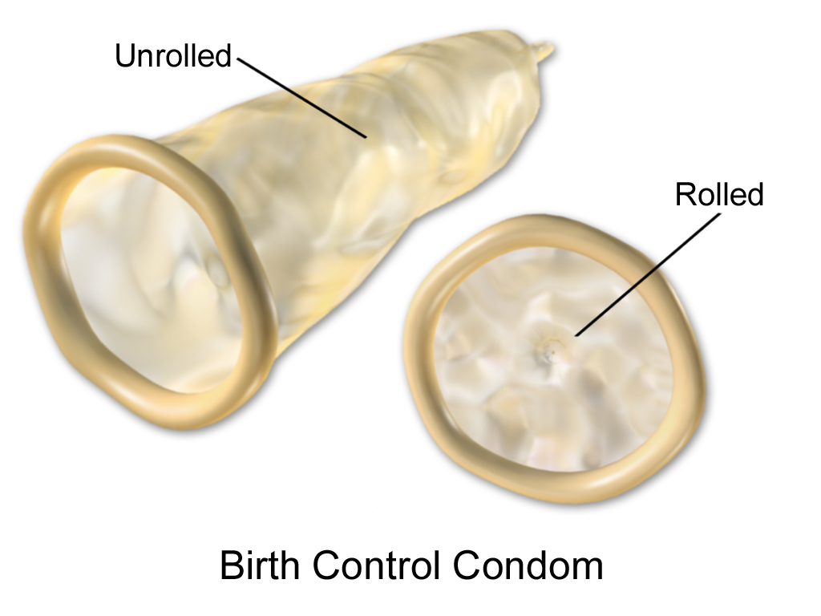
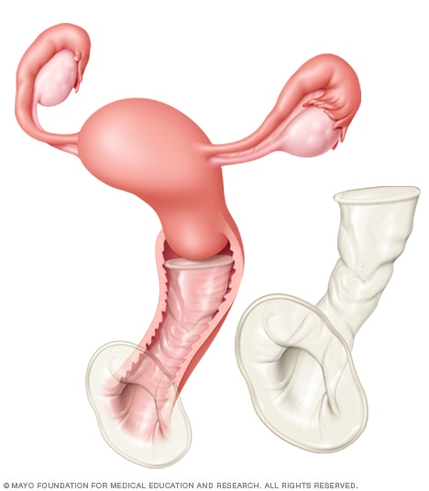
Condoms
The only form of contraception which has SOME protection against STI infections
Acts as a barrier so that gametes do not meet. If gametes do not meet, fertilization can not occur
Male Condom
Female Condom

Slide 44
Homework
Complete the female Reproduction Worksheet (from last class) and check answer key on website
Complete the UNIT REVIEW (handed out today)
Study for final 30 minutes each evening

