Slide 1
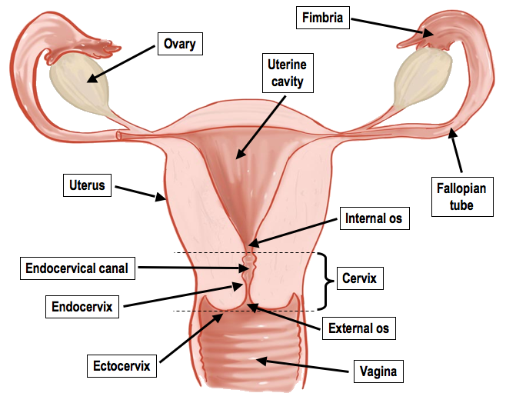
Female Reproductive System
Purpose:
To release ova
To house developing fetus

Slide 2
The purpose of the reproductive system is to pass on your genes to the next generation
Females need to "house" and feed the developing embryo
This requires a very healthy and fit individual to ensure a successful maturation of the offspring and a healthy birth

Slide 3
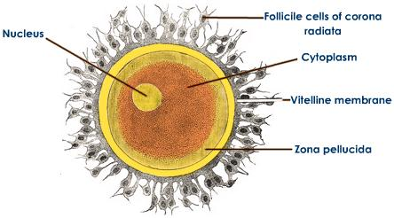
Gametes - Ovum
1. Nucleus houses the chromosomes of the female
2. Humans are viviparious - embryo develops INSIDE the female and gets nutrients from placenta
3. Girls start making "eggs" in ovaries at 9 weeks gestation (in utero)
4. A ovum is 26 x larger than a RBC (it's BIG for a cell)

Slide 4
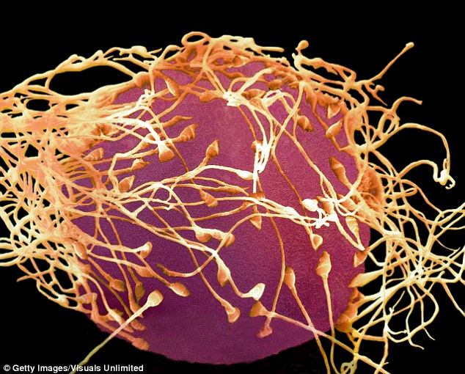
Gametes - Ovum
The human ova with sperm trying to fertilize it

Slide 5
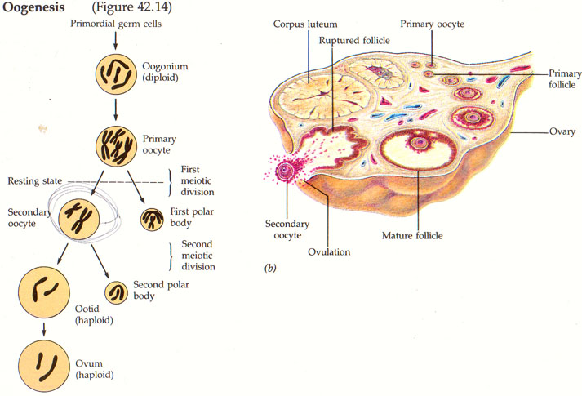
Oogenesis
1. Two stages of meiosis creates a haploid ovum (one copy of each chromosome)
2. Female ova are already formed in the ovaries and stay as primary oocytes until menstruation starts
3. One follicle and oocyte gets matured each cycle (sometimes more than one, younger women)

Slide 6
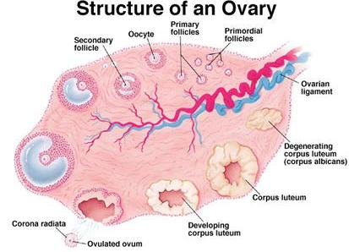

Slide 7
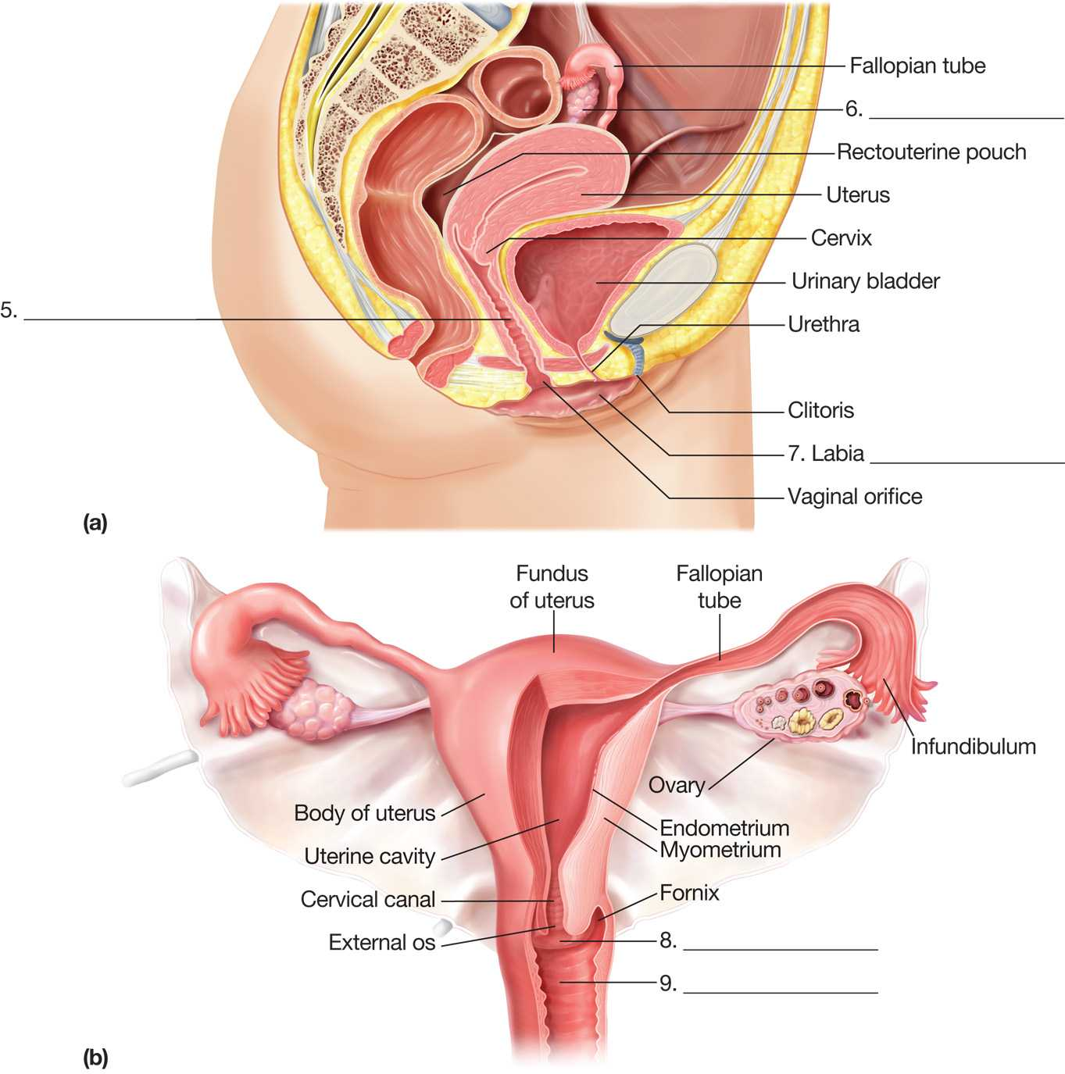
Path of the Ova
1. primary oocyte starts to develop in the ovary
2. mature secondary oocyte will erupt from the ovary, moved by fimbrae, and start to travel down the fallopian tube (cilia)
3. fertilization takes place up at the top of the fallopian tube near the ovary
4. If the ovum is fertilized, the ovum will implant itself into the endometrial lining and start to grow a placental lining
5. If the ovum is not fertilized, the ovum will be cleared away with menses as the endometrial lining sloughs off

Slide 8
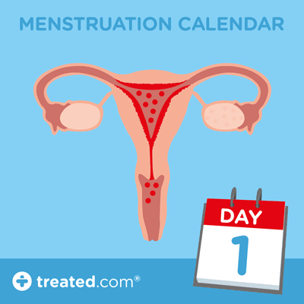
Path of the Ova

Slide 9
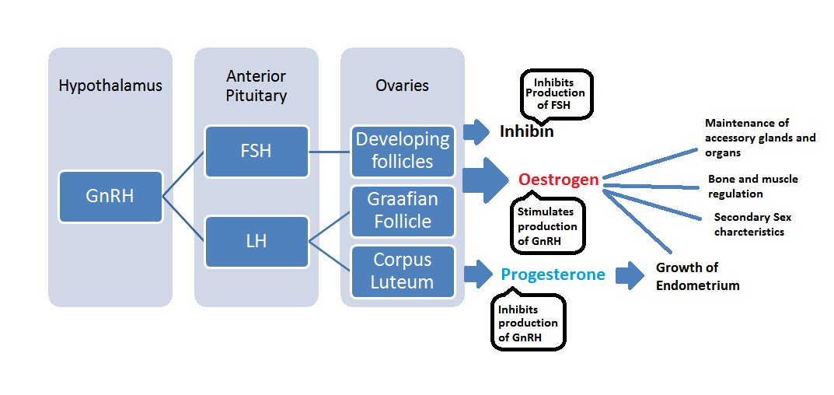
Hormones of Female Reproductive System

Slide 10
Hormones of Female Reproductive System
GnRH (from hypothallamus)
Gonadotrophic Releasing Hormone
Stimulates the pituitary gland to release LH and FSH hormones from pituitary
FSH (from pituitary gland)
Follicle Stimulating Hormone)
LH (from pituitary gland)
Luteinizing Hormone
Controls the release of ESTROGEN and PROGESTERONE
stimulates the ovary to start developing the follicle
Progesterone
(from ovary)
controls the secretory phase (endometrial lining)
Estrogen
(from ovary)
controls the proliferation phase, or the thickening of endometrial lining

Slide 11
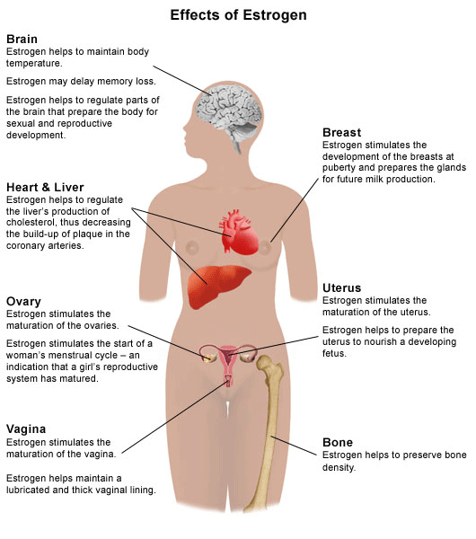

Slide 12
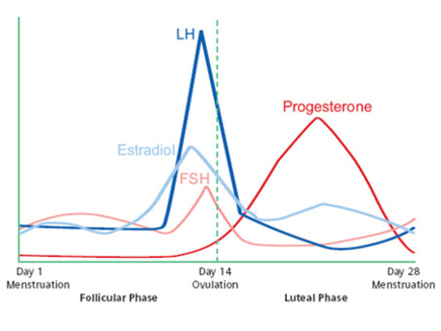
What spikes before ovulation?
What spikes after ovulation?

Slide 13
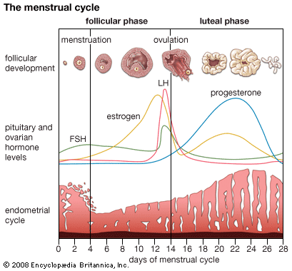
How does this relate to the menstruation cycle?

Slide 14
Ovarian Phases
Ovarian Phases | Events
Follicular Phase Day 1 - 13 | A new follicle grows and matures due to release of FSH ovum matures inside the Graffian follicle in the ovary
Ovulation Day 14 | increase in estrogen will cause a spike in LH The spike in LH causes the Graafian Follicle to burst and release the ovum
Luteal Phase Day 15 - 28 | remaining follicle (corpus luteum) will make progesterone and estrogen which send message to continue to mature and build up endometrial lining

Slide 15
Uterine Phases | Events
Menstral Flow Day 1 - 5 | LH reduction causes Corpus Luteum to disintegrate, which causes it to stop making estrogen and progresterone This drop in P will cause menstruation
Proliferation Day 6 - 14 | lining of uterus thickens (due to estrogen)
Secretory Phase Day 15 - 28 | progesterone causes a maturing of endometrial lining, with blood vessels and mucal cells
Uterine Phases

Slide 16
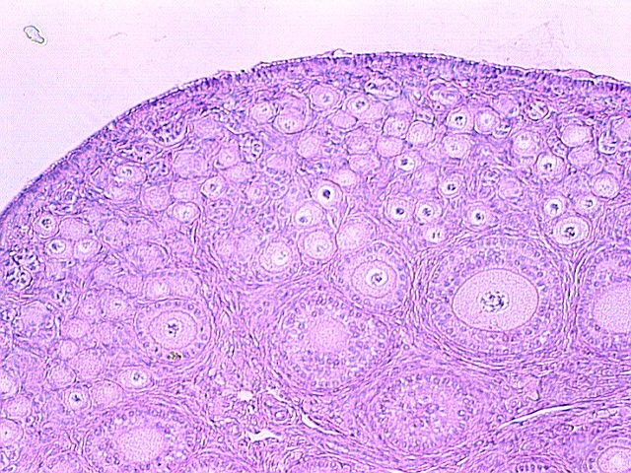
Cross Section of Ovaries

Slide 17
Secondary Sex Characteristics of Females
1. widening of hips
2. breast tissue development
3. start of menstruation
4. body and pubic hair

Slide 18
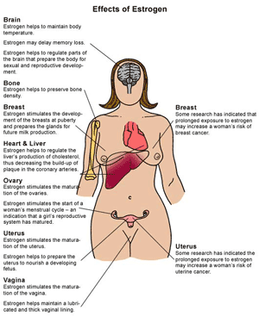
Estrogen helps with much more than just reproductive health, which is why many women use estrogen replacement during menopause (when they stop making estrogen)

Slide 19
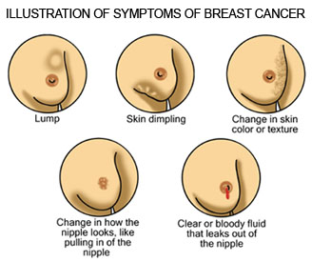
Health Issues Related to Female Reproductive System
Cancers:
Breast
Cervical
Ovarian
Uterine

Slide 20
Infertility
What could cause infertility in females?
Hormone | Normal Range | Infertility Range
FSH | 5-20 | Too High
Estrogen | 20-400 | Too low
LH | 5-20 | No surge
Progesterone | 2-25 | Too Low

Slide 21
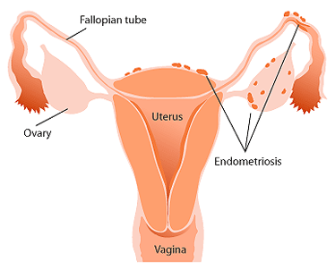
Health Issues Related to Female Reproductive System
Endometriosis
Endometrial lining on the outside of the uterus and fallopian tubes
Causes pressure and pain
Can reduce fertility

Slide 22
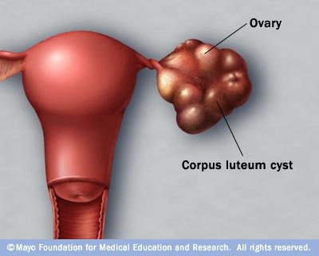
Health Issues Related to Female Reproductive System
Ovarian Cysts
Fluid filled pockets in the ovary
Inflammation and pain
Most disappear on own
Some can rupture (need medical intervention)

Slide 23
1. Draw the various parts of the female reproductive system:
ovary (with various stages of follicle and oocyte)
fimbriae
fallopian tubules
uterus (with perimetrium, myometrium, endometrium)
cervix
vagina
2. Draw the female hormone feedback loop for the following:
GnRH
LH
FSH
Estrogen
Progesterone

