Slide 1
Factors Affecting Enzymatic Speed Lab
Bi 12
Enzymes and Biochemistry Unit

Slide 2
Reminder… What changes how fast an ENZYME causes a reaction?
Substrate Concentration
Enzyme Concentration
Temperature & pH
Enzyme Inhibition
Enzyme Cofactors

Slide 3
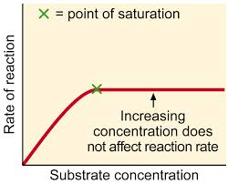
Substrate Concentration
Enzyme activity increases as substrate concentration increases because there are more collisions

Slide 4
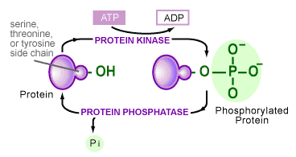
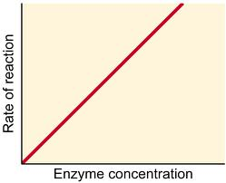
Enzyme Concentration
Enzymes can be increased by turning on the genes to make more of the protein
Phosphorylation is one way to activate protein (enzyme)

Slide 5
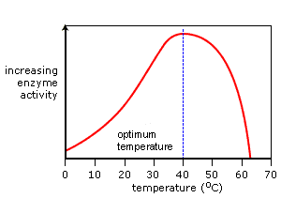
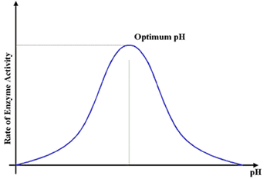
Temperature & pH
As temperature rises enzyme activity increases to an optimum temperature
Then protein denatures and stops being a activation site

Slide 6
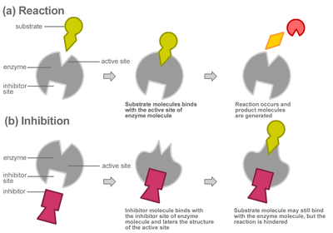
Enzyme Inhibition

Slide 7
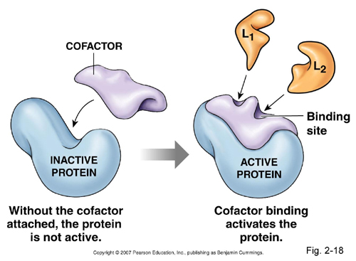
Enzyme Cofactors

Slide 8
Enzyme Cofactors
Vitamins are cofactors
A deficiency in a vitamin will cause a lack in the functioning of an enzyme
Niacin deficiency results in skin disease
Riboflavin deficiency results in cracks in corner of mouth

Slide 9
The Lab
You will be using LIVER to see the enzymatic reaction of catalase

Slide 10
The Lab
The reaction you will see:
How do you collect evidence ofr the presence of oxygen gas?

Slide 11
Your Control Data
Use a LIKERT SCALE to collect your data:
_{0 = no rxn}
_{1 = mild rxn}
_{2 = medium rxn}
_{3 = strong rxn}
_{4 = very strong rxn}
Test Sand and H₂O₂
_{This is your negative control}
₌ ₀
Test Manganese and H₂O₂
_{This is your positive control}
₌ ₄

Slide 12
Your BASELINE Data
Use a LIKERT SCALE to collect your data:
_{0 = no rxn}
_{1 = mild rxn}
_{2 = medium rxn}
_{3 = strong rxn}
_{4 = very strong rxn}
ANIMAL CELLS
_{Liver}
What is your reaction on a 0 – 4 scale?
PLANT CELLS
_{Potato}
_{What is your reaction on a}
_{0 – 4 scale?}

Slide 13
Your Independent Variables
Change the amount of enzyme (catalase)
More or less than baseline
Change the amount of substrate (H₂O₂)
More or less than baseline
Change the surface area of the material
Mash up the liver and potato
Change the temperature
Hot water bath or cold water bath
Change the pH
Add and acid or a base
Add an inhibitor
Add Lead nitrate

Slide 14
How to Stay Safe in the Lab
Wear goggles
If you spill lead make sure you wash your hands with lots of water RIGHT AWAY
No lead can go down the sink. Please place in the LEAD beaker in the fumehood.
CLEAN UP and PUT AWAY all equipment

