Slide 1
Excretory System
Biology 12

Slide 2
Prepare your Brain for learning…
What do you already know about the excretory system?
What do you want to know about the excretory system?

Slide 3
Purpose of excretory system
One way to rid the body of waste
Feces → digestive system
CO₂ → Respiratory system
Urine → Excretory system

Slide 4
Parts of the Excretory system

Slide 5
Human Kidney
Located behind the peritoneal lining of the abdomen
Not part of abdominal cavity
This is why we feel kidneys in our backs

Slide 6
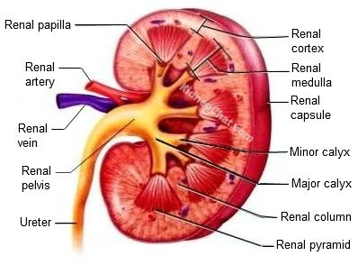
Interior of Kidney
The filtering happens in nephron which is in cortex and medulla
Collecting ducts drain into minor calyx → major calyx → renal pelvis → ureter

Slide 7
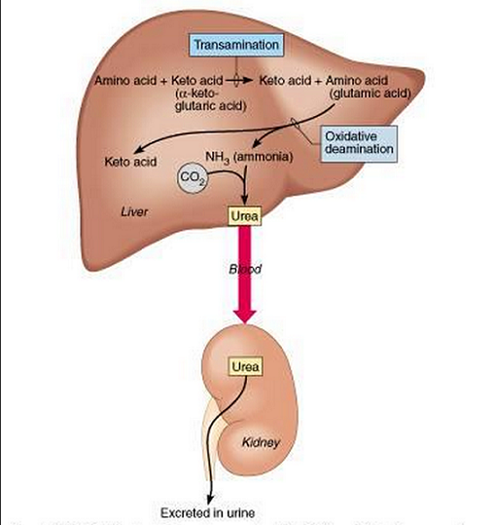
Liver production of urea
When proteins are broken down in digestion it produces ammonia (toxic)
Liver changes this to urea
Urea goes into blood stream
Removed into kidney filtration
Goes into urine

Slide 8
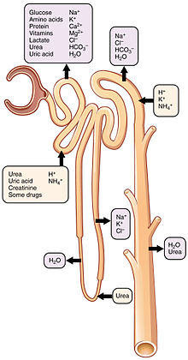
Functions of the kidney
1. excretion of metabolic waste
Urea from amino acid breakdown
Uric acid from nucleotide breakdown
2. Water-Salt Balance
Salts and water removed in the loop of henle of nephron

Slide 9
Functions of the kidney
3. Acid Base Balance
Hydrogen ion balance from blood stream
Part of secretion in distal convoluted tubule
4. Secretion of hormones
Erythropoetin – hormone to cause production of more RBC
Vitamin D activation (promotes calcium reabsorption)
Renin – leads to aldosterone
ADH – reabsorption of water
Blood pressure homeostasis

Slide 10
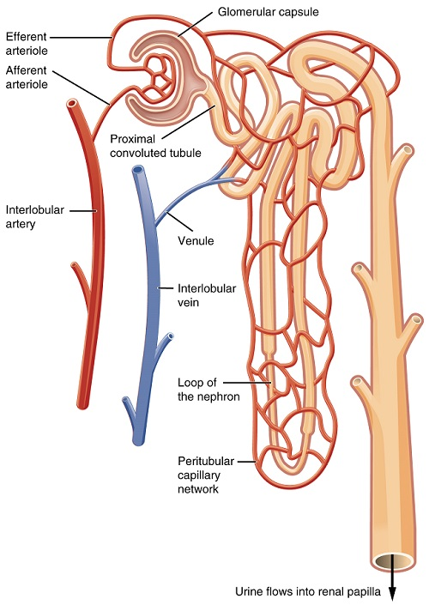
The Nephron
There are over 1 million nephrons in EACH kidney

Slide 11
The Process
Filtration – everything across in bowman’s capsule (except RBC, WBC, and large proteins)
Reabsorption – All good particles put back into blood stream
Secretion – H⁺ and k⁺ removed from blood if needed

Slide 12
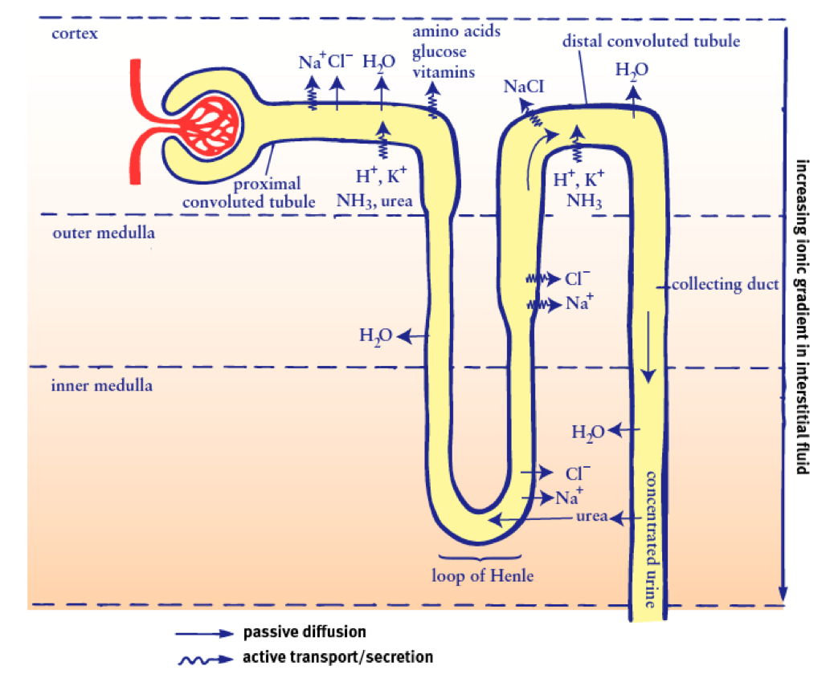
The Process

Slide 13
Practice Drawing A Nephron on Windows
What is circulatory system?
What is excretory system?
Label all nephron parts
Draw arrows to show the movement of any molecules:
Glucose
RBC
Amino acids
Urea
Water
Na+ Cl-
Water, Urea, K+

Slide 14
Filtration Rates
Items being passed | Volume produced
Blood passing through kidneys in 24 hours | 630 L
Filtrate produced in 24 hours | 105 L
Urine produced in 24 hours | 1.5 L

Slide 15
Urine
95% water
5% dissolved minerals, pigments, salts, hormones, urea, uric acid
Colour of urine is due to pigment (urochrome) which is from liver’s breakdown of RBC
Ph of urine is 4.5 – 6
Average daily output is 1.5 l

Slide 16
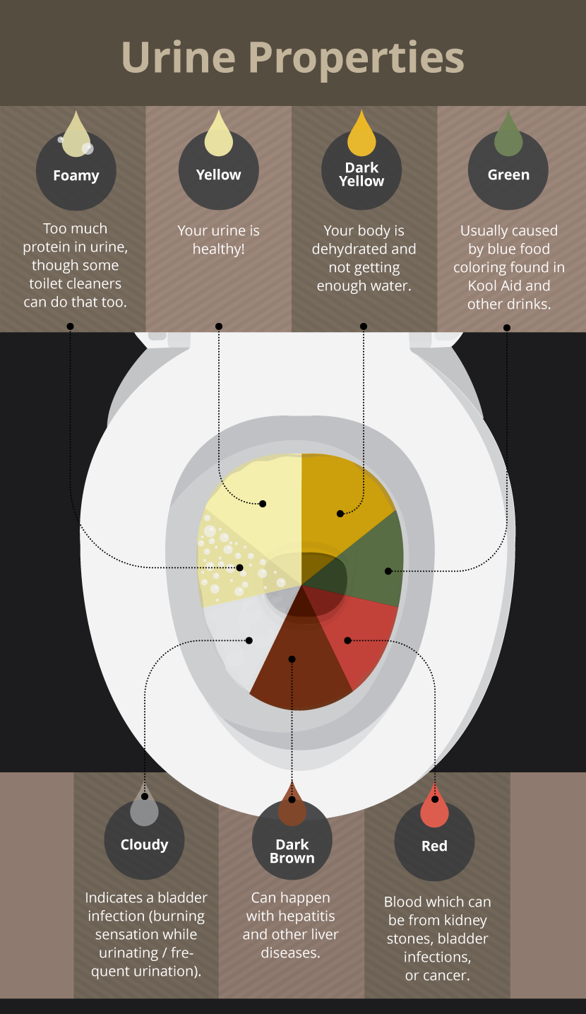
What colour is your pee?

Slide 17
Unhealthy Urine
Glucose
If high glucose in blood, then too much glucose can stay in filtrate, instead of getting removed in pct
Could be diabetes
Albumin
Too large to transfer into filtrate. It present, can indicate heave metal ingestion or bacterial infection
RBC
Too large to transfer into filtrate. Presence means kidney infection or bleeding sore in bladder

Slide 18
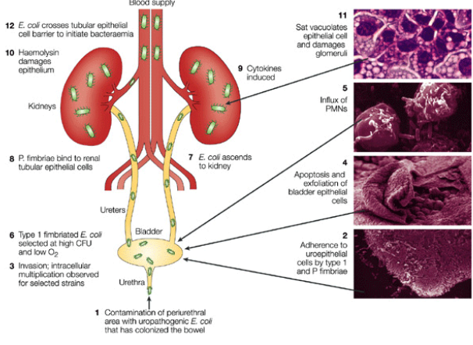
Urinary Tract Infection
Starts from E.coli getting into urethra
Travel up to bladder
Travel up ureters into Kidney
Can get into blood
Must be dealt with immediately to help prevent larger issues
Flush out bacteria with Lots of water or cranberry juice

Slide 19
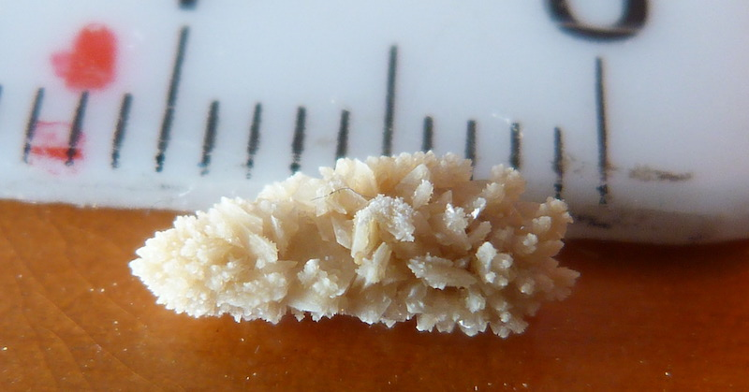
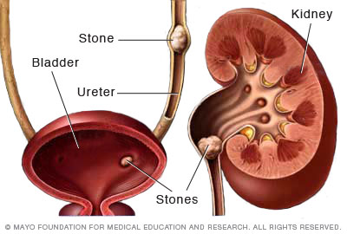
Kidney Stones
Kidney stones are hard mineral deposits that accumulate in kidney
Due to sharp crystallization it can cause lots of pain and bleeding when trying to pass through ureter and urethra
Flood system with water to round stone

Slide 20
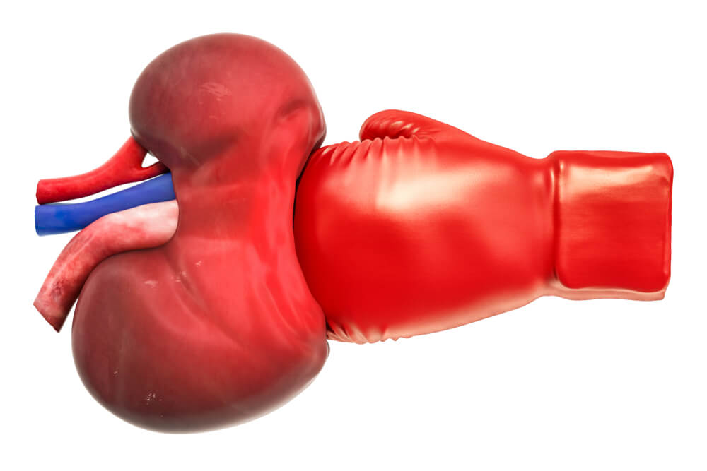
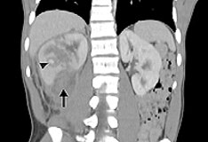
Blunt Kidney Trauma
Blunt Trauma from a hit to the back
Kidneys are well protected by back muscles and ribcage, but due to lots of small capillaries they can be damaged by a hit to back
Symptom → blood in urine
Must rest and let capillaries repair
Sometimes surgery is necessary

Slide 21
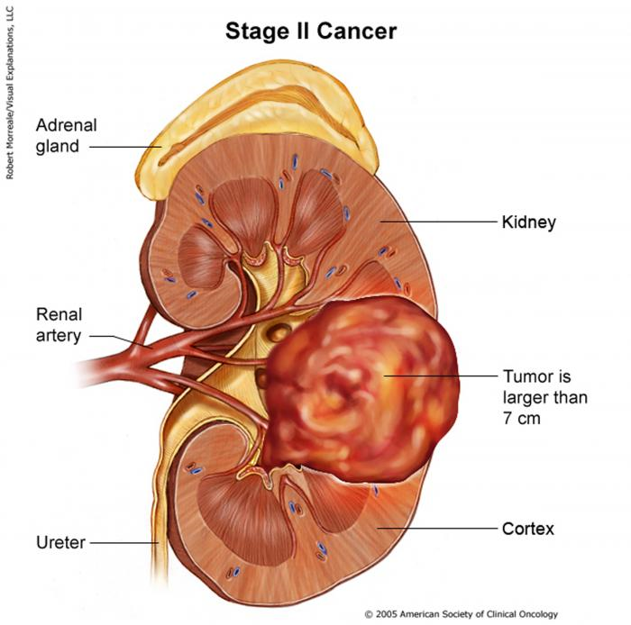
Kidney Cancer
10 most common cancers over the age of 65
Renal carcinoma cause malfunctioning of kidney

Slide 22
Homework Tonight
Your Holistic Medicine Poster is due tomorrow
Big question
6 supporting questions with answers
3 diagrams that will help me understand your topic

