Slide 1
Enzymes of Digestion
Biology 12

Slide 2
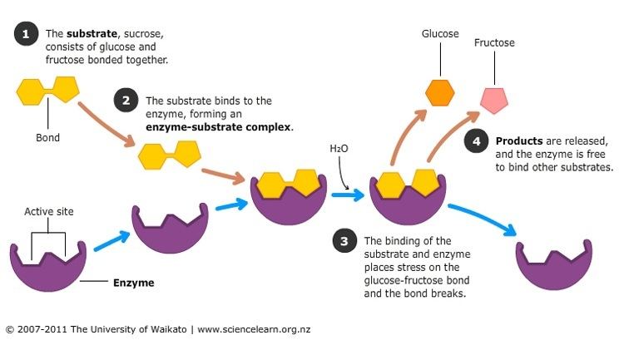
What is a digestive enzyme?

Slide 3
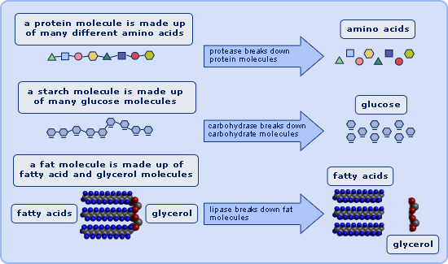
What is a digestive enzyme?

Slide 4
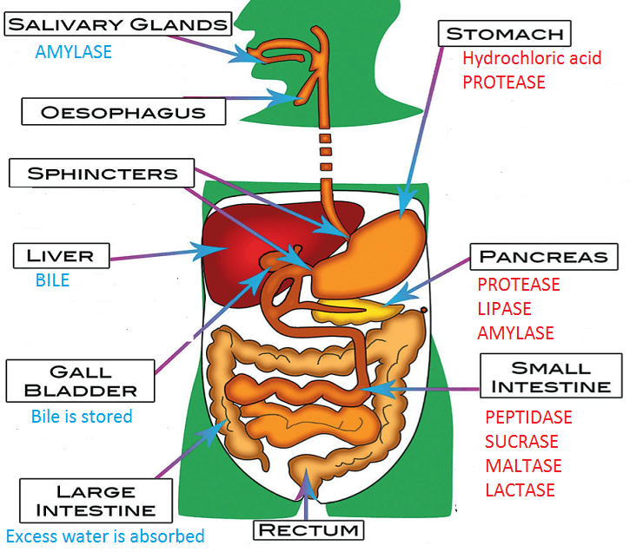
What is a digestive enzyme?

Slide 5
Carbohydrate Enzymes
Salivary Amylase – from parotid salivary amylase (pH 6.5)
Pancreatic amylase – from pancreatic juices (pH 8)
Sucrase, maltase, lactase – from duodenum (pH 8)

Slide 6
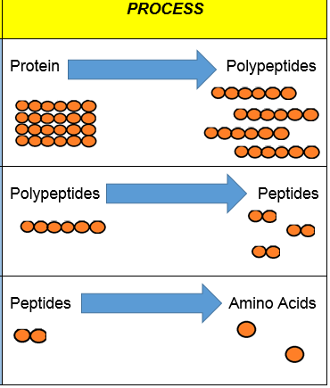
Protein Enzymes
Pepsinogen (inactive enzymes released by stomach cells) + HCl produces pepsin (pH 2)
Trypsin released by pancreas (pH 8)
Peptidases released in duodenum (pH 8)

Slide 7
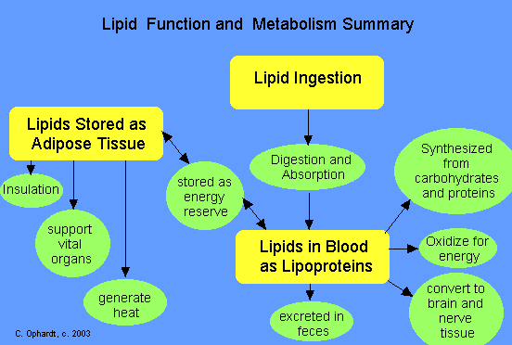
Lipid Enzymes

Slide 8
Lipid Enzymes
Bile is made in liver and stored in gall bladder
Bile is not an enzyme, it is an emulsifier
LIPASE is an enzyme made and released by pancreas
Once bile has made fat molecules smaller, lipase breaks down to fatty acids and glycerol
Monomers go into LACTEALS of the jejunum villi

Slide 9
Nucleic Acid Enzymes
Nuclease is made in the pancreas and acts in the duodenum
Rips apart the phosphate bond in DNA and RNA from the food we eat
Monomers are transferred into blood stream in jejunum villi

Slide 10
Macromolecule | Enzyme | Optimal pH | Where Made | Where Acts | Reactant | Product
Carbohydrate | Salivary Amylase | 6.5 | Parotid Salivary Gland | Mouth | Starch | Smaller polysaccharide
 | Pancreatic Amylase | 8 | Pancreas | Duodenum | Smaller polysaccharide | Disaccharide
 | Sucrase | 8 | Duodenum | Duodenum | Sucrose | Glucose + fructose
 | Maltase | 8 | Duodenum | Duodenum | Maltose | Glucose + glucose
 | Lactase | 8 | Duodenum | Duodenum | Lactose | Glucose + galactose
Lipid | Lipid | 8 | Pancreas | Duodenum | Emulsified Lipids | Fatty Acids + glycerol
Nucleic Acids | Nucleases | 8 | Pancreas | Duodenum | DNA + RNA | nucleotides
Protein | Pepsin | 2 | Stomach | Stomach | Denatured polypeptide | Smaller polypeptide
 | Trypsin | 8 | Pancreas | Duodenum | Smaller polypeptide | dipeptide
 | Peptidases | 8 | Duodenum | Duodenum | dipeptide | Amino Acid

